Slide 1

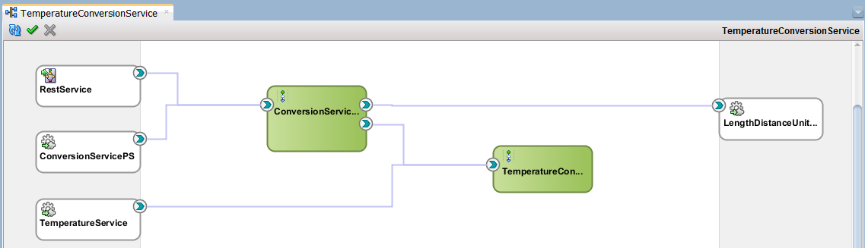
Chapter 3
JAX-WS
www.webservicex.net
/LengthDistanceUnitConvertorService

Slide 2

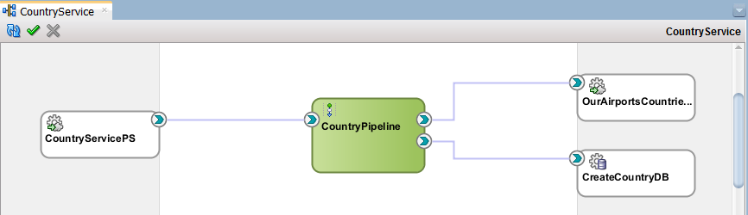
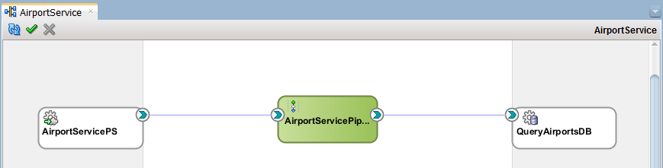

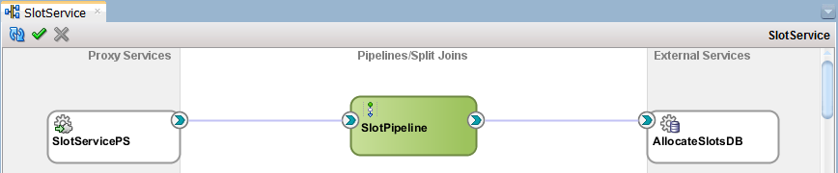

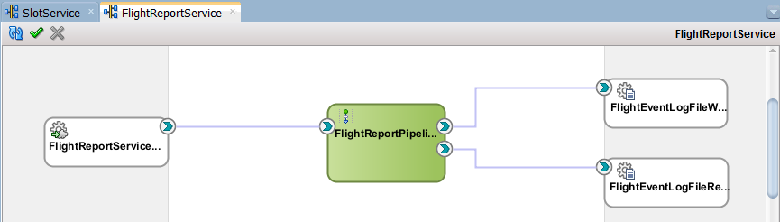
Chapter 4
www.ourairports.org
countries.csv
countries
airports
fut_allocate_slots
slots
/{FLIGHT_EVENTLOG_DIRECTORY}
/1-31/KL607FlightEventLog.txt
/MH89FlightEventLog.txt
/5-8/AM3FlightEventLog.txt
/LH9FlightEventLog.txt

Slide 3



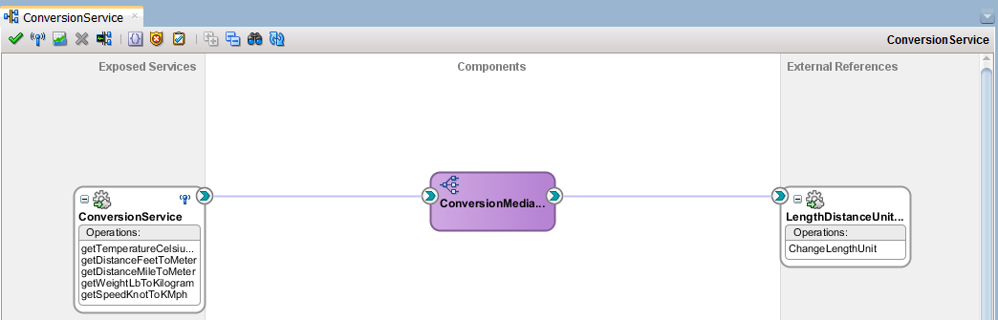

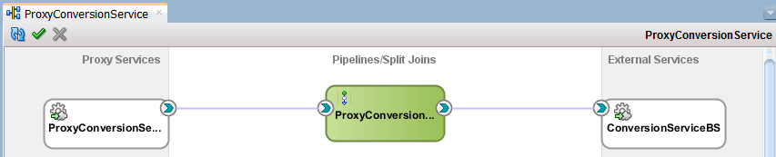
Chapter 5
www.webservicex.net
/LengthDistanceUnitConvertorService

Slide 4

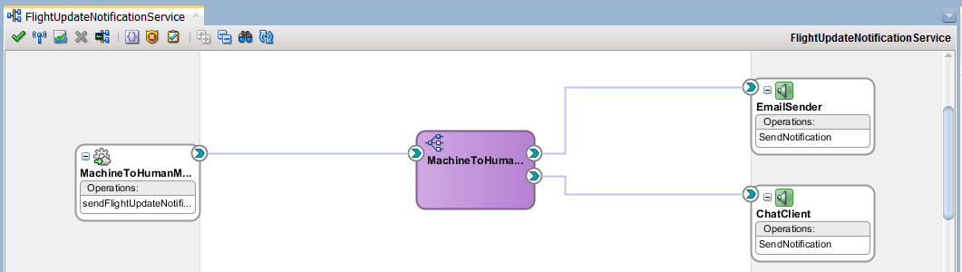

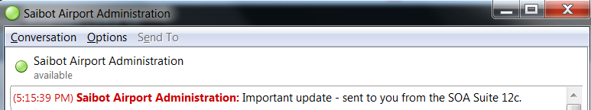
Chapter 6
Any mail
Gmail
XMPP Server
Chat Contacts on same or other XMPP Server

Slide 5
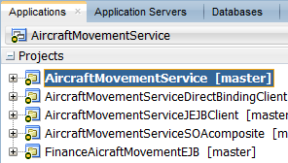
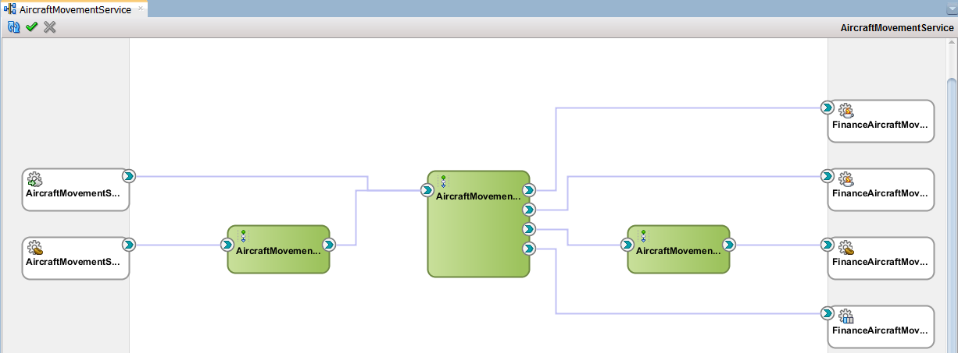
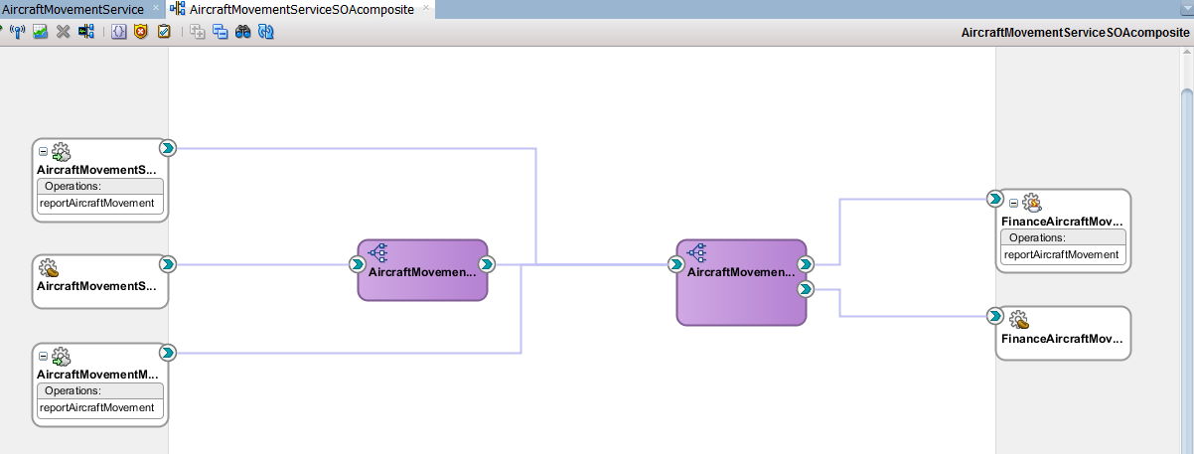
Chapter 6
SAIBOT_FINANCE
AQ
aircraft_movements_queue
JEJB
AircraftMovementServiceJEJBClient
JMS Queue
jms/finance/AircraftMovementsQueue
EJB
EJB
FinanceAircraft MovementReporter
Direct
Binding
AircraftMovement ServiceDirectBindingClient

Slide 6

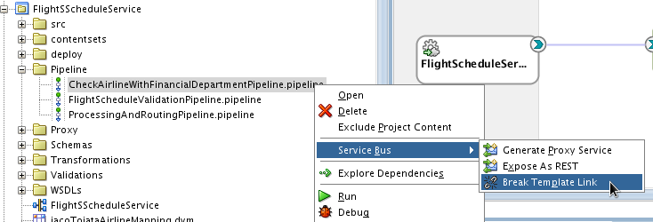
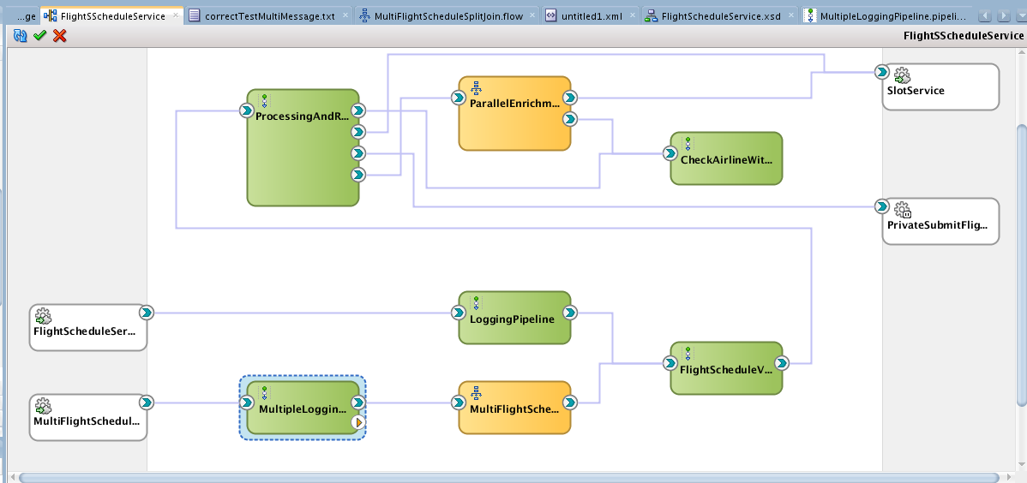
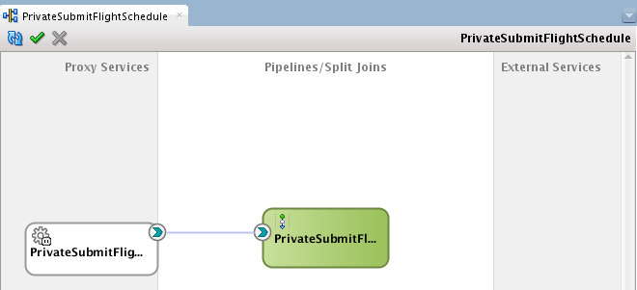
Chapter 7
SlotService (Ch4)
Java Class
ScheduledFlight Processor
Pipeline Template FinancialDepartment AirlineCheckPipeline
XQuery Library TimePlanningUnit Validations
Domain Value Map
icaoToiataAirline Mapping.dvm

Slide 7
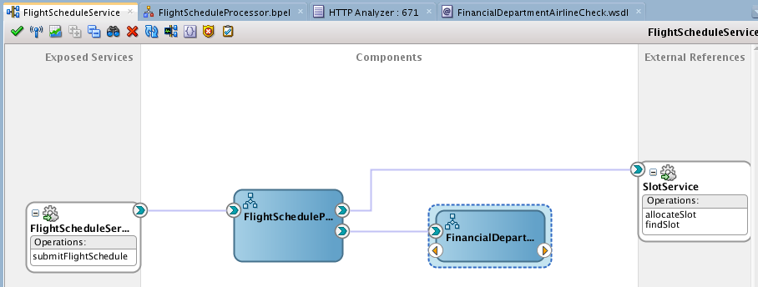
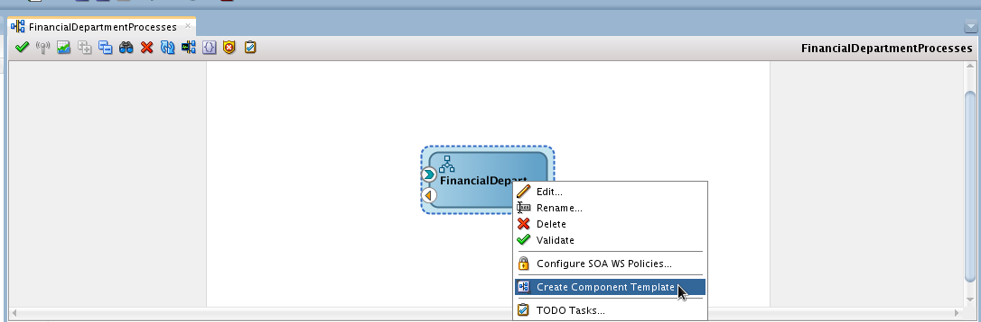
Chapter 8
SlotService (Ch4)
Java Class
FlightSchedule Processor
XQuery Library TimePlanningUnit Validations
Domain Value Map
icaoToiataAirline Mapping.dvm

Slide 8
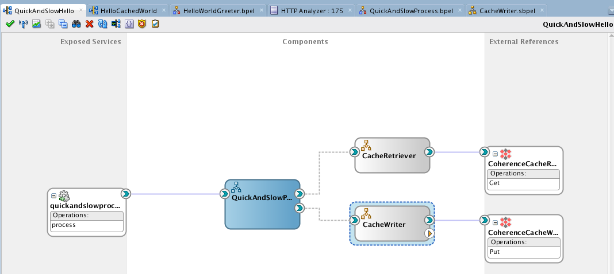
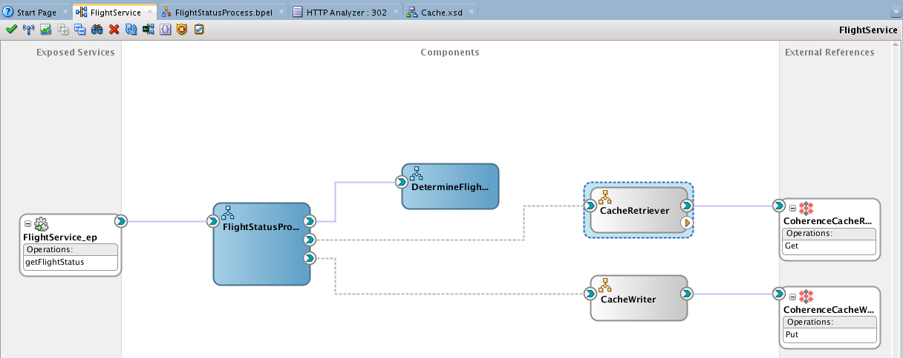

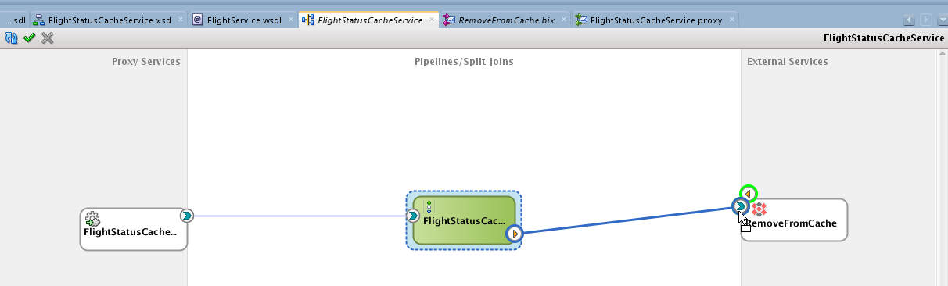
Chapter 9
SOA Component Templates
Coherence Cache

Slide 9
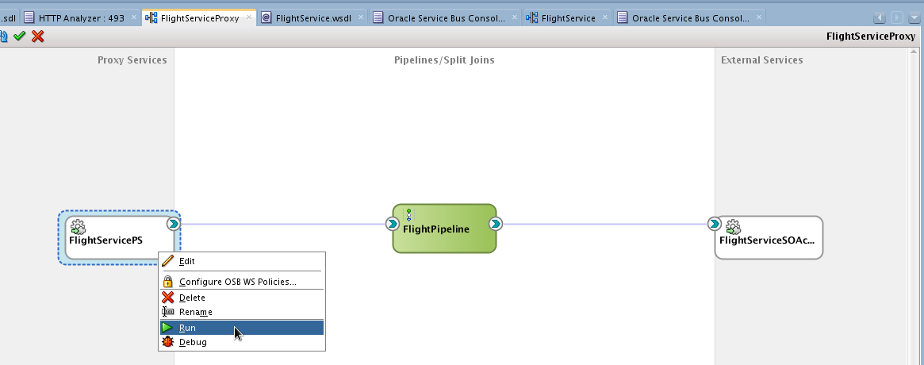
Chapter 9
Coherence Cache
Service Result Cache

Slide 10
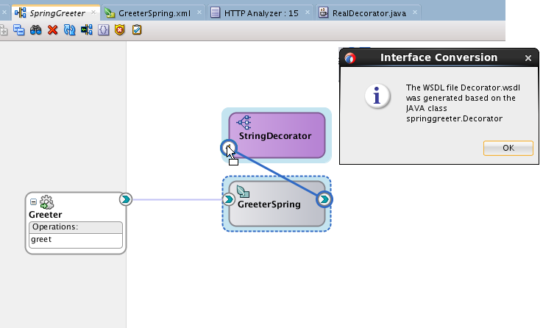
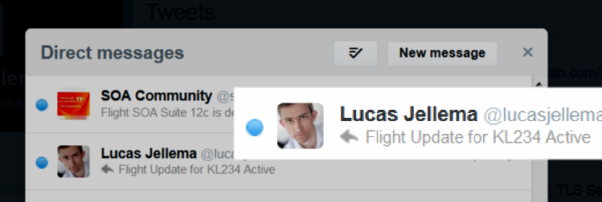
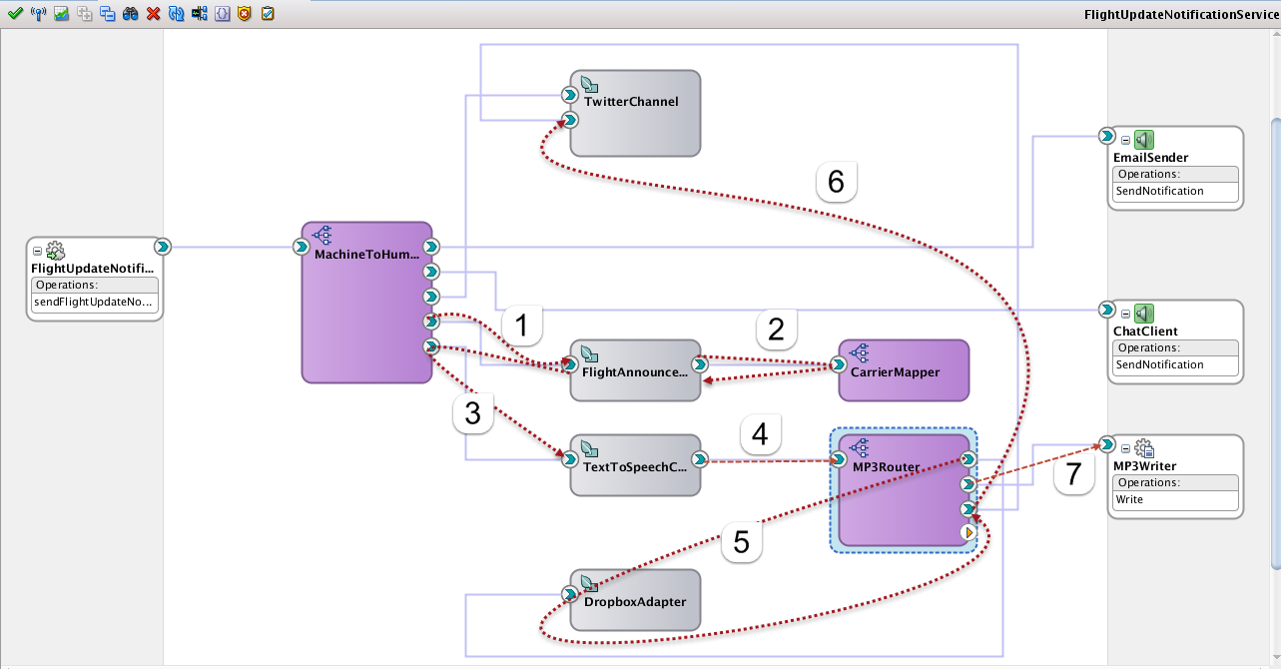
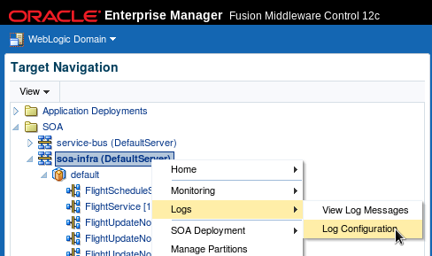

Chapter 10
Domain Value Map Airlines.dvm

Slide 11
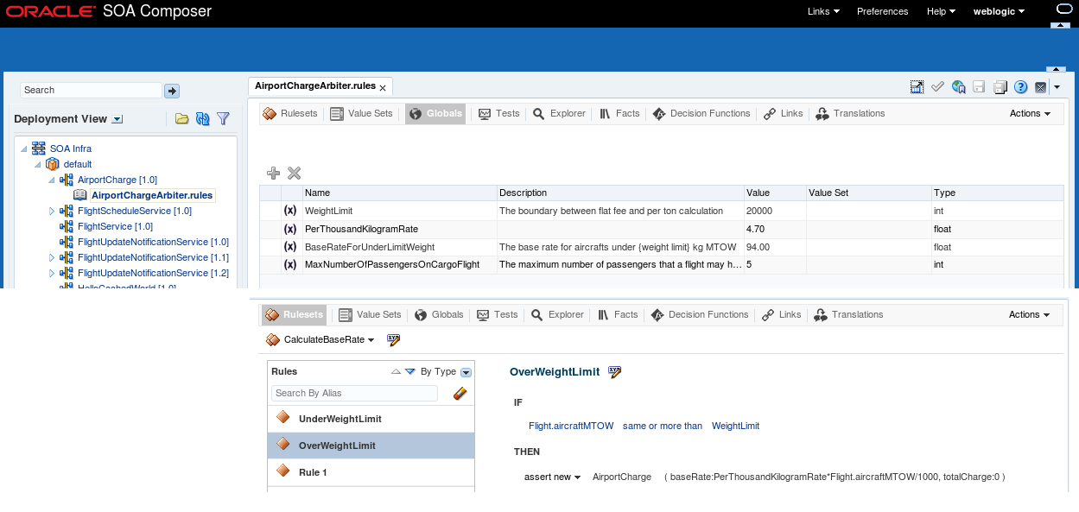
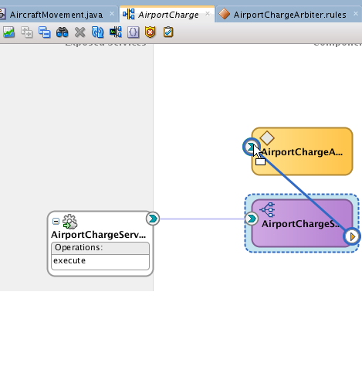
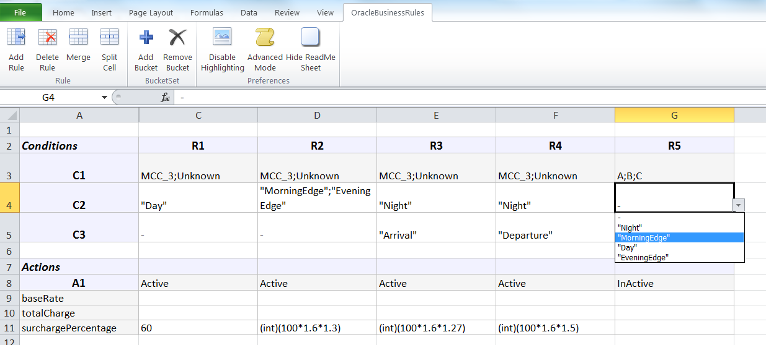
Chapter 11

Slide 12
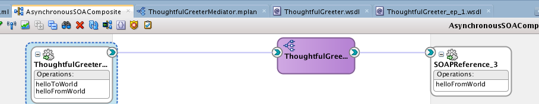
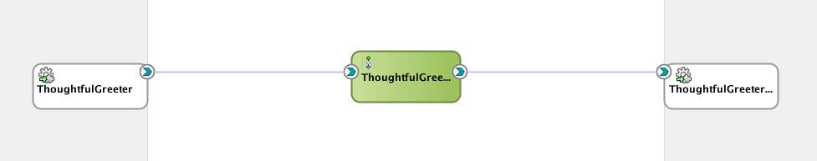
Chapter 12
Asynchronous Response/ Callback
Asynchronous Response/ Callback

Slide 13
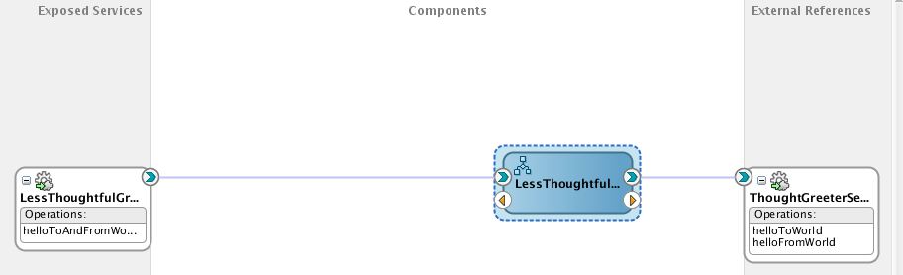
Chapter 12
Asynchronous Response/ Callback

Slide 14
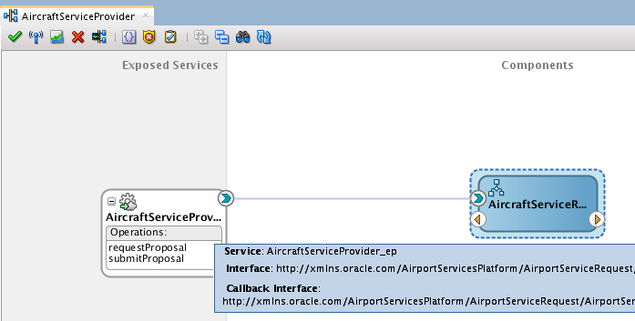
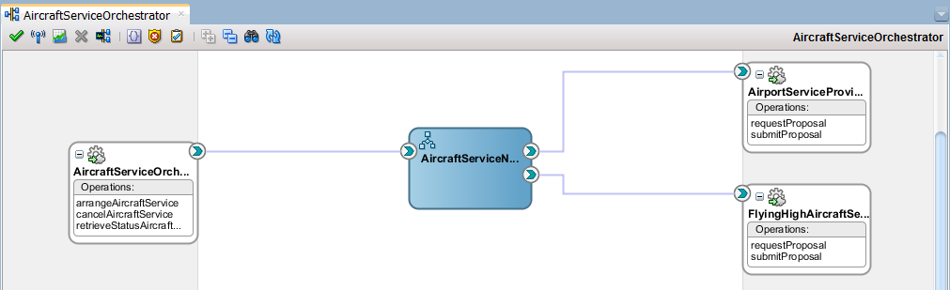
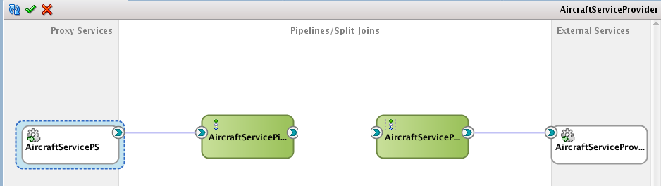
Chapter 12
Air Carrier
Cancel RFP
Initiate RFP
Get status
Asynchronous Response/ Callback

Slide 15

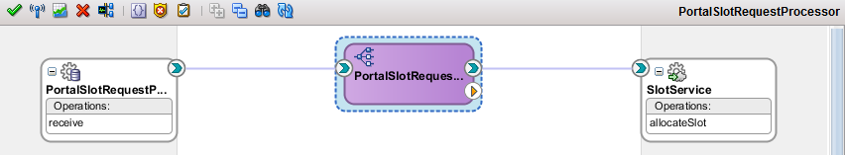
Chapter 13
PORTAL_SLOT_ALLOCATIONS
SlotService (Ch4)
fut_allocate_slots

Slide 16
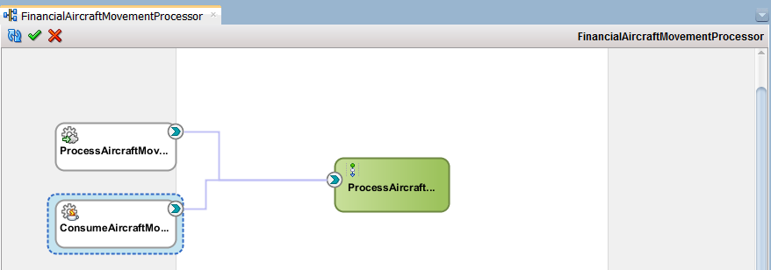
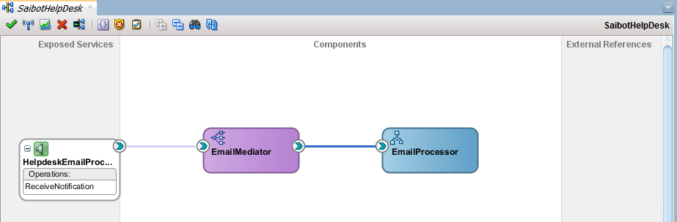
Chapter 13
Chapter 6
JMS Queue
jms/finance/AircraftMovementsQueue

Slide 17

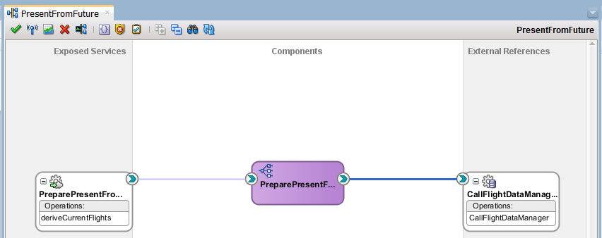

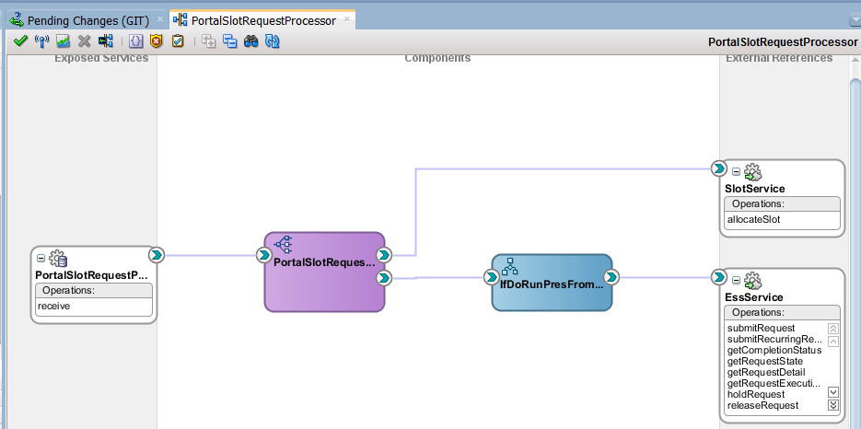
Chapter 14
CURRENT_ <FLIGHT-DATA>
Job Create CurrentFlightData
flight_data_manager
Enterprise Scheduling Service
Job CreateCurrent FlightDataPLSQL
FUTURE_ <SLOT-DATA>
Activate/ deactivate
SlotService (Ch4)
PORTAL_SLOT_ALLOCATIONS
Request for Job Create CurrentFlightDataPLSQL

Slide 18
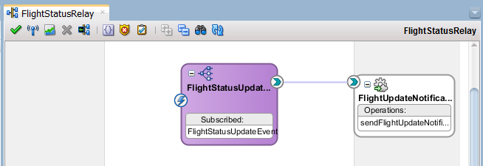
Chapter 15
Publish from: EM FMW Control,
Mediator, BPEL
FlightStatus Update event
FlightUpdateRelay

Slide 19
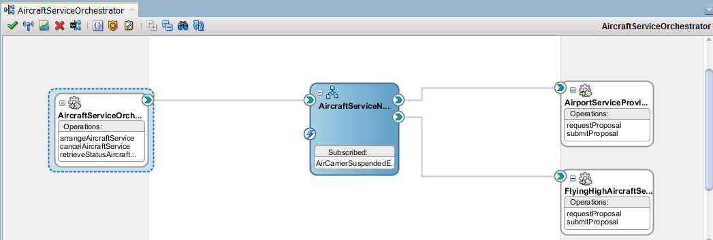
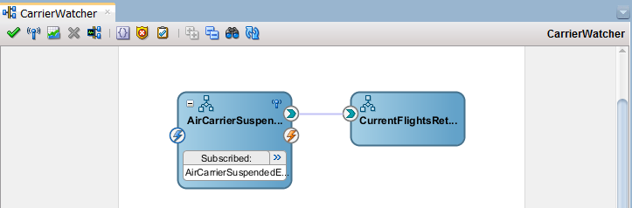
Chapter 15
Air Carrier Suspended event
FlightStatus Update event

Slide 20
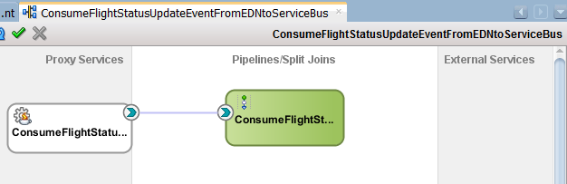
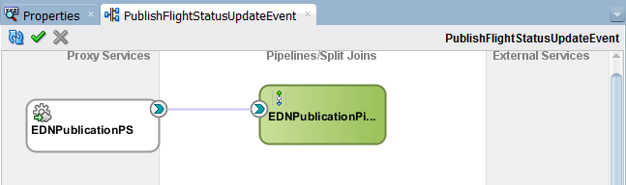
Chapter 15
Java Class
FlightStatusUpdateEventPublisher
EDN API
FlightStatus Update event
EDN API
Java Class
FlightStatusUpdateEventSubscriber
Java Class
EDNEventPublisher

Slide 21
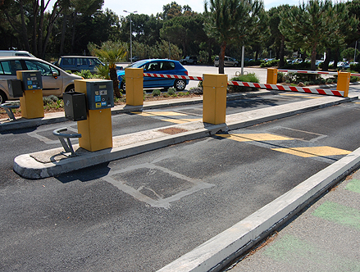

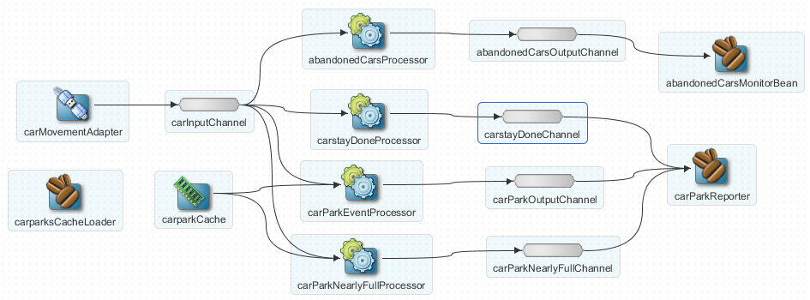
Chapter 16
Car Entry
- CarParkId
- Licence Plate
Fast Data
Car Exit
- CarParkId
- Licence Plate
OEP
AbandonedCar
- CarParkId
- Licence Plate
CarStayDone
- CarParkId
Licence Plate
Duration
CarParkStatus
- CarParkId
#cars
Avg stay
CarparkCapacityAlert
- CarParkId
- % full

Slide 22
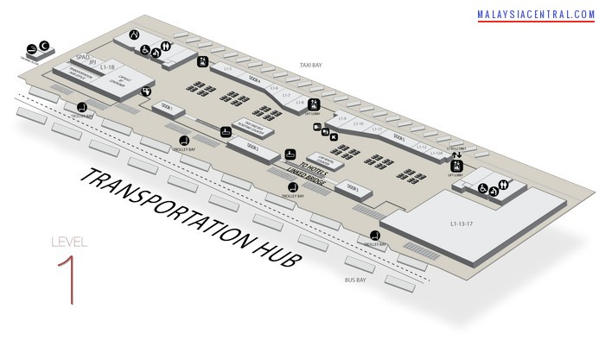

EXIT
$440
$250
$300
$380
Fast Data
Main Terminal
JMS Queue
OEP
msg
SOA Suite 12c
EDN
event
EDN
Medi- ator
event
TransactionLog.txt

Slide 23

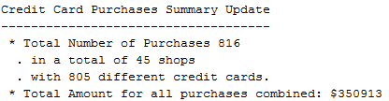
Chapter 16
CreditCardSummary
- # purchases, #shops
Total Amount
# Cards
SuspectCreditCard
- CreditCardNumber
- Shops, Amounts
EXIT
$440
$250
$300
$380
Fast Data
Main Terminal
JMS Queue
OEP
msg
SOA Suite 12c
EDN
event
EDN
Medi- ator
event
TransactionLog.txt

Slide 24
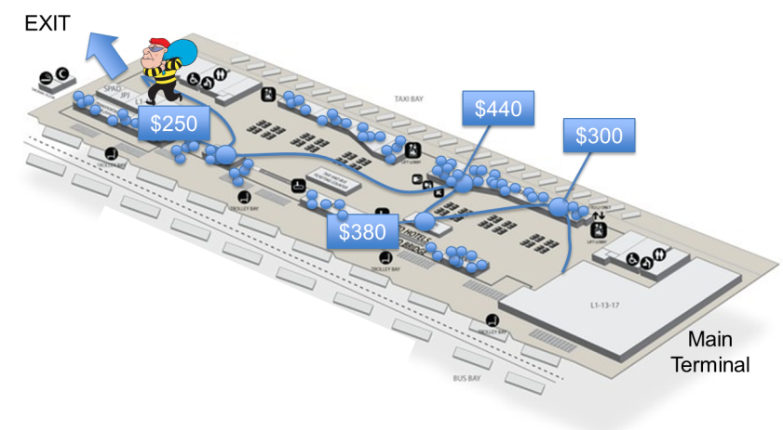

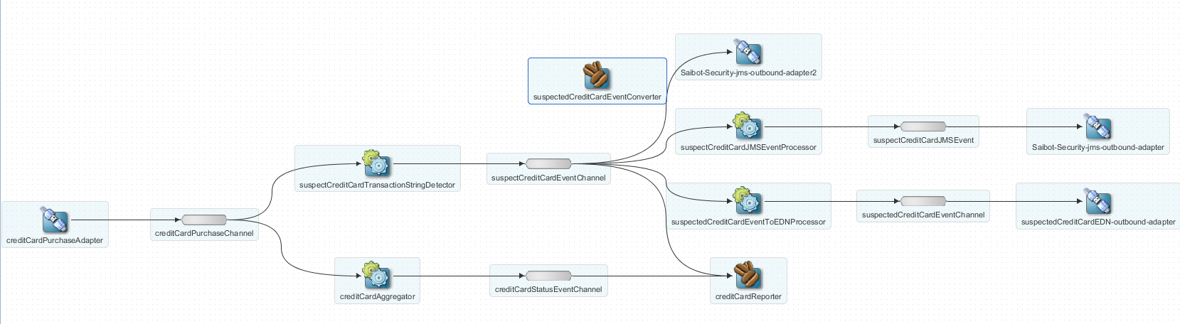



Chapter 16
JMS Queue
msg
EDN
event

Slide 25
Chapter 17 Proposal from Aircraft Service Provider
Decide on generated proposal
Manually refine the proposal and submit to workflow
Asynchronous Response/ Callback

Slide 26



Chapter 17 Simple tasks to judge generated proposal & create handcrafted proposal
email
Actionable response

Slide 27



Chapter 17 – Advanced Task Workflow

Slide 28

Chapter 18 Complex Process Flows with BPEL

Slide 29


Slide 30


Slide 31



Slide 32
Chapter 19 BPM(N) and ACM

Slide 33
Chapter 20 Operational (Functional) Process Insight
Composite Sensors
BAM Sensors, Process Analytics
BAM Dashboard
BAM Process Event Processing
Process Workspace
BPM Worklist Reports
Look ahead:
SOA Suite process analytics (OOW14)

Slide 34
Chapter 24 - Security

