Slide 1
Uyghur Language Class Scheduling System
Adalat Jurat
08/07/2023

Slide 2
Introduction
In this presentation, I will walk you through the features, logic, and development process of the Uyghur Language Class Scheduling System.
This application is designed to facilitate the scheduling and matching of students and teachers for Uyghur language learning or teaching.

Slide 3
Uyghur Language Class Scheduling System
The Uyghur Language Class Scheduling System is a terminal application that aims to connect students and teachers who are interested in learning or teaching the Uyghur language.
Our goal is to preserve and promote the Uyghur language, which is currently facing challenges and risks.
By providing a platform for students and teachers to provide their information and preferences, we can efficiently match them based on their needs and availability.

Slide 4
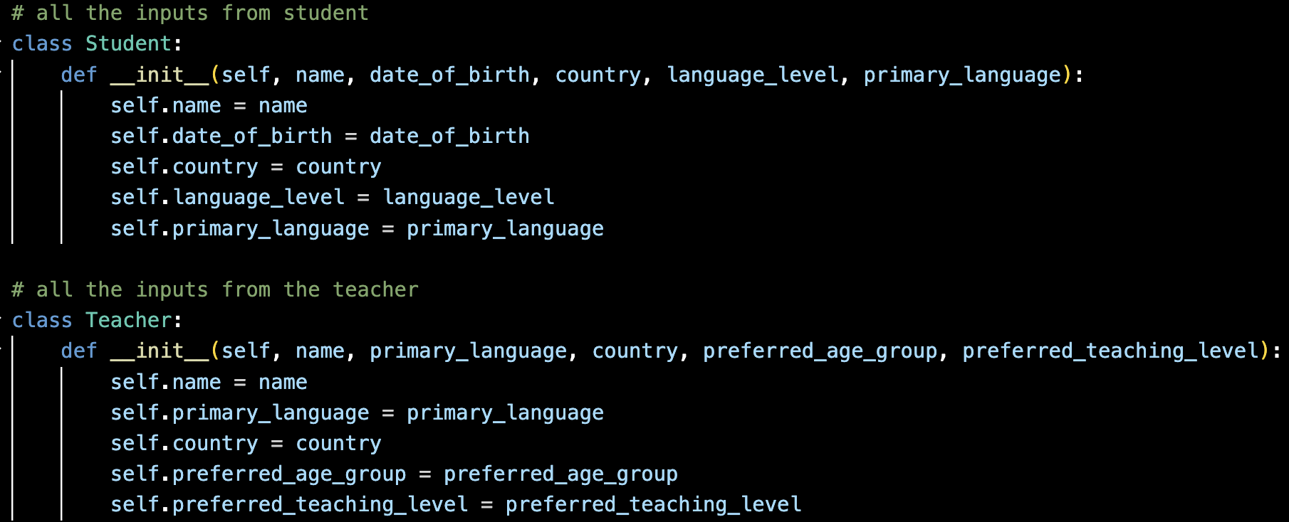
Main Features
Feature 1: Information Collection - Students and teachers can enter their details, including name, date of birth, country, language level, and preferred teaching age group. This feature allows the system to gather comprehensive information about the users, ensuring accurate matching and scheduling.

Slide 5
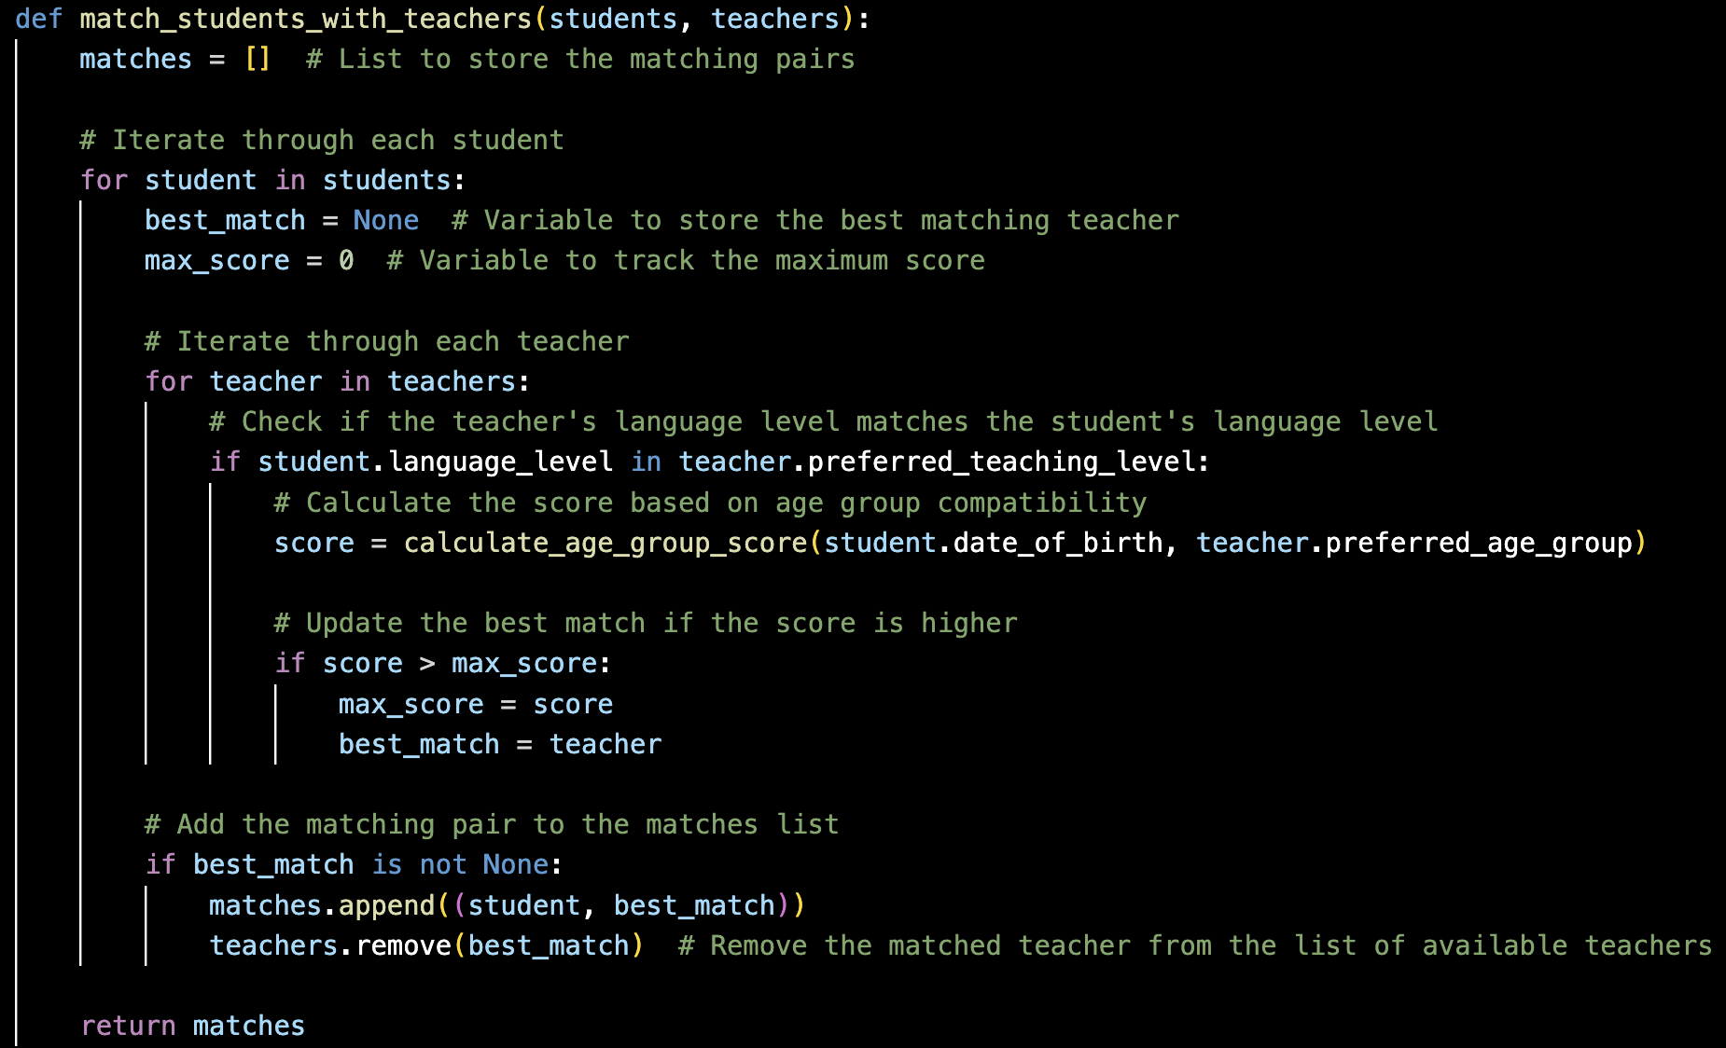
Main Features
Feature 2: Age and Language Level Matching - The system matches students with teachers based on age compatibility and language level proficiency. By considering the preferred teaching age group and the language level of both students and teachers, the application ensures optimal matches that facilitate effective language learning.

Slide 6
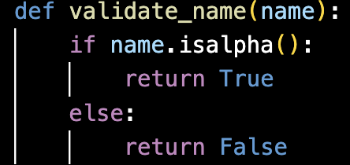
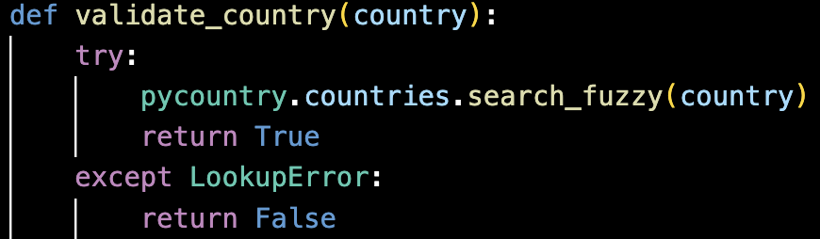
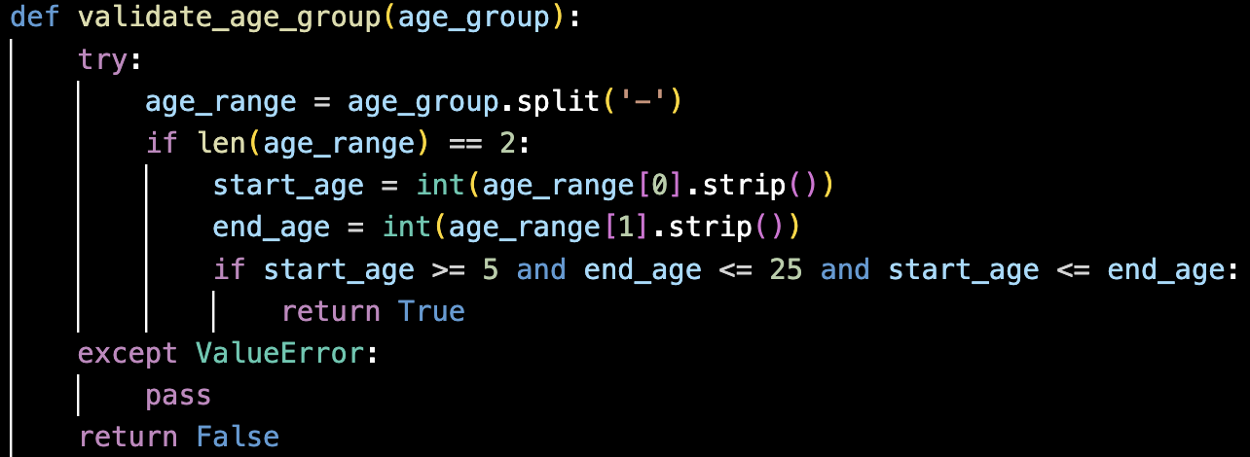
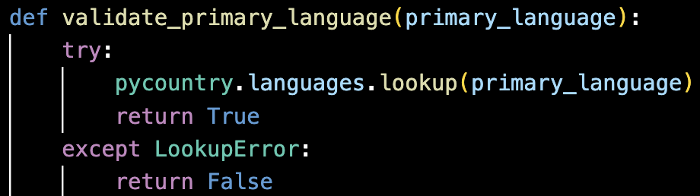
Main Features
Feature 3: Data Validation and Integrity - The system incorporates robust data validation mechanisms to ensure the accuracy and integrity of the information provided by students and teachers. By validating inputs such as names, countries, and language levels, the application minimizes errors and ensures reliable matching results.

Slide 7
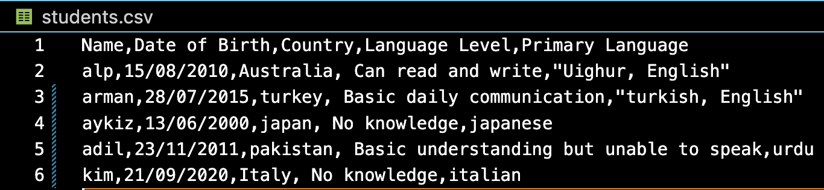
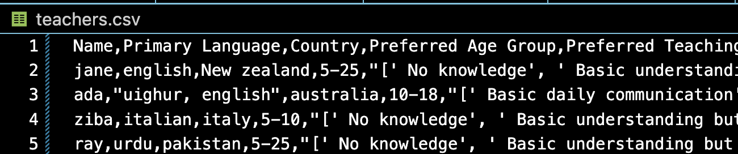
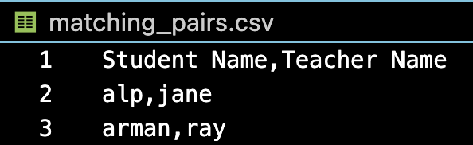
Main Features
Feature 4: Results Presentation - The system presents the matching results in a clear and organized manner, displaying the names of matched students and teachers. This allows users to easily identify their respective matches and initiate the language learning process.

Slide 8
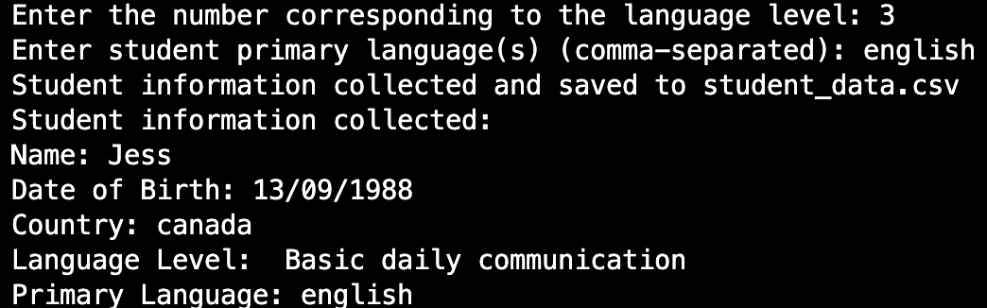
Overall Structure
Now, let's dive into the overall structure of the Uyghur Language Class Scheduling System.
The application is developed using Python and runs in the terminal environment.
Users interact with the system by entering their information and preferences through a series of prompts.
The system processes the data and provides matching recommendations for students and teachers.
Student input screenshot from terminal

Slide 9
Walk-through of Application Usage
To use the Uyghur Language Class Scheduling System, you have two options:
Option 1: Using script.sh
Ensure that the script.sh file has execute permissions. If not, run the following command: codechmod +x script.sh
Run the script.sh file using the following command:
./script.sh
Follow the prompts and provide the required information to interact with the application.
To exit the application, enter 0 when prompted to select your role.
For any further assistance or questions, please contact us at adalat.jurat@gmail.com.

Slide 10
Walk-through of Application Usage
To use the Uyghur Language Class Scheduling System, you have two options:
Option 1: Using script.sh
Ensure that the script.sh file has execute permissions. If not, run the following command: codechmod +x script.sh
Run the script.sh file using the following command: bash Copy code./script.sh
Option 2: Running main.py directly * Open a terminal or command prompt. * Navigate to the project directory. * Activate the virtual environment (if created). * Run the main script using the following command: bash Copy codepython main.py * Follow the prompts and provide the required information to interact with the application. * To exit the application, enter 0 when prompted to select your role. can you please look at above usage

Slide 11
Walk-through of Application Logic and Code
Input Validation: Input validation is crucial to ensure data integrity and maintain the quality of information stored in the application. The Uyghur Language Class Scheduling System incorporates input validation to validate student and teacher information. The application performs validation checks on various fields such as name, country, and language.
For names, the application checks if the input contains only alphabetic characters, ensuring that names are valid and do not contain any numeric or special characters.
In terms of country validation, the application utilizes the pycountry library to validate if the input country exists in the list of recognized countries. This validation ensures that only valid country names are accepted.
Language validation leverages the pycountry library as well. The application verifies if the input primary language exists in the list of recognized languages. This validation ensures that only valid primary languages are accepted.

Slide 12
Walk-through of Application Logic and Code
Age and Language Level Matching: The application performs matching between students and teachers based on age and language level compatibility. To determine age compatibility, the system compares the age of the student with the preferred age group of the teacher. The preferred age group is specified as a range (e.g., 5-25 years), and the application calculates a score based on the student's age within that range. A higher score indicates better age compatibility.
Language level matching involves comparing the language proficiency level of the student with the preferred teaching level of the teacher. The application checks if the language level of the student matches any of the preferred teaching levels of the teacher. If there is a match, the application proceeds to calculate a score for the match.
The application assigns a score to each potential match based on age and language level compatibility. The score calculation is specific to each matching criterion, and it aims to determine the best match for each student.

Slide 13
Walk-through of Application Logic and Code
object-oriented approach
In my application, I use an object-oriented approach to organize and manage the data of students and teachers. Think of objects as containers that hold all the information about a specific student or teacher, such as their name, country, and language level. I have separate 'Student' and 'Teacher' containers that are like blueprints, defining the structure and behavior of each student and teacher.
By using this approach, I can easily access and manipulate the information for each student and teacher throughout my application. It helps me keep everything organized and makes my code easier to read and maintain.
Think of it like having individual boxes for each student and teacher. I can put their details in their respective boxes, and it's much simpler to handle and work with that information. Plus, if I need to add more students or teachers in the future, I can simply create new boxes based on the same blueprint.
This object-oriented approach makes my code modular, reusable, and more manageable. It ensures that my application is structured, making it easier for me to add new features and maintain the code in the long run.

Slide 14
Review of Development/Build Process
During the development of the Uyghur Language Class Scheduling System, I encountered several challenges that helped me refine the application and improve its functionality. One of the main challenges I faced was implementing robust input validation for various fields. For example, I needed to ensure that names could not contain digits and that the date of birth (DOB) was in a valid format. Overcoming these challenges required careful consideration of edge cases and the implementation of appropriate validation techniques.
Another challenge I encountered was handling language skills for students and matching them with teachers based on preferred teaching levels. It was essential to find an effective way to store and process this information to ensure accurate matching. Through experimentation and iteration, I was able to devise a solution that allowed seamless integration of language skills for students and teachers.
The development process was not without its fair share of errors and setbacks. I found myself frequently debugging code, searching for misplaced parentheses, or fixing simple typographical errors. However, each error served as a valuable learning opportunity, and I grew more adept at troubleshooting and identifying issues.

Slide 15
Review of Development/Build Process
Despite the challenges faced, the development of this application was an immensely rewarding experience. Witnessing the application come together and seeing it successfully match students with suitable teachers brought a great sense of satisfaction.
Overall, this development process taught me valuable lessons in problem-solving, code optimization, and the importance of user-centric design. It was an opportunity for growth and learning, and I am proud of the final product I have created within limited time.

Slide 16
The End
Thanks for listening, please give my code a try and let me know if there is any problmes, contact me via email: adalat.jurat@gmail.com

