Slide 1
Exocomet Exploration
Adalyn Gibson

Slide 2
Audience and goal
The audience here is meant to be a college student in STEM with little knowledge of astrophysics.
Exocomets are important in understanding exoplanet formation and interstellar objects. Public knowledge of them is important.

Slide 3
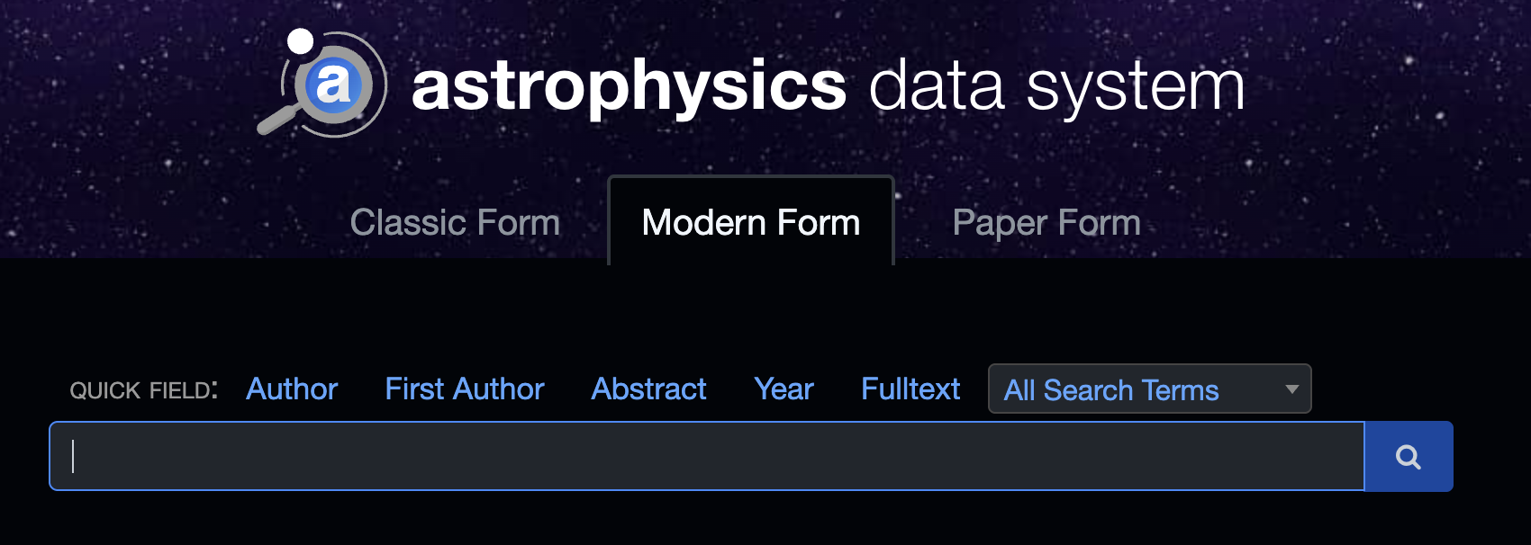
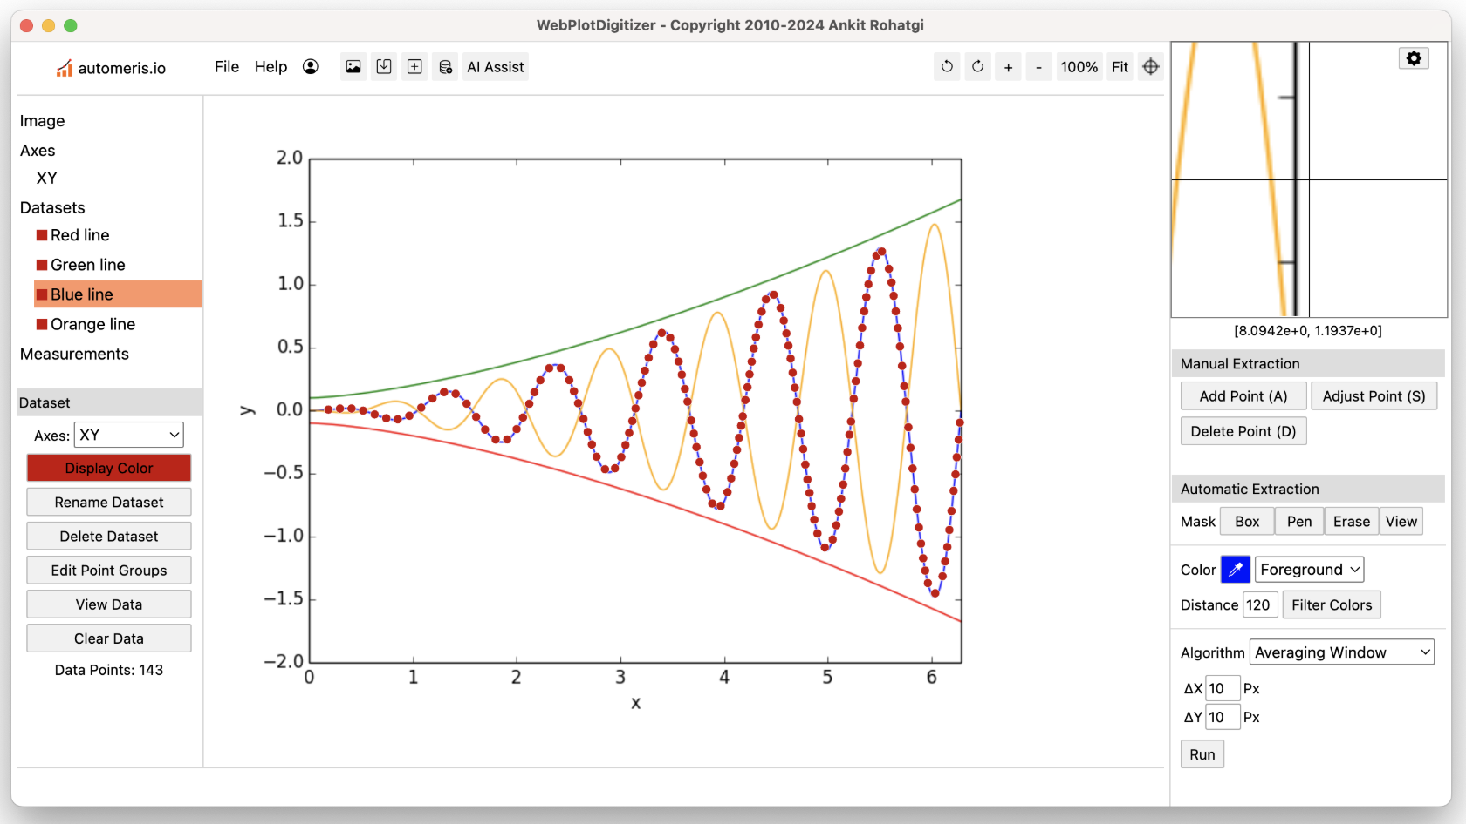
Data Acquisition
I obtained the data used in this project via exploration of currently known exocometary systems in the literature.

Slide 4
The dataset I created
The missing values in my dataset were purposeful and imputation of this dataset is not relevant.
Line of best fit to the size distribution.

Slide 5
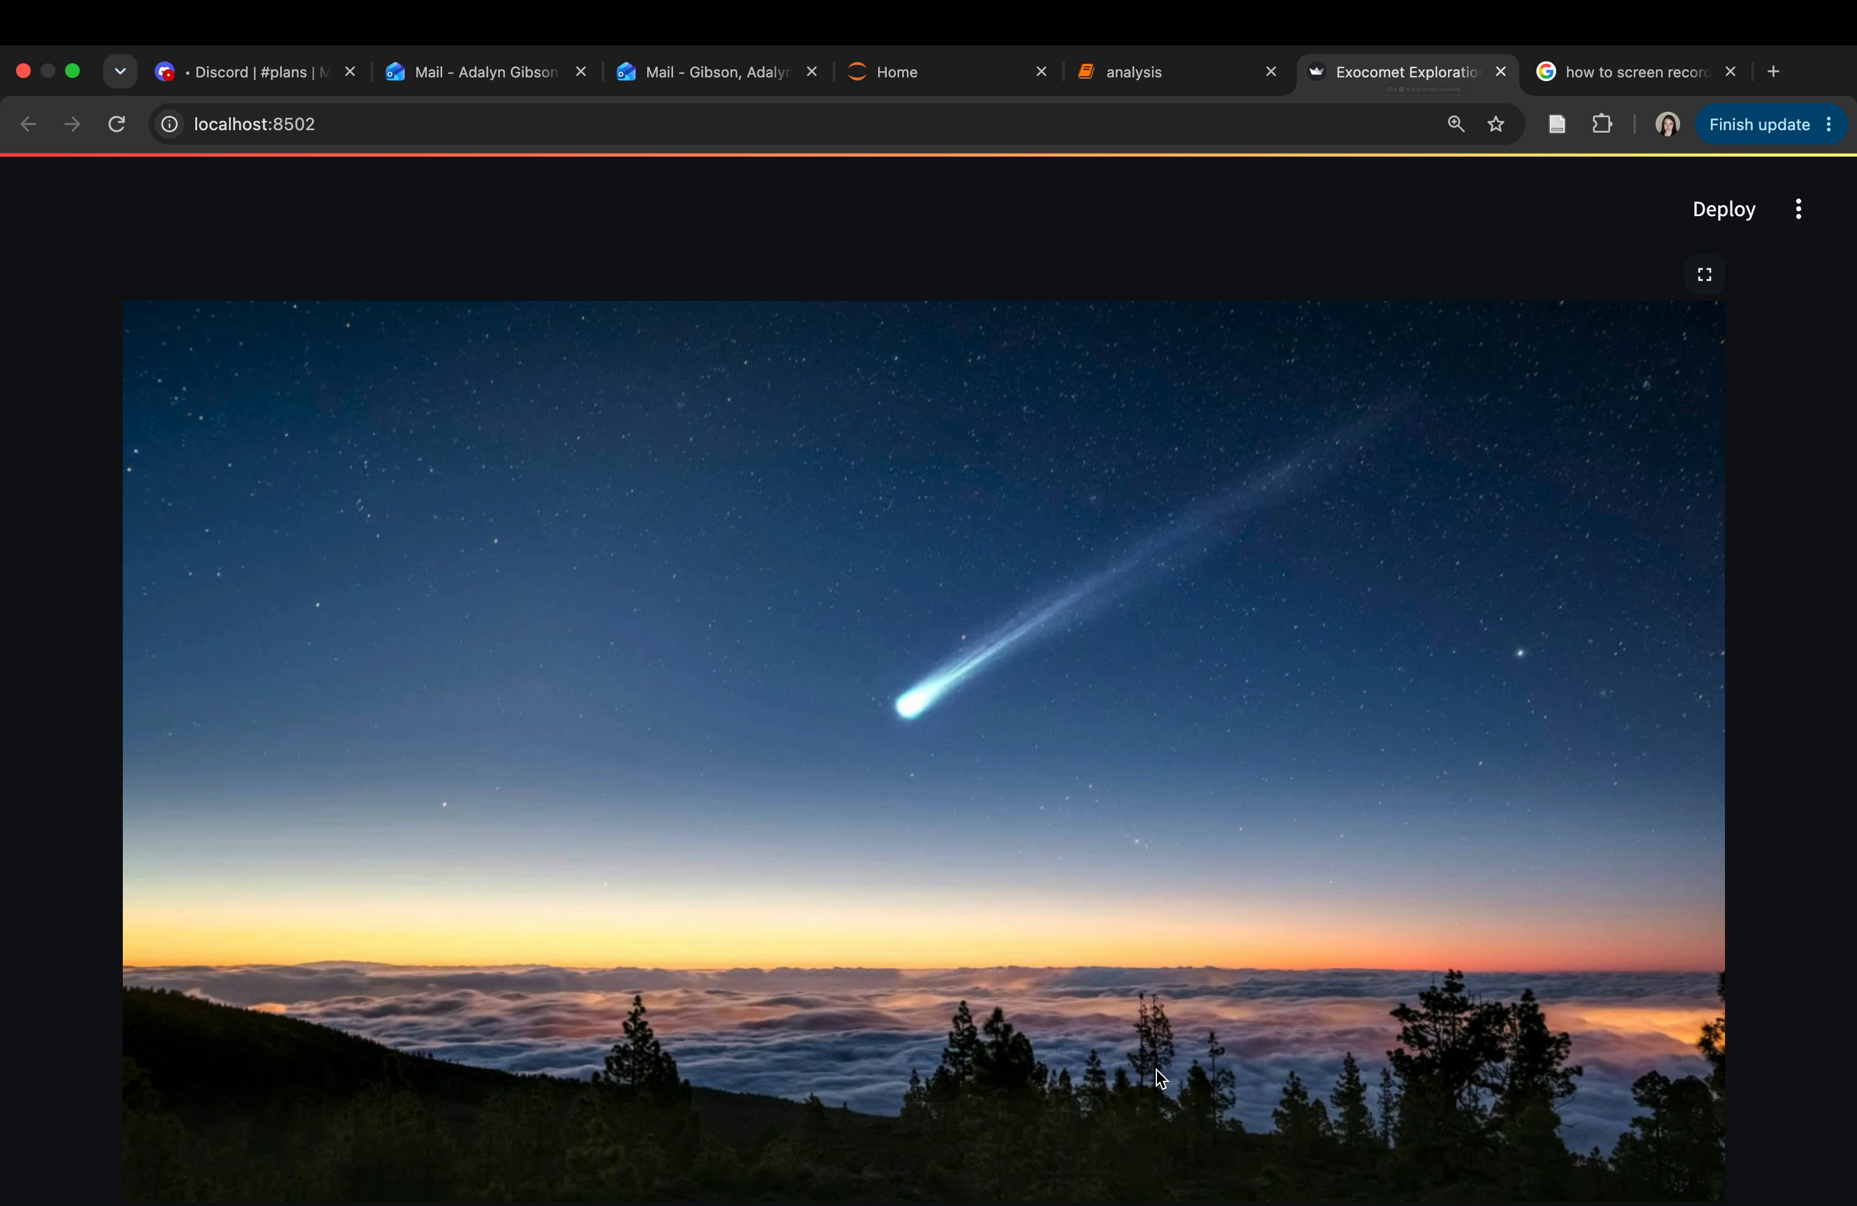
Live Streamlight demo
Link to Github: https://github.com/Adalyn-Gibson/MidtermProject
Link to Streamlight deployment (if notebook is run in appropriate environment): http://localhost:8502

Slide 6
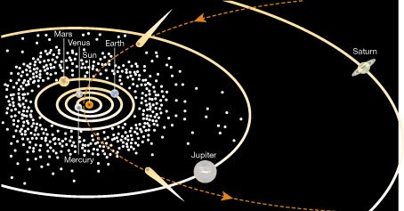
There are two known large exocometary systems
Our dataset is limited, with only two systems, a comprehensive comparison between solar system populations and exocomet systems is limited.

Slide 7
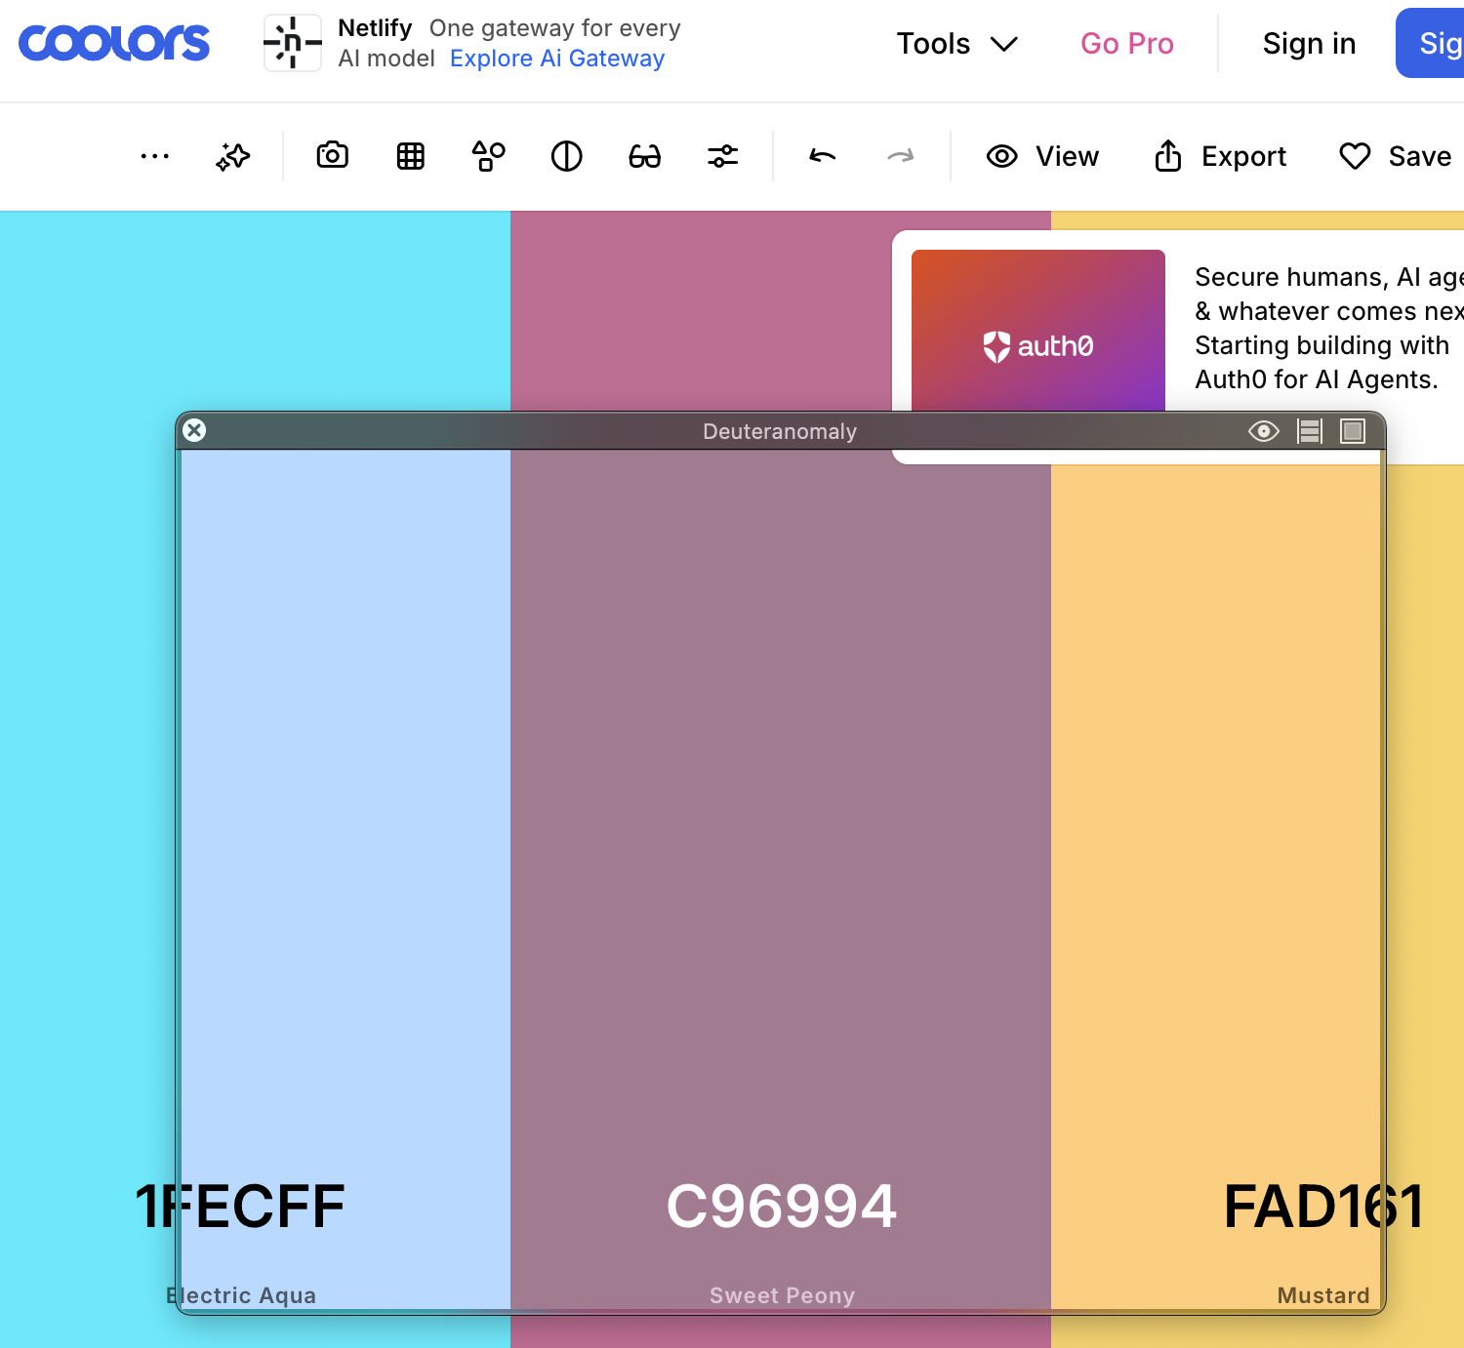
Accessibility Statement
Color blindness inclusion using known color blind palettes and tools like Sim Daltonism to ensure accessibility.

