Slide 1
MEDIA PLAYER
GROUP 2
BSCS2
HILARIO, RYAN VINCENT M.
JUTBA, ACE
MARCAIDA, ADAM JR.

Slide 2
TABLE OF CONTENTS
01
02
INTRODUCTION
PROBLEM
DEMO
USER INTERFACE
03
04
05
CODE

Slide 3
INTRODUCTION
In this project we make decisions that we make a application that can play video thru offline and online in short we make a Media Player.

Slide 4
PROBLEM
GUI
DOWNLOAD YT CONTENT
PATTERN
THREADING

Slide 5
GUI
PyQt5
-PyQt5 is a comprehensive set of Python bindings for Qt v5. It is implemented as more than 35 extension modules and enables Python to be used as an alternative application development language to C++ on all supported platforms including iOS and Android.

Slide 6
Download youtube content
Selenium – Webdriver
Selenium Webdriver is an open-source collection of APIs which is used for testing web applications.
2. Pafy
Pafy is a Python library to download YouTube content and retrieve metadata.
urllib.request
The urllib.request module defines functions and classes which help in opening URLs (mostly HTTP) in a complex world — basic and digest authentication, redirections, cookies and more.

Slide 7
pattern
Flyweight
is primarily used to reduce the number of objects created and to decrease memory footprint and increase performance. This type of design pattern comes under structural pattern as this pattern provides ways to decrease object count thus improving the object structure of application.

Slide 8
threading
Threading
A thread is a separate flow of execution. This means that your program will have two things happening at once. But for most Python 3 implementations the different threads do not actually execute at the same time: they merely appear to.

Slide 9
Demo video
01

Slide 10
User Interface/User Experience
1. Features
Play Video
Make a list of your favorites video
Download your desire video
Save Data
No Ads
Dark Mode

Slide 11
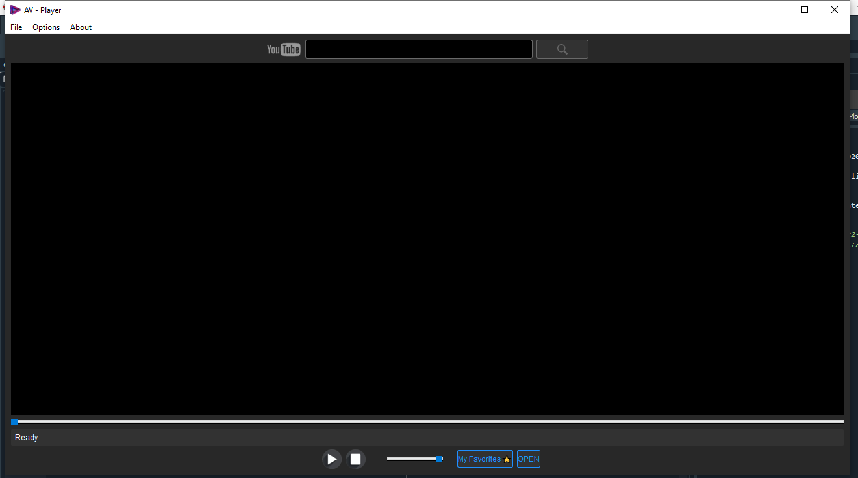
MEDIA PLAYER

Slide 12
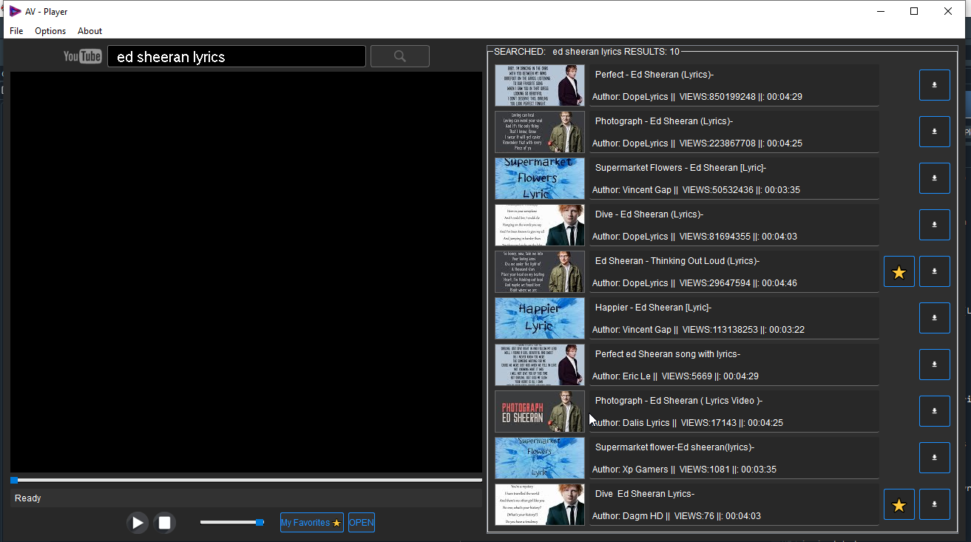
MEDIA PLAYER

Slide 13
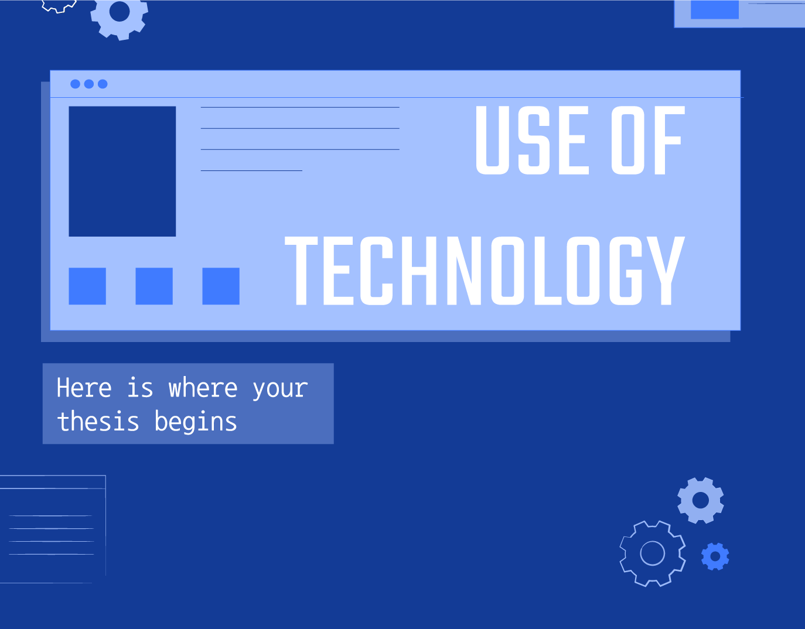
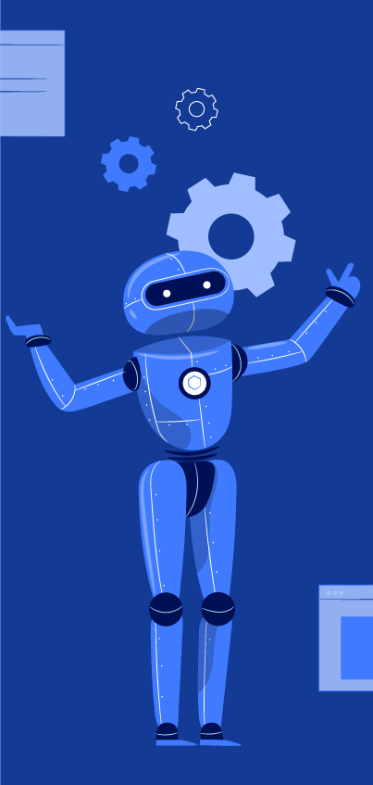
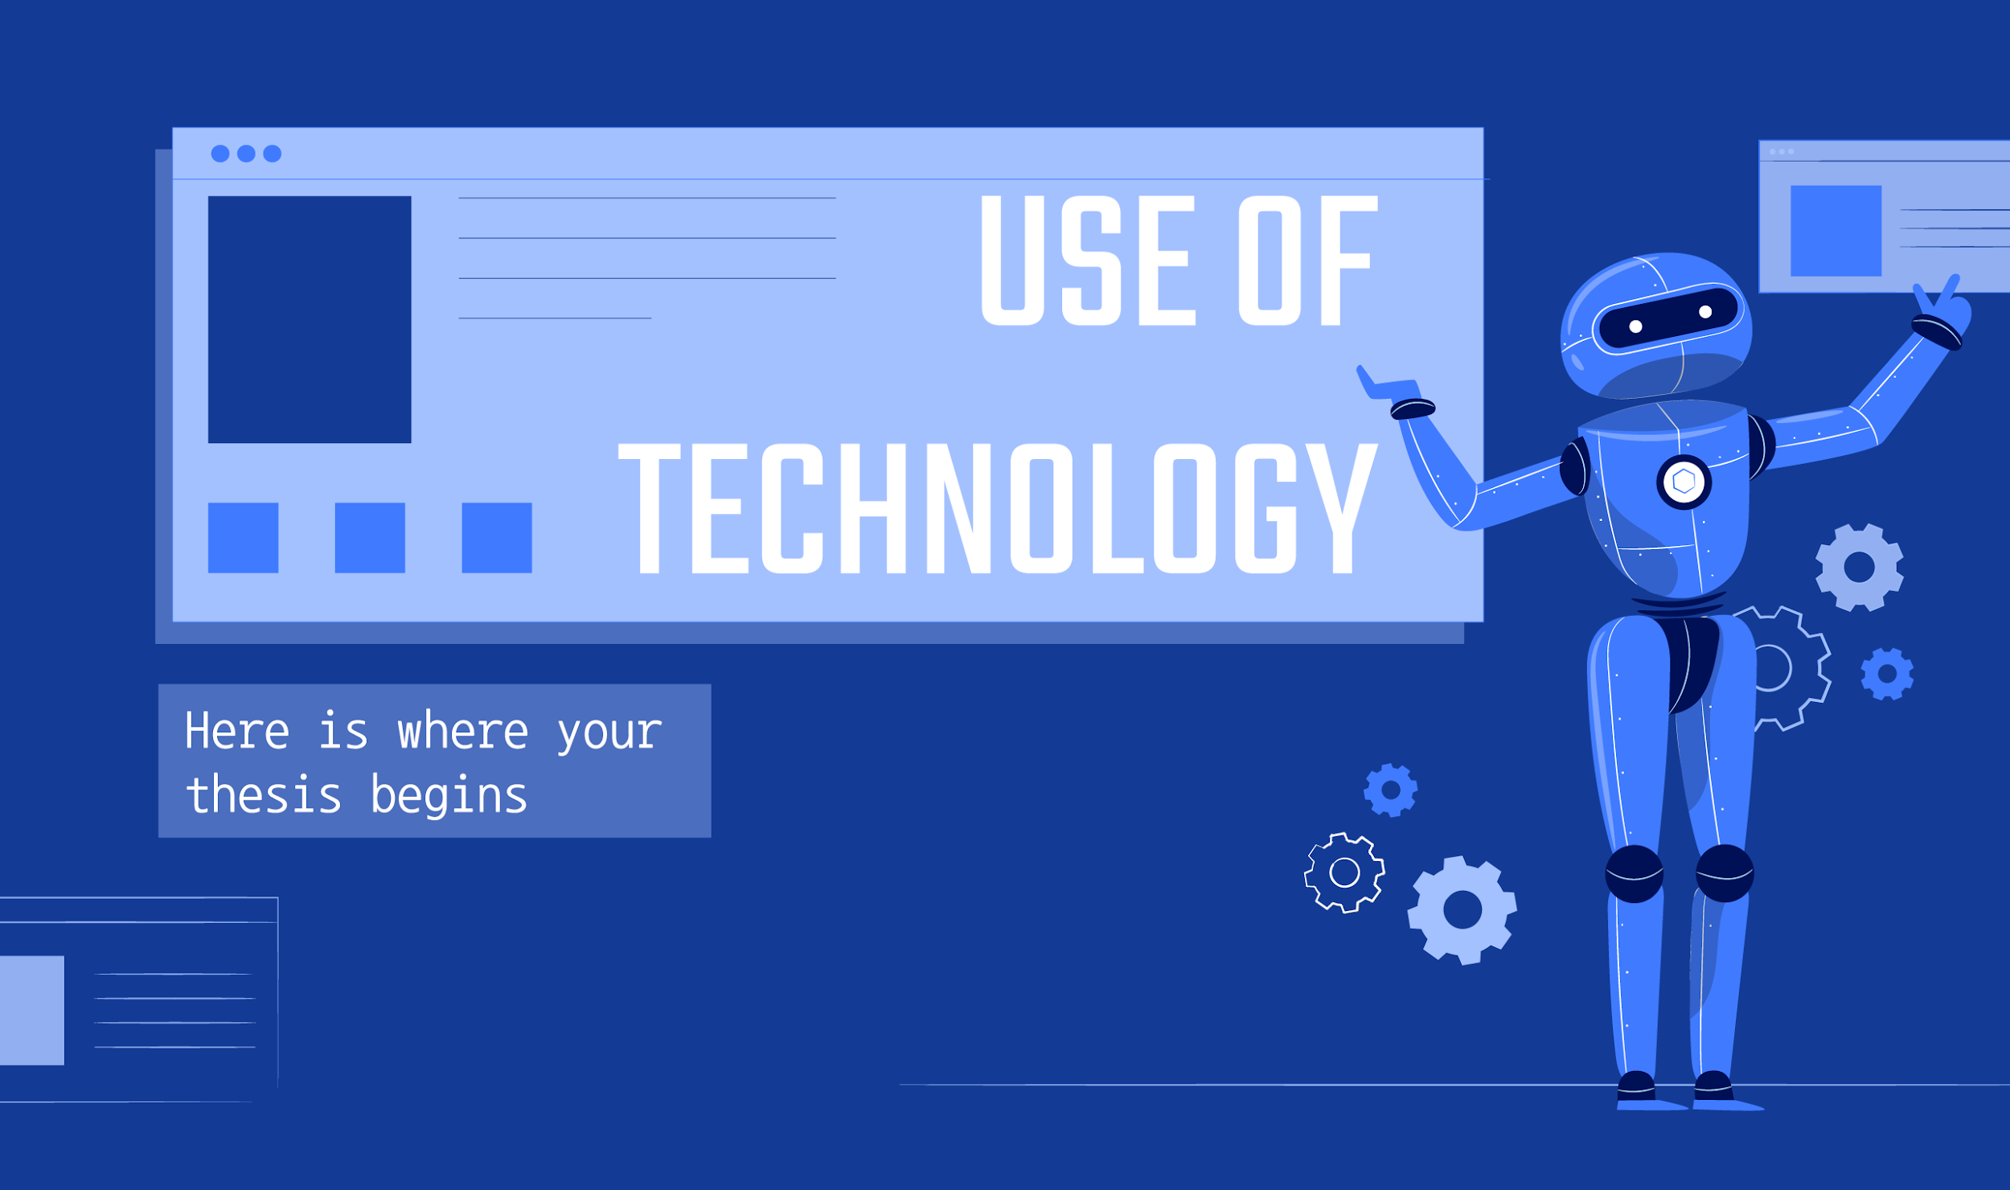
Code explanation here

Slide 17
THANKS
Does anyone have any questions?

