Slide 1
Stacks and Queues ADTs

Slide 2
Stack
A stack is an abstract data type (ADT) that supports the following methods:
Push (stack, object): Inserts object onto top of stack Input: Object, stack identity; Output: can be an error code
Pop (stack): Removes top object from stack
Input: stack identity; Output: Object
Top (stack): Returns the top object of stack
Input: stack identity; Output: Object
Stack obeys LIFO

Slide 3
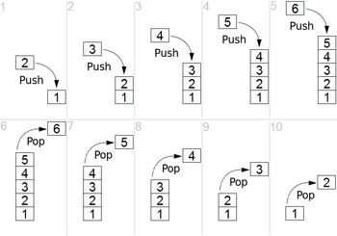
How a stack works

Slide 4
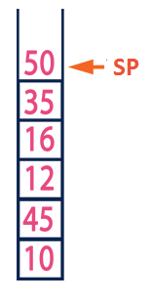
Stack ADT
struct stack { int sp;
int data[size]; };
int push(struct stack *s, int item);
int pop(struct stack *s);
int top(struct stack *s);
int init(struct stack * s); // set sp
int full(struct stack * s); // return 1 if full
int empty(struct stack * s); // return 1 if empty

Slide 5
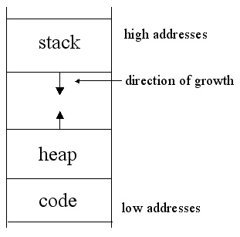
Stake Applications
Reversing the order of set of data.
Creating local scope for functions and sub programs.
All auto variables are created in Stack
All static vars and dynamically allocated mem. are in Heap
Expression evaluation

Slide 6
Queue
Queue is an ordered collection of items (FIFO)
Items are deleted from the head (Front)
Items are added at the tail (Rear)
Queue ADT provides at least two access functions
Enqueue (queue, object): Inserts object onto tail Input: Object, queue identity; Output: error code
Dequeue (queue): Removes the object at the head
Input: queue identity; Output: Object

Slide 7
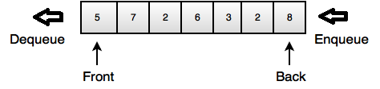
Queue ADT
struct queue { int head, tail;
int data[size]; };
int enqueue(struct queue *q, int item);
int dequeue(struct queue*q);
int init(struct queue* q); // set head and tail
int full(struct queue* q); // return 1 if full
int empty(struct queue* q); // return 1 if empty

Slide 8
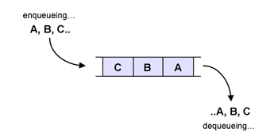
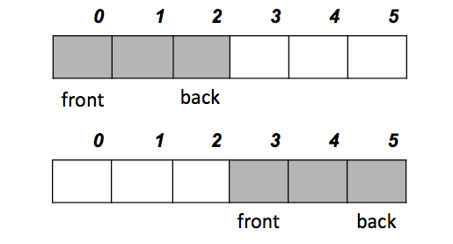
Queue in Action
Active part of the queue keeps on moving and hit the array limit at some stage ☹

Slide 9
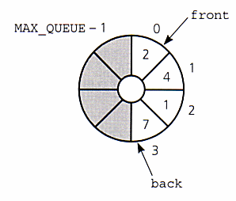
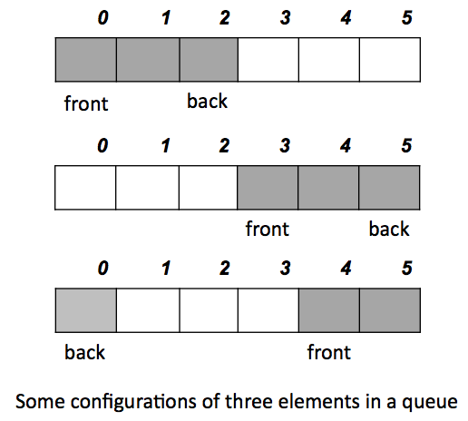
Circular Array Implementation

Slide 10
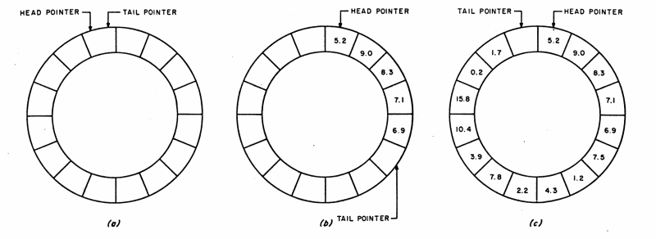
Circular Array Implementation

Slide 11
Applications
Print queue
Buffers for communication between two entities
Network cards need a packet buffer
Secondary storage write through buffers

