Slide 1
Hobby Web Application
QA Travel Journal

Slide 2
Objective
The objective of this project was to build an OOP-based web application, with utilization of supporting tools, methodologies, and technologies.
Languages used:
Java (Eclipse)
JSON (Postman)
JavaScript (Visual Studio Code)
HTML (Visual Studio Code)
CSS (Visual Studio Code)

Slide 3
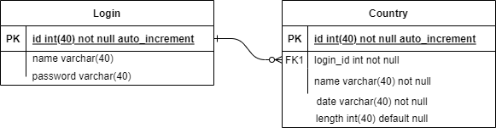
ERD Diagram

Slide 4
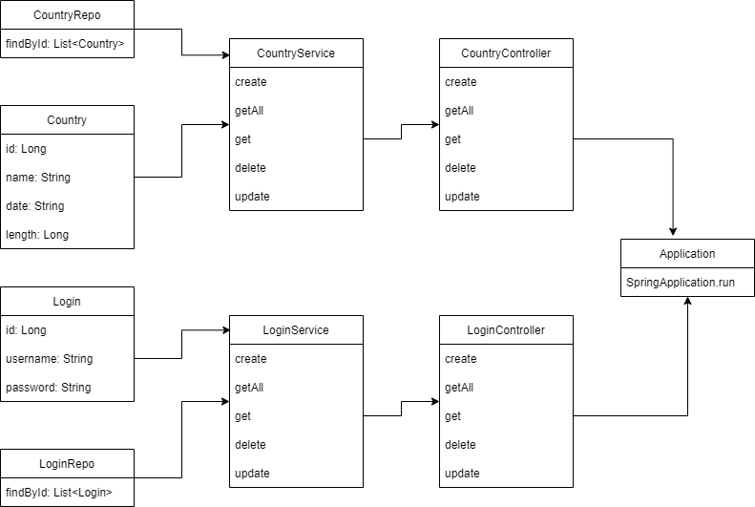
UML Diagram

