Slide 1
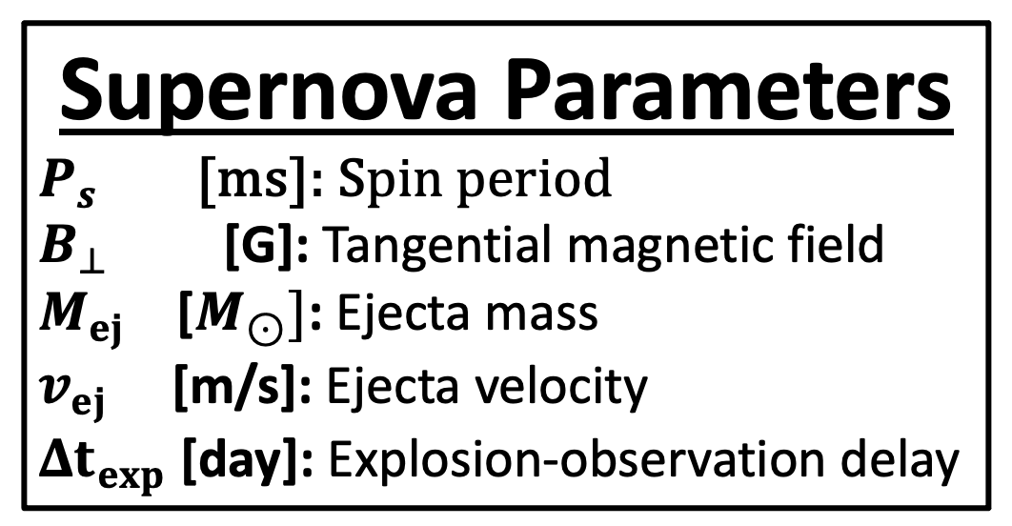
1. Gaussian Process
2. Autoencoder
...
...
...
Compressed Light Curve
3. Masked Autoregressive Flow
…
MADE
MADE
Supernova Parameters
$P_{s}$ [ms]: Spin period
$B_{⊥}$ [G]: Tangential magnetic field
$M_{ej}$ [$M_{⊙}]$: Ejecta mass
$v_{ej}$ [m/s]: Ejecta velocity
$Δt_{exp}$ [day]: Explosion-observation delay

