Slide 1
ArgsParser
Team Members:
Adam Butler
Colby Hilyer
Grady Houlditch
Cody McGee
Colby Morris
Avery Whitecotton

Slide 2
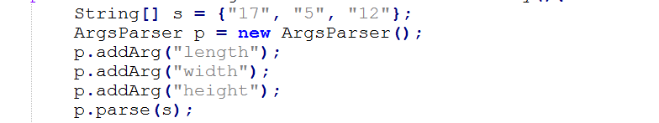
Overview
Allows users to use the command line to process information into their program.

Slide 3
Important features

Slide 4
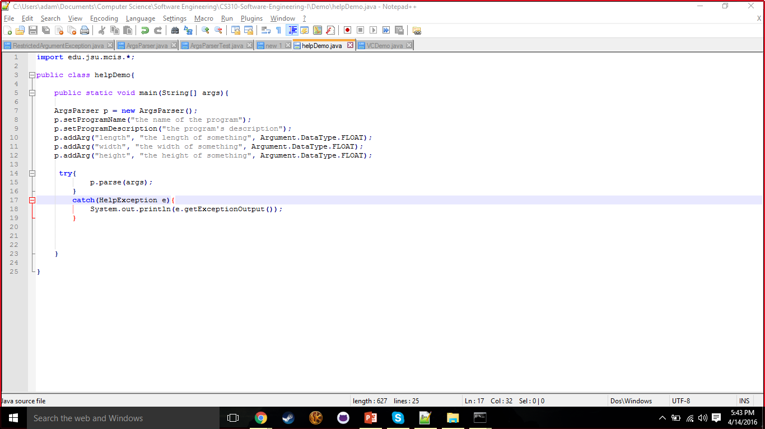
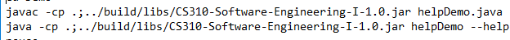
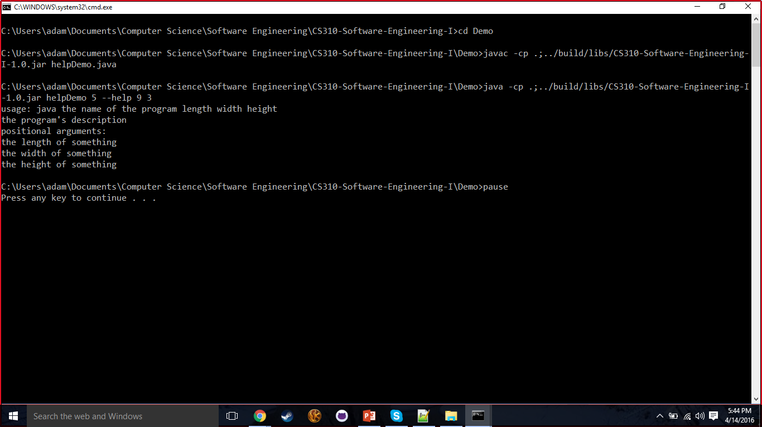
Help Command and additional info

Slide 5
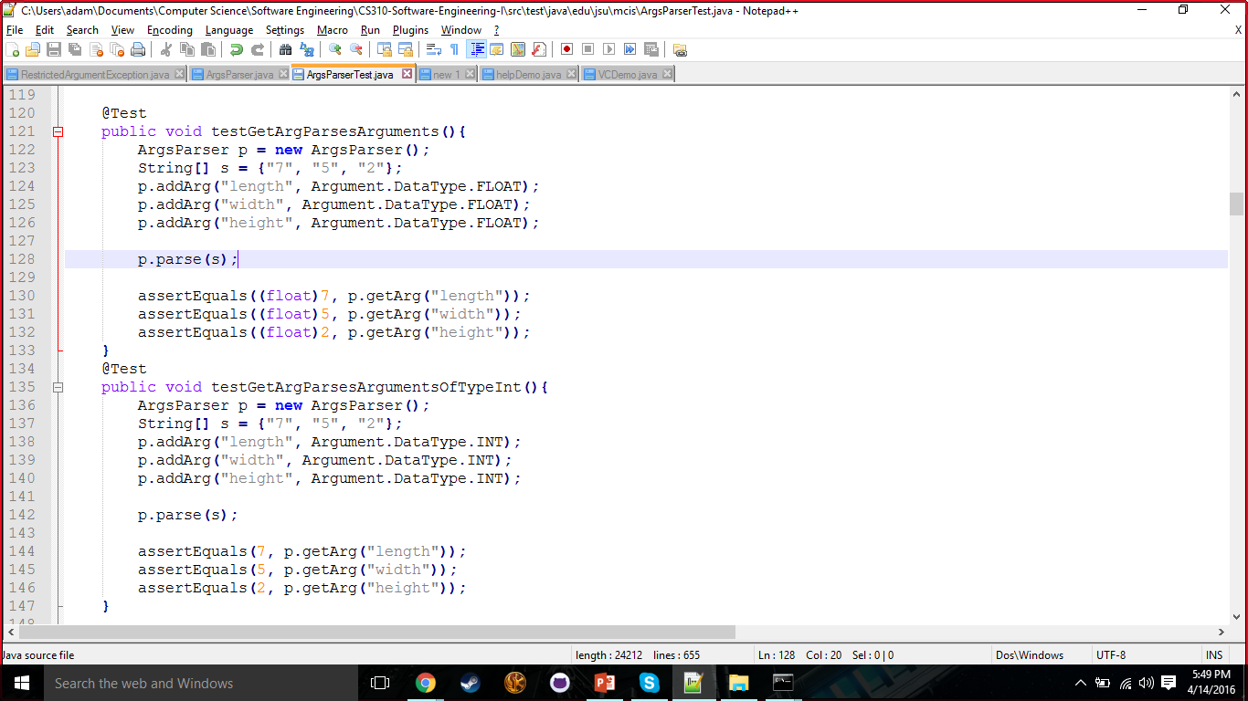
Different datatypes are allowed

Slide 6
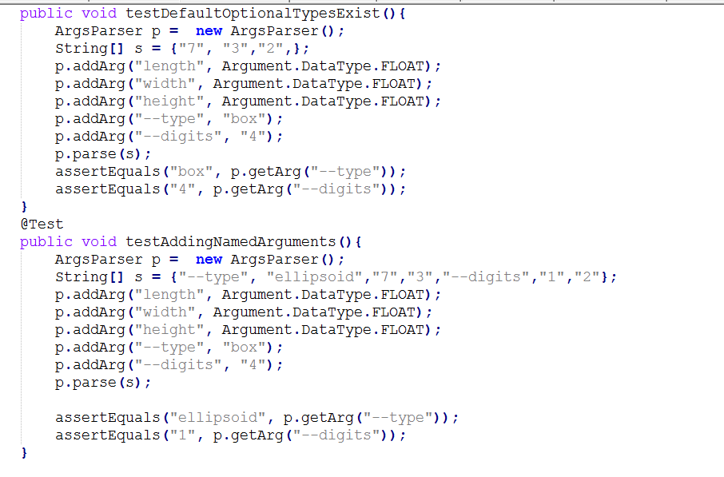
Named arguments are allowed

Slide 7
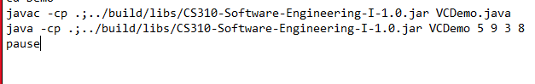
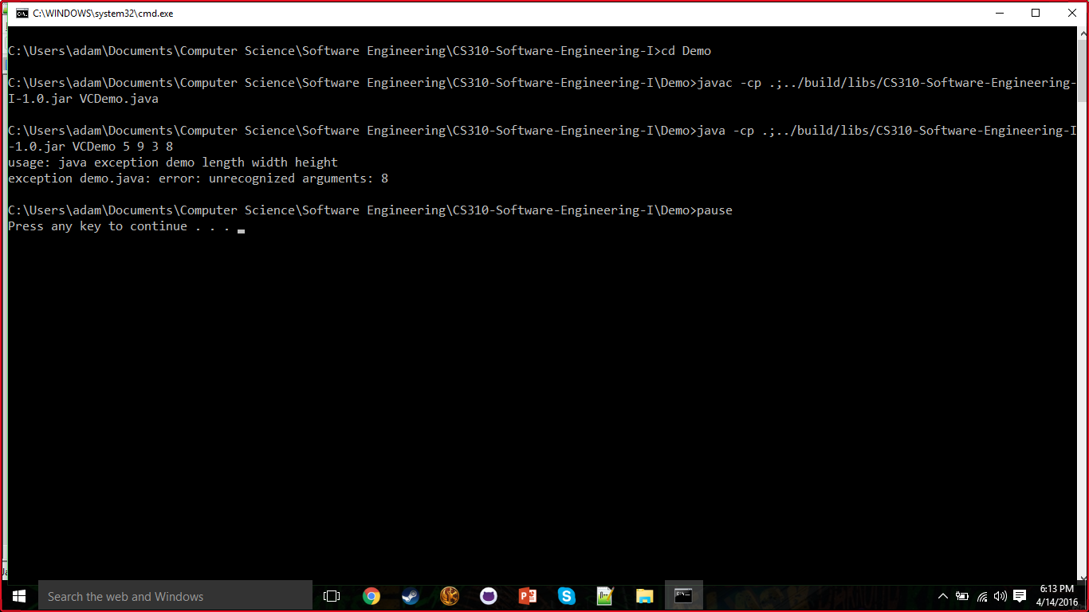
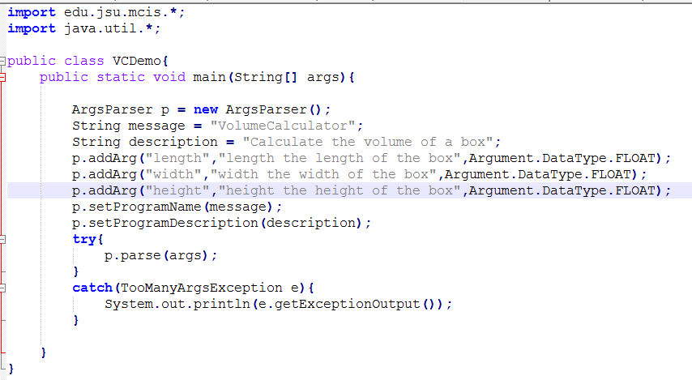
Exceptions thrown when program used incorrectly

Slide 8
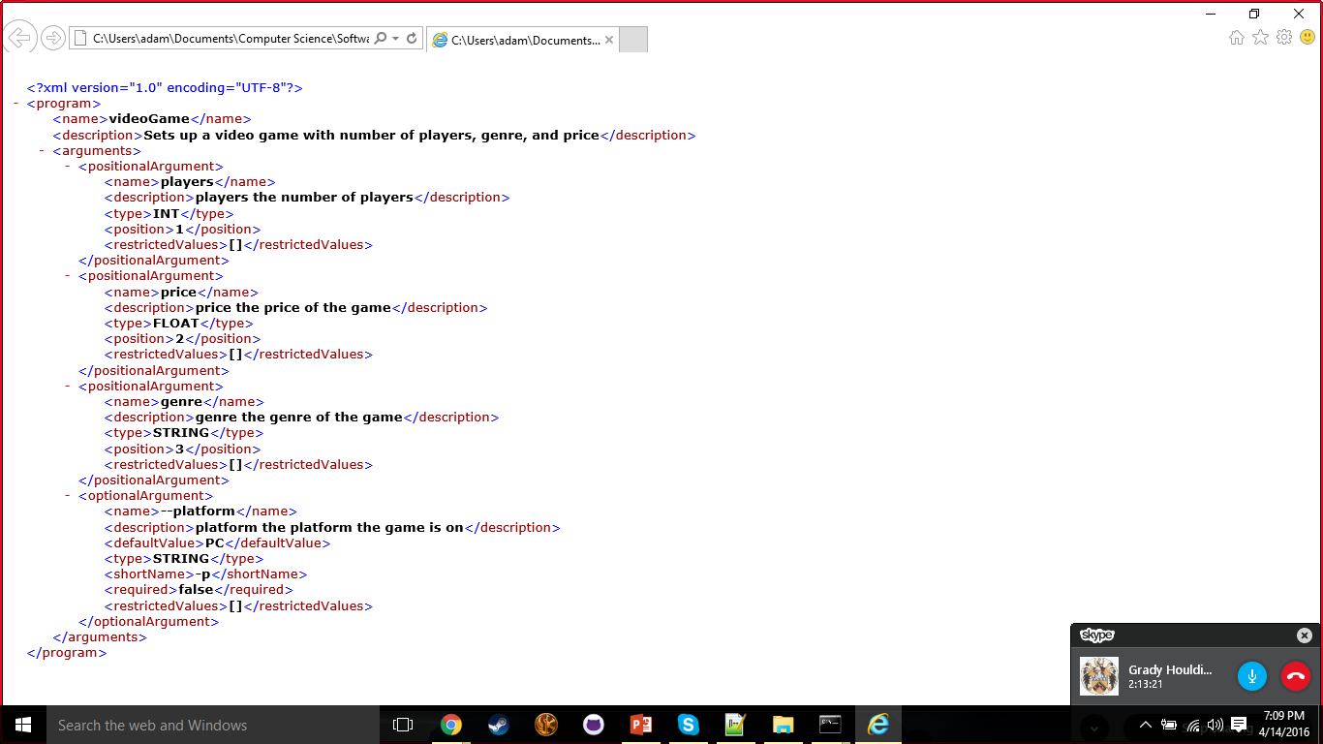
XML Saving and loading

Slide 9
Documentation
C:\Users\adam\Documents\Computer Science\Software Engineering\CS310-Software-Engineering-I\build\docs\javadoc\index.html

Slide 10
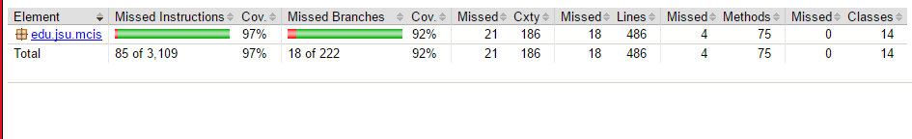
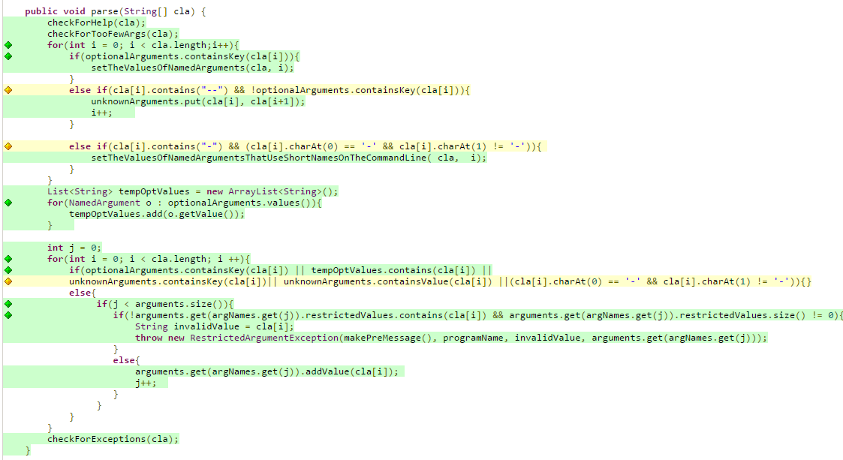
Test coverage
T
E
S
T
C
O
V
E
R
A
G
E

Slide 11
QUESTIONS?

