Slide 1
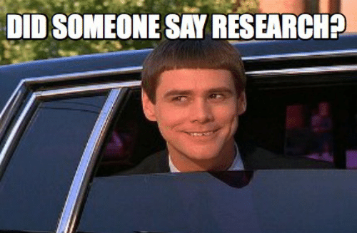
Capstone A Intro to Research
Jacquie Cheun, PhD

Slide 2
Housekeeping
Review the Syllabus
Look at it constantly
Lines of Communication
Email and Course Wall only
Files

Slide 3
Goal
To complete a Research Journal Article in 30 weeks with a group of 2-3 students
Present the research at Immersion in during Capstone B

Slide 4
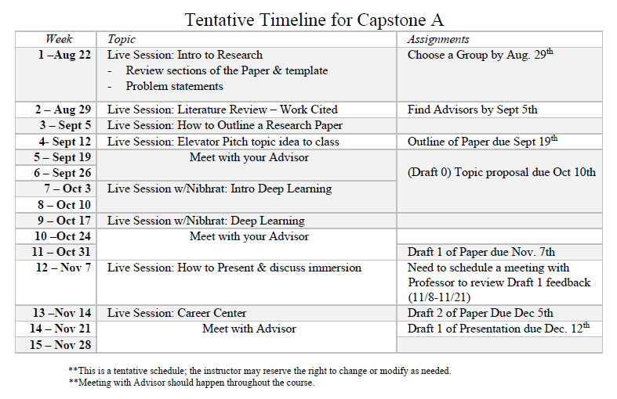

Slide 5
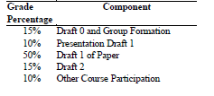
Grade Breakdown

Slide 6
Resources for Research
SMU Library
Data Science Journal Articles
Graduate Writing Center
Must use on Draft 2
Purdue OWL Citation
APA Citations
Advisor

Slide 7

What is the purpose of Research?

Slide 8
Group Set-up
Students in Groups of 2-3
Each group will need to email me your groups with all the group members cc’d
Every assignment requires each Group to complete a peer evaluation forms (found in files on 2DS)
Recommend Microsoft Teams, Slack, or campus email to communicate with your groups.

Slide 9
Group Journal
This term you will be keeping a Log/Journal of all the work you do on the capstone.
See Files for the Excel Sheet
Each Group member must be contributing.

Slide 10
3 Purposes of Research
Exploration
Description
Explanation
Notes:
1.
To satisfy the researcher’s curiosity and desire for better understanding
To test the feasibility of undertaking a more extensive study
To develop the methods to be employed in any subsequent study
2. Describe situations and events through scientific observation
3. Descriptive studies answer questions of what, where, when, and how
Explanatory studies answer questions of why

Slide 11
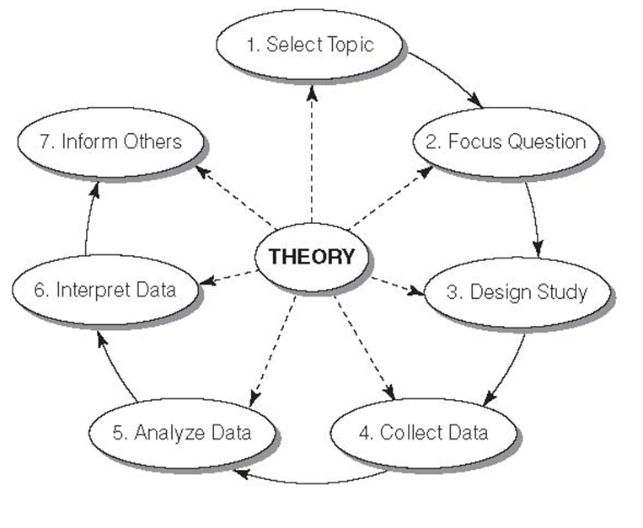
Steps in the Research Process

Slide 12
How to Design a Research Project
Define the purpose of your project – exploratory, descriptive, or explanatory?
Specify the meanings of each concept you want to study
Select a research method
Determine how you will measure the results
Determine whom or what to study
Collect empirical data
Process the data
Analyze the data
Report your findings

Slide 13
Non-Scientific Production of Knowledge
Personal Experience and Common Sense
Overgeneralization
Statements that goes beyond what can be justified based on the data…….. “All teens are bad drivers”
Selective Observation
Process or examination in a way that reinforces preexisting thinking……. “Guns are bad”
Premature Closure
Making a judgment or reaching a decision and ending an investigation before amount/depth of evidence required…….When do we have enough evidence?
Halo Effect
Prior reputation of persons, places, or things to color one’s evaluation rather than being neutral or in a equal manner…….In a report from UTD….or The president stated….or My professor stated…..
False Consensus
Project one’s way of thinking onto other people. The person assumes that everyone else thinks like they do…..As we all know…….or Everyone believes….or No one supports……

Slide 14
Non-Scientific Production of Knowledge
Experts and Authority
Someone in power says so..
Popular and Media messages
Window into a distorted reality
Road Rage
Holiday Havoc
Ideological beliefs and values
“it’s the way things have always been”

Slide 15
Criteria for Causality
Variables must be Correlated
Correlation – an empirical relationship between two variables such that changes in one are associated with changes in the other, or particular attributes in one are associated with particular attributes in the other.
Temporal Order
The cause takes place before the effect
X before Y
IV before DV
Nonspurious
Spurious Relationship – a coincidental statistical correlation between two variables shown to be caused by some third variable

Slide 16
Advisor
All groups need an Advisor by Sept 5th
Email me and include your Advisor to introduce us
I will be sending them information through out the project.
I need their contact information
Name
Email

Slide 17
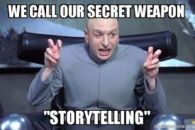

Slide 18
Your Research paper is a BIG story
Introduction
Problem Statement
Literature Review/Background
Hypothesis
Methods
Data
Results
Discussion – Application of the Results
Ethics
Conclusion

Slide 19
Components of an Introduction
Establish the problem or issue
Provide an overview of existing thinking about your research problem
Identify gaps
Relevance- Why should we care about your research?

Slide 20
The Research Proposal – Draft 0
At least 5 pages in length
Draft of Abstract
Introduction
Problem or Objective
Literature Review
10 different peer-reviewed research studies
Data
What data are you using?
Methods
What Methods do you hope to use
Citations are in APA format

Slide 21
Next Live Session
Start Brainstorming a Topic
Librarians will be in Live Session to go over resources that library has to offer.

