Slide 1
Lost & Found
Adam O’Flynn
Conor Smyth
Brian Stone (Supervisor)

Slide 2
Idea
Geolocation application for android that acts as an easy to access forum for users to post information about an item that they have either lost or found.
Users can search for lost or found items in a certain area or they can use location services to see listings near them.

Slide 3
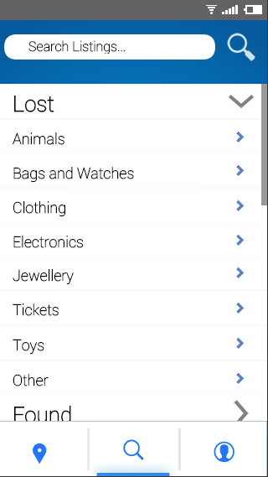
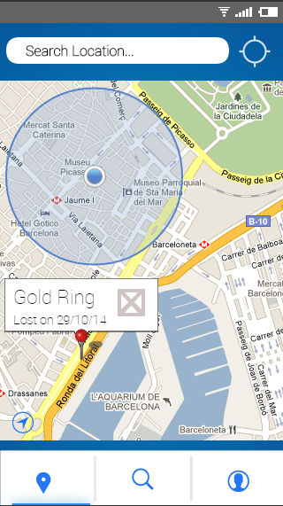

Slide 4
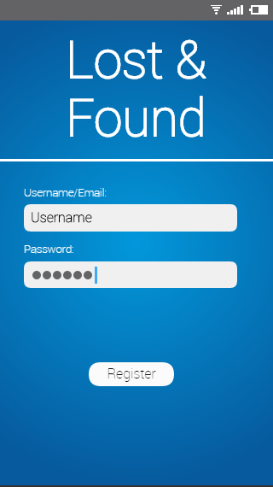
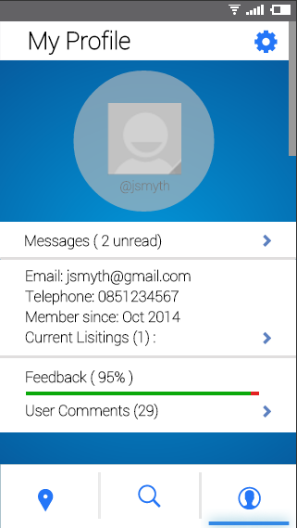

Slide 5
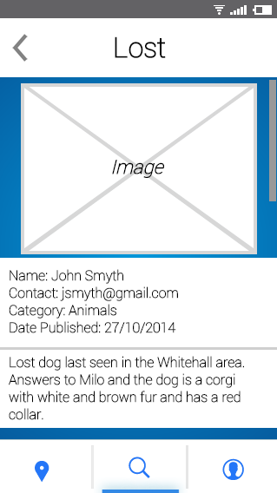
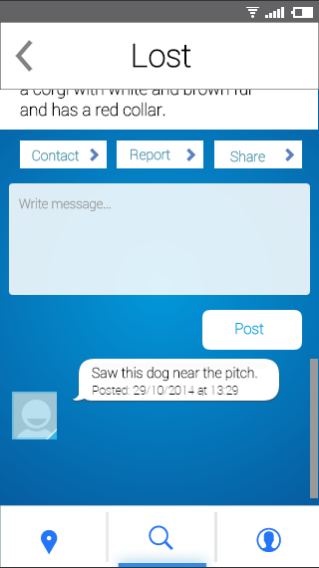

Slide 6
Technology
Initially our plan is to work with android and java using the android SDK to make our application.
However we may switch to an iPhone implementation due to large numbers of iPhone users and for an opportunity to learn something new.
We will be implementing a REST architecture for user profiles and listings.

