Slide 1
emissions
File created on: 1/27/2023 12:06:59 PM

Slide 2
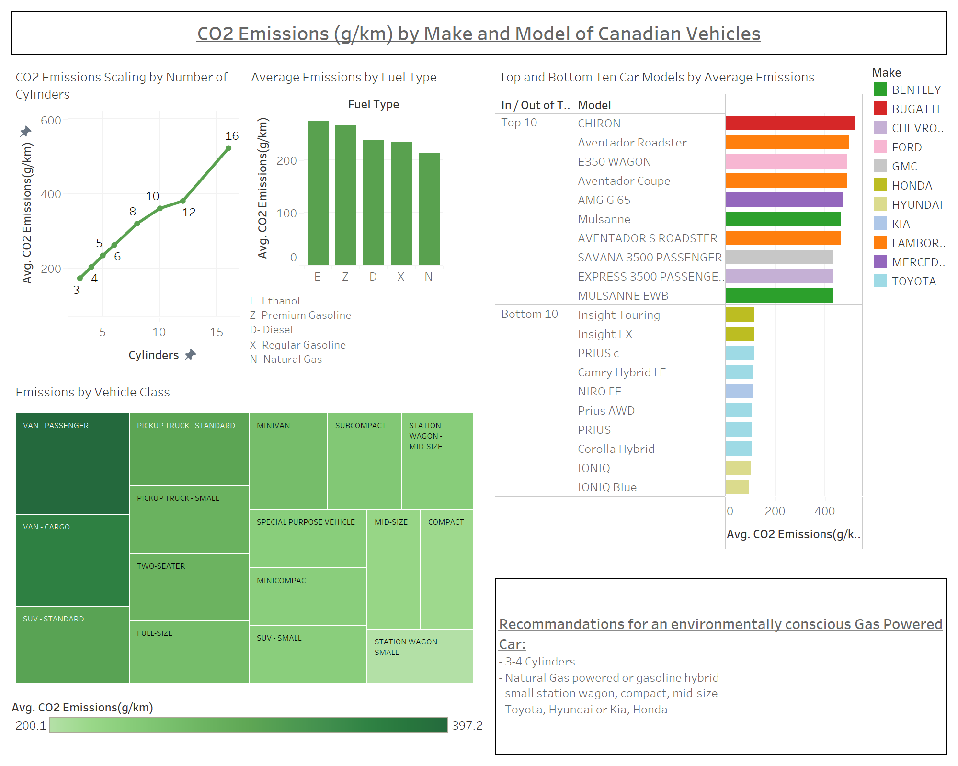

Slide 3
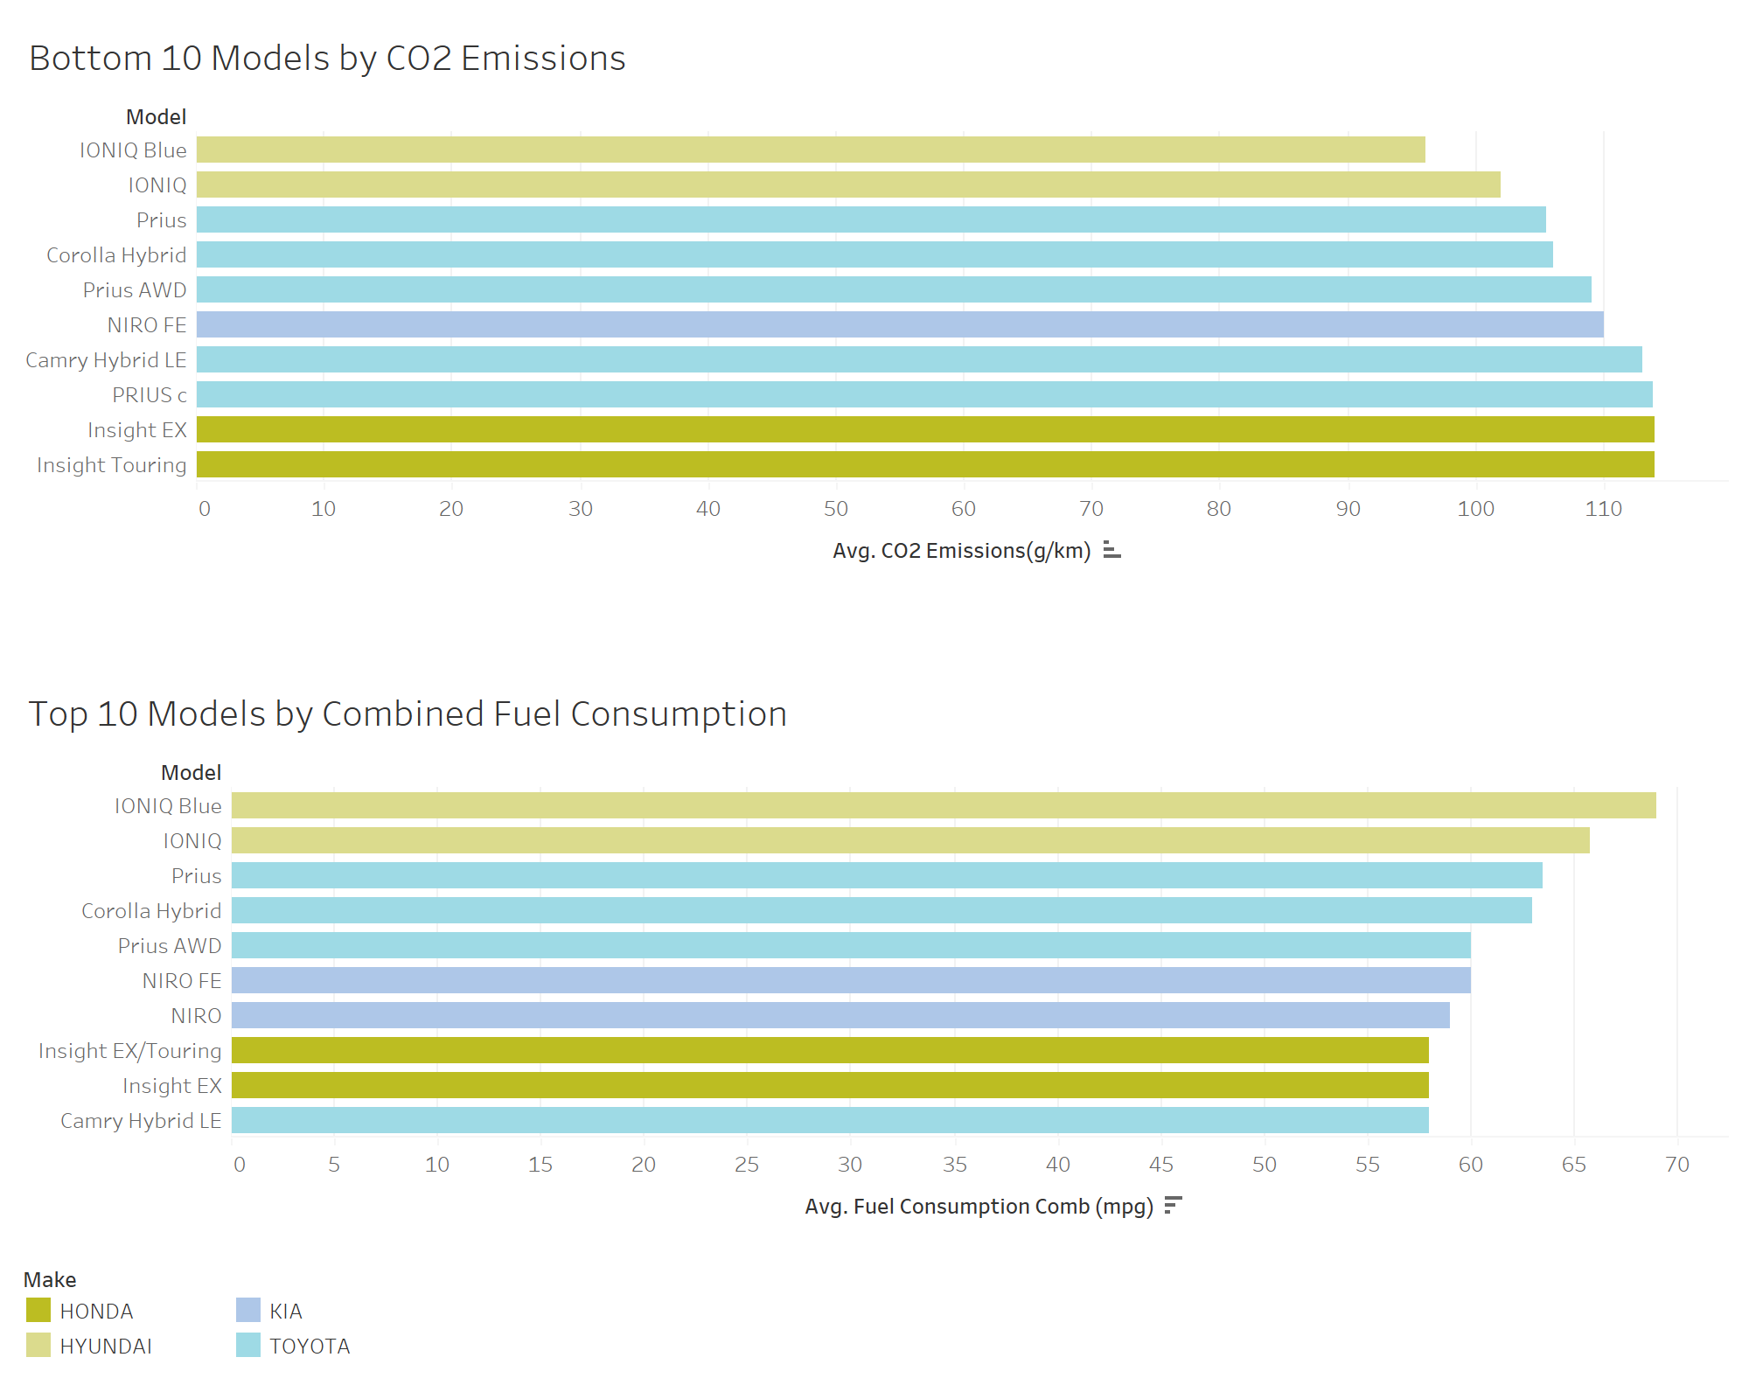

Slide 4
