Slide 1



22 September Update
Adam Dvorak
Gorm Andresen
Marta Victoria
Department of Mechanical and Production Engineering, Aarhus University, Denmark

Slide 2
Agenda
Pressure calculations
Assumptions
No results yet (sorry)!
Questions yet to be answered
Planning for the paper

Slide 3
Under Pressure— Traditional
Energy requirement:
0.695 kW H2/100 kW CH4
2.021 kW CO2/ 100 kW CH4
Total: 2.717 kW/ 100 kW CH4
emitted

Slide 4
Under Pressure-- Bacteria-based
Energy requirement:
2.154 kW CH4 / 100 kW CH4

Slide 5
Assumptions
Constant amount of methane demand—3MW

Slide 6
Questions
Where should the solar farm be located?

Slide 7
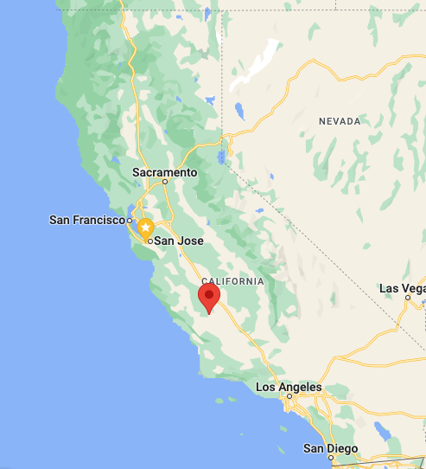
Apple HQ
California Flats
Apple Solar Farm

Slide 8
Questions
Where should the solar farm be located?

