Slide 1
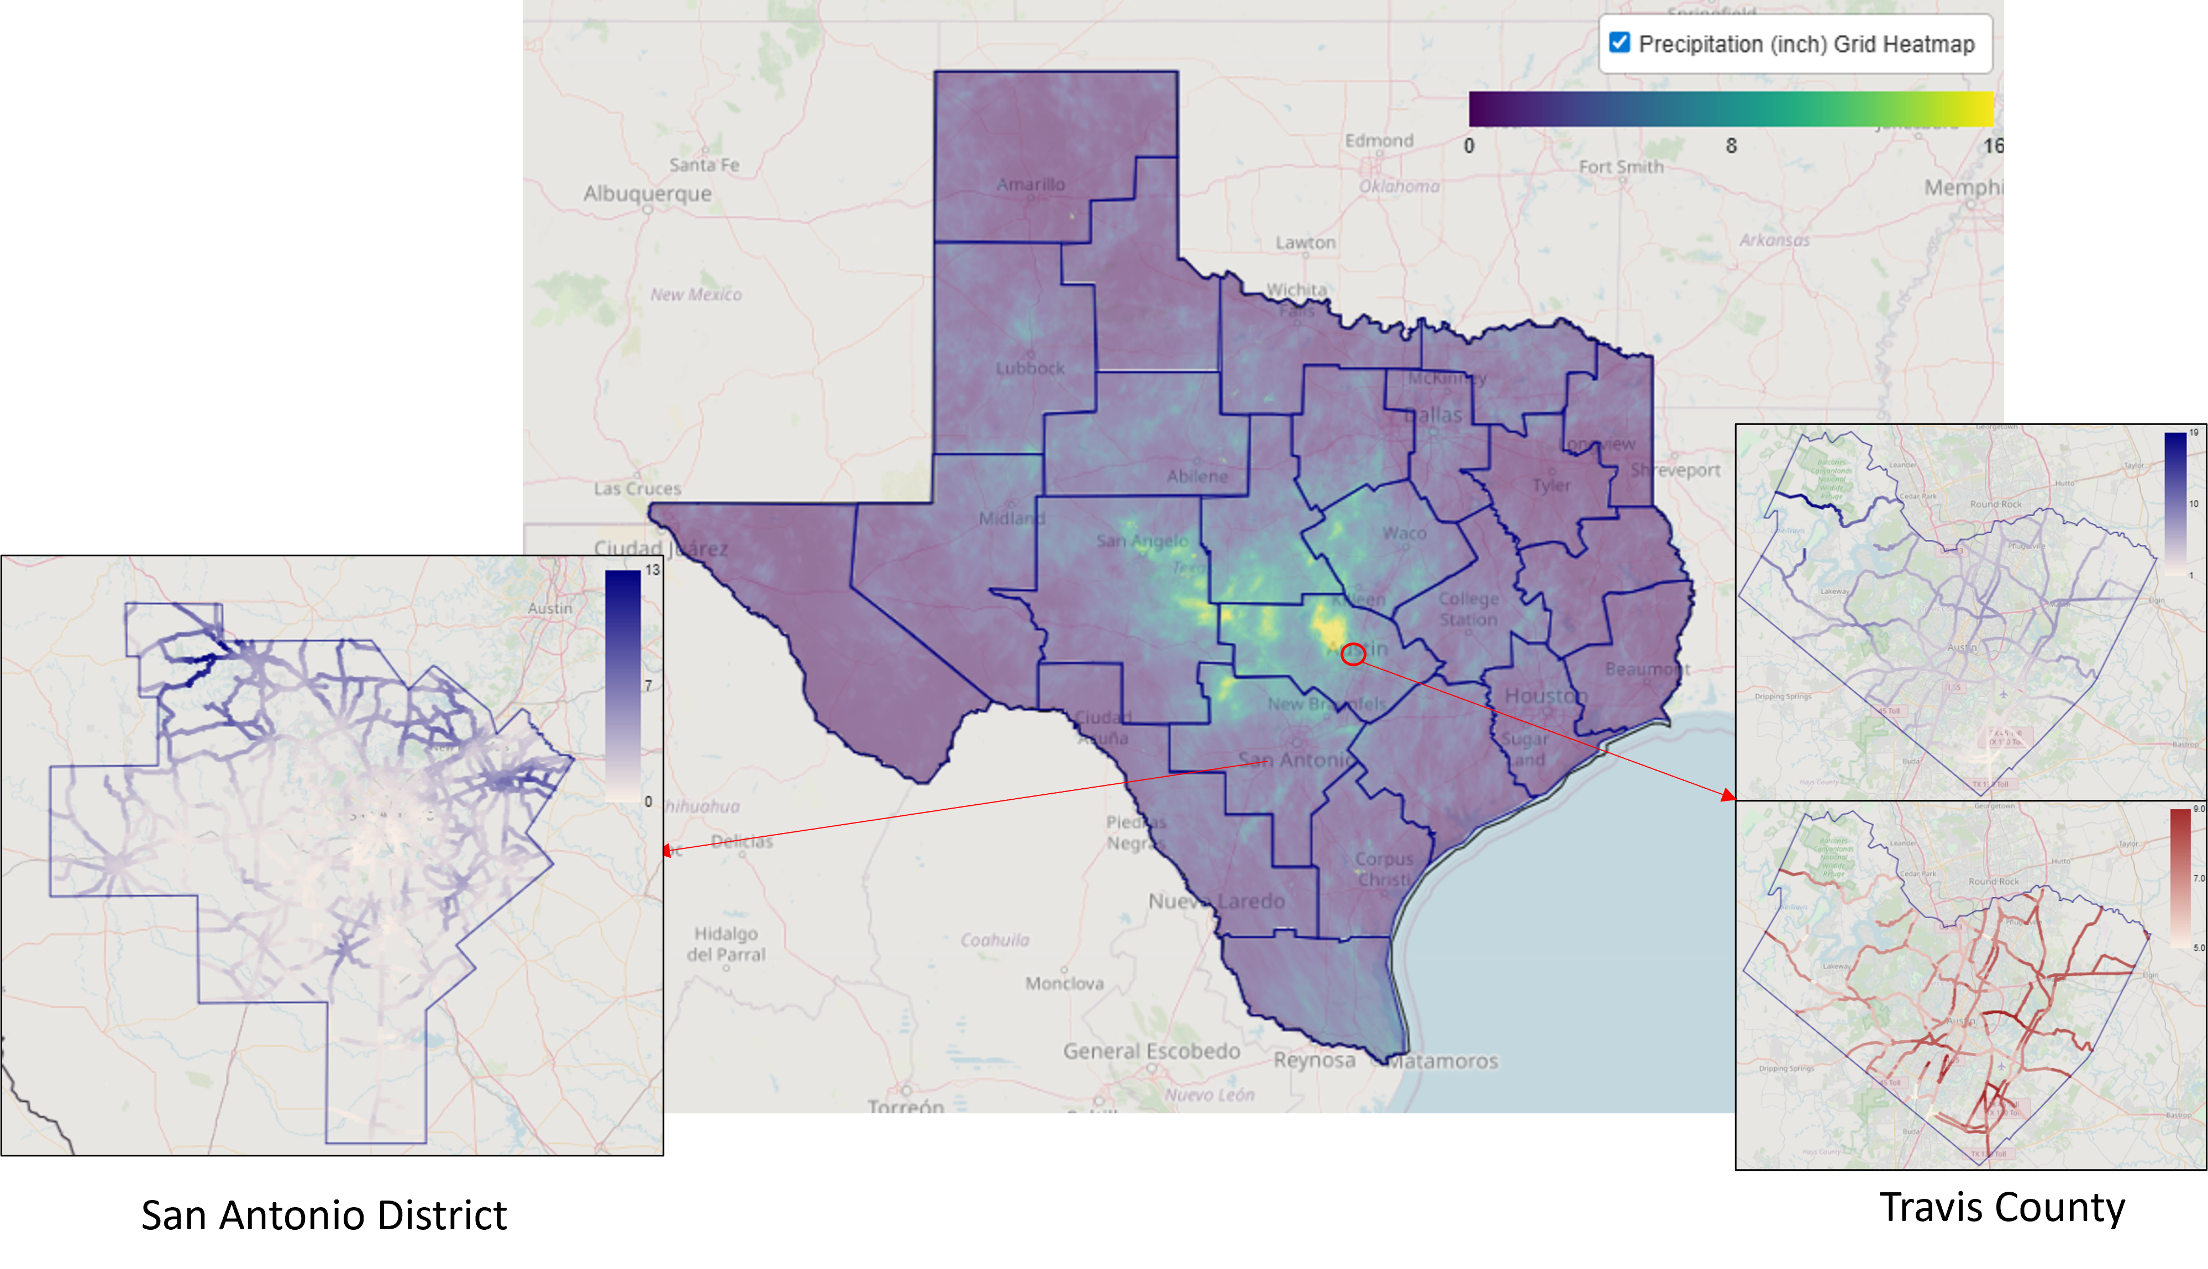
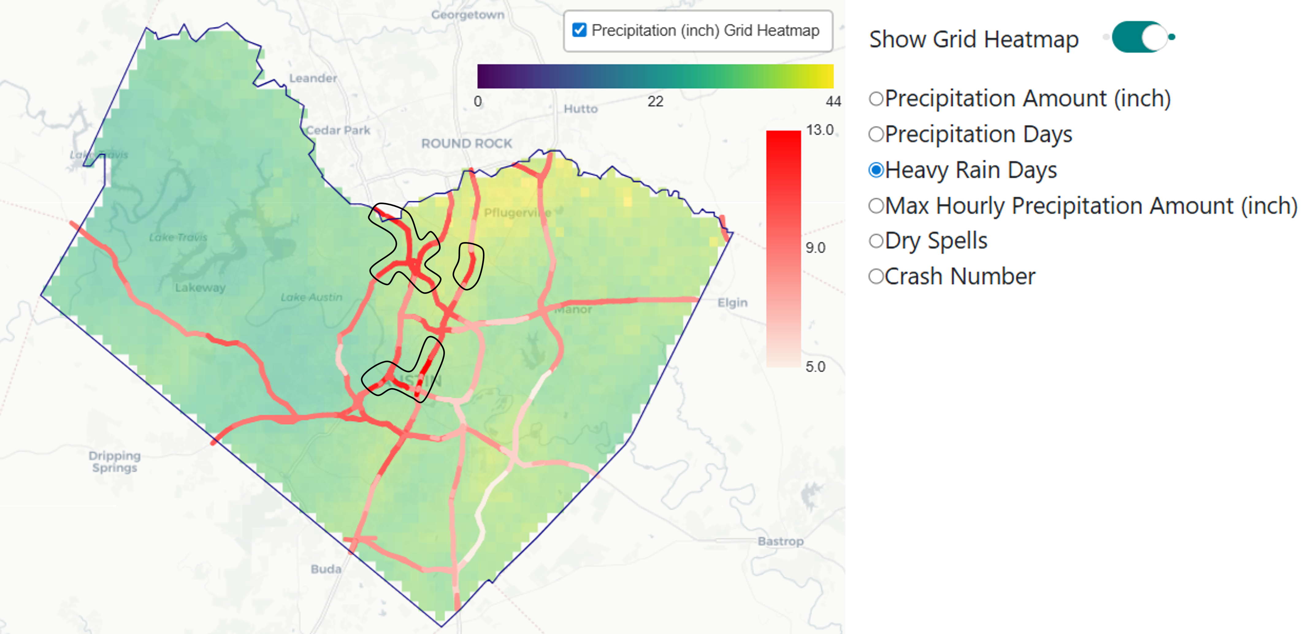
Computing Roadway Weather Variables using Gridded Weather Data:
A Proof of Concept in Texas
Yu Li, Adam Kosicki, Saddam Hossain, Natalia Ruiz-Juri
Background
Methodology Overview
Scaling Visualization to Statewide
Motivation: Precipitation events can adversely impact traffic safety and mobility. Analyzing fine-grained precipitation data on roadway segments is critical to explore and mitigate weather impacts.
Gap: Sensor-based weather datasets are available, but often lack coverage, and cross-agency integration is challenging. NOAA provides fine-grained nation-wide gridded data. Such data requires extensive processing to derive segment-level variables.
Contribution:
Scalable workflow to map gridded precipitation data to the roadway network and to compute segment-level weather variables.
Interactive visualization of segment-level precipitation metrics and crash data.
Data:
Precipitation: NEXRAD Stage IV (4 km, hourly) and MRMS (1 km, 2min)
Roadway: INRIX segments and TxDOT On-System Roadway network
Crash data: TxDOT CRIS database (mapped within 30 m of segments)
Workflow: 1) Download gridded precipitation data ➔ 2) Map each roadway segment to nearest grid cell ➔3) Aggregate hourly data to daily / monthly metrics ➔ 4) Link segment-day weather with crash records ➔ 5) Visualize results in an interactive map.
To demonstrate workflow scalability, an extended application at the statewide level was conducted, processing MRMS precipitation data for the 10-day period from July 1, 2025 to July 10, 2025.
Workflow of Road Segments Precipitation and Visualization
Processed Segment-Level Weather Metrics: Total Precipitation, Number of Precipitation Days, Heavy Rain Days, Maximum Hourly Precipitation, Dry Spells, etc.
The precipitation heatmap of all district in Texas
Segment-Level Visualization
Future Directions
Segment-level metrics showing precipitation characteristics in Travis County, aggregated across all grid cells from July 2023 to June 2024.
Extend the workflow to include additional weather variables (e.g., temperature, snow/ice?, wind) and multi-year data
Improve scalability by optimizing roadway segmentation and large-volume gridded data processing
Further integrate weather metrics with crashes, speeds, and operations to support weather-aware transportation management
This work was funded by Texas Department of Transportation Strategic Initiatives and Innovation Division under their Strategic Partnerships for Expedited Data Innovations (SPEDI) program (Contract No.601CT0000032793).
The annual precipitation amount
The total heavy rain days

