Slide 1
Smart home and building solutions.
Global. Secure. Connected.
December 1st – OpenLine: EMS

Slide 2
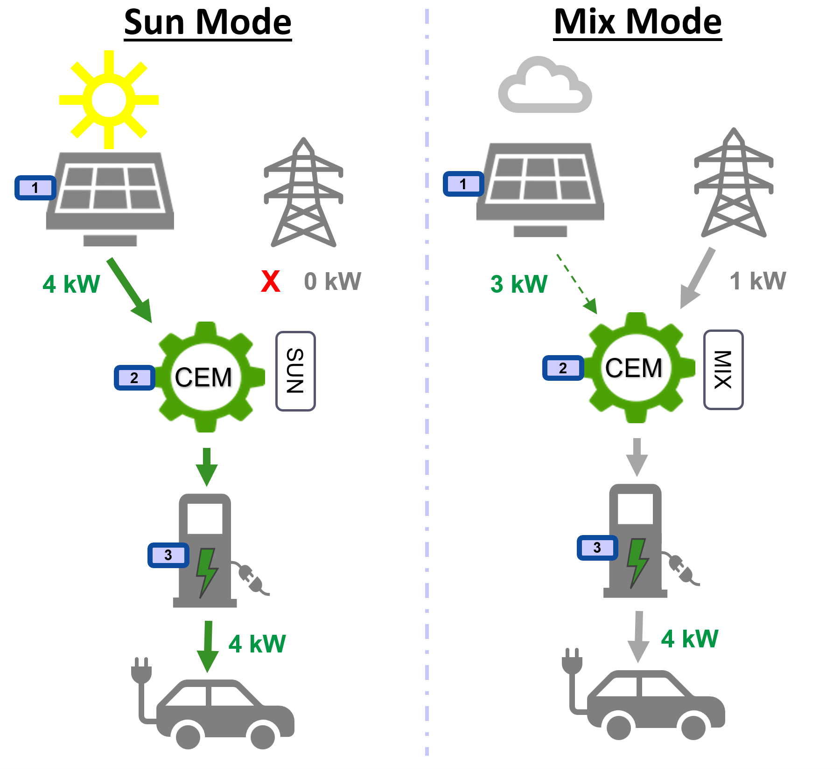

EMS: Energy Management System
This is about when to charge the EV.
Either ‘Sun Mode’: take into account present renewable energy; I only need the EV some time later
Or ‘Mix Mode’: don’t care about present renewable energy; I need the EV anytime soon
Smart home and building solutions.
Global. Secure. Connected.
Join us
www.knx.org

Slide 3
EMS: details
Demonstration applications for;
  Photovoltaic Invertor: ‘PV’
  Central Energy Manager: ‘CEM’
  Electric Vehicle Charger: ‘EV Charger’
Environment/platform:
  For this very presentation: Windows
  Also foreseen: Linux
Illustrate the capabilities of KNX IoT technology in managing:
  renewable energy
  charging infrastructure
Smart home and building solutions.
Global. Secure. Connected.
Join us
www.knx.org

Slide 4
Demonstration applications
Fixed and pre-loaded configuration
Concept:
PV
CEM
Charger
Smart home and building solutions.
Global. Secure. Connected.
Join us
www.knx.org

Slide 5
Demonstration applications: Architectural options
Base: 3 apps
Several combinations possible
PV +
CEM
Charger
PV
CEM +
Charger
Smart home and building solutions.
Global. Secure. Connected.
Join us
www.knx.org

Slide 6
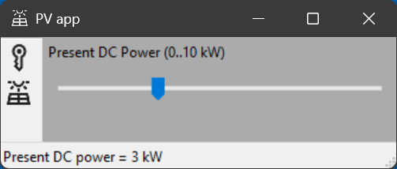
Photovoltaic app (PV)
Simulates a solar inverter providing data regarding present renewable energy
Enables adjustment (by means of a slider) of the solar production value (0–10 kW) for testing
Smart home and building solutions.
Global. Secure. Connected.
Join us
www.knx.org

Slide 7
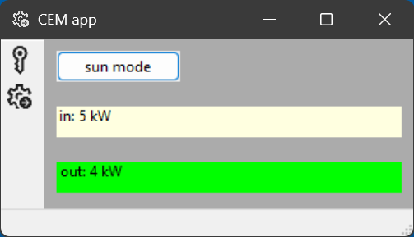
Central Energy Manager app (CEM)
Acts as the brain of the system
Two operation modes:
  Sun Mode: EV charges only if present renewable energy ≥ 4 kW
  Mix Mode: EV charges at 4 kW regardless of present renewable energy
Calculates and sends out the appropriate charging rate
Smart home and building solutions.
Global. Secure. Connected.
Join us
www.knx.org

Slide 8
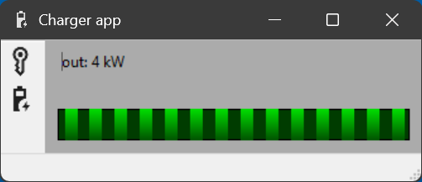
EV Charger app (Charger)
Represents an EV charger
Receives and applies the charging request from the CEM app
Smart home and building solutions.
Global. Secure. Connected.
Join us
www.knx.org

Slide 9
EMS apps: fixed and pre-loaded configuration
This means that no tool is required to make the system operational
Base: serial number of the CEM device
Procedure, at start up:
  The CEM device derives its settings from its own serial number
  The PV device also derives its settings from this serial number
  The Charger device also derives its settings from this serial number
Settings:
  Datapoints
  IPv6 multicast address
  OSCORE: data protection
Smart home and building solutions.
Global. Secure. Connected.
Join us
www.knx.org

Slide 10
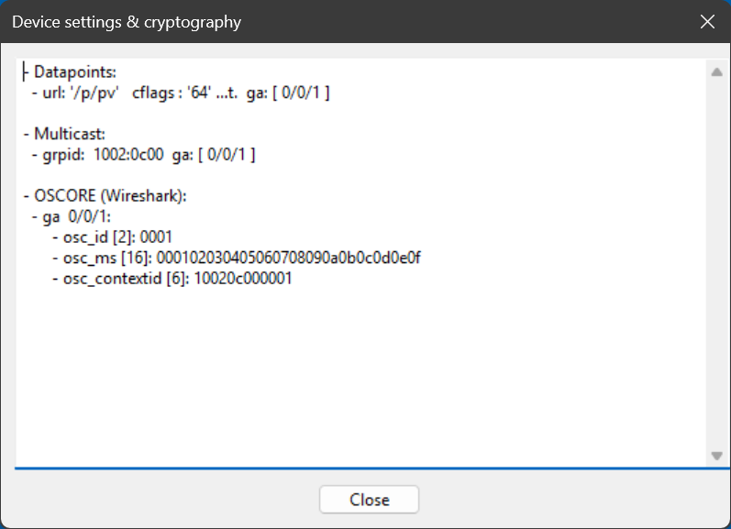
PV app: fixed and pre-loaded configuration
Technical details:
1 datapoint
  cflags = t : transmit to medium
  url : PV = present renewable energy
IPv6 multicast: groups the devices
OSCORE: protection of the exchanged data
Smart home and building solutions.
Global. Secure. Connected.
Join us
www.knx.org

Slide 11
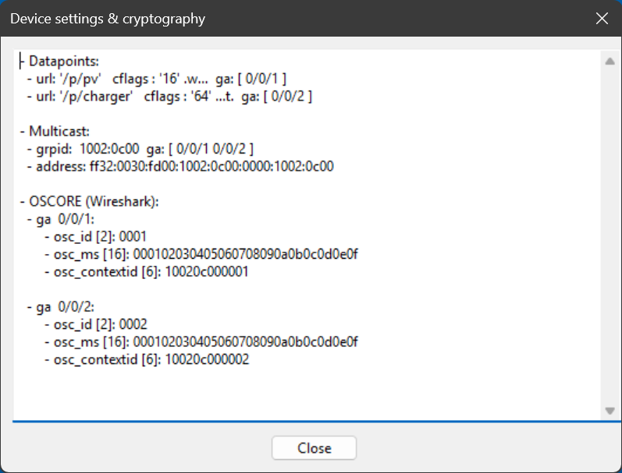
CEM app: fixed and pre-loaded configuration
Technical details:
2 datapoints
  cflags = w : write from medium
  cflags = t : transmit to medium
  url : PV = present renewable energy
  url : Charger = requested charge rate
IPv6 multicast: groups the devices
OSCORE: protection of the exchanged data
Smart home and building solutions.
Global. Secure. Connected.
Join us
www.knx.org

Slide 12
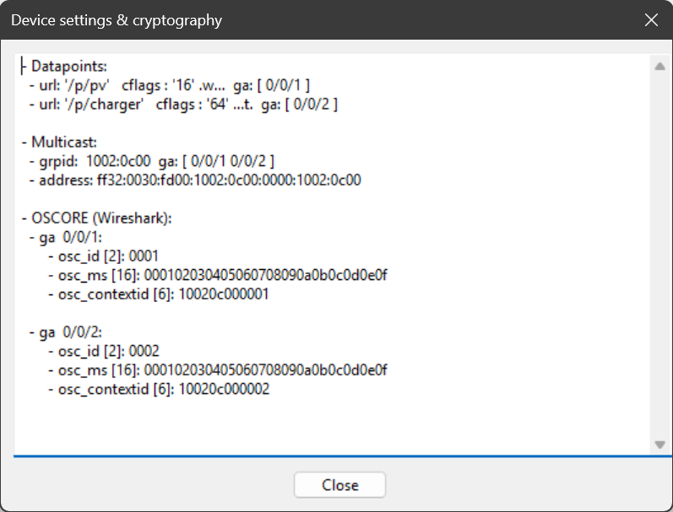
Charger app: fixed and pre-loaded configuration
Technical details:
1 datapoint
  cflags = w : write from medium
  url : Charger = requested charge rate
IPv6 multicast: groups the devices
OSCORE: protection of the exchanged data
Smart home and building solutions.
Global. Secure. Connected.
Join us
www.knx.org

Slide 13
EMS apps: demo
Smart home and building solutions.
Global. Secure. Connected.
Join us
www.knx.org

Slide 14
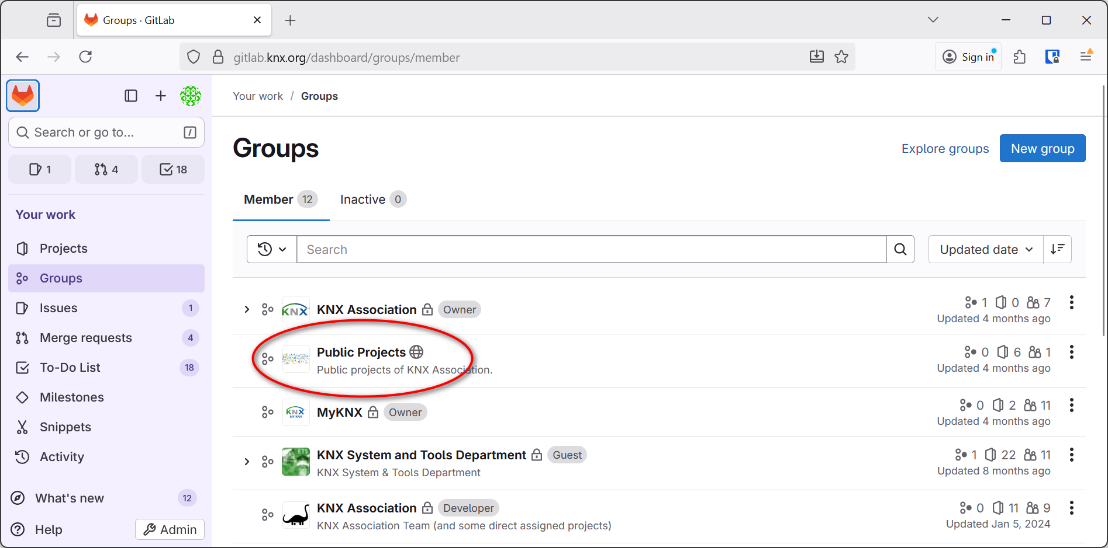
Open Source: get it from our GitLab repo
Smart home and building solutions.
Global. Secure. Connected.
Join us
www.knx.org

Slide 15
Christophe Parthoens
christophe.parthoens@knx.org

