Slide 1
Smart home and building solutions.
Global. Secure. Connected.
December 1st – OpenLine: EMS

Slide 2
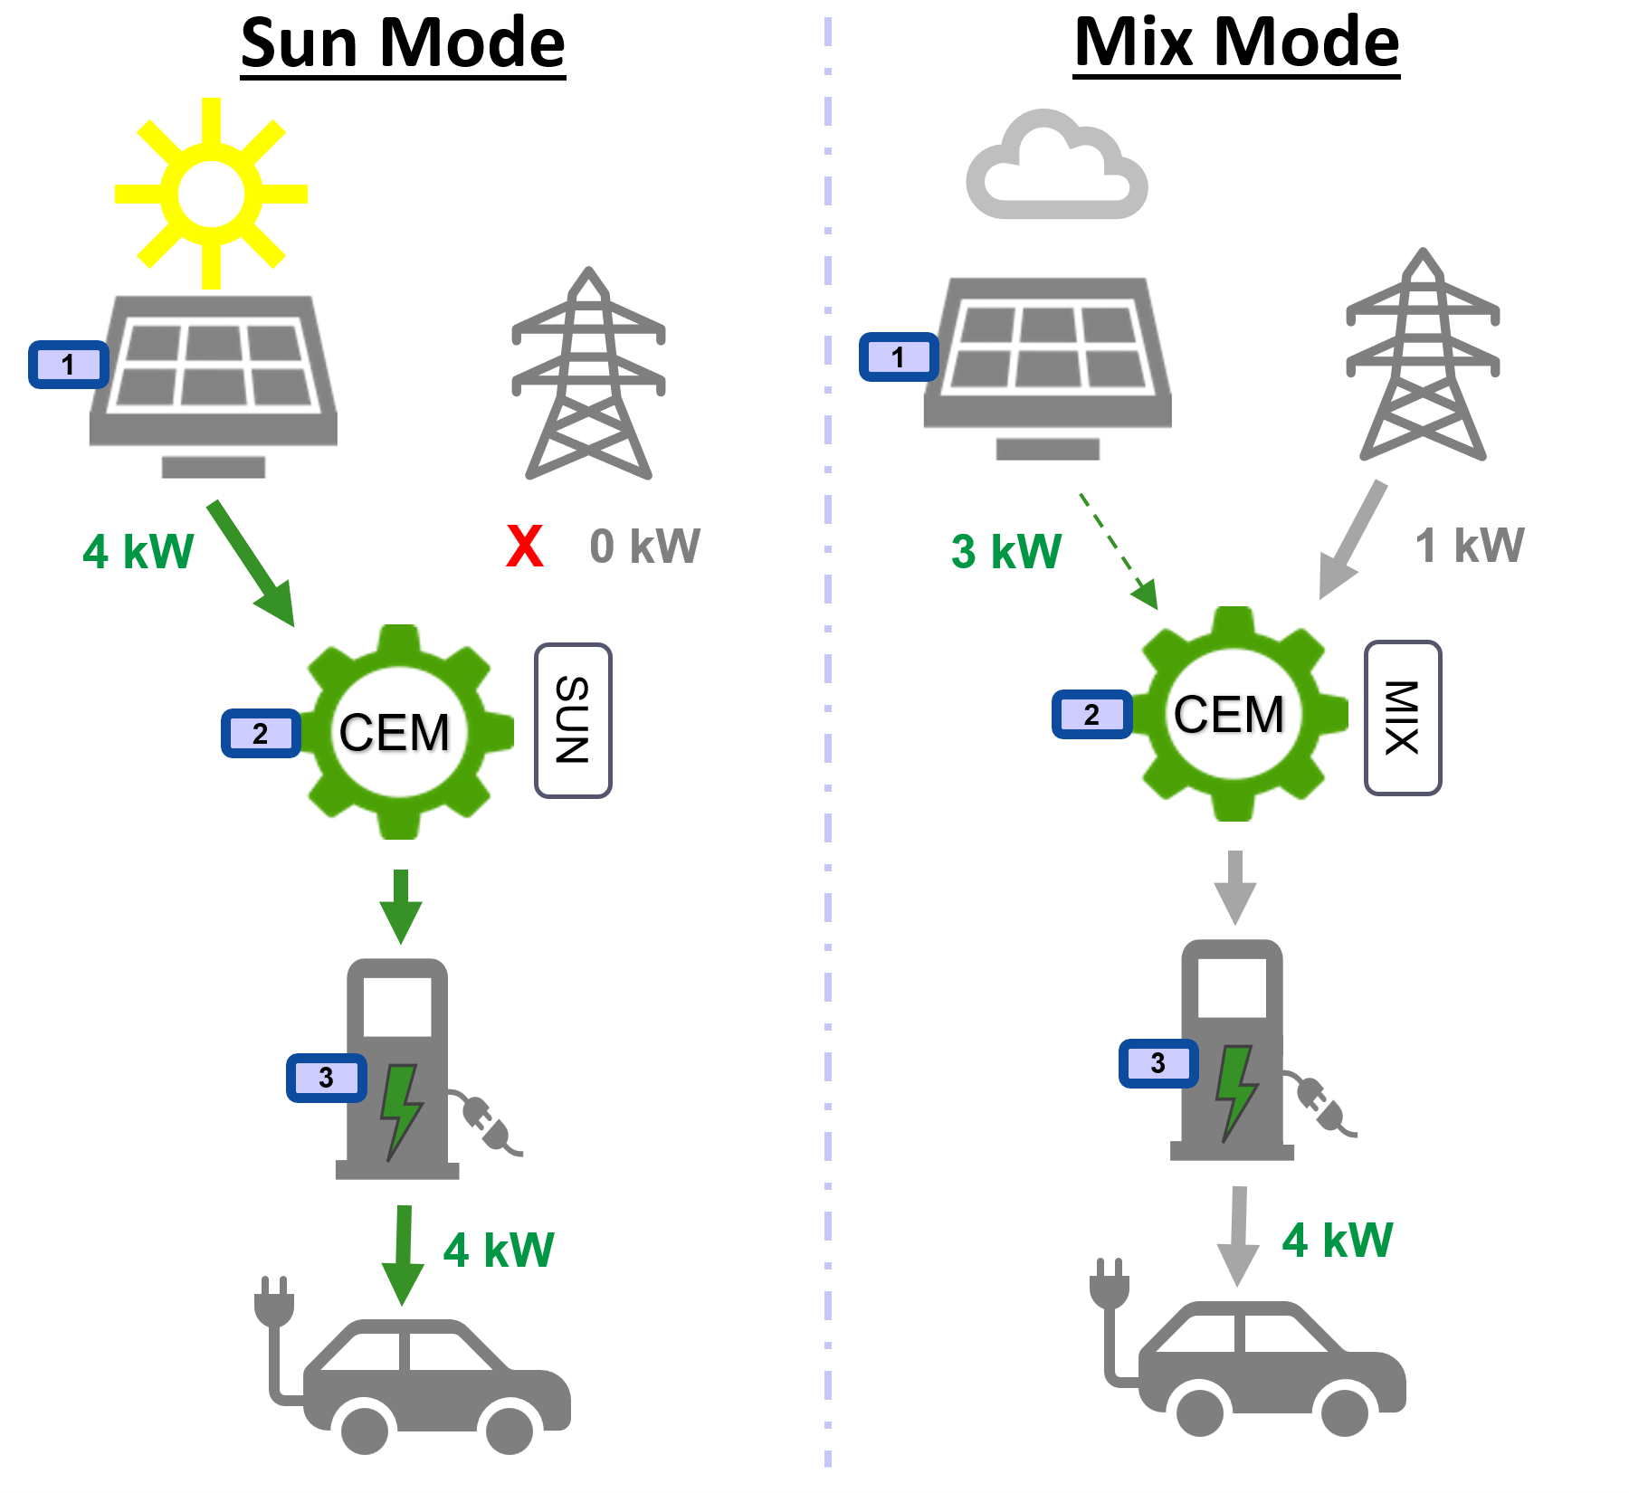

EMS: Energy Management System
This is about when to charge the EV.
Either ‘Sun Mode’: take into account present renewable energy; I only need the EV some time later
Or ‘Mix Mode’: don’t care about present renewable energy; I need the EV anytime soon
Smart home and building solutions.
Global. Secure. Connected.
Join us
www.knx.org

Slide 3
EMS: details
Demonstration applications for;
  Photovoltaic Invertor: ‘PV’
  Central Energy Manager: ‘CEM’
  Electric Vehicle Charger: ‘EV Charger’
Environment/platform:
  For this very presentation: Windows
  Also foreseen: Linux
Illustrate the capabilities of KNX IoT technology in managing:
  renewable energy
  charging infrastructure
Smart home and building solutions.
Global. Secure. Connected.
Join us
www.knx.org

Slide 4
Demonstration applications
Concept:
PV
CEM
Charger
Smart home and building solutions.
Global. Secure. Connected.
Join us
www.knx.org

Slide 5
Demonstration applications: Architectural options
Base: 3 apps
Several combinations possible
PV +
CEM
Charger
PV
CEM +
Charger
Smart home and building solutions.
Global. Secure. Connected.
Join us
www.knx.org

Slide 6
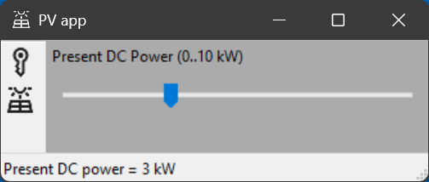
Photovoltaic app (PV)
Simulates a solar inverter providing data regarding present renewable energy
Enables adjustment (by means of a slider) of the solar production value (0–10 kW) for testing
Smart home and building solutions.
Global. Secure. Connected.
Join us
www.knx.org

Slide 7
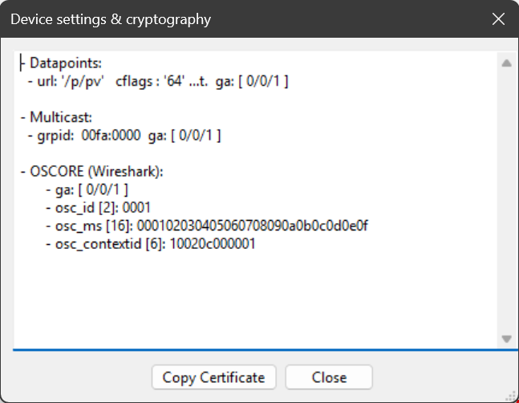
PV app: how to link?
Technical details:
1 datapoint
  cflags = t : transmit to medium
  url : /p/pv = present renewable energy
IPv6 multicast: groups the devices
OSCORE: protection of the exchanged data
‘Copy Certificate’: used by CEM for linking
Smart home and building solutions.
Global. Secure. Connected.
Join us
www.knx.org

Slide 8
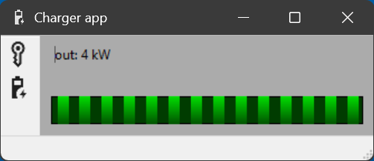
EV Charger app (Charger)
Represents an EV charger
Receives and applies the charging request from the CEM app
Smart home and building solutions.
Global. Secure. Connected.
Join us
www.knx.org

Slide 9
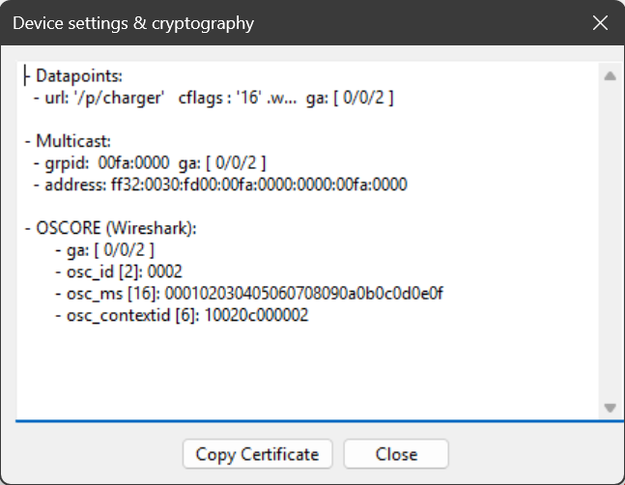
Charger app: how to link?
Technical details:
1 datapoint
  cflags = w : write from medium
  url : /p/charger = requested charge rate
IPv6 multicast: groups the devices
OSCORE: protection of the exchanged data
‘Copy Certificate’: used by CEM for linking
Smart home and building solutions.
Global. Secure. Connected.
Join us
www.knx.org

Slide 10
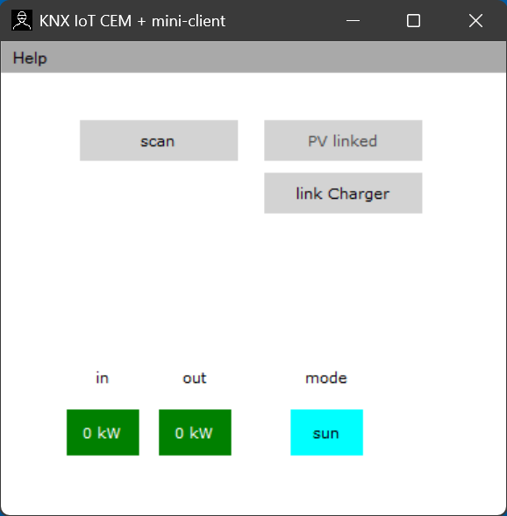
Central Energy Manager (CEM)
Acts as the brain of the system (‘spider in the web’)
In practice: not an end-device, no physical interface onboard
Two operation modes:
  Sun Mode: EV charges only if present renewable energy ≥ 4 kW
  Mix Mode: EV charges at 4 kW regardless of present renewable energy
Calculates and sends out the appropriate charging rate
Comes with client features:
  Read-in device certificates (QR)
  Device scanning over the medium (serial numbers)
  Linking (commissioning)
Smart home and building solutions.
Global. Secure. Connected.
Join us
www.knx.org

Slide 11
CEM app: how to link the other devices?
Technical details:
2 datapoints
  cflags = w : write from medium
  cflags = t : transmit to medium
  url : /p/pv = present renewable energy
  url : /p/charger = requested charge rate
IPv6 multicast: groups the devices
OSCORE: protection of the exchanged data
‘Enter Serial Number’: ???
Smart home and building solutions.
Global. Secure. Connected.
Join us
www.knx.org

Slide 12
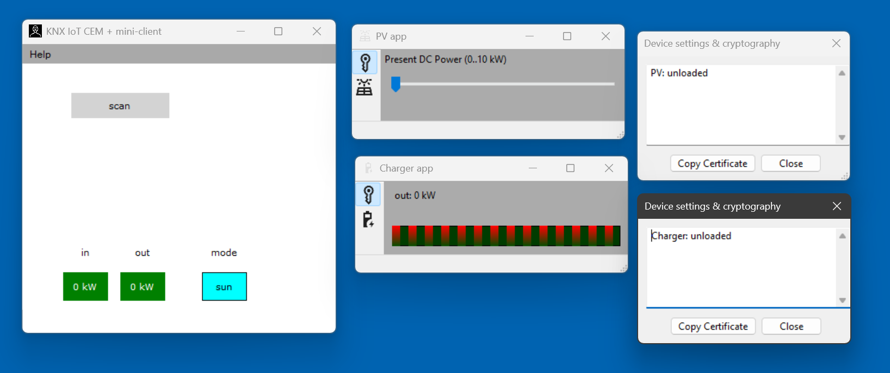
Linking: initial situation
click
Smart home and building solutions.
Global. Secure. Connected.
Join us
www.knx.org

Slide 13
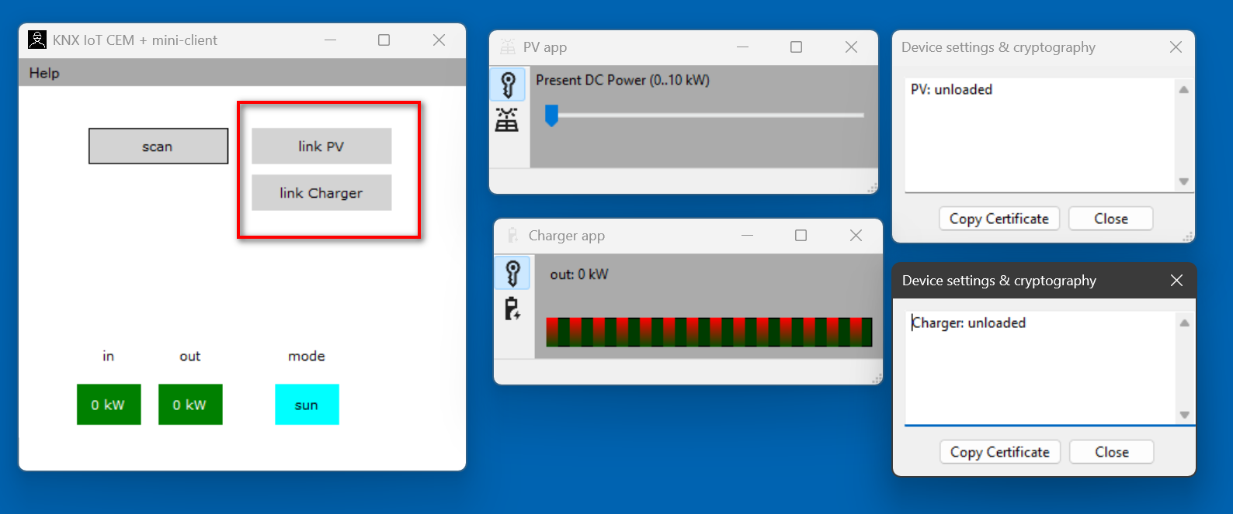
Linking: two devices discovered after scanning
click
Smart home and building solutions.
Global. Secure. Connected.
Join us
www.knx.org

Slide 14
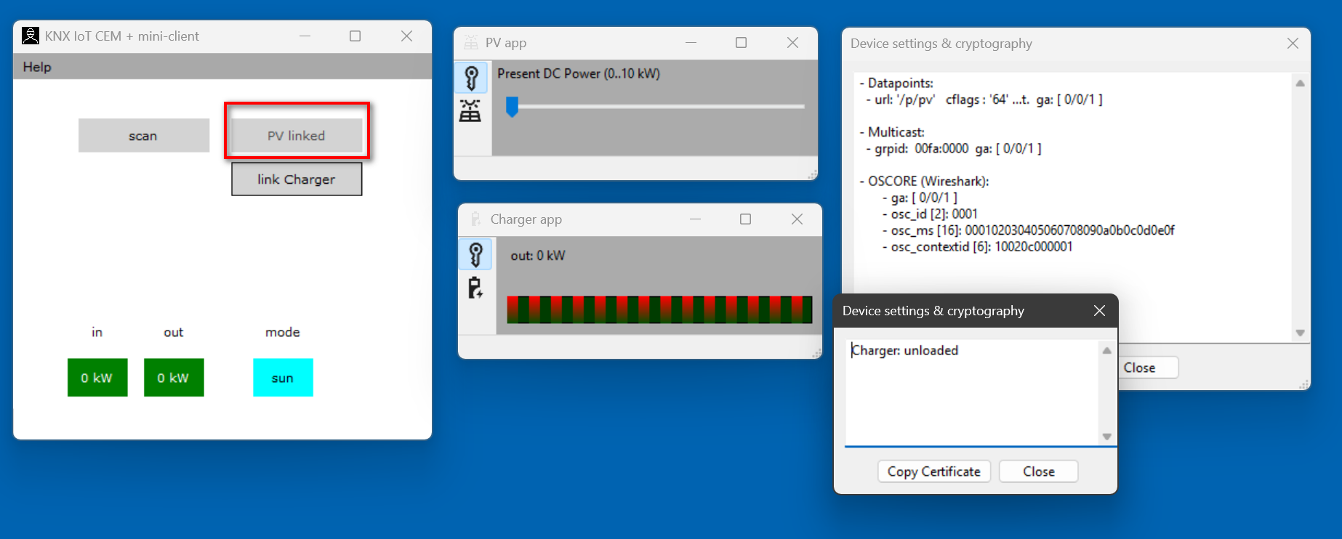
Linking: PV linked, Charger not yet
click
Smart home and building solutions.
Global. Secure. Connected.
Join us
www.knx.org

Slide 15
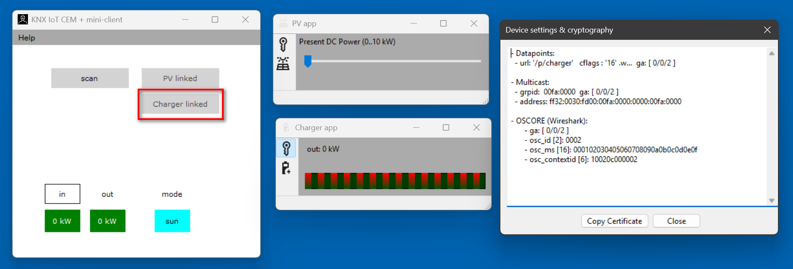
Linking: done, devices are now operational
Smart home and building solutions.
Global. Secure. Connected.
Join us
www.knx.org

Slide 16
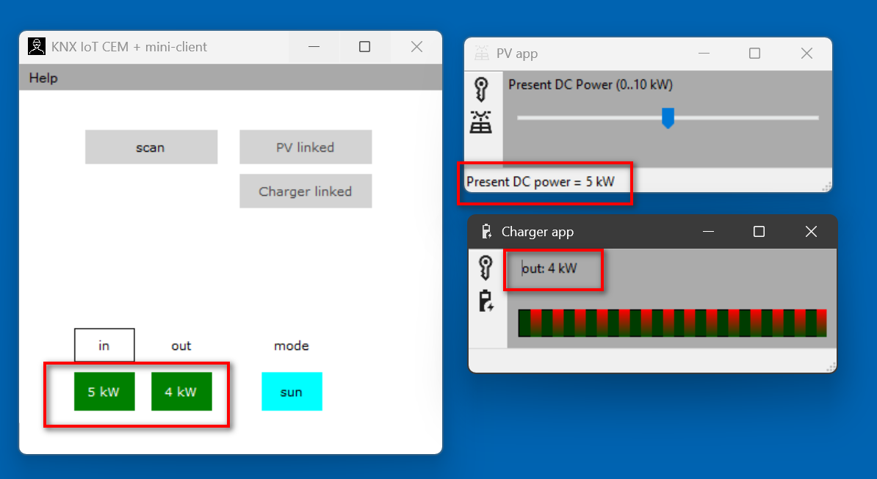
Operational devices
Smart home and building solutions.
Global. Secure. Connected.
Join us
www.knx.org

Slide 17
EMS apps: demo
Smart home and building solutions.
Global. Secure. Connected.
Join us
www.knx.org

Slide 18
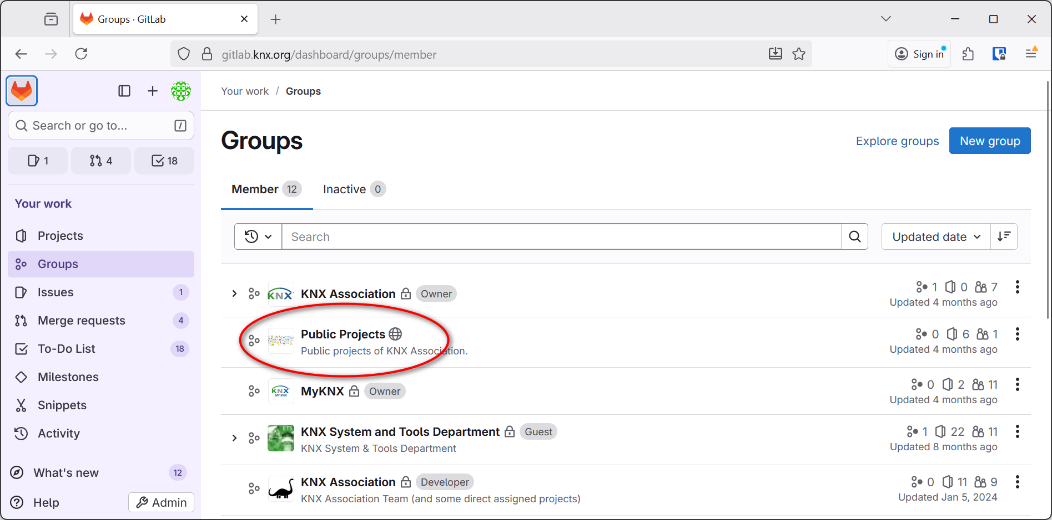
Open Source: get it from our GitLab repo
Smart home and building solutions.
Global. Secure. Connected.
Join us
www.knx.org

Slide 19
EMS apps: considerations
Format of the exchanged power data = KNX standardized
  4 datapoints
  According to DPT: 14.056, see KNX standard 3/7/2
    Size: 4 octets
    Unit: W
Commissioning:
  CEM: Link feature
  Open source mini-client
    Windows: in preparation
    Android and iOS: still undefined
Certification:
  No need to change the format of the exchanged power data
  The link/config datapoints cannot longer be used; commissioning by ETS instead
Smart home and building solutions.
Global. Secure. Connected.
Join us
www.knx.org

Slide 20
Christophe Parthoens
christophe.parthoens@knx.org

