Slide 1




Design and implementation of web banking system for near future
Jan Fajfr

Slide 2
Context
Banks to innovate web banking portals
Desire to acquire new clients
Concurrent applications offer services which banks could offer at the first place
Internship proposed by OCTO Technology for two reasons
Master new innovative ideas in retail banking
Master new technologies and tools for .NET platform

Slide 3
Aims of the project
Identification and description of innovative ideas which might in the future affect the web banking industry
Design and implementation on the .NET platform
Use of new technologies for and tools .NET platform
Notes:
Desire to estimate the new technologies to come in next 3 to 5 years.

Slide 4
Identified innovative ideas and functions
Personal Finance Management
Payment categorization
Budget management
Payment planning
Comparison with the community
Mobile applications
Sharing of electronic documents between bank and the client
Opening of the data for external applications and developers
Simplified authentication process

Slide 5
Other technically interesting aspects of the implementation
The „Design by Contract“ methodology
Parameterized Unit Testing (Using the PEX tool)
Acceptance testing on the FitNesse platform
OAuth protocol for rights delegation
Use of the Windows Azure platform
Notes:
Design By Contract - termín definoval Bertrand Meyer během vývoje jazyka Eiffel.
Vývojáři by měli definovat rozhraní každé komponenty – pomocí tří termínů: „post-conditions“, „pre-conditions“ a „invariant“.
MS vytvořil sadu nástrojů : „Code contracts“ která právě tenhle přístup umožňuje.
PEX – speciální odvětví unit testing – kdy jednotlivě parametry funkcí jsou generovány analalyzátorem kódu s cílem dosáhnout maximálního pokrytí kódu.
Akceptační testování pomocí platformy FitNesse. Umožňuje vytváření akcetpačních testů business analytikům – nevývojářům, uživatelům.

Slide 6
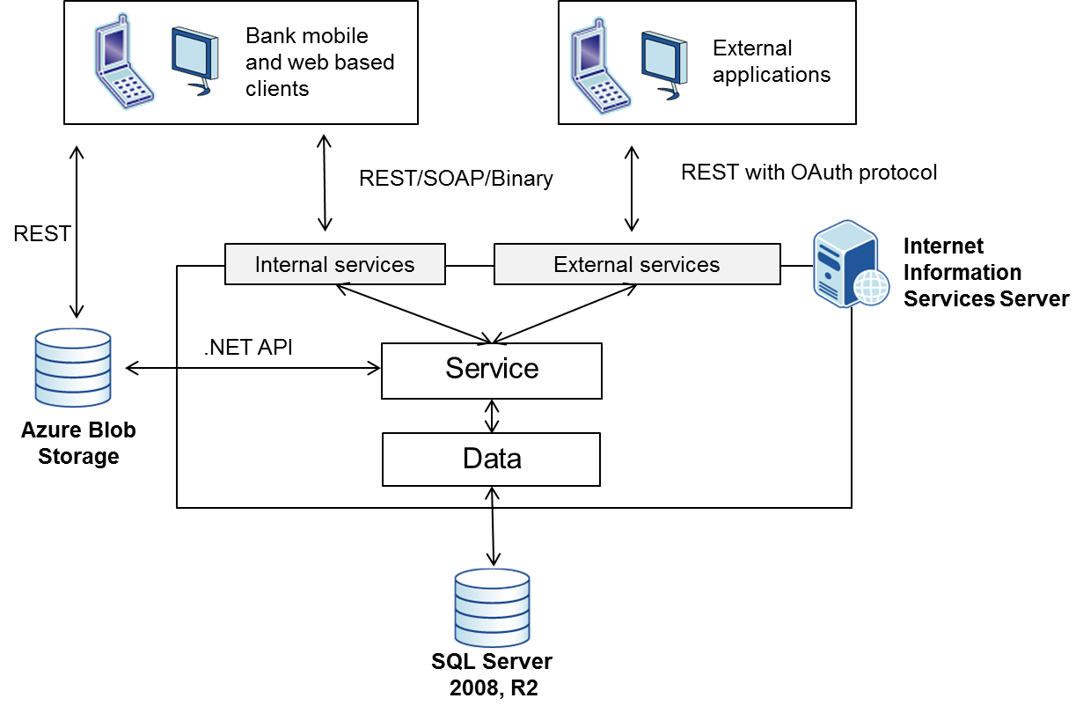
Architecture of the application

Slide 7
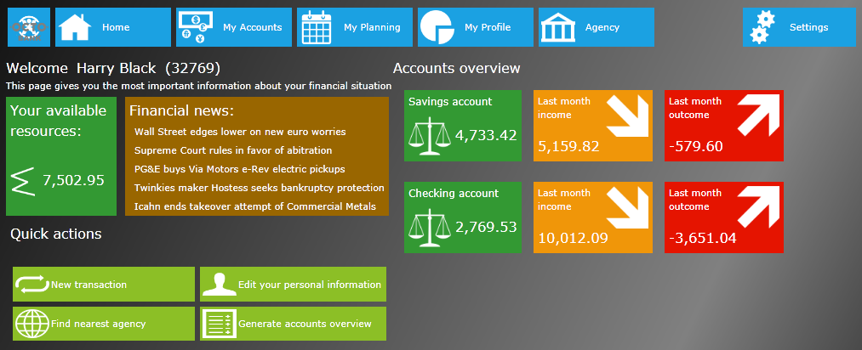
Initial screen

Slide 8
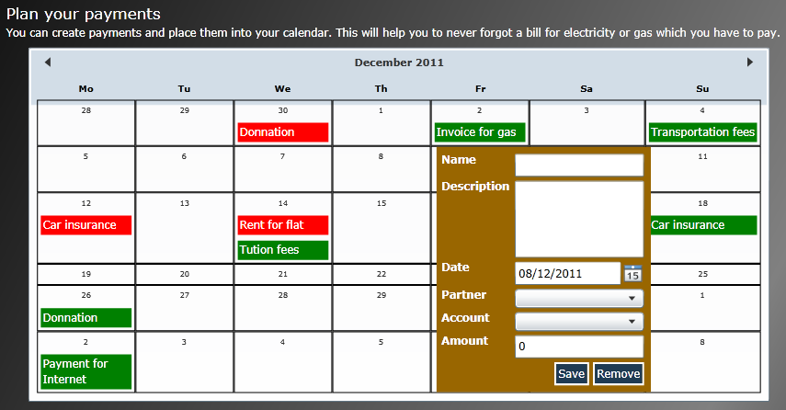
Personal Finance Management – payment planning
Planning calendar

Slide 9
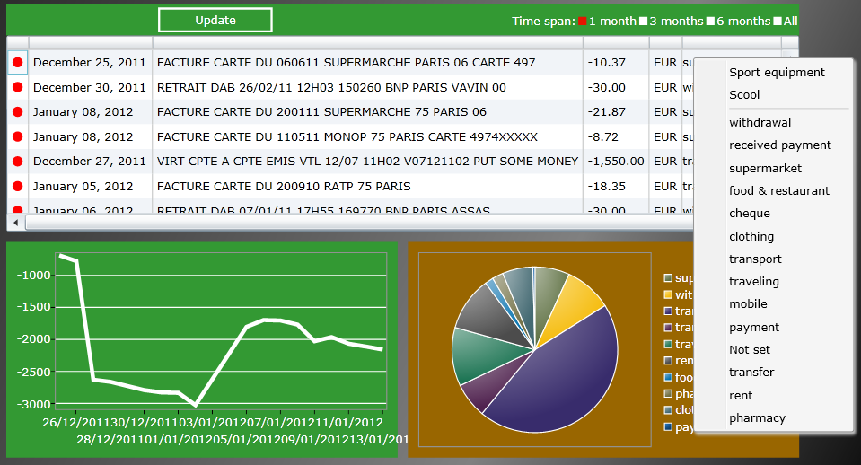
Manual payment categorization

Slide 10
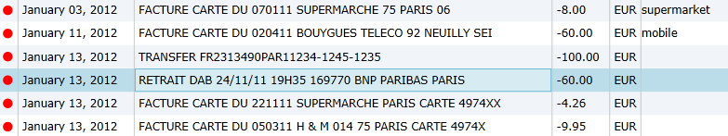
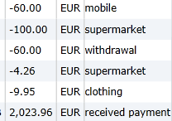
Automatic payment categorization
Implemented Naïve Bayes classifier for the open source library machine.codeplex.com.
Amount of the payment
Payment description

Slide 11
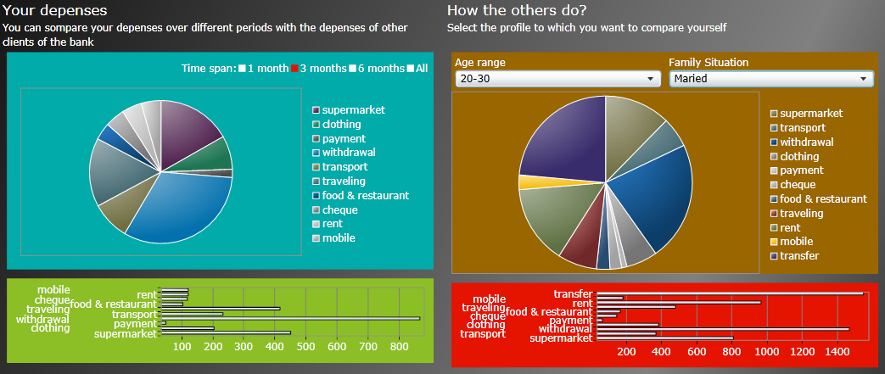
Comparison with other clients
Budget of the client during the selected period
Average budget of selected type of client

Slide 12
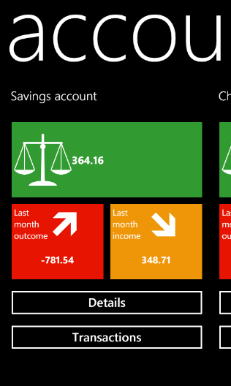
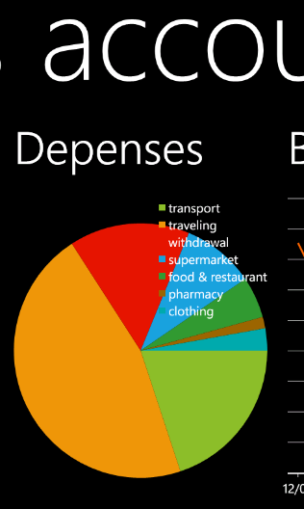
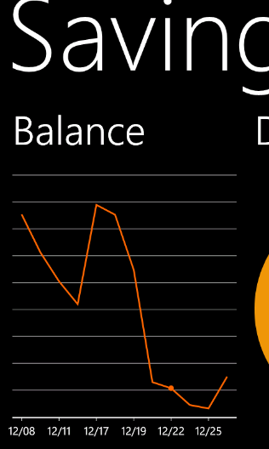
Mobile client – Windows Phone 7
The same graphical concept for the mobile interface

Slide 13
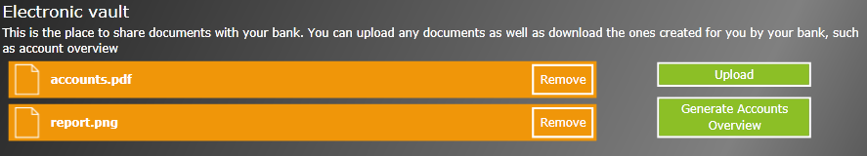


Sharing documents between the client and bank
All documents are stored in Azure Blob Storage
Get Access
Security Token
Request & Security token
Data
3
Client
1
4
2
Generate files (Account overviews...) & Manage Security
Azure BLOB
Storage
Bank

Slide 14



Opening the data for external applications OAuth protocol
External Application
Bank Web Service
Bank Web Service
External Application
Transactions:
....
....
....
Has application rights?
Get and filter data
Transactions
analysis
Get data
Client
Bank
Bank
Login
Grant access?
Client Number
Accounts
Transactions
******
Login
Authorize

Slide 15
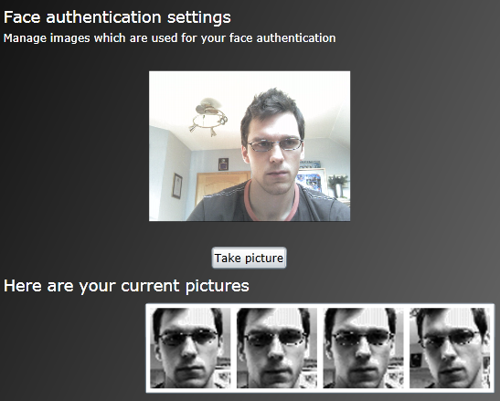
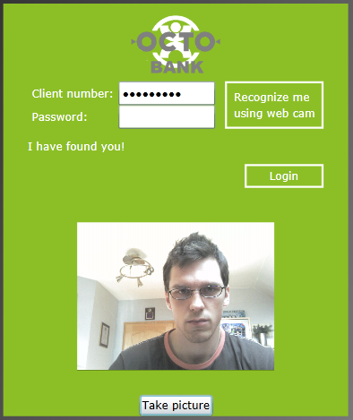
Simplified authentication – client recognition
Notes:
Využita knihovna EmguCV, potažmo OpenCV.
K automatickému rozpoznávání je použit Eigenfaces algoritmus, který je postaven na analýze hlavních komponent.
Bank Australia používá rozpoznávání hĺasu k ověření přístupu do webového bankovnictví.
Španělská BankInter používá rozpoznávání rohovky k authentifikaci do mobilní aplikace.

Slide 16
Summary
Functional prototype implemented
Possible improvements
Improvements of graphical user interface
Improvements of components of the application
Adding new innovative functions

Slide 17
Thanks for the attention
http://octoinnovation.cloudapp.net/

