Slide 1
US Hospital Visitor Statistics Analysis
by Belliuseiskii Valentin

Slide 2
Assignment
Determine if there are differences in the reasons why individuals are admitted to the hospital.
Identify if there's a predominant average severity level of the patients' illnesses.
Identify the most and least sought-after hospital departments.
Determine the predominant age groups among patients (top three).
Formulate hypotheses based on the data regarding why more/less individuals might have certain specific health issues.

Slide 3
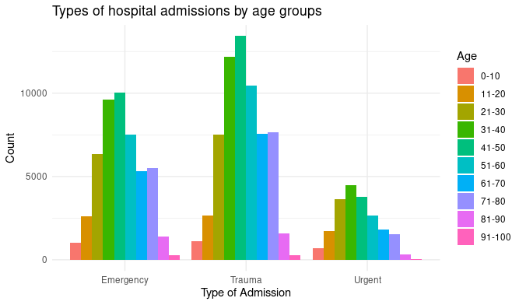
The highest number of cases falls under the criteria of Trauma and Emergency category is people aged 41-50.
The largest age group among Urgent cat. aged 31-40.

Slide 4
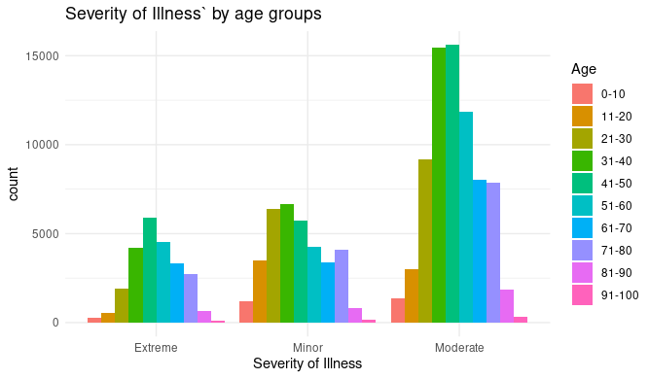
The highest number of cases falls under the criteria of moderate severity issues.
The age group 41-50 years old also predominates in moderate and extreme severity problems.

Slide 5
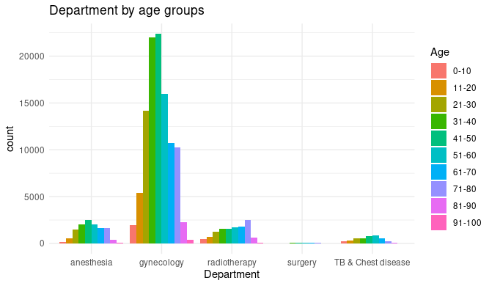
The highest number of hospital visits are to the gynecology department.
The least number of hospital visits are to the surgery department.
The largest group seeking medical attention falls within the 41-50 age bracket.

Slide 6
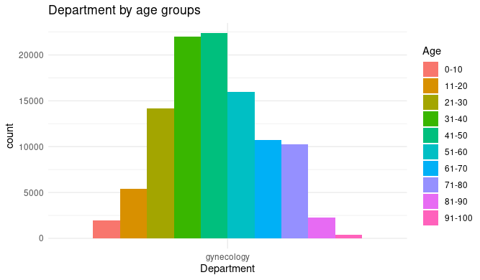
The largest group of people seeking care at the gynecology department of the hospital are those aged 41-50 years old.
The top three age groups seeking gynecological care are individuals aged 31-60 years old.

Slide 7
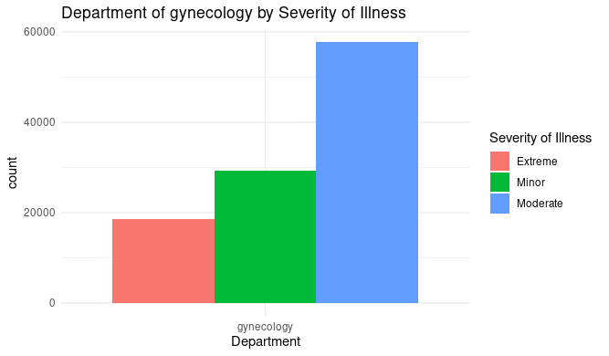
Most visits to the gynecology department involve individuals with moderate severity issues.

Slide 8
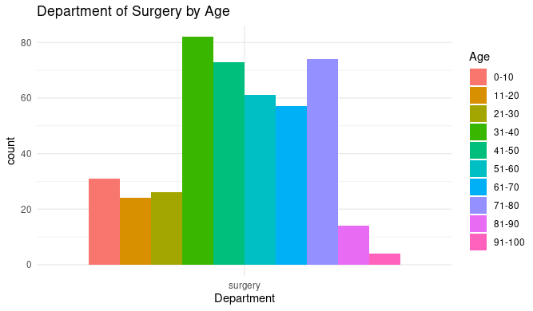
The largest age group seeking surgery is between 31-40 years old.
Surprisingly, the second largest age group consists of individuals aged 71-80 years.

Slide 9
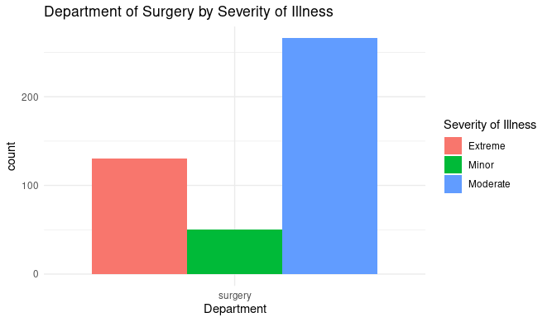
The majority of those seeking surgery have issues of moderate severity.
However, the second largest group in terms of visits presents extreme severity problems.

Slide 10
Conclusion
Gynecology: The probable reasons for these statistics may not only be age-related exacerbations of urogenital system issues but also the outcomes of unprotected sexual contacts.
Surgery: Moreover, an individual's hypothetical habitat area significantly expands with age, leading to a continuous possibility of injury-inducing situations for any biological being.

Slide 11
The end

