Slide 1


Slide 2


An introduction to Special Educational Needs and Disabilities
Nicole Evans-Dear
SEND Inclusion Support Officer
12th October 2020

Slide 3
Workshop purpose and outline
Purpose – to begin to recognise and acknowledge Special Educational Needs and Disabilities (SEND) whilst considering how you can support your peers, at home, at school, work and in the community.
Outline –
  What is a Special Educational Need and Disability?
    Definitions of disability and impairment
    Terminology and political correctness
    Models of disability
    Categorising disability
    Legal obligations of the Local Authority and educational establishments
    Scenario task
  How can the Local Authority work even closer with young people to ensure the service is even more effective than it currently is?
    Your thoughts

Slide 4
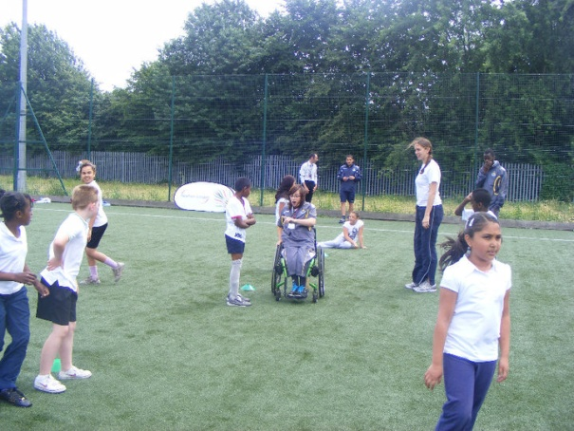
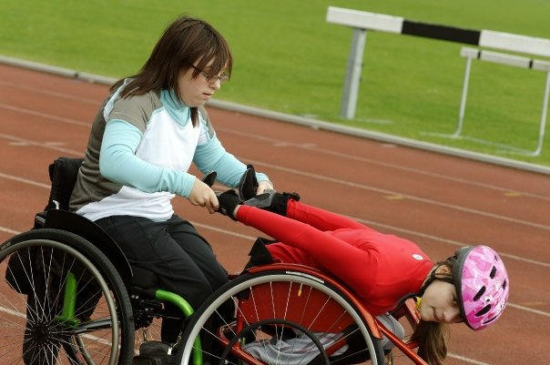
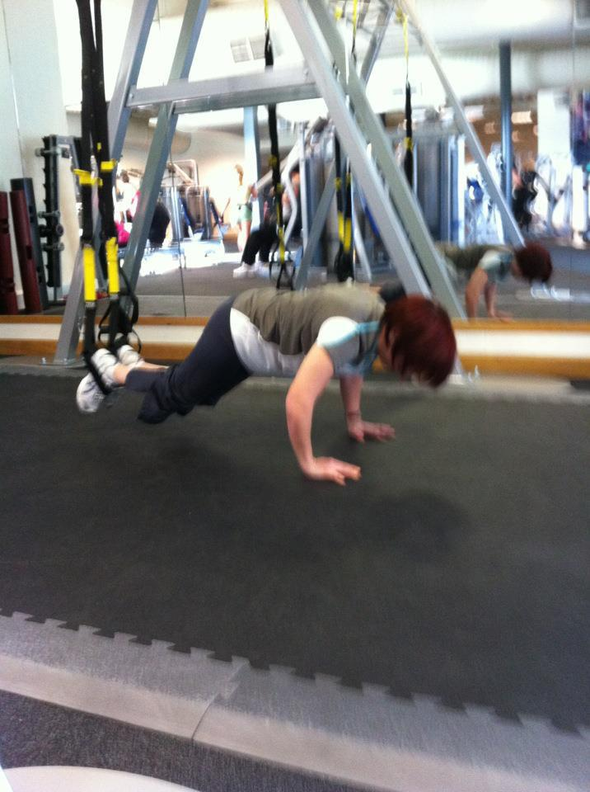
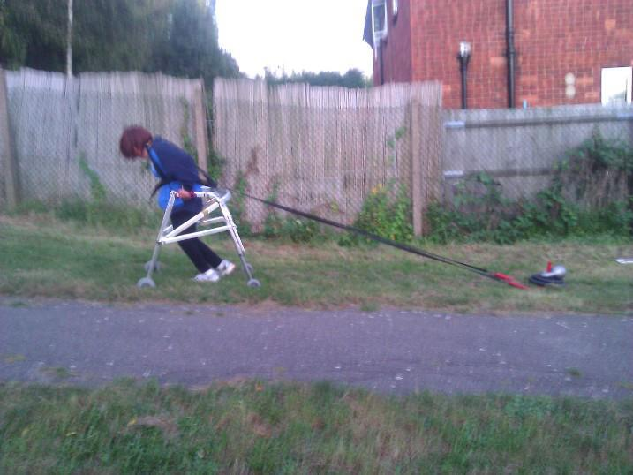
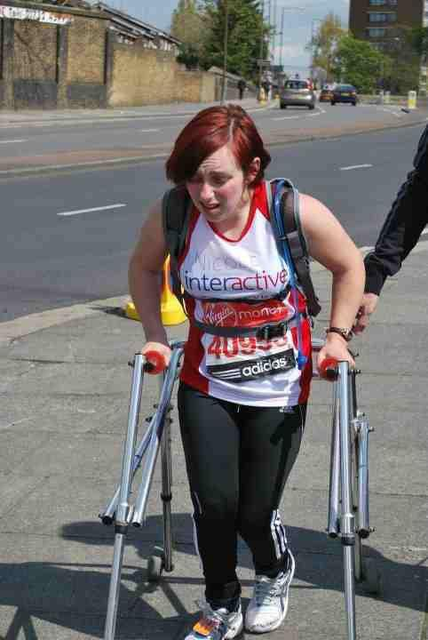
What is SEND?

Slide 5
Defining Disability and Impairment
Impairment:
an injury, illness, or congenital condition that causes or is likely to cause a loss or difference of physiological or psychological function.
Disability:
the loss or limitation of opportunities to take part in society on an equal level with others due to social and environmental barriers.

Slide 6
Terminology Task
Can you identify which on the sheet is politically correct?

Slide 7
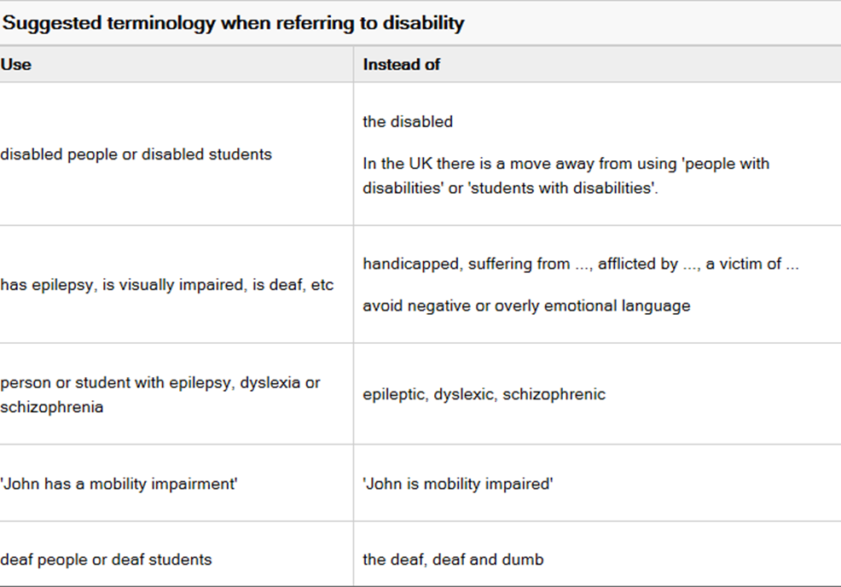

Slide 8
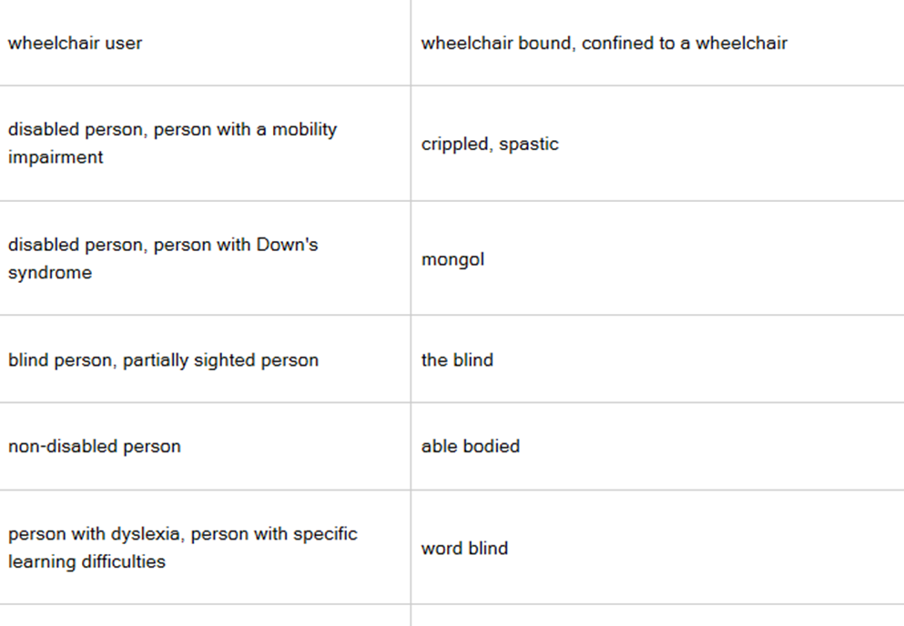

Slide 9
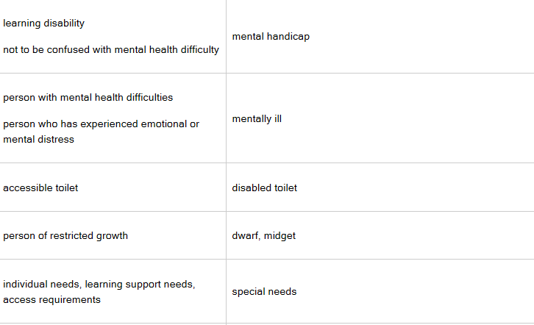

Slide 10
Models of Disability
Perceptions of disability are constructed and contained within two meticulous models – Can you name them?
  Medical Model
    person is defined by illness or medical issue
    Disability is the problem of the individual only
    Medical profession decides ‘what’s best’
  Social Model
    Disability as a result of societal issues

Slide 11
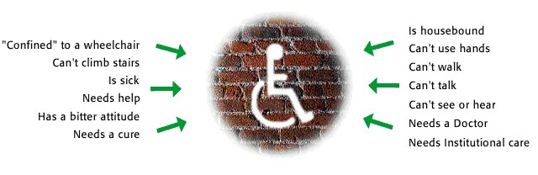
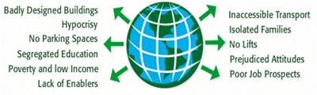
ILLUSTRATIONS OF DISABILITY
Medical Model
Social Model

Slide 12
Categorising Disability
Need to identify the disability:
For eligibility
To better match related services to student needs
Match individual development levels with appropriate support

Slide 13
Statutory Responsibilities
SEND Code of Practice 2014
Local Authority
  Assess and make a decision on what level of support will be appropriate for each pupil working cross-departmental.
  Draft EHC Plans
  Quality Assurance
  Manage the ‘Local Offer’
Education Establishments
  Identify need
  Support parents and pupils through the EHC plan process including the requests to assess
  Use the graduated approach to learning and support the whole school in this process.
  Put in place appropriate support for the pupil
  Assess, Plan, Do, Review

Slide 14
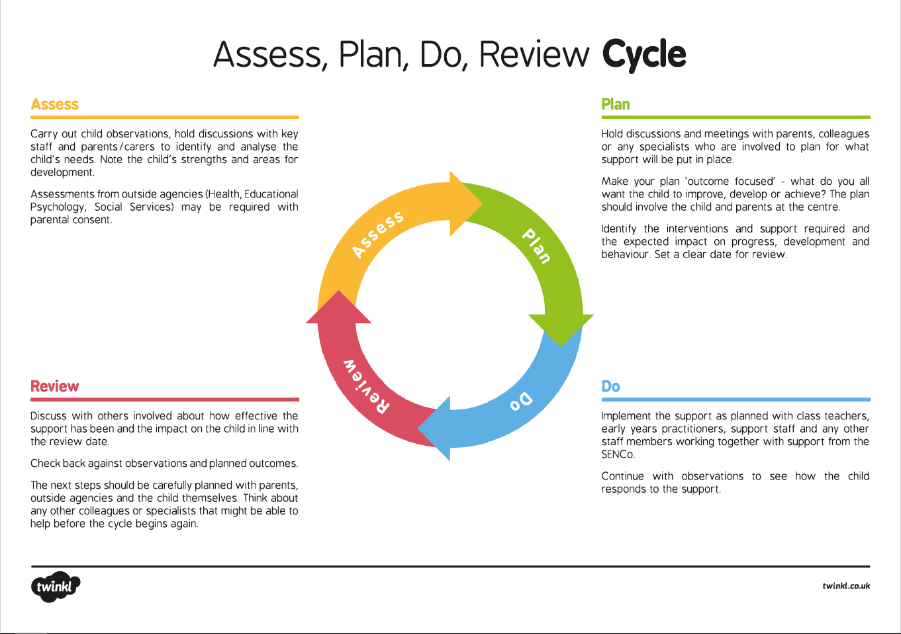
SEN Support
Scenarios

Slide 15
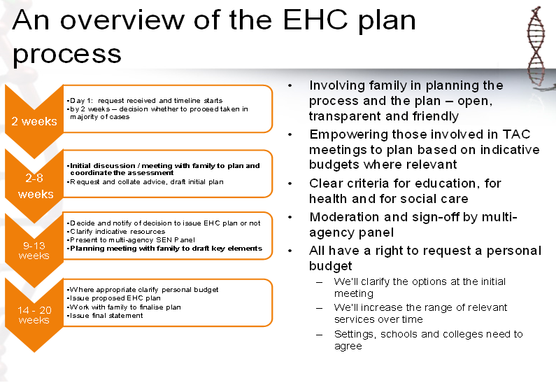

Slide 16
Case Study
Think about ways the young person could get involved in making decisions about his life and future, and how he may do this:
John is 13 years old. He is in a mainstream school, which he likes, but struggles in class. He is in the process of getting an EHC plan. He is worried that there will not be enough support for him when the local authority decides what to give him.
He enjoys hanging out with his friends, and thinks that after-school clubs are a good way of hanging out, but he doesn’t enjoy any of the activities that are put on in his youth club. He struggles to reach the youth club because the bus route is confusing to him, and he feels the bus drivers are not patient.
John is independent and is good on the computer. Someone has showed him the Local Offer website, but he thinks it is confusing and there isn’t enough information on there. He has his own ideas about how to show this information.

Slide 17
Case Study
Ask yourself the following questions:
  Are there any points here where John should get involved about decisions that affect him?
  How can John get involved here? Are there any difficulties in him participating?
  Thinking about your own experiences, would it be easy for John to know he has the right to participate in these decisions? Or would he be lacking any information or be confused?
  Think about things in your life you would like to get involved in changing. What are they? Why do you want to change them? How will you do it?
Notes:
Notes for group leader to prompt YP:
• John has the right to participate in his EHC Plan, which has a whole section for this. John should be able to share his views, interests, and aspirations in this section.
• John has the right to join a local participation group. Information should be available on the Local Offer for this, but he can ask his local IAS Service if there is a group near him. He can then join the group and share his views on services, such as after-school clubs, or transport, in his area. Service providers should take this on board
• The Local Offer in John’s area should have been co-produced (made with adults and young people). It should be reviewed by young people periodically. John has the right to be involved in these processes. John can leave his feedback online, or find a local group to join and share his views on it.

Slide 18
How can the Local Authority work even closer with young people to ensure the service is even more effective than it currently is?
Please make a note of these and email Roberta Fontaine at
Rfontaine@thurrock.gov.uk

Slide 19
Thank You

