Slide 1

Notes:
1

Slide 2
Travelling Tips

Slide 3

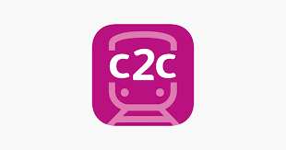

Useful apps whilst travelling
First Bus App
This app allows you to: plan travel routes, buy tickets and see live
bus times. It is very useful and has a simple layout that is easy
to understand. Anyone can use this app and it can be downloaded
from the Play or Apple Store.
C2C Train app
This app allows you to: plan travel routes, buy tickets and see live
train times. It is very useful and has a simple layout that is easy
to understand. It is the same as the First bus app but for trains.
Anyone can use this app and it can be downloaded from the Play
or Apple Store.
Moovit app
This app allows you to get directions and travel using any of the
available transport methods. you can see bus stations and train
lines. This app is like the first two apps but focuses more on
planning than actually buying tickets. Anyone can use this
app and it can be downloaded from the Play or Apple Store.

Slide 4
Top tips for travelling with disabilities
Plan ahead if you can. Use apps or online support to help plan routes. If there are places that you go often e.g. work, school etc. have a route on your phone so that if you need help you can ask.
Don’t be afraid to ask for help. Many people who work in train or bus stations would have come across people with disabilities if not explain to them what you need help with and they are more than happy to help.
When travelling for the first time try the routes you want to go on ahead of time to gain more confidence.
Make sure that if you need a cane, wheelchair or have hearing aids that you look up the procedures in place for you, if there are yellow lines on stairs, wheelchair access etc.

Slide 5
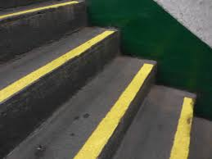
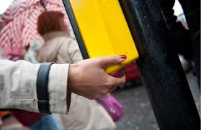
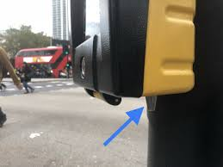
If you have a cane the bus driver has to stop and tell you what the bus number is and where it is going.
Yellow lines are used as markers on stairs so that you can indicate stairs.
There are ‘hidden’ buttons on the traffic lights. They are useful for the deaf or anyone with disabilities. You put your fingers around it and when it is safe to cross it will spin.
.

Slide 6
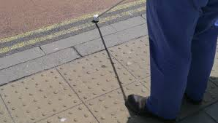
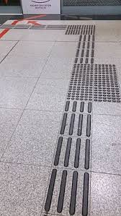
The tactile pavements are indications of the road crossings.
The train lines also have markers to indicate
getting closer to the train station.
Down below is a useful video.
https://meet.google.com/linkredirect?authuser=0&dest=https%3A%2F%2Fwww.youtube.com%2Fwatch%3Fv%3DcdPymLgfXSY

Slide 7
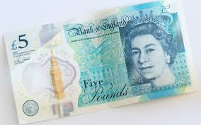

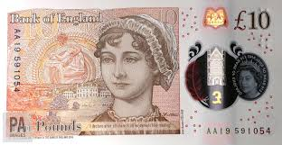
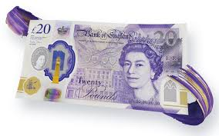
Did you know that there is braille on our £5, £10 and £20 pound notes? it is used to help indicate which is which.If you have any of these notes you will notice some raised bumps in the corner. It is a small block of 4 dots. This is what we call the letter ‘g’. On the £5 note there is no briailie. On the £10 there are 2 blocks of 4 dots and on the £20 there are 3 blocks of 4 dots. When it comes to recognising coins blind and visually impared people use touch. Each coin feels different and has a different shape. When the £50 comes out it should also have braille on it .

Slide 8

Thank You

