Slide 1
Overview of the purpose of the project
Taranveer Singh

Slide 2


Inspiration
The COVID-19 pandemic has introduced various challenges to delivering university education. Especially first year undergraduate students had an unwelcome experience as they had to adapt to a remote learning from the very beginning.

Slide 3

Project’s aim
Educational games to help beginners to learn basics of computer science
Providing a more enjoyable platform to learn
Support the university in identifying students at risk
Provide extra support and feedback

Slide 4

Constraints
Accessible on as much devices as possible
No extra costs to access the platform

Slide 5
Project software architecture
Introduction
We tried to get it right from the start (Project Proposition file)
Decisions were being made during project as well
We started with a stub for simplicity
We did have to change some things later on
The evolution of the software architecture of the project will be shown on following slides

Slide 6
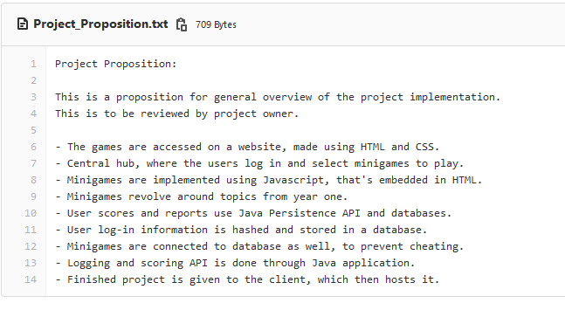

Slide 7
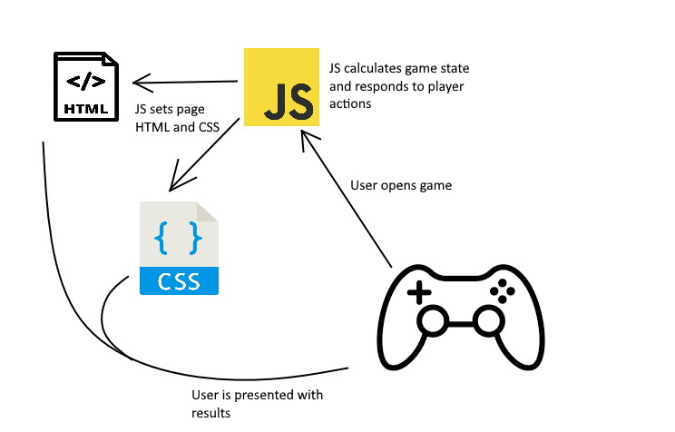
How it started
The game website was just a bunch of html files in folder hierarchy with links to those files

Slide 8
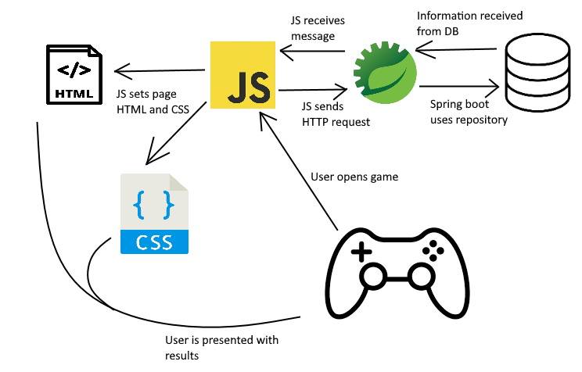
Identifying user
Implementing MVC pattern, all of HTML files were transformed into JSP files for Spring Boot Project

Slide 9
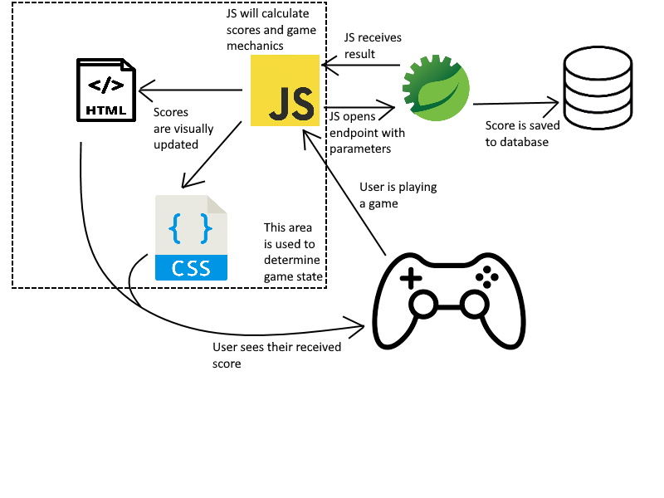
Scoring the user
It was at this point that we really learned how projects grow in complexity, as this had to be integrated with logging-in system.
Thus, we had to make some changes to finish the project.

Slide 10
Potential problems
This could be exploited by accessing endpoint and putting into parameters fake information (for example score=100000)
One just needs to look up Javascript code to see what needs to be sent and cheat the system
We didn’t have enough time to fix this, that would have to be priority for the project moving forward

Slide 11
Adding and loading questions
This is not standardized
Currently sometimes it’s done through UI and sometimes by modifying files
Some of the games load questions from text file and some from database
- This looks like on slides “How it started” and “Identifying user”

Slide 12
Moving forward with software architecture
Some changes have to be made before the project could be extended.
First priority is to fix exploits and make it more secure
Example fix to cheating could be to include Spring Boot project into dotted square on previous slide (involve Java project in scoring player since this can’t be modified on user side)
Shared elements like side-bar could be stored in one place and copied into created JSPs (currently every page has copy of side-bar code)
Generally make it more extendable

Slide 13
Legal and Ethical issues
By Oliver Gamble

Slide 14
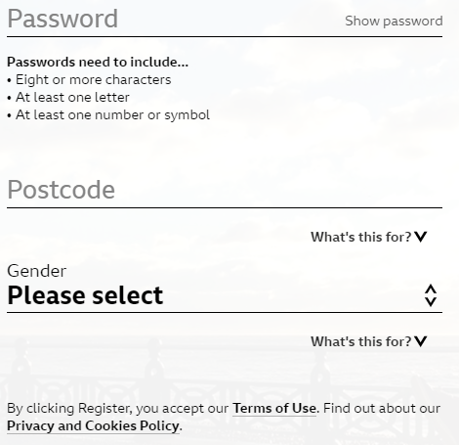
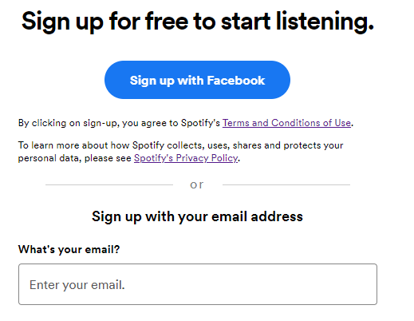
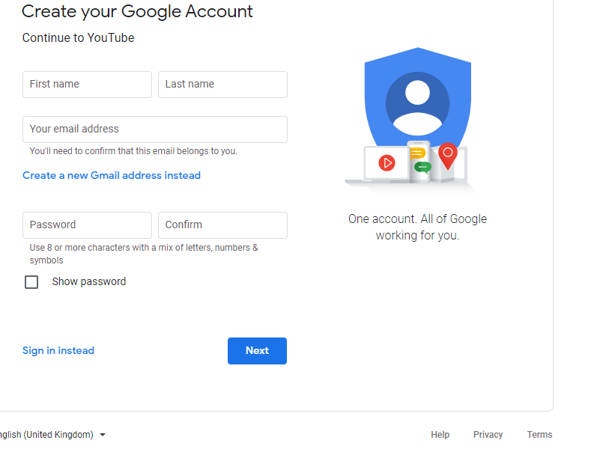
Legal Issues:
Websites with the option to create an account almost always have a terms and conditions section and a privacy section.
Links to these areas of the webpage are always found (when present) on the sign up page.

Slide 15
Resolving the legal issues:
This legal issue can be resolved by including a terms and conditions link and a privacy link on the sign up page.
Similar to the examples shown, the act of registering the account can be confirmed by the user pressing the create account button.

Slide 16
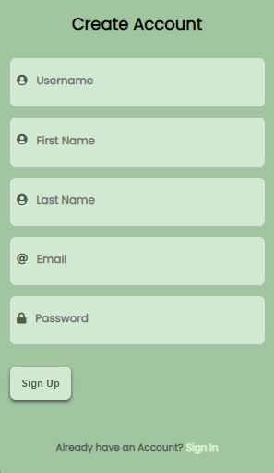
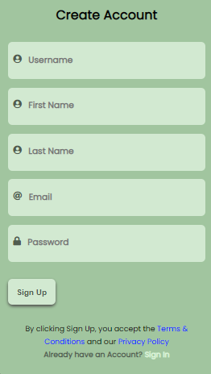
Updated account form

Slide 17
Key terms and conditions
The user should know how to the use the content:
No offensive or explicit content.
No content that harasses or upsets other people.
No content that is racist or sexist.
User Guidelines:
The users aren’t allowed to tamper with the webpage’s source code.
The users aren’t allowed to hack the webpage.

Slide 18
Key privacy concerns
The user should know how we use their data:
That their data is stored inside a database.
Other users can view their basic details when logged in.
Staff can see their progress with the games and their scores.
Information about the user rights:
The right to delete your account details.
The right to see the details held about you.
The right to change your personal details held by the website.

Slide 19
Copyright (Legal Issues)
The terms and conditions agreement should include statements that explain user’s are not allowed to post any copyrighted content.
The game layouts used in the website need to be original.
The images used in the website should not be copyrighted images.
The questions used in the website should be original.
The majority of the code used to create the website should be original.
If a small bit of code isn’t original then it should be correctly referenced within the code.

Slide 20
Ethical Issues:
With account creation, there are several ethical issues:
One person creating multiple accounts with different email addresses.
Do not pass along chain email messages, especially threats.
The addition of an email notification tool for the webpage games. If this feature was added the user should be able to either opt-in or opt-out from it.
The users should be able to hide their details so that other users cannot see them.
The privacy policy is also a ethical issue.

Slide 21
Presentation Links:
https://www.spotify.com/uk/legal/end-user-agreement/
https://www.bbc.co.uk/usingthebbc/terms-of-use/
https://www.spotify.com/uk/legal/privacy-policy/
https://accounts.google.com/signup/v2/webcreateaccount

Slide 22
Communication during the project
- How we communicated
- What went well
- What didn't go well

Slide 23

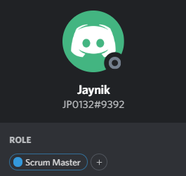
How we communicated?
Discord
Free
Widespread
Simple intuitive design
Roles
Easy to keep track of who is currently Scrum Master for the project

Slide 24


What went well
Active Discussion
Asking questions and updating progress
Making notes of what the recent discussion
Planning next steps
frequent calls to discuss progress
Good communication with client
Asking questions and showing progress

Slide 25
What went wrong
Not communicating
Missing group meetings
Not updating GitLab

Slide 26
Non–Technical Things Learnt
Jaynik Parsotomo

Slide 27

Adaptability to changes
Project lasted from January to March.
Needed to work on this project for a long duration
Had to work on the project under restrictions.
The environment we are working in
No face-to-face meetings
Unable to get help in person
Group members unable to complete work.
Group members not being able to participate
Group members not contributing

Slide 28
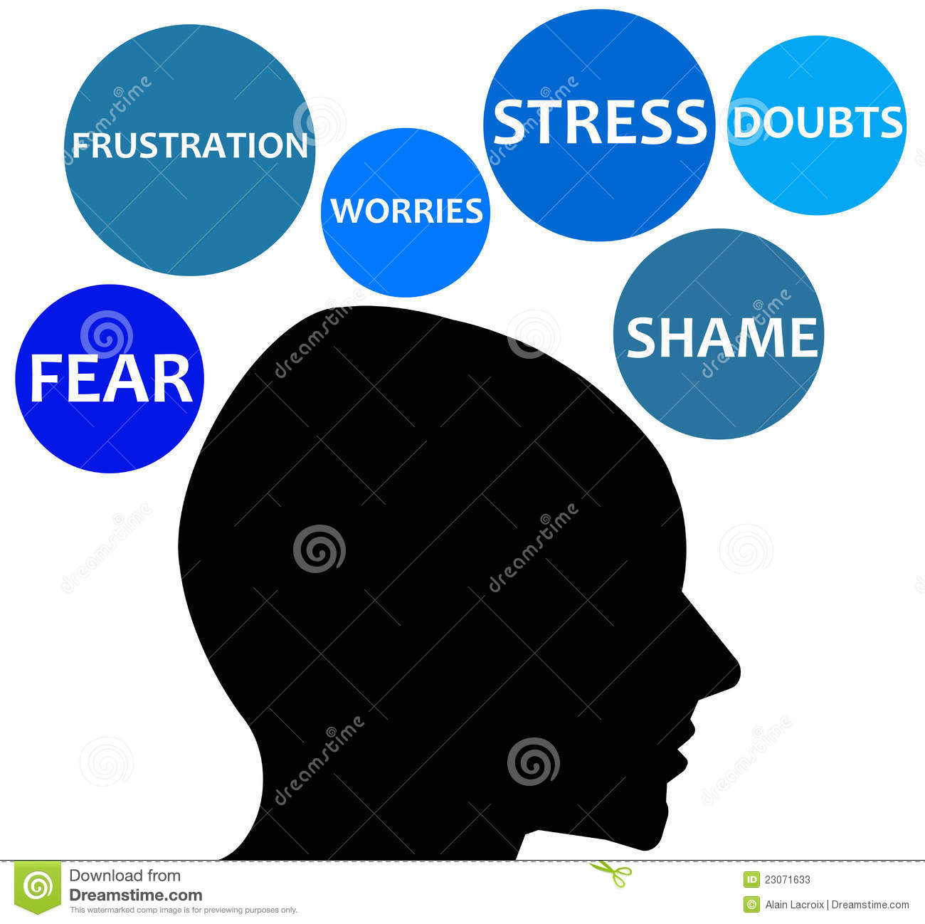

Positive Attitude
There were times when negatives feelings like frustration and worries would arise
Some problems are just out of your hand
Stressing about it is not going to help
Hence a positive attitude was necessary

Slide 29
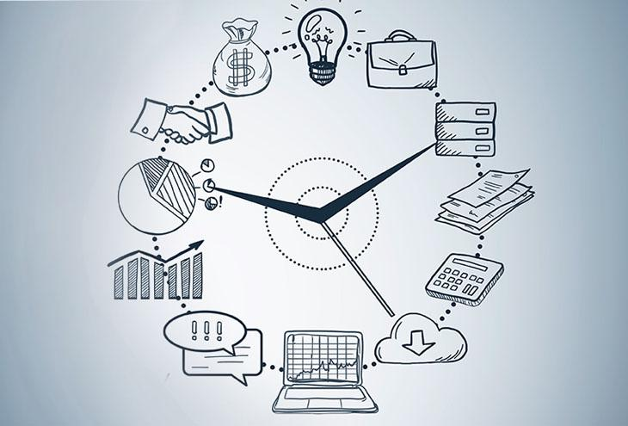

Time management
Needed to make sure a reasonable amount of time was put into the project
Not too much or too less time was spent
Manage the time so there is time to spend on other things
Need time to complete other course works
Important skill which will be necessary in any future careers

Slide 30

Saying No
This is an important skill learnt from this project, the ability to say no
Prepared to say NO to stop adding more changes to a feature

Slide 31
Realistic plans to take the project onwards

Slide 32
Interactive GUI
The primary purpose of our GUI is to deliver the kind of clarity that will allow its users to rapidly begin interacting and engaging with the system.
A benefit of a good user interface design is that it can be shaped to ensure that users remain in control of their experience.
Another benefit of a good user interface design is the ability to ensure that each screen supports a single action that provides meaningful value to the user.
Screens that promote multiple actions may become confusing, while screens with a single clear purpose will still provide concrete value and encourage meaningful interactions.

Slide 33
Action steps that respond to risk
As much as we’d like to prevent our project from screwing up, anything can happen along the way that could set our project back.
To overcome this, we need to be aware of the possible project management risks we may encounter.
A risk assessment will allow us to determine the likelihood and seriousness of future project threats, allowing us to formulate flexible action steps that quickly react to and resolve problems that might arise.

Slide 34
Solid goals
Having concrete goals in place enable us to visualize, plan, and document clear objectives that will clear the path for effective project management.
if we have specific goals in place, It becomes a lot simpler for us to develop and present a strategic project that will eventually gain the confidence of our stakeholders and users.
Which is most likely to move the project forward.

Slide 35
Adding more games
This will cover more topics/modules
Which means more first year students will participate
More users

