Slide 1

Flight Delays and Cancellations
A predictive analysis by Syntax Terminators

Slide 2

Delayed/Cancelled Flights – What’s the hold up?
It is crucial for airline companies to ensure that air travel is safe, efficient, and reliable.
Flight delays can have a significant economic and social impact on both individuals and organizations.
Using Machine learning, we can identify causes for cancellations and delays.
Notes:
Adam

Slide 3

Why flights?
Lots of cool data in a short date window.
As users of airlines, we wanted to know why our flights are delayed and how we can mitigate those delays going forward.
We wanted to challenge ourselves and this was the perfect opportunity to learn through data analysis.
Notes:
Adam

Slide 4

Data Description
We used a combination of 7 different CSV Files to make our final Dataset which contained over 4 million rows of data!
We narrowed the columns down from 160 to 10 columns that were relevant to our data needs using the following tools:
SQLite
Random Forest
MatPlotLib
Tableau
Dask Library
Pandas
Notes:
Jeremy/Stephanie

Slide 5

Data exploration
Successes/Challenges
ETL
Database
ML
EDA
Notes:
Jeremy/Stephanie

Slide 6
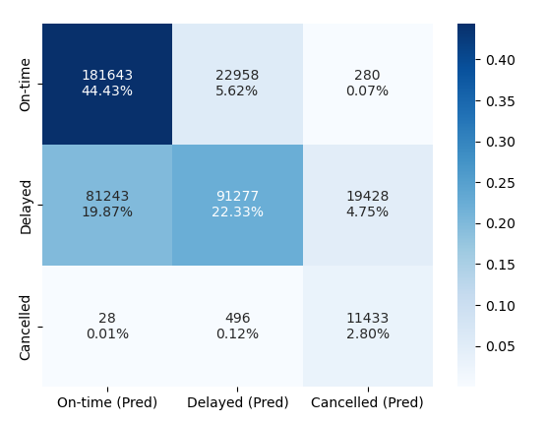
Analysis Results

Slide 7
Important features
Bad Weather
Day
Carrier Issues
Destination Airport
Origin Airport
NAS
Month
Operating Airline
Notes:
Kristirose

Slide 8
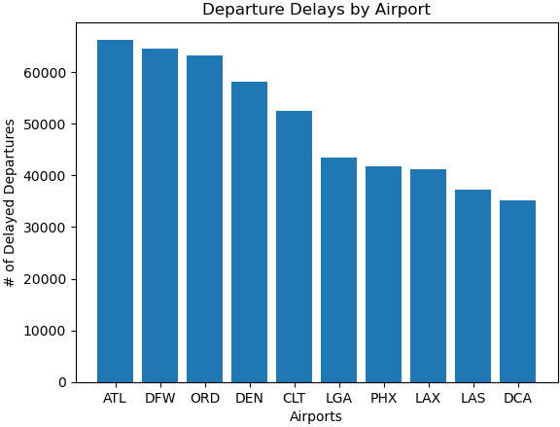
Analysis Results

Slide 9
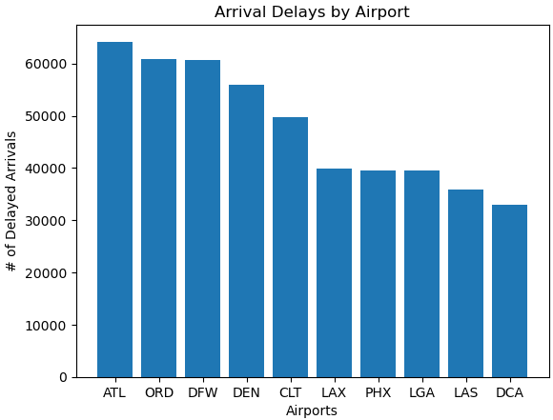
Analysis Results

Slide 10
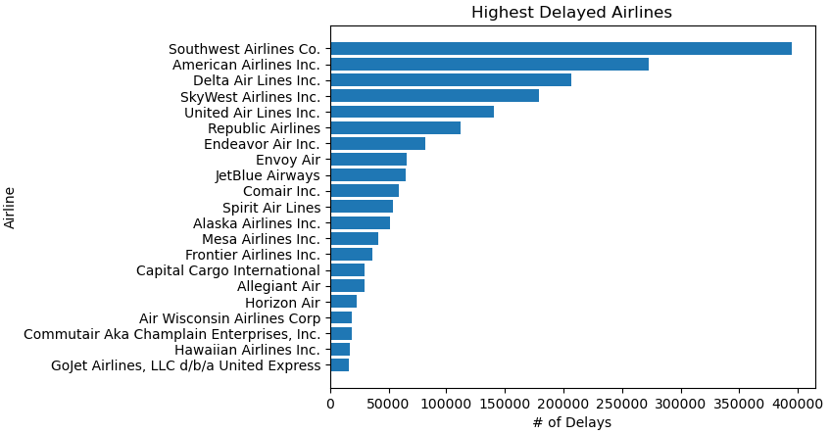
Analysis Results

Slide 11
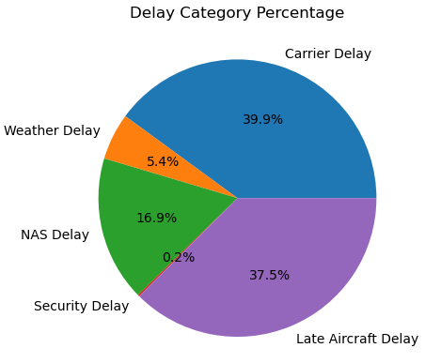
Analysis Results

Slide 12
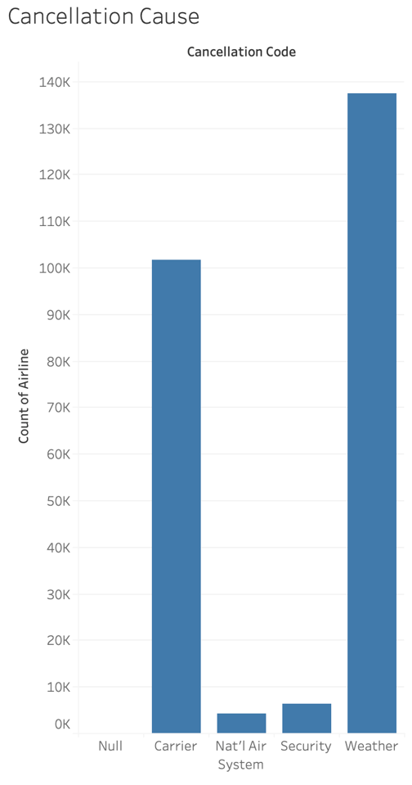
Analysis Results

Slide 13
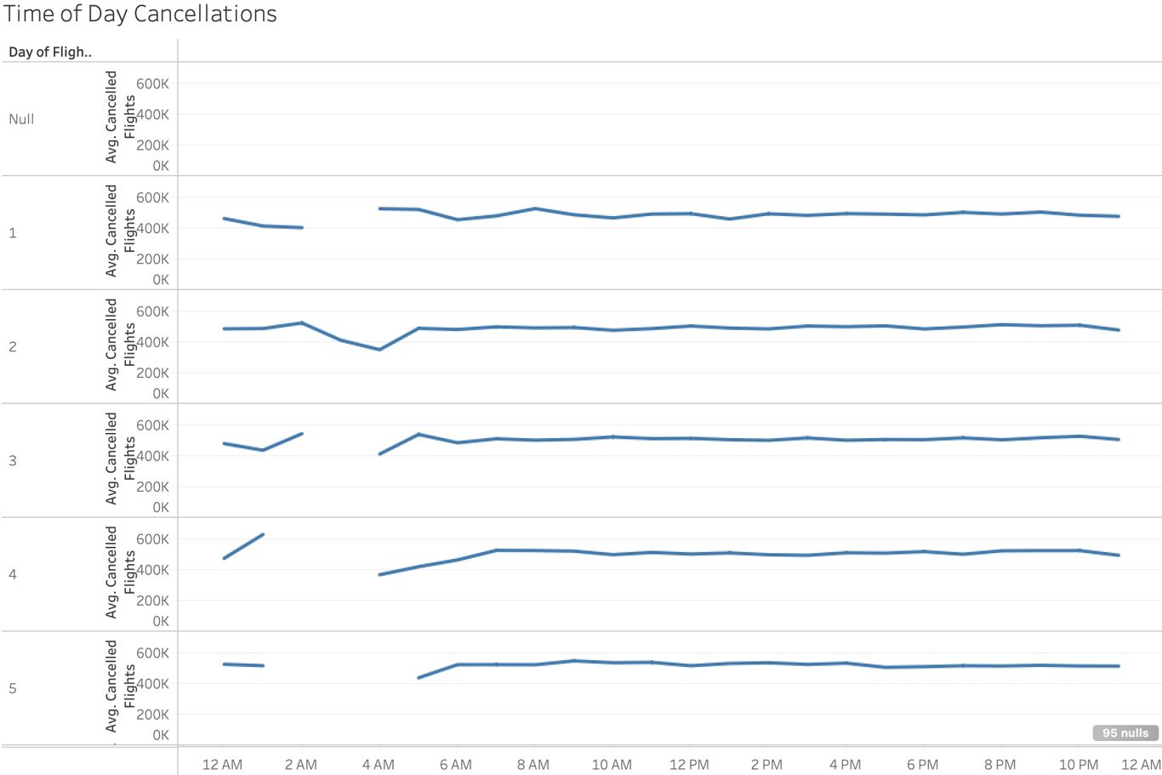
Analysis Results

Slide 14
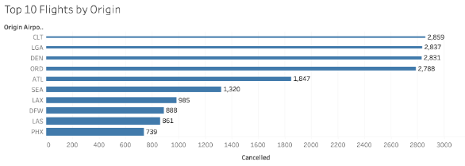
Analysis Results

Slide 15
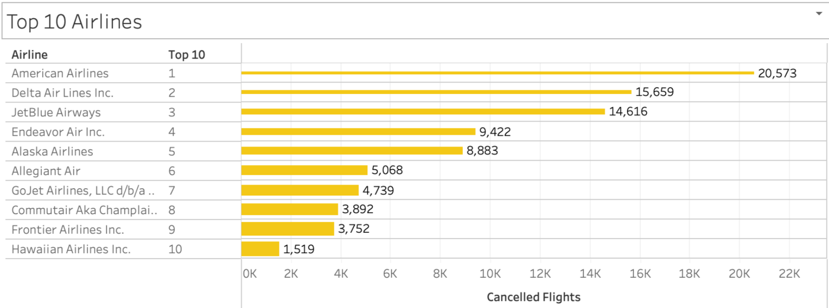
Analysis Results

Slide 16
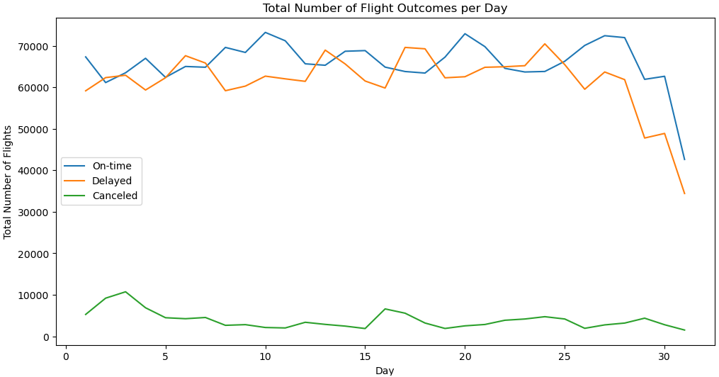
Analysis Results

Slide 17
Future Recommendations
What else could be done?
What would we have done differently?
Added Feature Data: Seats sold etc.
So many options to choose from on how we can analyze the data set. (Feature Adding)
API’s
Etc.
Conclusion
Notes:
Kristirose

Slide 18

Questions/Comments?

