Slide 1
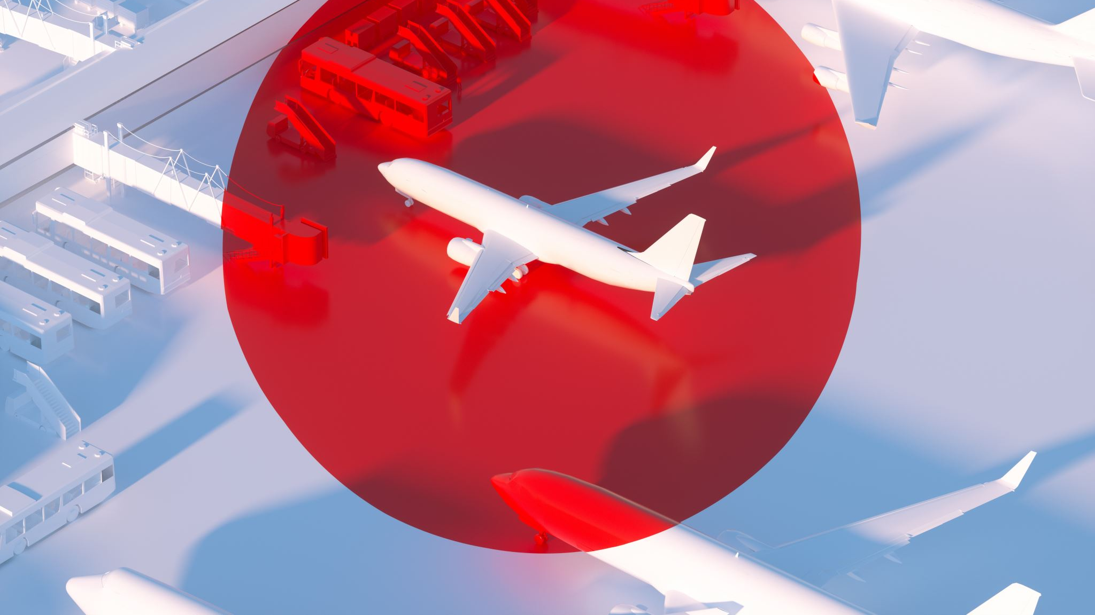
Flight Delays and Cancellations
A predictive analysis by Syntax Terminators

Slide 2

Overview/Purpose
Flight delays can have a significant economic and social impact on both individuals and organizations. By studying flight delay and cancellation data we can identify trends and patterns, pinpoint the causes of delays, and develop strategies to mitigate their effects. The information we are analyzing is crucial as airline companies need to ensure that air travel is safe, efficient, and reliable. Using Machine learning, we can help passengers make informed decisions about their travel plans. Such as choosing the best time to fly or selecting a carrier with a good on-time performance record.

Slide 3

Why did we pick this topic?
There is a lot of cool data…4 Million rows in a just a small window of time!
So many options to choose from on how we can analyze the data set. (Feature Adding)
API’s
Etc.
As users of airlines, we wanted to know for ourselves why our flights are delayed and how we can mitigate those delays going forward.

Slide 4
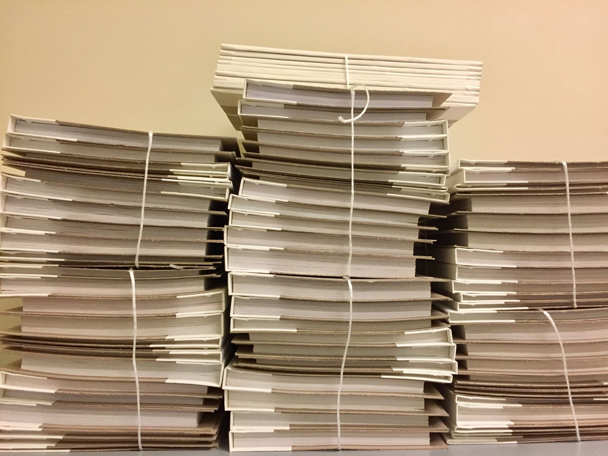
Data Description
We used a combination of 7 different CSV Files to make our final Dataset!
We identified and kept the columns that would get us the answers we were after.
What tools we used
Pandas
SQLite
Random Forest
MatPlotLib
Tableau
Dask Library
Pathlib
Numpy
LAMBDA!
SQL Functions

Slide 5

Data exploration
Talk about how we did the ETL
Talk about how we did the Database
Talk about the machine learning model selection
What techniques/languages used for the process

Slide 6
Analysis
Summarize the reasons we started with vs reasons we ended with
Talk about how we did the EDA and why we chose what we did
Summarize what techniques/languages used for the process

Slide 7
Analysis Results
Answer our questions
Visuals

Slide 8
Analysis Results
Answer our questions
Visuals

Slide 9
Analysis Results
Answer our questions
Visuals

Slide 10
Future Recommendations
What else could be done?
What would we have done differently?
I would have like to judged how long a flight was delayed before it was cancelled. Did people wait in the terminal?

Slide 11

Questions/Comments?

