Slide 1

PnP Community Sample Discussion Board formatting
André Lage
Twitter: @aaclage GitHub: https://github.com/aaclage

Slide 2

Analyze Discussion Boards
Validate what already exist and improve for our own needs.
Classic Discussion Board List and others
Additional JSON formatting
Menu with support features
Permission checker, default option, comment, response…
Discussion Board Timeline View
Answers Lookup for support “Discussion answers List”
View Responses “Discussion answers List”
Vote, Emotions
Use existing features
Microsoft SharePoint Page
Filter Web Parts
Microsoft Power Automate
Declarative JSON for Flow
Microsoft Teams
Fields
Views
JSON
Formatting
Support features
Power Automate

Slide 3
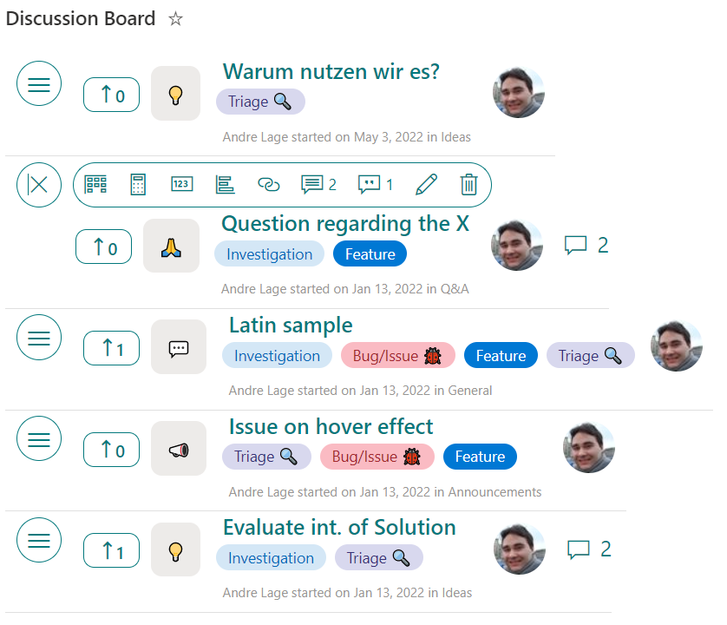
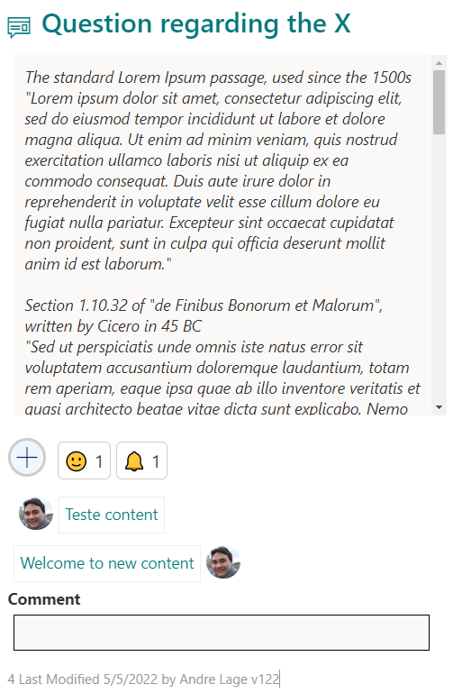
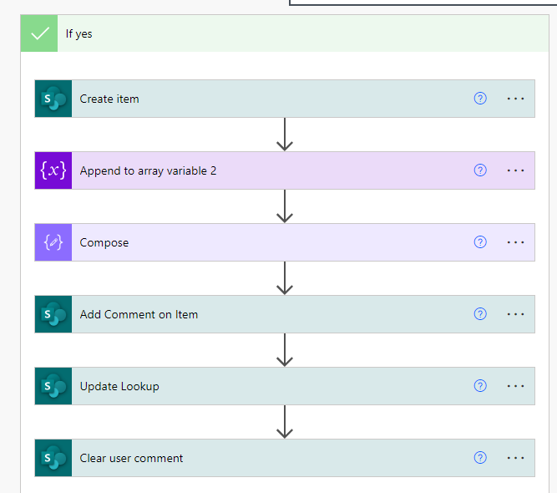

List Formatting – Discussion Board
Create Comment Add to Lookup
Condition
Flow

Slide 4

List Formatting – Discussion view
Microsoft List Formatting
Discussion Menu
Vote
Category
Created by
Responses Lookup
Title, Tag, Created, Created by, Category
Fixed menu options
Support Features
Permission checker, Link, Responses, Comments, Edit, Delete

Slide 5
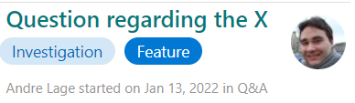
List Formatting – Discussion card
Title
Microsoft List Formatting
Description
Emotion
Answers Lookup
UserComment
Modified, Modified by, owshiddenversion

Slide 6

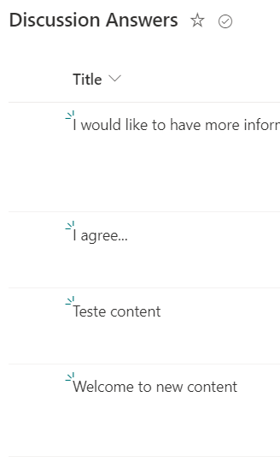
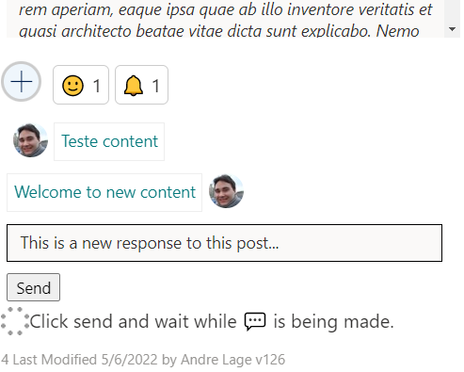
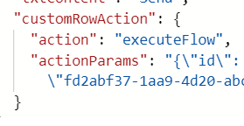
Discussion Board – Responses
Microsoft List Formatting
Manual PnP New response
Support List

Slide 7
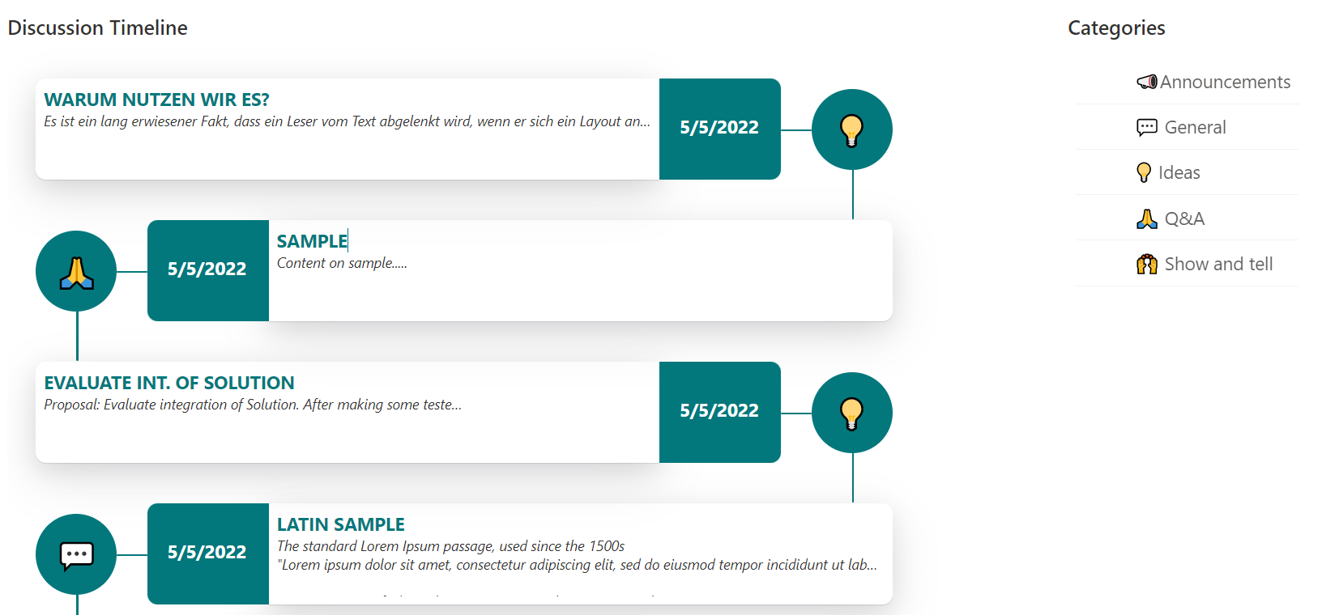
List Formatting – Discussion Timeline
Order by Modified
Discussion Card Display
Emotion editable
Filter by Categories

Slide 8
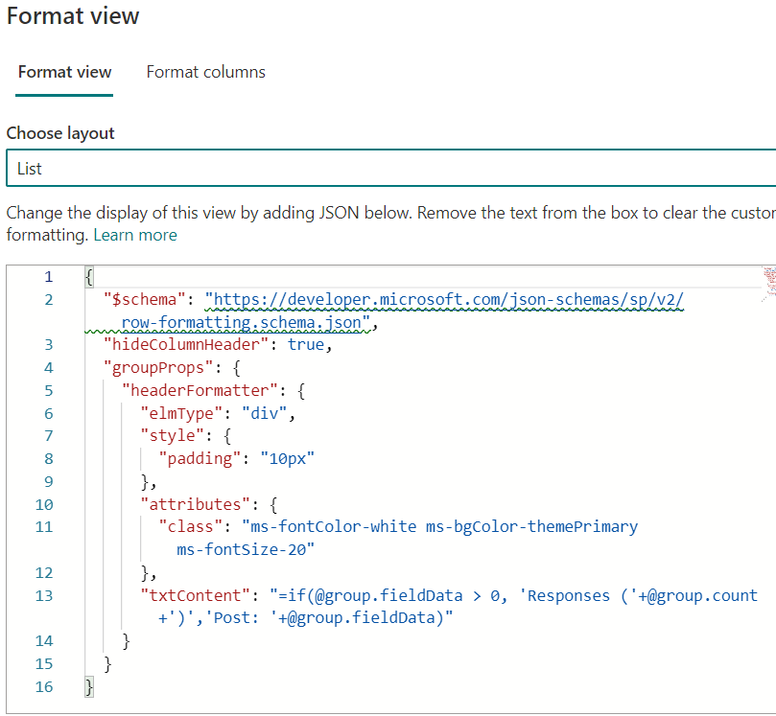
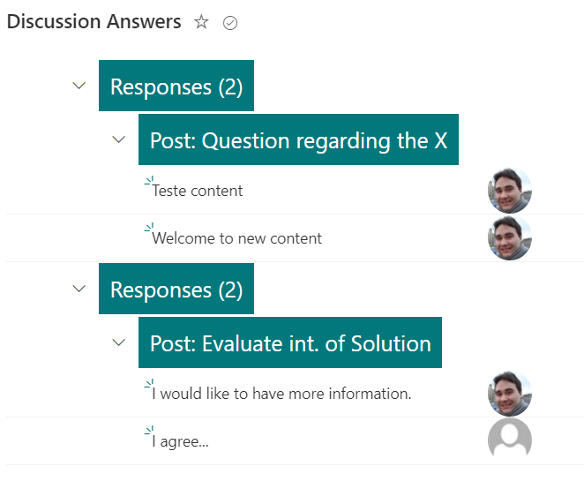
List Formatting – Discussion Answers
Grouped by Post – ID and Title

Slide 9
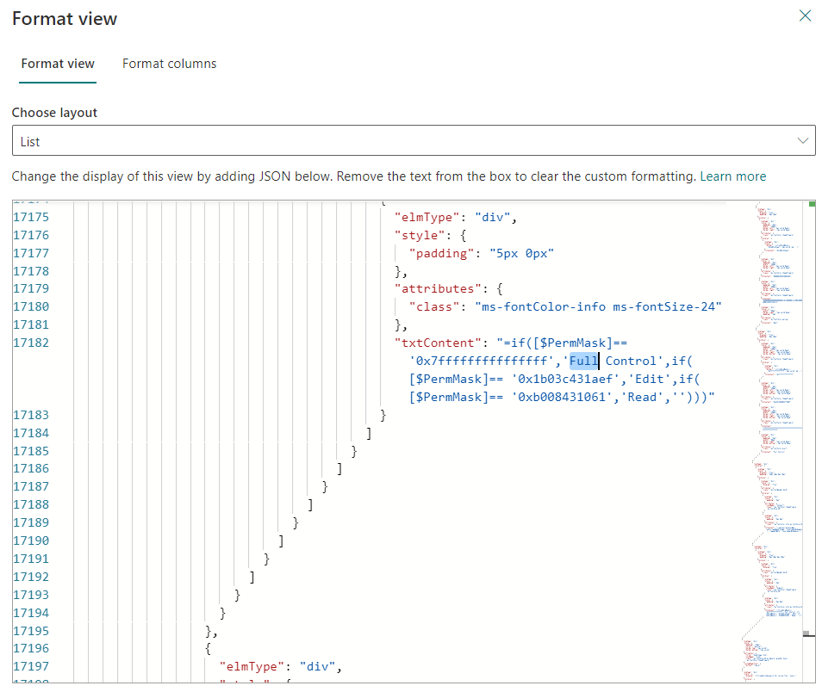
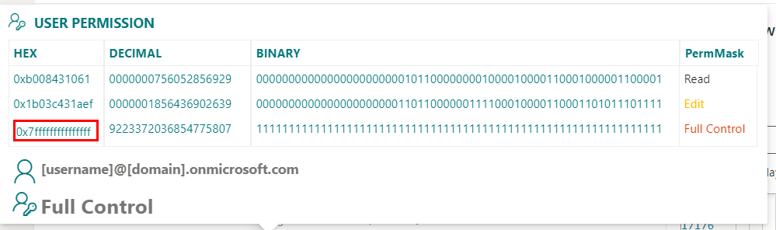
List Formatting – Permission checker
Goal: Provide user permission status on item.
Support field: [$PermMask]
JSON validates HEX content to display user permission on item

Slide 10
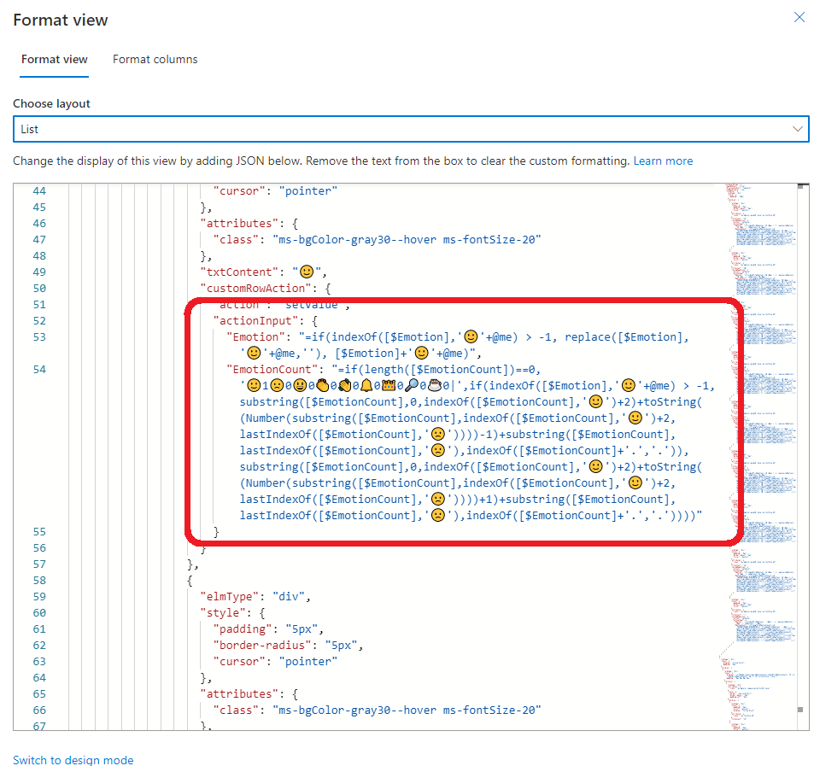
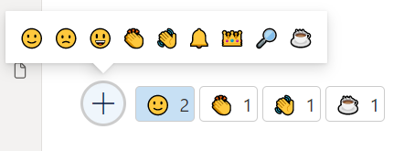
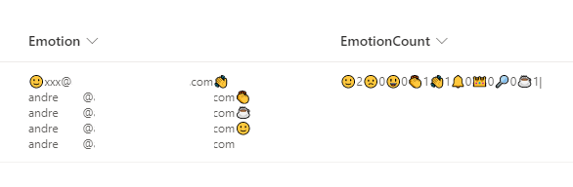
List Formatting – Emotions
Goal: Allow selection of emoji’s for the user.
Allow selection of emoji’s for the user and display total selected by all users in the item.
Emoji's are embedded in JSON.
„customCardProps“ to display Emotions and “customRowAction”, “setValue” with conditions to store user and/or emoji count.

Slide 11
Demo

Slide 12
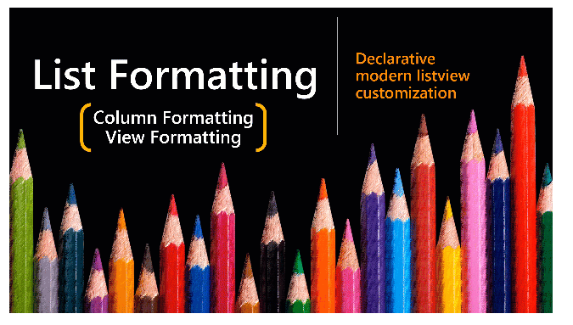
Samples – List Formatting
Thank you
https://github.com/pnp/List-Formatting

