Slide 1
Predicting the Airbnb Booking Journey

Slide 2
Agenda
Problem Statement
Data Preparation & Feature Engineering
Data Overview
Modeling Approach
Pre-Cleaning EDA
Evaluation
EDA & Key Findings
Business Insights

Slide 3
Problem Statement
Goal : Airbnb wants to predict the first booking destination of new users
Why it matters: Predicting the trip early helps the marketing team show the right ads to the right user.

Slide 4
Data Overview
Data Information
1. Train_users.csv : 213,000 past users
2. test_users.csv : 62,000 new users
3. sessions.csv : Over 10 million rows of web clicks.
(Note → Big data approach)
4. countries.csv : Details about the countries
5. age_gender.csv : Details about people in those countries.

Slide 5
Data Overview
Data Challenges
1. Unbalanced Target Data: Most users are NDF or US.
2. Huge Session Data: sessions.csv has over 10 million rows of web clicks. → One user can have thousands of rows.
3. Risk of Target Leakage: countries.csv has data about the final answer.
4. Illogical Data: Some user data makes no sense (for example, Age = 2014 or Age = 150).

Slide 6
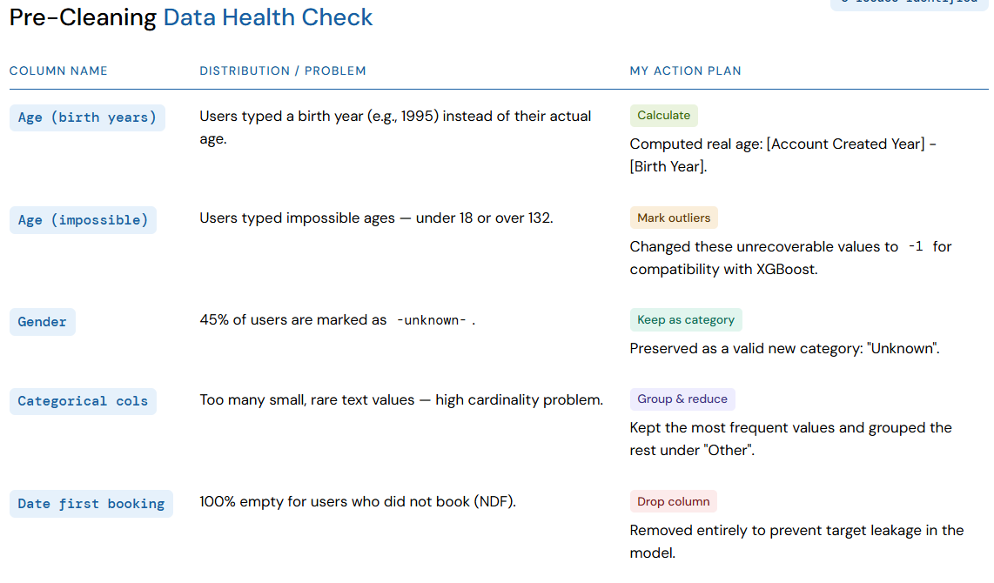
Pre_Cleaning EDA (train_user)

Slide 7
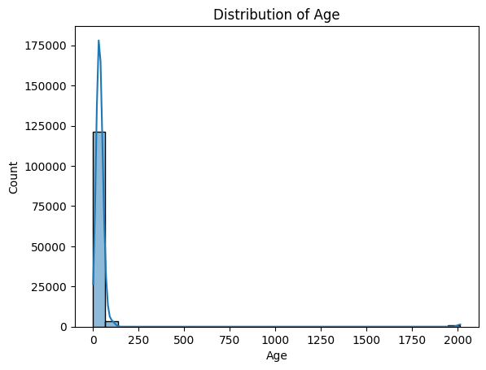
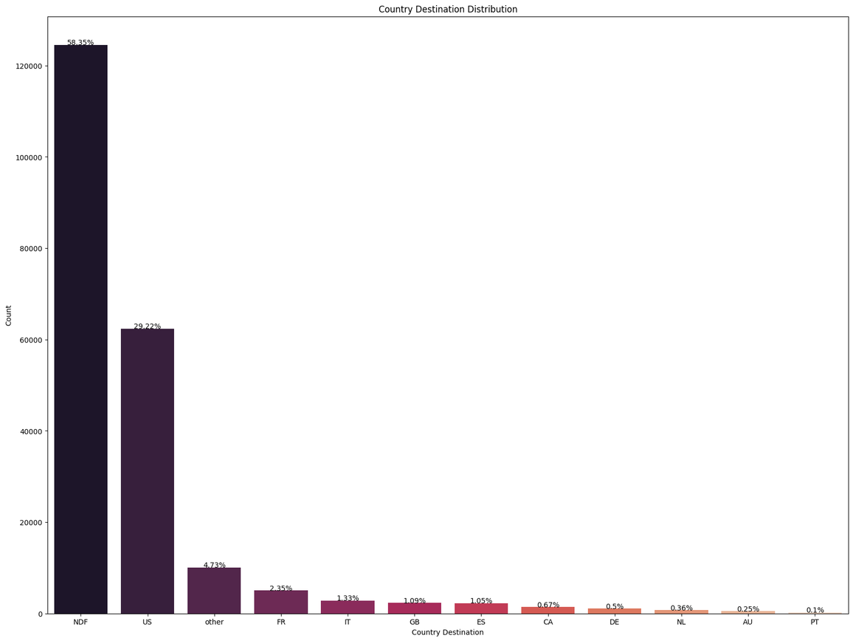
EDA (Train Data & Target Imbalance)
Age Outliers
Imbalance Target

Slide 8
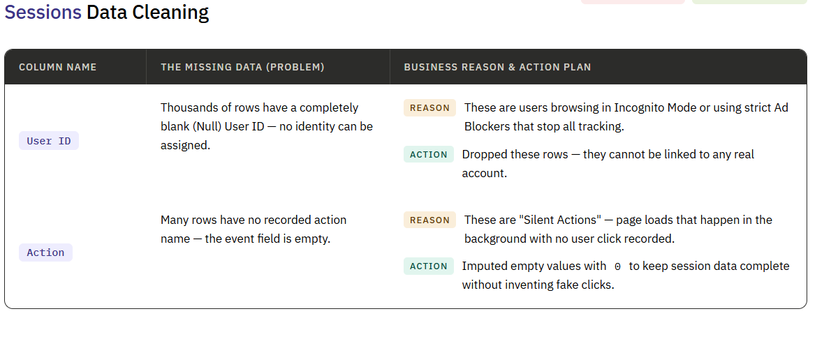
EDA(Sessions)

Slide 9
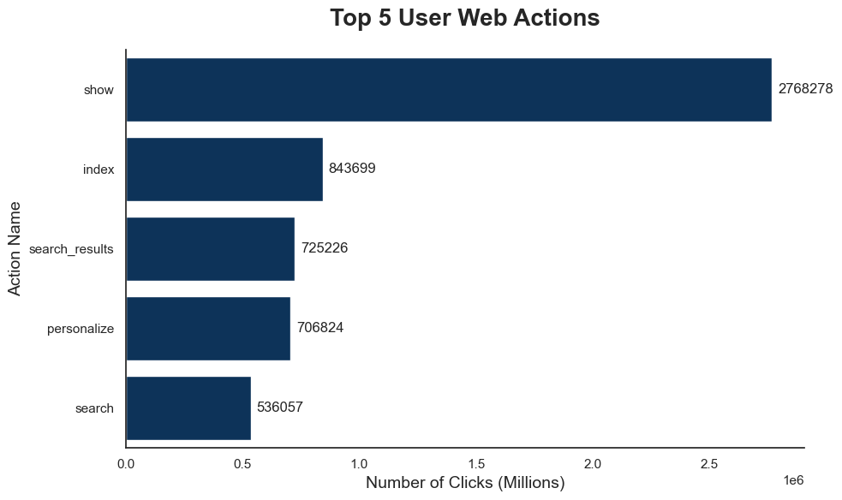
EDA (Sessions )

Slide 10
Data Preparation
Step 1: Clean Sessions. Dropped "ghost users" and filled silent actions.
Step 2: Aggregate. Grouped millions of clicks by user_id to extract features (total clicks, total seconds, unique actions).
Step 3: The Merge. Joined these new session features perfectly into both the train and test datasets.
Result: Every user now has a complete profile in one single table

Slide 11
Feature Engineering
Date Extraction: Split date_account_created into three new columns: Year, Month, and Day.
Type Casting: Changed signup_flow from an integer to a String (Categorical).
Encoding (OHE): Converted text categories into numbers so the AI can read them.

Slide 12
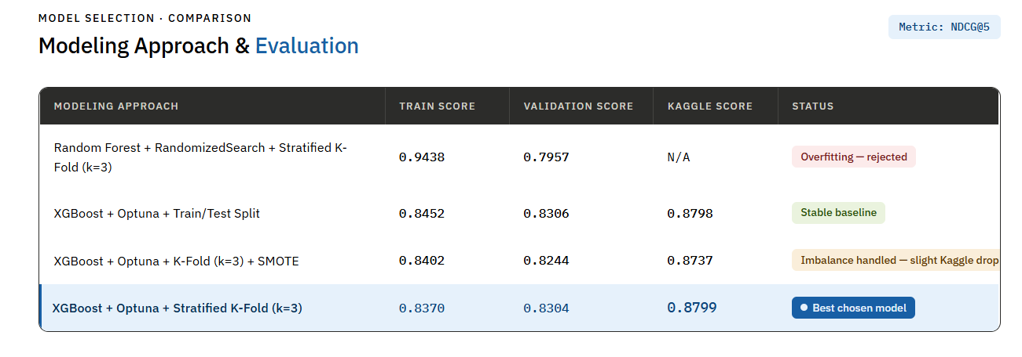
Modeling Approach

Slide 13
Evaluation
XGBoost is currently the best chosen model.
Key Features:
1. Speed and Performance: XGBoost is very fast. Using Optuna helped us automatically find the fastest and smartest settings.
2. Efficiency with Large Datasets: It easily handled the complex features we extracted from the 10 million session rows.
3. Accuracy & Stability: Using Stratified K-Fold stopped the model from overfitting.
4. Business Focused: use NDCG@5. This is perfect for the business because it gives the marketing team the Top 5 best country recommendations for every user.

Slide 14
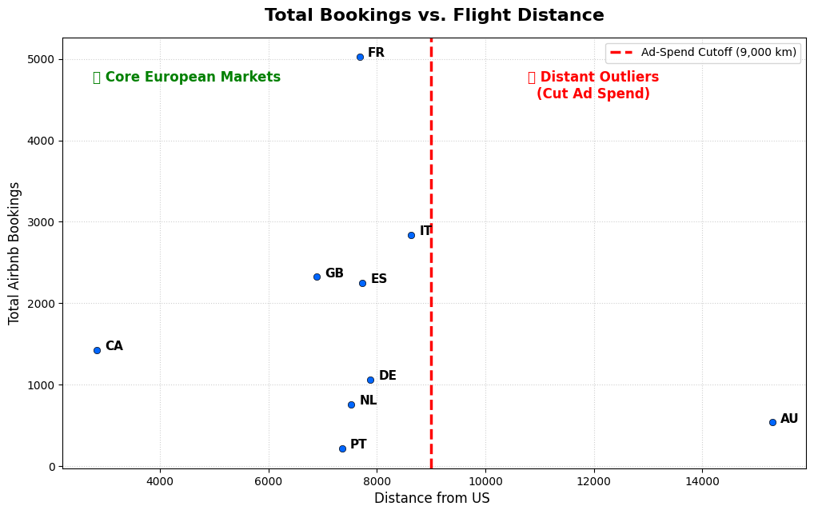
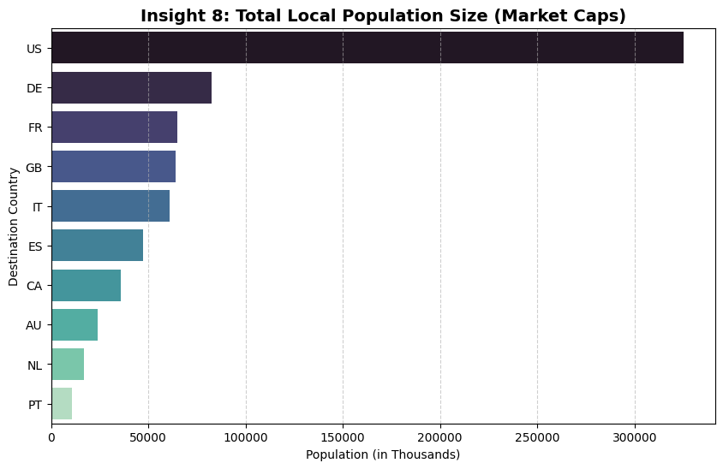
Business Insights (Marketing & Ad Spend)

Slide 15
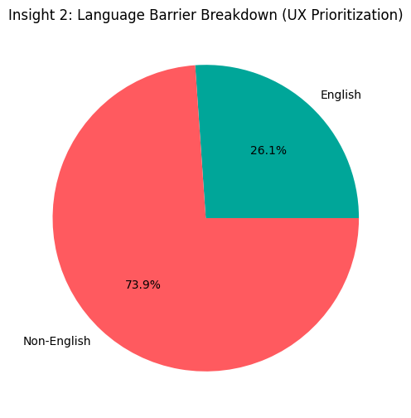
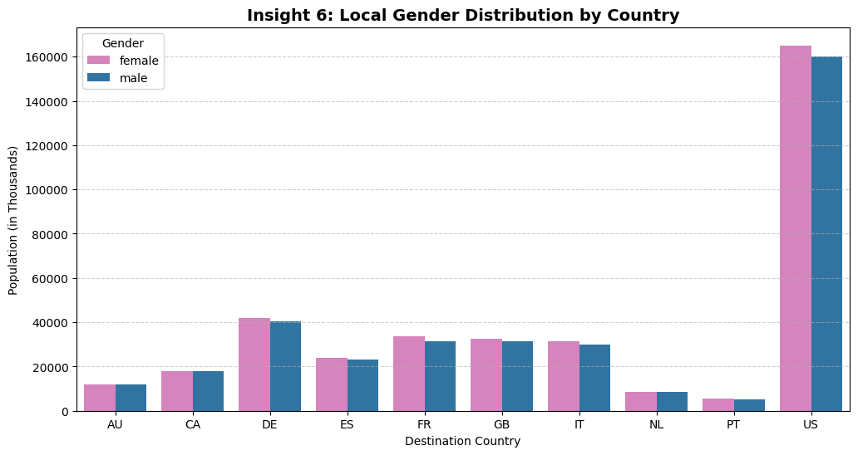
Business Insights ( UX & Demographics)

Slide 16
Thank You
presented by :Adam Mohamed

