Slide 1
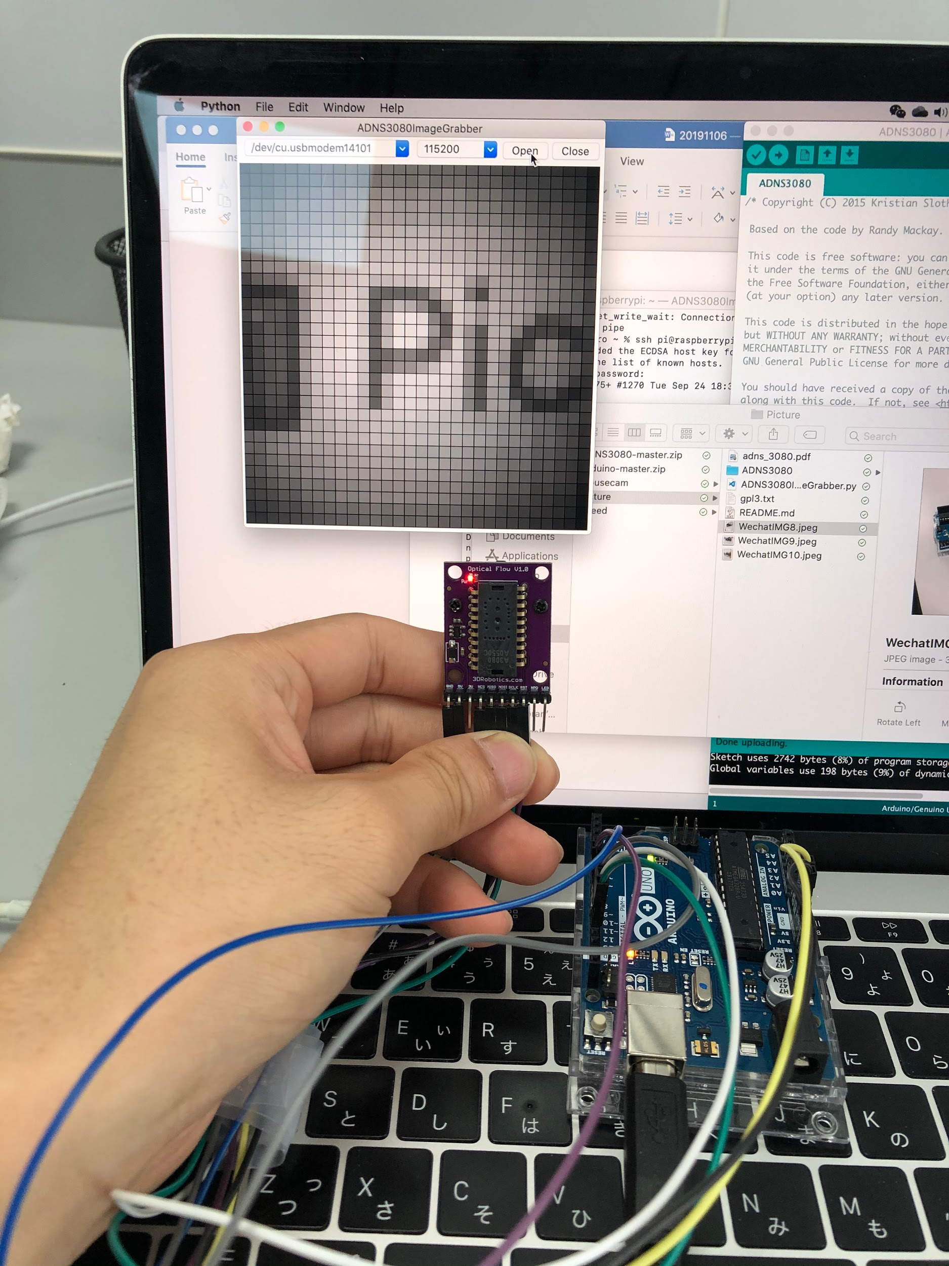
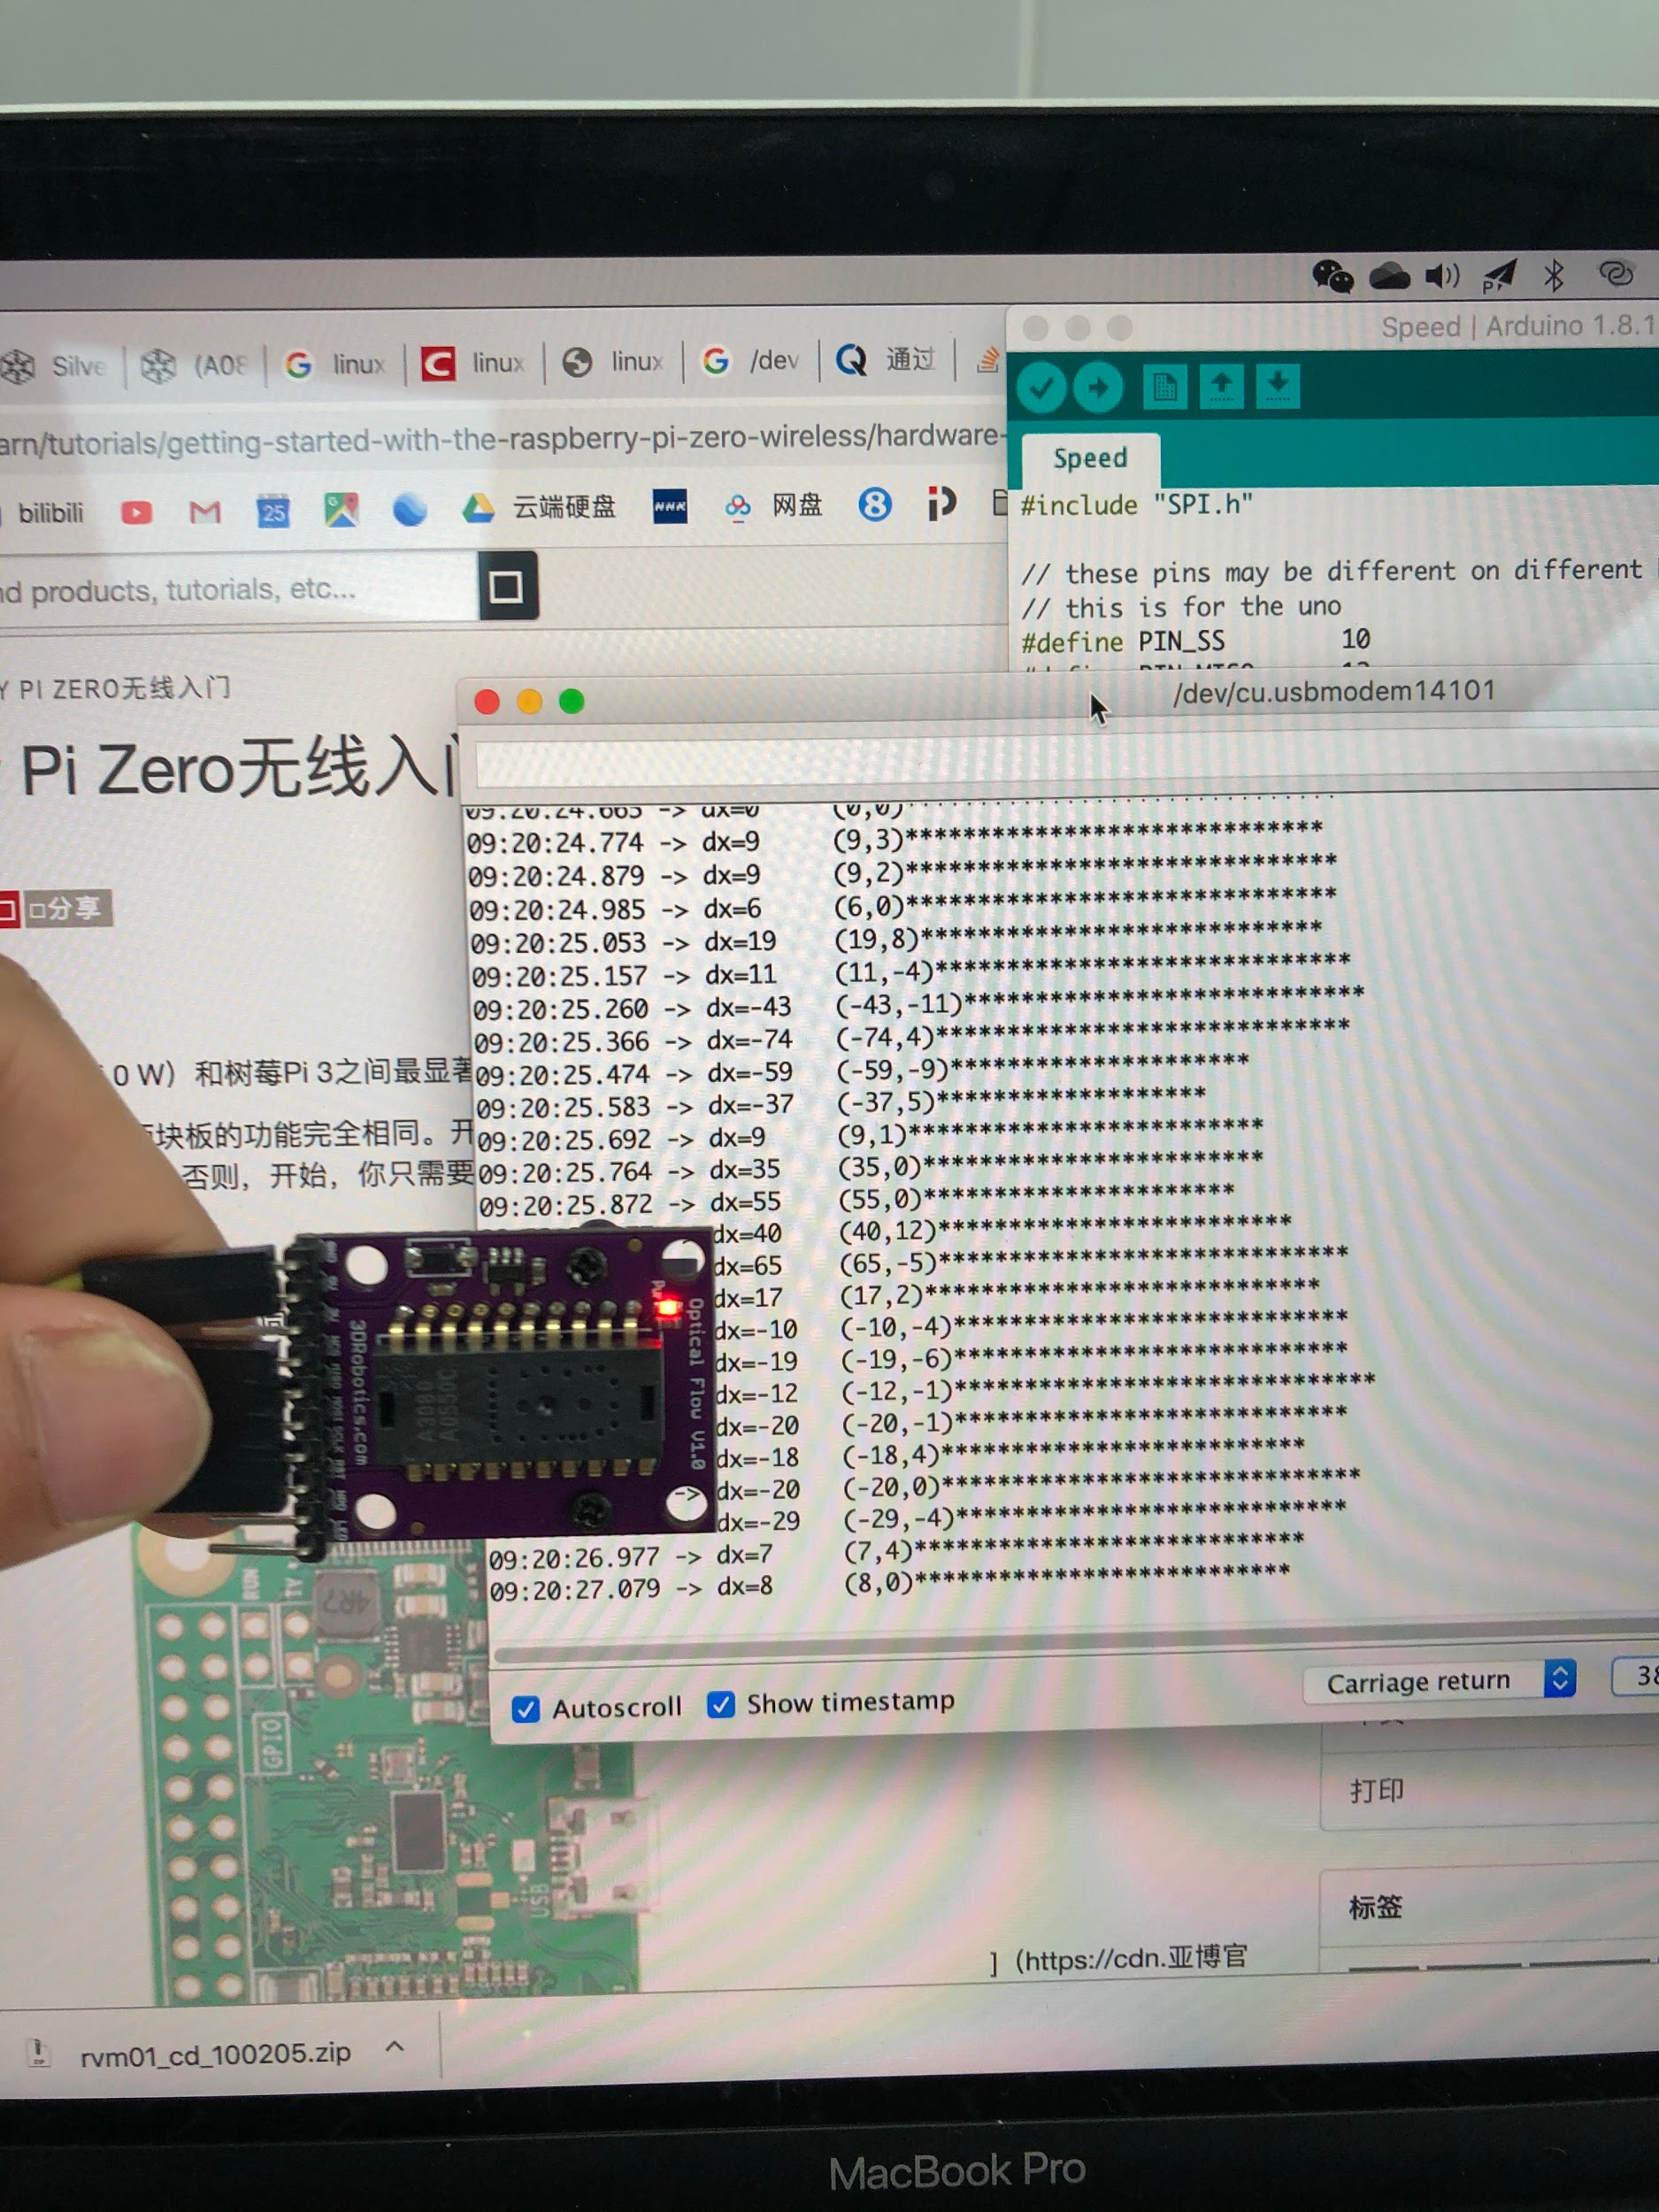
Taking Pictures using ADNS3080
Mearsuring Speed using ADNS3080
Key Features:
Resolution:
30*30 pixels
Baud rate:
115200
Frame rate:
up to 6400 frames/sec
Speed is measured by calculating the average pixel moving distance between two frames

