Slide 1

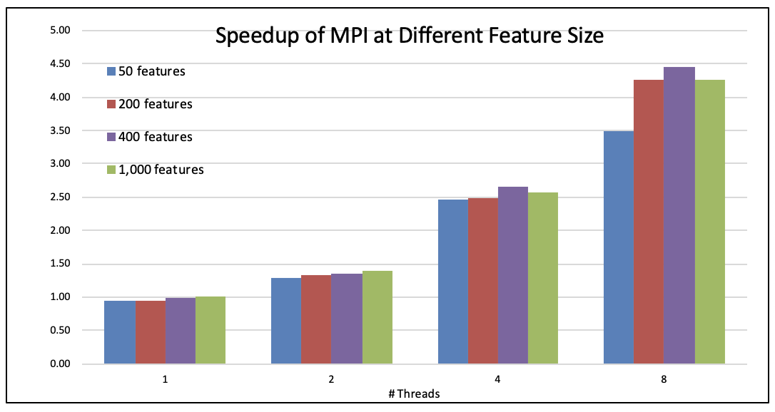
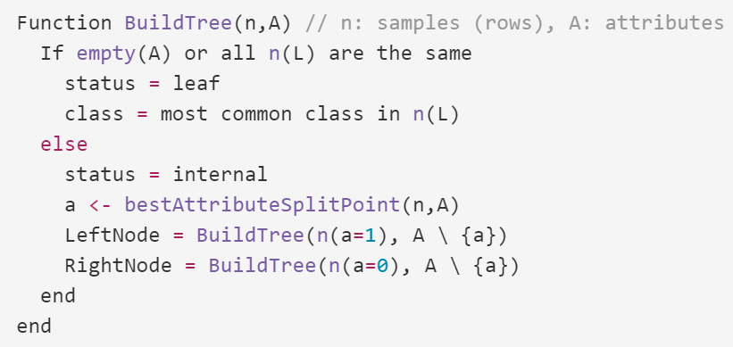
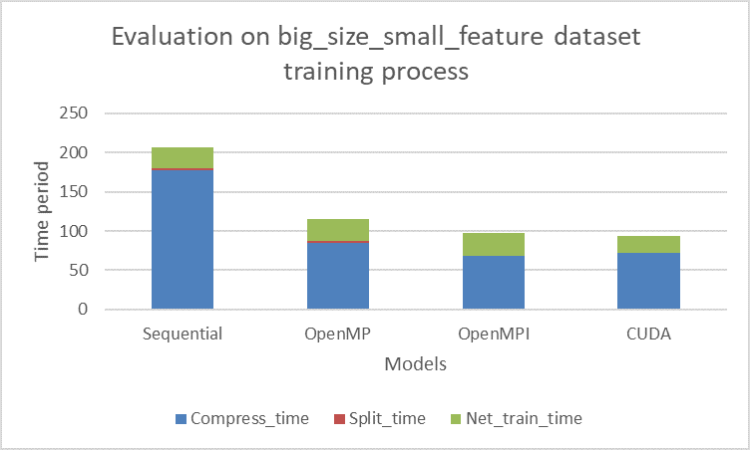
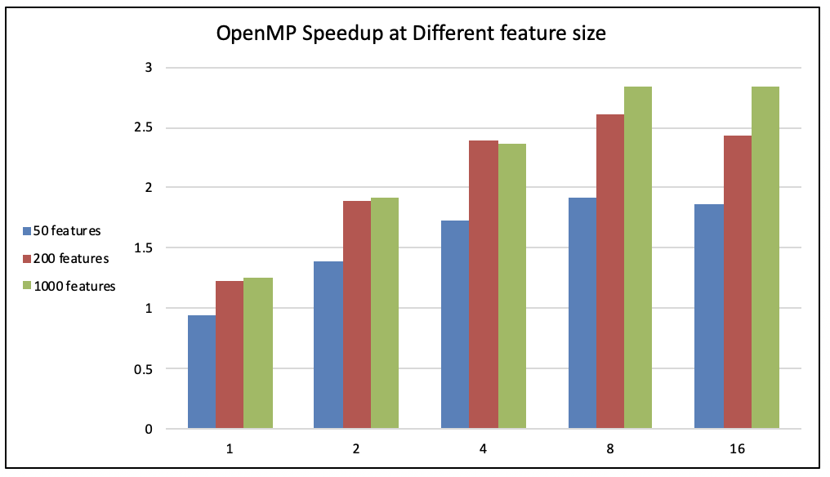
Parallel Streaming Decision Tree
Anxiang Zhang, Ke Ding
Abstract
Implementation
Evaluation
We implemented the sequential version, the OpenMP version, the OpenMPI version and the CUDA version for decision tree with histogram and compared the performance of four implementations over several datasets.
OpenMP
Data parallel + Feature parallel
Reorder the loop to avoid race condition
OpenMPI
Data parallel + Feature parallel
Message-passing version
When facing contention, introduce local variables, then send to master and merge
CUDA
Four kernels
Serialize the dataset, rewrite some operations
Data parallel + Feature parallel
Fixed thread number and block number for kernels
OpenMP speedup over different feature sizes
Sequential, OpenMP, OpenMPI and CUDA version’s compress time, split time and net train time comparison
Introduction
Decision Tree is widely used in Machine Learning. It is simple and intuitive.
Discussion
Kernel name | Thread num | Block num
histogram_update | # features | #leaves
calculate_feature_value | 128 | (#features+127)/128
calculate_gain_deltas | max bin size | #features
navigate_sample | 128 | (#data+127)/128
Approach
Node parallel
When splitting nodes, parallel over all unlabeled leaves in tree
Pro: most intuitive way to speed up
Con: unbalanced workload
Feature parallel
When find the best split in tree, parallel over different features
Pro: reduced communication cost O(P)
Con: manually synchronize best split point information for all features
Data parallel
When update histograms with values, parallel over data in dataset
Pro: huge parallelism in large data size
Con: manually synchronize the updated histograms in each worker. The histograms are the contention
Evaluation
OpenMP speedup over different feature sizes
Takeaways
1. OpenMP scales over feature size, while OpenMPI scales poorly over feature size.
2. OpenMPI could achieve a higher speedup than OpenMPI.
3. On large data size, CUDA could achieve higher speedup than OpenMP and OpenMPI.
References:
[1]: Srivastava, Anurag, et al. "Parallel formulations of decision-tree classification algorithms." High Performance Data Mining. Springer, Boston, MA, 1999. 237-261.
[2]: Ben-Haim, Yael, and Elad Tom-Tov. "A streaming parallel decision tree algorithm." Journal of Machine Learning Research 11.Feb (2010): 849-872.
[3]: Zhang, Huan, Si Si, and Cho-Jui Hsieh. "GPU-acceleration for Large-scale Tree Boosting." arXiv preprint arXiv:1706.08359 (2017).
[4]: Jin, Ruoming, and Gagan Agrawal. "Communication and memory efficient parallel decision tree construction." Proceedings of the 2003 SIAM International Conference on Data Mining. Society for Industrial and Applied Mathematics, 2003.
[5]: Chih-Chung Chang and Chih-Jen Lin, LIBSVM : a library for support vector machines. ACM Transactions on Intelligent Systems and Technology, 2:27:1--27:27, 2011
Notes:
Decision Tree is widely used in Machine Learning. It is simple and intuitive.
The traditional way to build a decision tree is expensive in finding the best attribute split point because it needs to iterate all the data set to find the best split for one feature. So this would lead to t O(data*feature) complexity.
The approximate algorithm with histograms could reduce the computational cost of building a decision tree. This algorithm compresses the data into a pre-defined number of bins of histograms, and then iterate each histogram to find promising splits for one feature. It reduces the complexity to O(bins*feature).
In this project, we are using the approximate algorithm to build the decision tree. The computational expensive parts include two functions: find_best_split (find the best split point) and compress (update histograms with values). Our goal is to parallelize these two functions.

