Slide 1
10 Important events in computer history
Yirgalem Gidey Gebru

Slide 2
What is a Computer
“noun - an electronic device for storing and processing data, typically in binary form, according to instructions given to it in a variable program.”

Slide 3
History
Year | Associated heading
1642 | Blaise Pascal
1833 | Charles Babbage
1945 | E.N.I.A.C.
1947 | The Keyboard
1958 | William Higinbotham
1963 | Douglass Engelbart
1975 | Portable Computer
1986 | Age of Computers
1991 | W.W.W.
1998 | Google

Slide 4
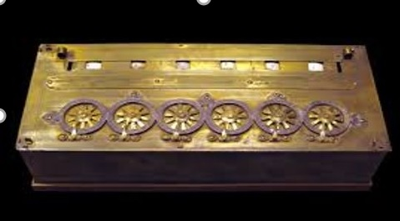
Calculator
1642 Blaise Pascal.
Invented the mechanical calculator. This early machine was able to carry out addition, multiplication, division and subtraction.
Notes:
‘Further information on each event mentioned, including photographs, will follow.'

Slide 5
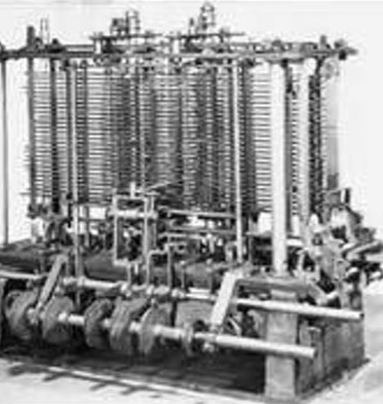
First Computer
1833 Charles Babbage.
Invented the first computer called The Difference Engine
Notes:
‘Further information on each event mentioned, including photographs, will follow.'

Slide 6
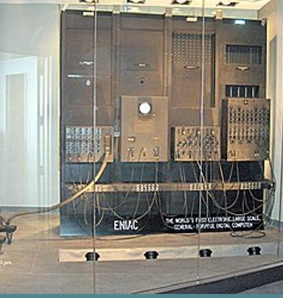
Digital computer
1945 ENIAC.
Electronic Numerical Integrator and Computer. The digital era had started with the first general-purpose digital computer.
Notes:
‘Further information on each event mentioned, including photographs, will follow.'

Slide 7
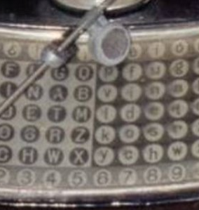
Keyboard
1947 Keyboards are more efficient for entering data than the punch cards they replaced. Information can now be processed more efficiently.
Notes:
‘Further information on each event mentioned, including photographs, will follow.'

Slide 8
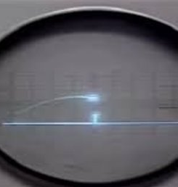
The First Video Game
1958 Physicist William Higinbotham created the first video game. It was a very simple tennis game that became the inspiration for a video game called "Pong".
Notes:
‘Further information on each event mentioned, including photographs, will follow.'

Slide 9
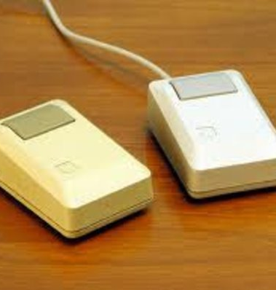
The Computer Mouse
1963 Douglass Engelbart. Invents the first computer mouse. Nicknamed a "mouse" because of the cable looking like a tail.
Notes:
‘Further information on each event mentioned, including photographs, will follow.'

Slide 10
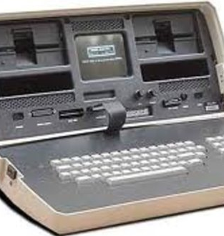
Portable computers
1975 The MIT Suitcase Computer. The size was made possible by "Micro-processors".
Notes:
‘Further information on each event mentioned, including photographs, will follow.'

Slide 11
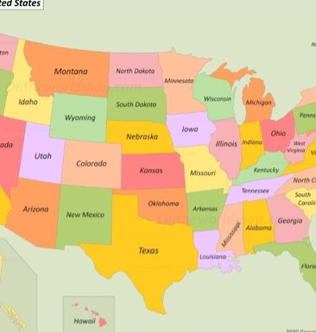
Computers for everyone
1986 Computer Age has arrived. More than 30 million computers are in use in the United States.
Notes:
‘Further information on each event mentioned, including photographs, will follow.'

Slide 12
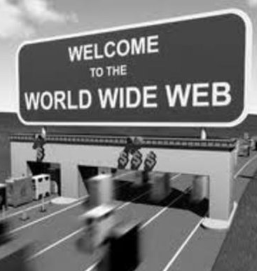
The Worldwide Web
1991 The World wide Web was launched in August. Information is transported at almost instantaneous speeds.
Notes:
‘Further information on each event mentioned, including photographs, will follow.'

Slide 13

Google
1998 Sergey Brin and Larry Page founded Google. So important that a Verb was created. "To Google".
Notes:
‘Further information on each event mentioned, including photographs, will follow.'

