Slide 1


Indicating verbs and cognition-to-form mapping: Pointing away from 'agreement' and back again?
Adam Schembri

Slide 2
Over
Overview
Theoretical background
Data from spoken and signed languages
Kibrik (in press): Form to form mapping vs. cognition to form mapping
Applications to sign languages
A way forward?
Notes:
I’m excited to present this talk, because this is an area where my thinking is changing very fast. I’m reading the proofs of a paper now which is about to go into print, but I’m not sure I totally agree with it any more.
First of an overview of this presentation. I will briefly give a summary of the theoretical background involved in the ongoing debate about agreement in sign languages. I will discuss, again briefly, data from spoken language agreement systems and from signed language verb directionality
In particular, I wish to focus on new work in cognitive linguistics by the Russian linguist, Andrej Kibrik, whose work on ‘cognition to form mapping’ presents a challenge to what Kibrik calls the ‘form to form’ mapping approach used by some typologists, including Greville Corbett. Corbett’s work has been playing a key role in the debate about agreement in sign language linguistics over the last decade. I will briefly explore how this work can be applied to sign languages, and I will hint that perhaps it offers a way out of the terminological and conceptual disagreements between sign language linguists working in different theoretical frameworks.

Slide 3

No agreement on ‘agreement’
No consensus about the nature of verb directionality
In the generative tradition, most researchers see verb directionality = agreement system
Some researchers in the cognitive-functional tradition consider verb directonality ≠ agreement system
Notes:
Currently, there is no consensus amongst sign language linguists about the nature of verb directionality.
Despite a number of alternative analyses, researchers in the generative tradition mostly agree that verb directionality represents an agreement system.
Researchers in the cognitive/functional tradition fall into number subgroupings, with some arguing against the agreement analysis.

Slide 4
No agreement on ‘agreement’
Why important?
The debate between different theoretical perspectives in linguistics
Verb directionality - linguistic universals vs. linguistic diversity?
BUT sign language linguists have not problematised the notion of agreement very much
Notes:
Why is this topic important?
It represents a key example of the debate between different theoretical perspectives in linguistics
Does verb directionality in sign languages have something to teach us about linguistic universals, about linguistic diversity, or both?
BUT sign language linguists have not problematised the notion of agreement very much

Slide 5


Canonical typology of agreement
Canonical typology: Corbett (2006)→ indicating verbs in sign languages (e.g., Lillo-Martin & Meier, 2011; Costello, 2016; Schembri et al., in press).
An agreement feature is a feature that originates in one linguistic element - a controller - and is copied onto another one - a target.
Controller → | Target
CHILD ^{↓left} | HELP ^{left→right}
^{'The child} | ^{helps (someone)’}
Notes:
Greville Corbett’s (2006) book included a typology of agreement systems in spoken languages. He described agreement as involving a feature originating in one linguistic element – the controller – that is copied onto another one – the target. We can see this in the English verb ’help’ which takes the third person singular –s suffix in this context. Although he claimed that verb directionality in sign languages did not fit into his definition of an agreement system, and did not include it in his typology, his work has become very influential in sign language linguistics.
In particular, his definition of agreement has been used to show how directionality – if one takes location as a feature – can in fact sometimes look like an agreement system, as in this BSL example here.

Slide 6

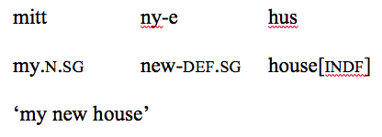
Canonical typology of agreement: challenges
Clear examples of agreement marking: marking on controller and target
Italian:
Less clear examples of agreement marking: no marking on controller
Norwegian:
Notes:
Corbett’s canonical typology is intended, however, to recognise that there are range of phenomena which might be considered examples of agreement marking in spoken languages. Some languages have canonical agreement that fits into Corbett’s definition in every way, such as we see here in Italian, where the masculine gender and singular number is marked on the controller noun, and the target determiners and adjectives. Other languages have less clearly canonical agreement systems, such as definite marking in Norwegian, where we do not see the marking on the controller.

Slide 7
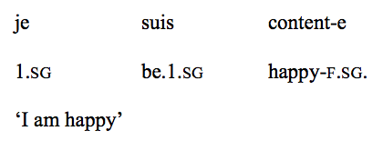
Canonical typology of agreement: challenges
Less clear examples of agreement marking: no relevant features marked on controller
French:
Less clear example of agreement (?) marking: person/gender/number features not relevant and no controller
BSL: HELP ^{left→right}
Notes:
Another with a less clearly canonical agreement system is the example here of gender marking from French, where we do not see the marking on the controller. Instead here the gender marking comes from the gender of referent of the pronoun ‘je’. Examples of something similar are common in BSL where it is possible to have clauses without any controller being present, and the location marking might come from the location of the present referents, or associated with absent referents.

Slide 8

Canonical typology of agreement: challenges
Researchers don’t agree:
a canonical agreement system (e.g., Costello, 2016)
a non-canonical agreement system (e.g., Lillo-Martin & Meier, 2011)
not an agreement system at all (Liddell, 2000; Schembri et al., in press).
Notes:
Researchers have variously interpreted this approach as suggesting that indicating verbs represent:
a canonical type of agreement system (e.g., Costello, 2016)
a non-canonical agreement system (e.g., Lillo-Martin & Meier, 2011)
a system that shares properties with, but is ultimately distinct from, agreement systems (Liddell, 2000; Schembri et al., in press).

Slide 9
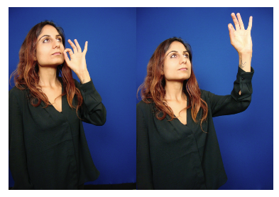
Canonical typology of agreement: What do the data tell us?
There appears to be good reason for such a range of views, at least for BSL (Fenlon et al., 2018)
BSL Corpus evidence that supports an agreement account:
feature matching with controllers
animacy
syntactic effects
Notes:
There appears to be good reason for such a range of views, at least for BSL (Fenlon et al., 2018)
We have BSL Corpus evidence that seems to support an agreement account: we do see some examples where the location feature on targets matches location features on controllers. We also see, as in spoken languages that certain conditions, such as the animacy of the arguments, influence verb directionality. We see an interaction between verb directionality and syntax. I do not have time to go into detail today, but please read our paper on the BSL indicating verb study.

Slide 10
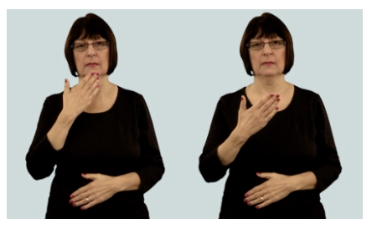
Canonical typology of agreement: What do the data tell us?
BSL Corpus evidence that raise questions for a canonical agreement account:
no verb directionality
absent controllers
no features marked on controllers
constructed action
motivated uses of space and body
Notes:
We also have BSL Corpus evidence that does not seem to support an agreement account: we do see many examples where there is no directionality, no controller in a clause or indeed anywhere in the discourse, or no location features marked on the controller. We also see that certain conditions, such as the use of constructed action and the preference for the use of the body as subject or agent, which interact with verb directionality in ways predicted by the work of Liddell.

Slide 11
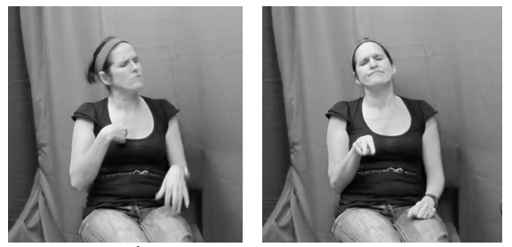
Canonical typology of agreement: What do the data tell us?
Why agreement marking and verb directionality is so common cross-linguistically is not explained by formalist agreement accounts
BSL Corpus data support reference-tracking function
Agreement and verb directionality both work as part of the tracking system of language (Talmy, 2018), or argument indexing (Haspelmath, 2013)
Notes:
What is verb directionality and agreement marking for anyhow?
BSL Corpus data support reference-tracking function: coreference was a significant factor in our analyses, with co-reference leading to more use of modification in indicating verbs
Agreement and verb directionality both work as part of the tracking system of language (Talmy, 2018), ), or argument indexing (Haspelmath, 2013)
Why agreement marking and verb directionality is so common cross-linguistically is not explained by formalist agreement accounts

Slide 12
Rethinking Corbett’s typology of agreement
Kibrik (in press): what control relationship?
Co-occurrence ≠ cause and effect?
Cognitive representation of a referent -> same features on different sites
Noun phrase ⇧ | Verb⇧
CHILD ^{↓left} | HELP ^{left→right}
^{'The child} | ^{helps (someone)’}
Notes:
In this paper that is currently in press, Kibrik (in press) challenges assumptions in canonical typology and indeed in formalist accounts of agreement in general: how do we know that there is a control relationship?
Co-occurrence does not mean there is cause and effect.
He argues that instead a language-external cause, and the cognitive representation of this cause, leads to the coding of the same features on different sites in the language: this is what he calls cognition to form mapping rather than form-to-form mapping.

Slide 13
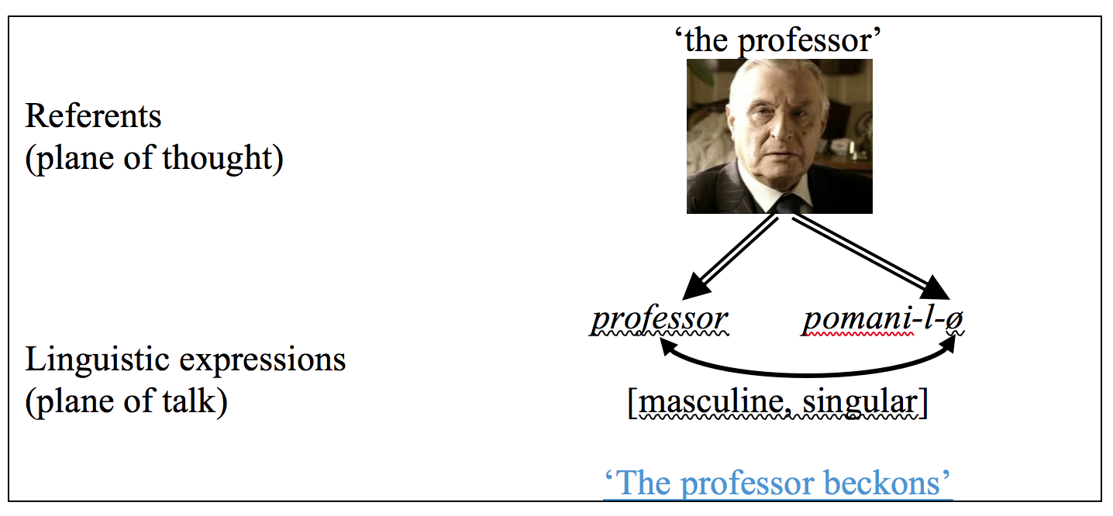
Rethinking the typology of agreement
Kibrik (in press): broad definition of agreement as cognition to form mapping
Cognitive representation of referent
Feature activation during ‘thinking for speaking’
With or without a controller
Although we have a Russian example here, the sites vary from language to language
Notes:
Kibrik (in press) proposes a broad definition of agreement as cognition to form mapping
When mentioning a referent, a speaker has a cognitive representation of the referent
This includes features, such as person, number, gender etc activated along with the referent during ‘thinking for speaking’
This feature activation occurs with or without a controller
Although we have a Russian example here, with gender and number marking on the verb, the sites vary from language to language

Slide 14
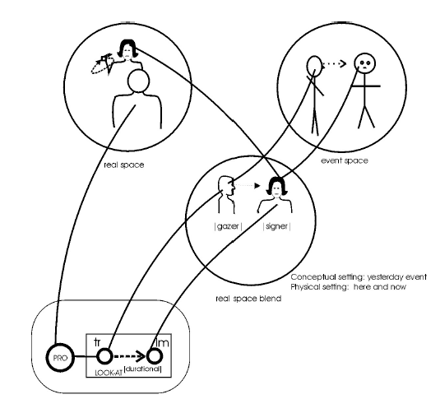
Rethinking the typology of agreement
Compare this with Liddell (2003): real space blends in indicating verbs
Although he did not use the term, it’s clearly cognition to form mapping model
Notes:
Compare this with Liddell (2003): real space blends in indicating verbs
Although he did not use the term, it’s clearly cognition to form mapping model

Slide 15
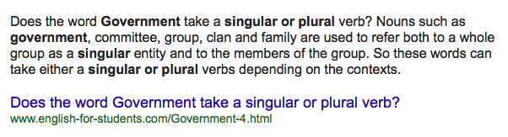
Rethinking the typology of agreement
Corbett’s model (2006): the control relationship and form-to-form mapping is central
Kibrik (in press): the non-canonical phenomena are too numerous!
Non-canonical agreement
Canonical
agreement
Notes:
Corbett’s model (2006) makes form-to-form mapping central in its typology of agreement, and other types peripheral
Kibrik (in press): the form-to-form approach encounters massive difficulties when confronted with data, such as missing controllers or feature mismatches. In fact, the the peripheral phenomena are too numerous!

Slide 16
Rethinking the typology of agreement
Kibrik’s (in press) analysis of Russian evidence suggests that the cognition-to-form mapping approach has a much greater explanatory force than the traditional form-to-form approach
Form to form mapping is not central, in fact, but a side effect of mappings from the same cognitive representation
He predicts that the cognition-to-form mapping approach will be shown to apply to a variety of languages
Cognition to form mapping
Form to form
mapping
Notes:
Analysis of Russian evidence suggests that the cognition-to-form mapping approach has a much greater explanatory force than the traditional directed form-to-form approach
he argues, cognition to form mapping is the driving force behind agreement systems
Form to form mapping is not central, but a side effect of mappings from the same cognitive representation
It may be that the cognition-to-form mapping approach, simple and clear in its logic, will be shown to apply to a variety of languages.

Slide 17
Rethinking the typology of agreement
Form to form mapping: a formalist approach
Cognition to form mapping: a functional approach
Most examples of agreement do not require a formalist approach
Agreement is instead seen as reference-tracking, serving human communicative needs
Cognition to form mapping
Form to form
mapping
Notes:
The focus on form-to-form mapping reflects linguists’ traditional focus on formal structure. Kibrik’s proposal, like others by Talmy and Haspelmath, is that agreement is a functionally based process. Under the cognition-to-form mapping approach, the vast majority of instances do not require any formal considerations. There are only little pockets in which we need to solicit support of such considerations. This cognition-to-form mapping approach is in line with the view that language is a functional system serving human needs.

Slide 18
Rethinking the typology of agreement
Cognition to form mapping:
larger range of phenomena now relevant
location (like person, number, gender) may be a feature in sign languages
languages may differ in how form to form vs. cognition to form mapping work
Notes:
In a functionalist approach, a larger range of phenomena are relevant to an understanding of agreement. Apart from person, number, and gender, there are other agreement features, such as definiteness and location.
Languages may differ in the extent to which lend themselves to this or that analysis of agreement, and that is an empirical question. It may be that the cognition-to-form mapping approach, simple and clear in its logic, will be shown to apply to a variety of languages.

Slide 19
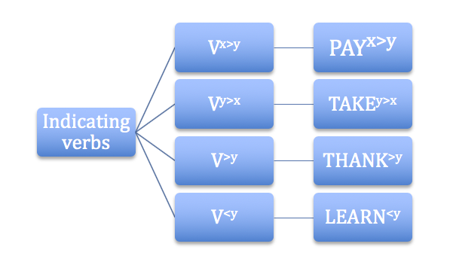
Application to BSL and other sign languages?
Fenlon et al. (2018)
feature matching with controllers
animacy
syntactic effects
no verb directionality
absent controllers
no features marked on controllers
constructed action
motivated uses of space and body
reference-tracking function
Cognition to form mapping (Kibrik, in press) in a construction grammar account (Schembri et al. in press)
Notes:
So looking back at the picture of verb directionality we get from the BSL Corpus study, we see that all of the factors involved in verb directionality in the BSL Corpus study (Fenlon et al., 2018) can be accounted for under a cognition to form approach combined with a construction grammar account (Schembri et al., in press)

Slide 20

Cognitive/functionalism to the rescue?
Liddell (2000, 2003) : cognition-to-form mapping
But was he wrong to assume that agreement in spoken languages is form-to-form mapping?
Formalists: verb directionality is an agreement s
A functionalist cognition-to-form mapping, rather than form-to-form mapping, unifies agreement related phenomena
Notes:
Liddell (2000, 2003) partly right: cognition-to-form mapping at work in sign languages
Partly wrong: not all linguists think agreement is form-to-form mapping in spoken languages
Formalists partly right: sign language and spoken language agreement systems have much in common
Partly wrong: a functionalist cognition-to-form mapping unifies a range of agreement phenomena more effectively

Slide 21
References
Kibrik, A. (in press) Agreement. Cognitive Linguistics.
Schembri, A., Cormier, K. & Fenlon, J.(in press) Indicating verbs as typologically unique constructions: Reconsidering verb ‘agreement’ in sign languages Glossa.

