Slide 1

Anti Mileage Fraud System
Adam Cahill

Slide 2
Introduction
What Is the purpose of an Anti Mileage Fraud System in a vehicle?
Protect buyers in the second-hand automotive market.
Prevent warranty fraud.
Protect leasing companies.
Where did I get the idea for the Anti Mileage Fraud System?
Being apart of a team who investigated the problem within JLR as an undergrad.
Family who have been a victim to mileage fraud in the second-hand market.

Slide 3
Functional Requirements
These are the list of features the final application will include:
Accurate Mileage Logging.
Tamper Detection.
Safe Storage of Mileage Data.
Data Integrity.
Reporting Tampering Attempts.

Slide 4
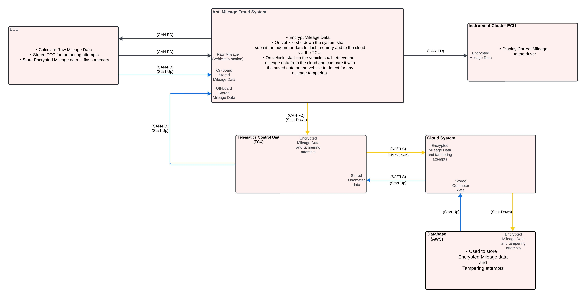
Context Diagram

Slide 5
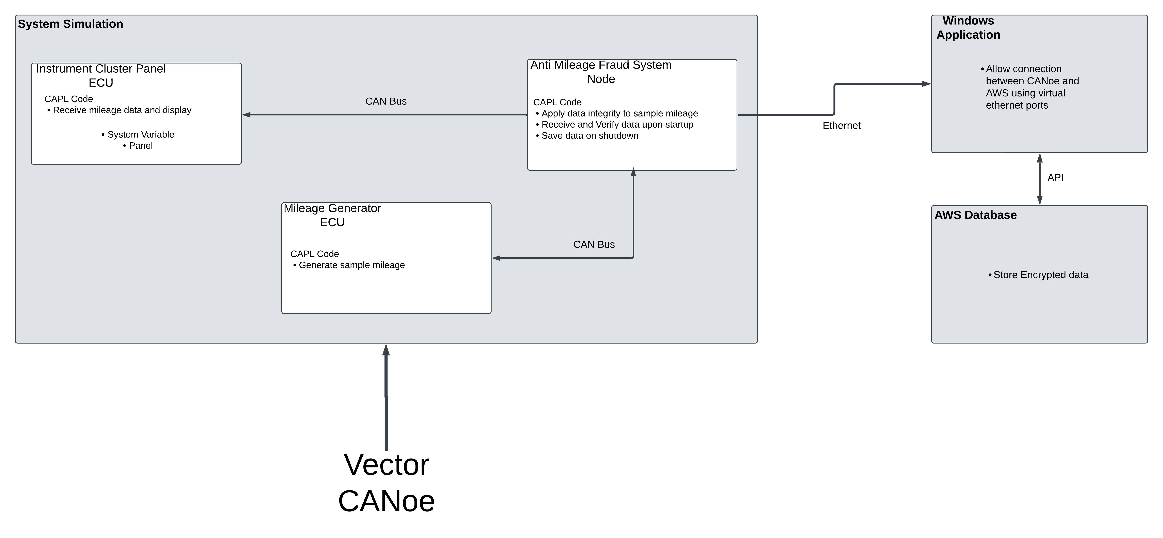
Software Architecture
CANoe
CAPL Code
CAN Bus
Ethernet Communication
AWS Database
RESTful API
AES-128
SecOC
TLS

Slide 6
Prototype Summary
System Elements Implemented:
Simulation of Onboard System
Can Bus network
Offboard Communication
Summarise results/progress.

Slide 7
Prototype Demo
Demo
Q&A

