Slide 1
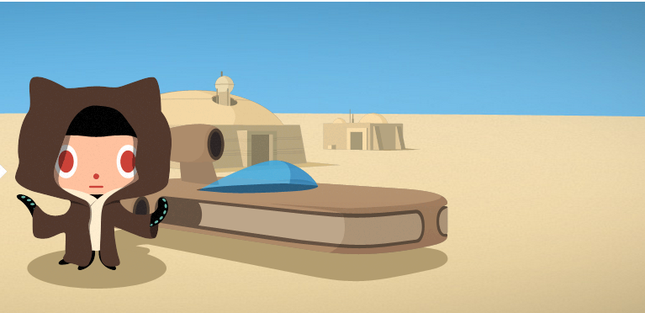
Content Authoring on Docs Tools Overview
microsoft confidential

Slide 2
GitHub & GitHub Terms
Git | An open-source version control system. Linus Torvald created it.
GitHub | A company that provides open source code repository hosting as a service. We are using their service as a content management system. GitHub is built on top of Git. To interact with GitHub, you can use their web interface or install Git tools (like Git Bash) on your local machine.
repository (repo) | Our content databases in GitHub. At the command line, commands that include “upstream” are acting on the repository. Ours is at https://github.com/Azure/azure-content-pr.
‘the public repo’ | External facing content repo (e.g., Azure-RMSDocs); customers and infrequent contributors can submit changes to articles.
‘the private repo’ | Internal facing content repo (Azure-RMSDocs-pr); anyone inside Microsoft can obtain perms and contribute new articles and changes to existing articles. Frequent contributors should use the private repo, and all content with a disclosure date must be authored here.
fork | Your online copy of the repository in GitHub. You push your changes into your fork first to help protect the core repository. My fork, for example, is at https://github.com/msmbaldwin/Azure-RMSDocs-pr. At the command line, commands that include “origin” are acting on your fork of the repo.
clone | The local copy of your fork on your computer.
branch | A copy of the repository within each core, fork, or local version of the repo. The core repository has a master branch, a daily publishing branch, and some milestone release branches. You check content into the branch that corresponds to the release you are targeting. On your local computer, you create and author within local working branches.
pull request | You create a pull request to move changes from your fork to the main repository – the pull request shows all the diffs between your fork and the branch you want to changes to go to in the main repository. All pull requests are reviewed before acceptance to ensure that metadata is present, basic markdown is correct, content regressions are avoided, and that validation issues are resolved.
merge conflict | When Git cannot automatically merge two different sets of changes to the same file. Merge conflicts have to be resolved manually.

Slide 3

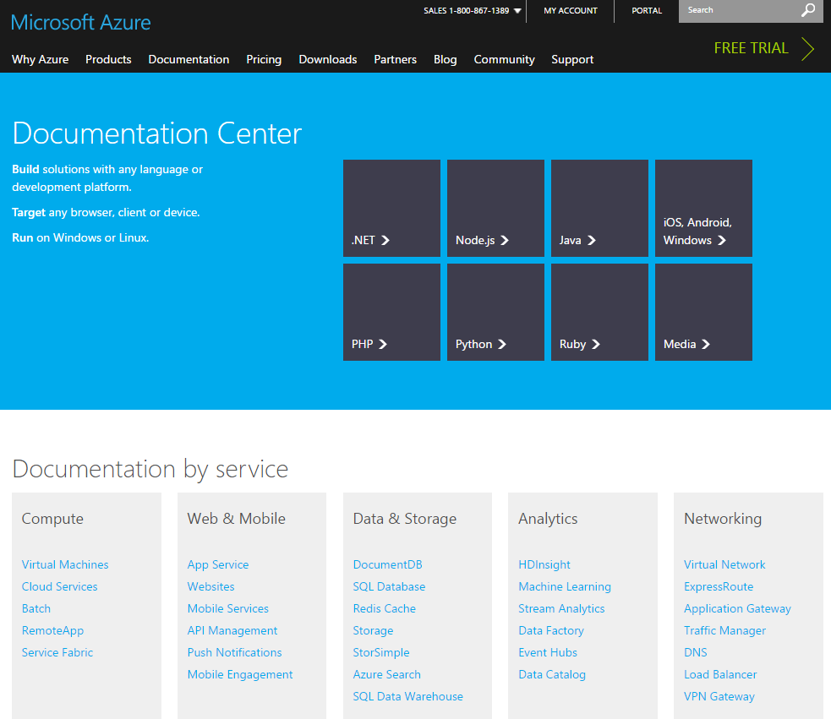




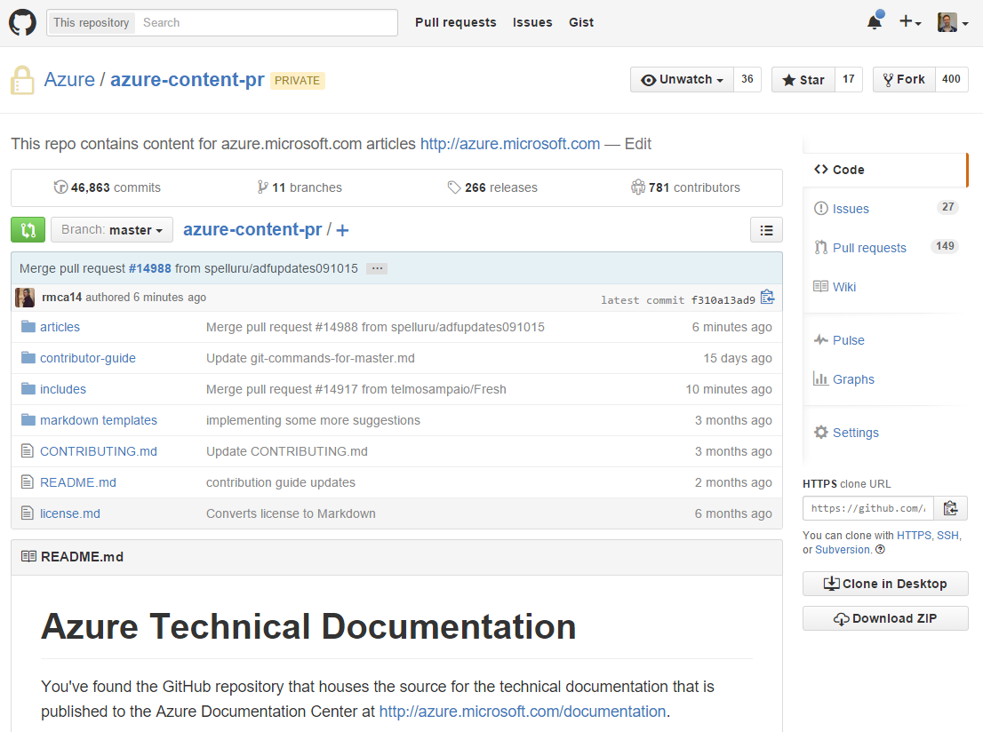

Workflow: internally created content
You create the content in your local clone of the private GitHub repository
push
*diffs
https://github.com/<account>/azure-content-pr
Your GitHub fork of the private repository
Live site: https://azure.microsoft.com/documentation/articles
push
Azure-content-pr/master
*diffs
Pull request
merge
DPS
Publishing, run by PubDesk
Automated quality validation
Staging for review
Feedback from pull request reviewer

Slide 4
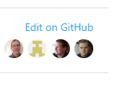
Azure-content-pr/master
DPS
(Private repo)
Live site: https://azure.microsoft.com/documentation/articles
https://github.com/<account>/azure-content
Pull request
PubDesk creates a PR from public to private
Customer submits changes through their GitHub fork
Workflow: external contributions
Community can modify articles in the GitHub public repository
Azure-content/master
Pull request
Proposed changes are sent to author for review
Feedback/communication to contributor
Thank contributor
(Public repo)

Slide 5


Your individual workflow
Pull request
Azure/azure-content-pr
your_account/azure-content-pr
UPSTREAM (repository)
ORIGIN (your fork)
*diffs
git pull upstream
git push origin
*diffs
Your local clone of azure-content-pr

Slide 6
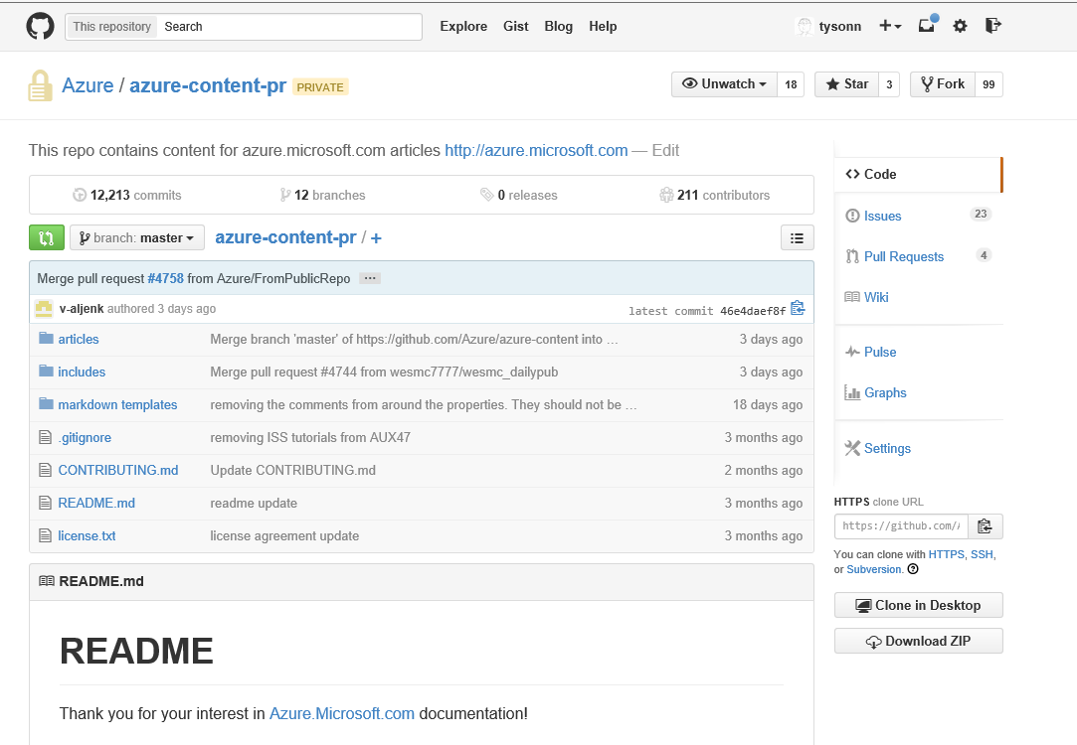
The GitHub UI
Tells you which org, repository, and fork you are looking at.
1. Tells you which org, repository, and fork you are looking at.
The list of branches that exist in the repository.
2. The list of branches that exist in the repository.
5. Click here to view or file a pull request.
All our articles live in this folder.
3. All our articles live in this folder.
Markdown templates are stored here.
6. Markdown templates are stored here.
All our reusable content lives in the “includes” folder.
4. All our reusable content lives in the “includes” folder.
Contributing.md lists all the commands for normal workflow.
7. Contributing.md is the overview topic in our contributors’ guide.

Slide 7
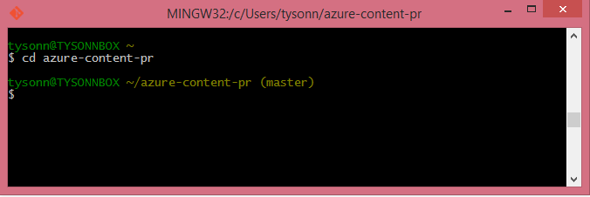
Git Bash
Updated 10/28/2014
The command line tool you use to interact with the core repo, your forked repo, and the local copy of your fork. You use it to pull content from and push content into branches in all of these places.
You usually have to change (cd) into the repository folder on your local computer.
The local working branch is listed in parentheses. The default is usually “master”. Work only in master if you want your changes to be published to the live site.

Slide 8
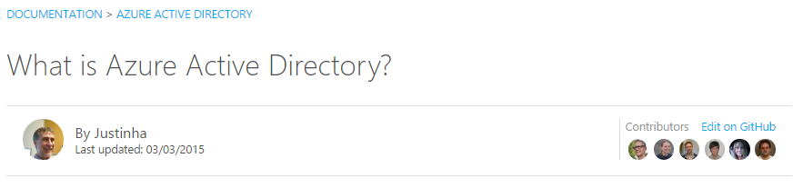
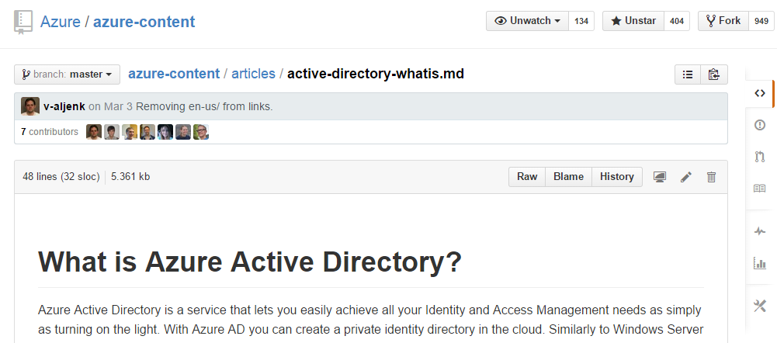
Quick text-only changes
You can use the UI.
Go to the article you want to modify.
Click the Edit on GitHub link.
Click the edit button.
Limitations of the UI:
You can’t work with images.
You can’t resolve merge conflicts.
You won’t learn the git commands. The git commands offer way more functionality.

Slide 9
Working with articles using Git commands and a markdown editor
DEMO
git pull upstream master
git checkout YOURBRANCH
Do work
git status
git add --all
git commit -m “Message that everyone will see!”
git push origin YOURBRANCH
Go to github and create a PR!

Slide 10
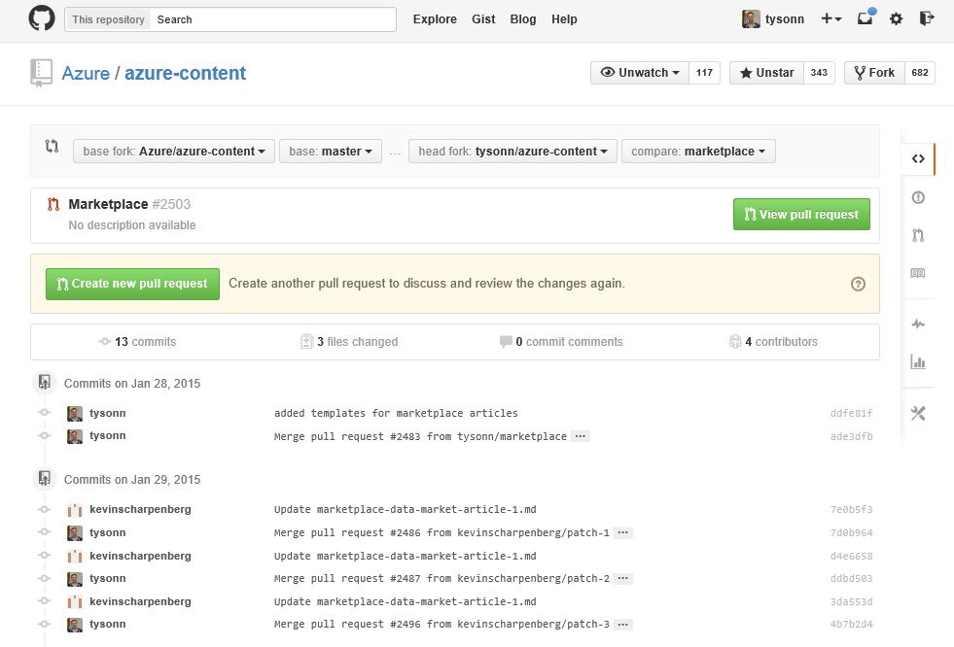
Pull request
On the left, you select where you want to move the changes to. Usually, it is to the upstream repo.
On the right, you select the source of the changes. Usually, this is your fork and a branch in your fork.
You move changes from one branch to another using a pull request.
All pull requests must be reviewed and accepted by a pull request acceptor.
Pull requests protect the repo’s integrity.
Pull requests are reviewed by a designated person on the content team. Expect feedback!

Slide 11
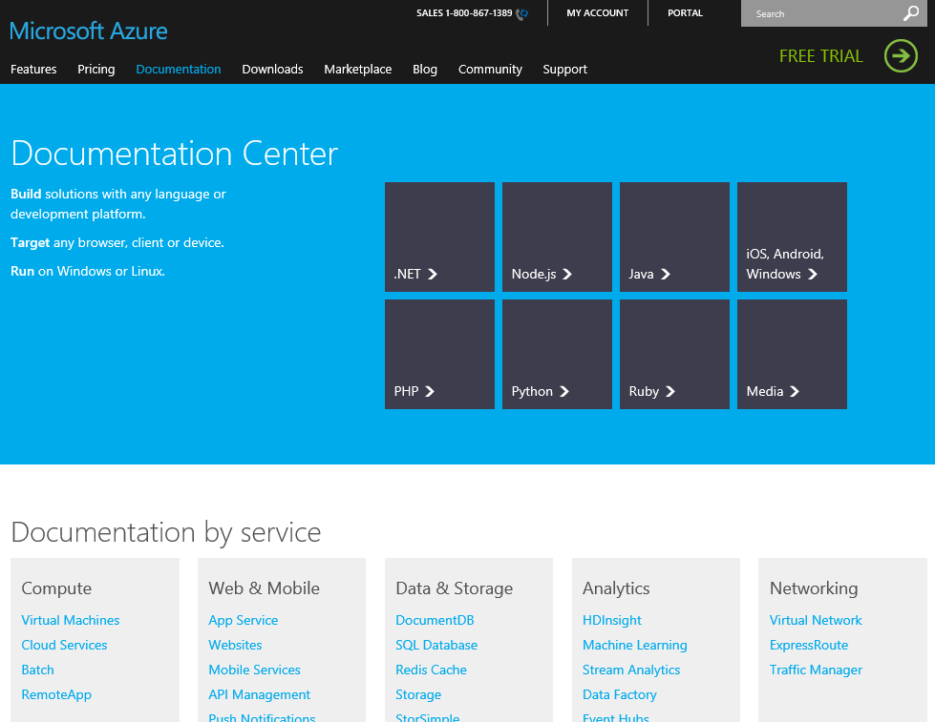
Publishing
Any content present in the master branch of azure-content-pr is published live at 10 AM and 3 PM Monday - Friday.
Pull requests have to be accepted before the content can be published.

Slide 12

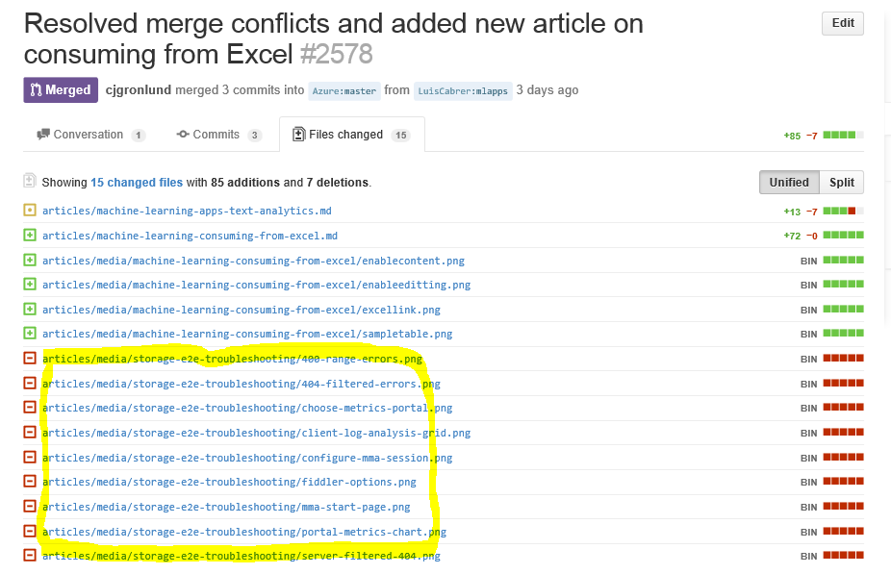
Check your pull requests in GitHub
Content loss can occur in our repo if correct processes are not followed.
Review your pull requests CAREFULLY when you submit them.
If there are unexpected files listed, cancel the pull request and troubleshoot.
Ask a peer to review your pull request prior to official review by a pull request reviewer.
Resolve all validation issues called out by the validation bot.
Check comments for feedback on your pull requests.
What are you supposed to look for? Files that are in the change list that you did not intend to change.

Slide 13
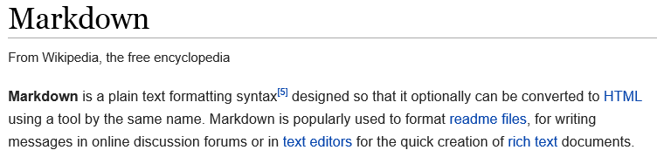
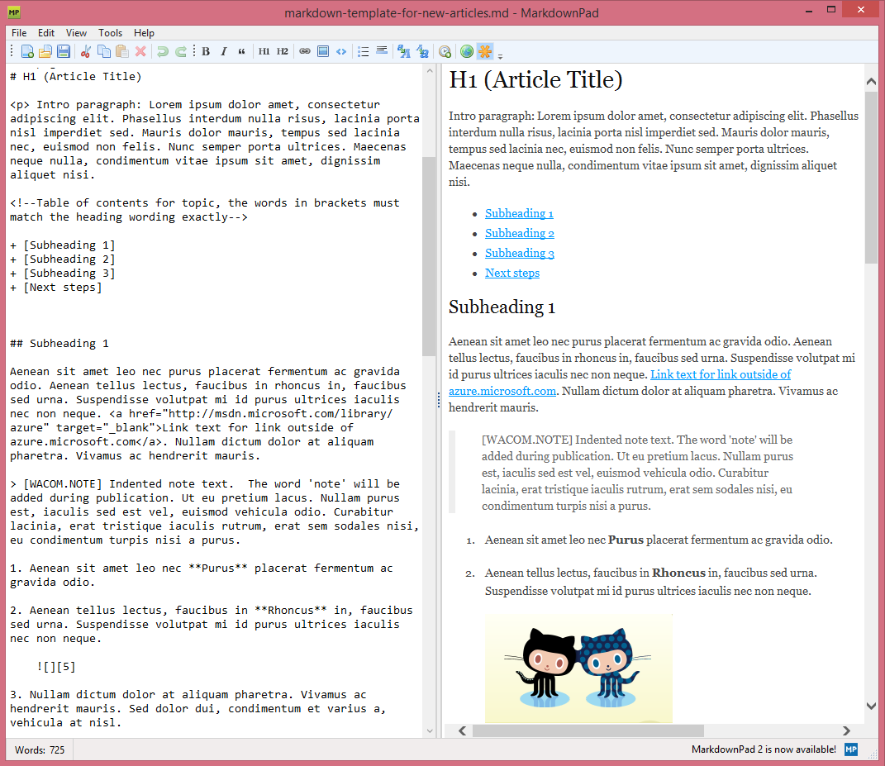
Creating and editing articles
We use Markdown to format content.
We use GitHub flavored markdown.
We use Atom to edit articles.
You can create new articles directly in Windows Explorer, Atom, or at the command line.
We have a template article with common formatting so you can learn markdown by using it.
Special things like notes, videos, and other elements are enabled by extensions. See the extensions wiki topic for details.
To add images, you must create a folder in the “media” folder for each article, and then put your images in that folder. The folder name must be identical to the topic name. Each topic must have it’s own image folder – do not share images across topics.
More info – see the contributors guide.

Slide 14
Understand what you’re getting into
When you publish an article, it’s like having a child – you are committing to a long term effort around the article.
You’ll review and update articles every 3 months to ensure they are fresh.
You’ll monitor and respond to Disqus comments on articles.
You’ll review customer feedback submitted through the site and make improvements to address the feedback.
Content Freshness KPI
 Most Fresh (0-60 days)
 Fresh (61-90 days)
 Stale (91-120 days)
 Abandoned (121 days +)

Slide 15
Next steps
Set up your GitHub account and install the tools: Tools and setup for authoring in GitHub
External facing contributors’ guide: https://github.com/Azure/azure-content/blob/master/contributor-guide/contributor-guide-index.md
Internal wiki: https://microsoft.sharepoint.com/teams/azurecontentguidance
A more complete version of this deck is available: Azure content onboarding​

