Slide 1
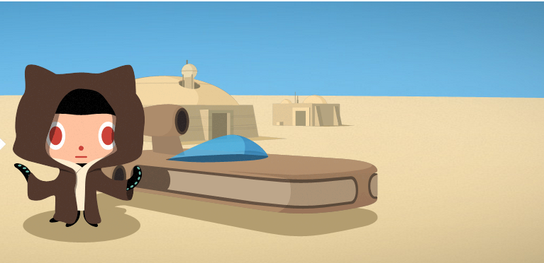
Content Authoring on Docs Tools Overview
microsoft confidential

Slide 2
Prerequisites
This training assumes you have completed this subset of steps from the Tools and Setup guide:
Created a Microsoft-specific Github account
Completed your Github profile
Enabled multifactor authentication for your Github Account
Connected to the Microsoft org
Installed and configured Git tools
Installed a markdown editor
This training will use the Docs repo, found at https://github.com/Microsoft/Docs.

Slide 3
GitHub & GitHub Terms
Git | An open-source version control system.
GitHub | A company that provides open source code repository hosting as a service. We are using their service as a content management system. GitHub is built on top of Git. To interact with GitHub, you can use their web interface (github.com) or install tools such as Git bash locally.
repository (repo) | A discrete project in GitHub. Docs.ms repos are within the “Microsoft” org, and are either external-facing public repos (e.g. Azure-RMSDocs) for customers and infrequent contributors, or internal-only private repos (e.g. Azure-RMSDocs-pr) for contributors inside of Microsoft.
fork | Your personal copy of a repository in GitHub; for instance, the Azure-RMSDocs-pr fork for github user “msmbaldwin” would be found at https://github.com/msmbaldwin/Azure-RMSDocs-pr. A user has full permission to his fork and restricted permissions for the main repo, which allows
clone | The local copy of your fork on your computer.
“origin” | An alias set to the Github source of a clone. If github user msmbaldwin cloned his fork of Azure-RMSDocs-pr, “origin” would be set to https://github.com/msmbaldwin/Azure-RMSDocs-pr.
“upstream” | An alias set to the original repo from which the fork (and clone) were created. If github user msmbaldwin cloned his fork of Azure-RMSDocs-pr, “upstream” would be set to https://github.com/Microsoft/Azure-RMSDocs-pr.
branch | A working version of a repository, allowing you to make changes without modifying the main “master” branch. You will typically work in a branch of your clone of a fork
merge | To integrate the changes made in one branch into another branch. After making changes in your working branch, for instance, you will use a “pull request” (see below) to ask that they be merged into the master branch of the original repo. Two or more sets of changes that modify the same content trigger a “merge conflict”, which much be resolved.
pull request | The mechanism by which you “request” that a branch (typically the master branch of the original repo) “pull” in the changes you made in your working branch. If a PR is accepted, the changes will be merged.
See more git and github terminology at the Github Glossary.

Slide 4

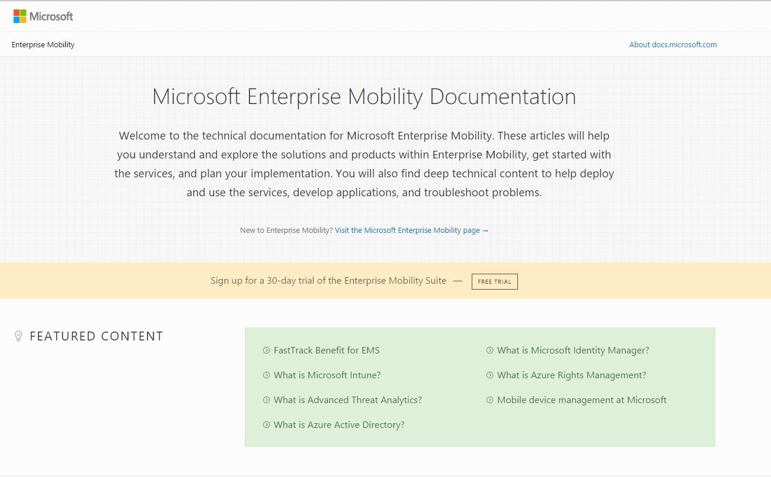



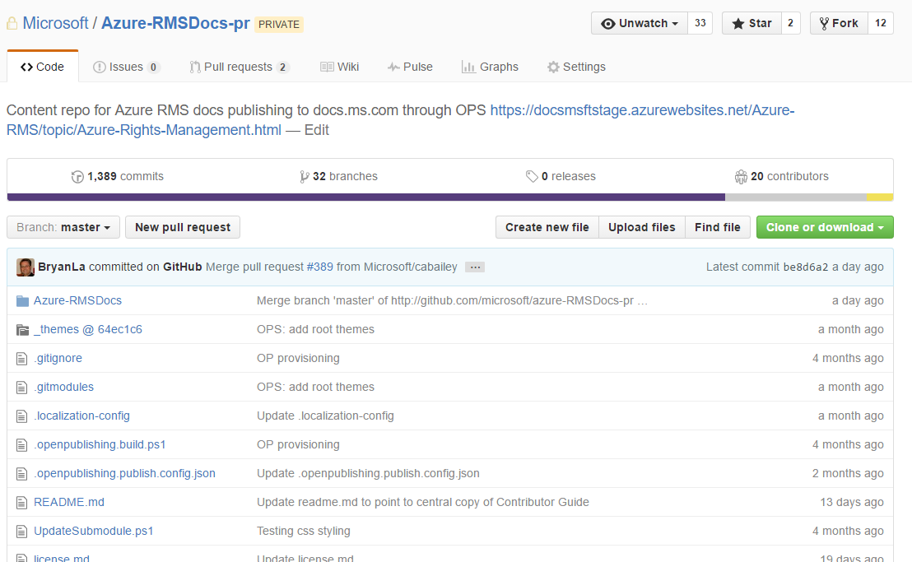

Workflow: internally created content
You create the content in your local clone of the private GitHub repository
push
*diffs
https://github.com/<account>/Azure-RMSDocs-pr
Your GitHub fork of the private repository
Live site: https://docs.microsoft.com/
push
Azure-RMSDoc-pr/master
*diffs
Pull request
merge
OPS
Publishing, run by PubDesk
Automated quality validation
Staging for review
Feedback from pull request reviewer

Slide 5


Your individual workflow
Pull request
Microsoft/Azure-RMSDocs-pr
your_account/Azure-RMSDocs-pr
UPSTREAM (repository)
ORIGIN (your fork)
*diffs
git pull upstream
git push origin
*diffs
Your local clone of Azure-RMSDocs-pr

Slide 6
The GitHub UI
Tells you which org, repository, and fork you are looking at.
The list of branches that exist in the repository.
Provides the URL to clone
Click here to create a new PR
All our articles live in this folder.

Slide 7
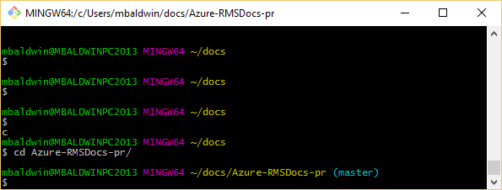
Git Bash
Updated 10/28/2014
The command line tool you use to interact with the core repo, your forked repo, and the local copy of your fork. You use it to pull content from and push content into branches in all of these places.
You usually have to change (cd) into the repository folder on your local computer.
The local working branch is listed in parentheses. The default is usually “master”, but contributors should work in their own branch.

Slide 8
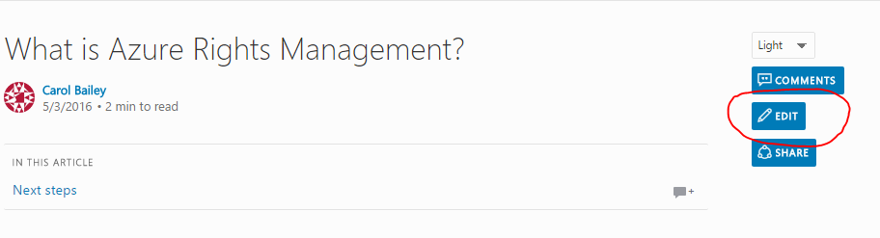
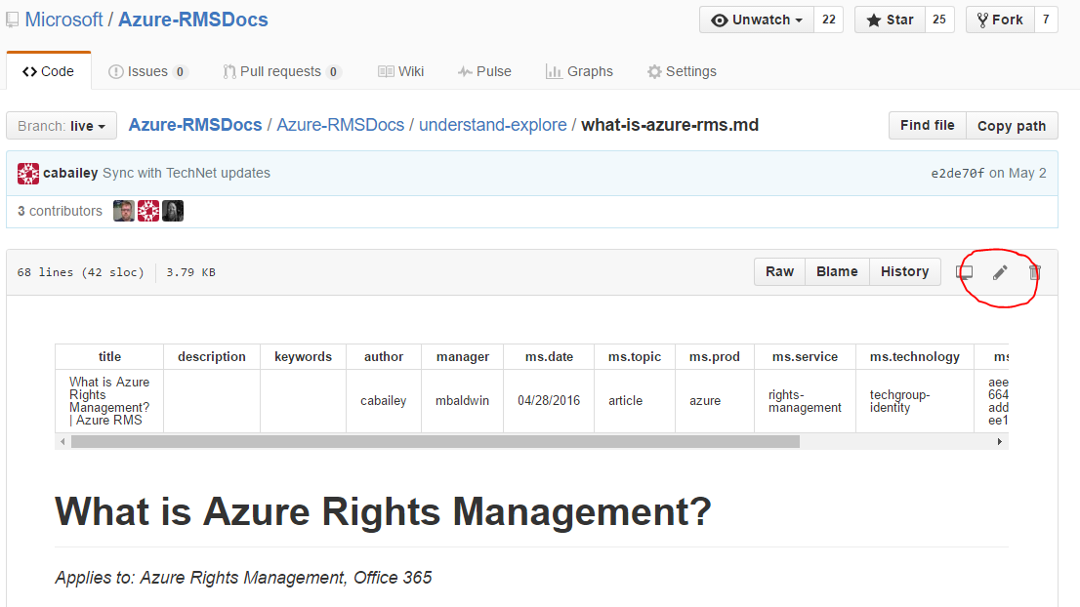
Quick text-only changes
You can use the UI.
Go to the article you want to modify.
Click the Edit on GitHub link.
Click the edit button.
Limitations of the UI:
You can’t work with images.
You can’t resolve merge conflicts.
You won’t learn the git commands. The git commands offer way more functionality.

Slide 9
Working with articles using Git commands and a markdown editor
DEMO
git pull upstream master
git checkout YOURBRANCH
Do work
git status
git add --all
git commit -m “Message that everyone will see!”
git push origin YOURBRANCH
Go to github and create a PR!

Slide 10
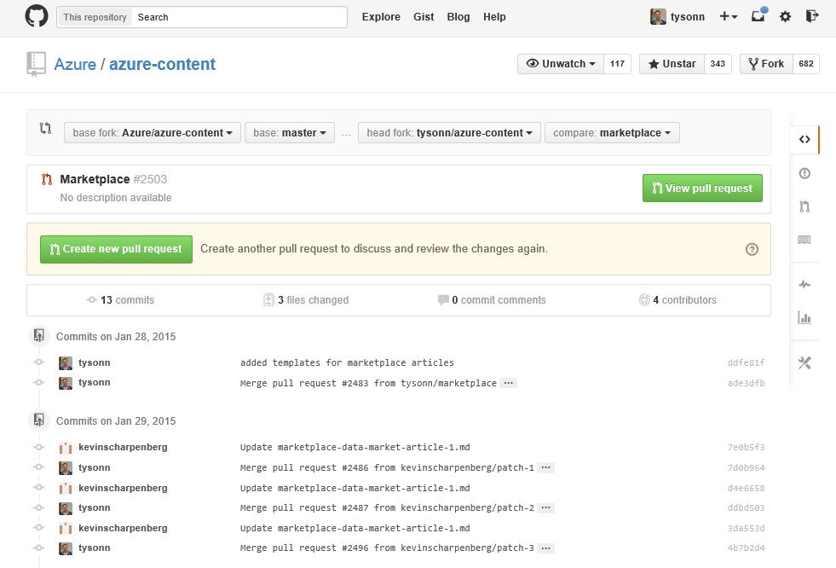
Pull request
On the left, you select where you want to move the changes to. Usually, it is to the upstream repo.
On the right, you select the source of the changes. Usually, this is your fork and a branch in your fork.
You move changes from one branch to another using a pull request.
All pull requests must be reviewed and accepted by a pull request acceptor.
Pull requests protect the repo’s integrity.
Pull requests are reviewed by a designated person on the content team. Expect feedback!

Slide 11
Publishing
Any content present in the master branch of a private repo is published live at 10 AM and 3 PM Monday - Friday.
Pull requests have to be accepted before the content can be published.

Slide 12

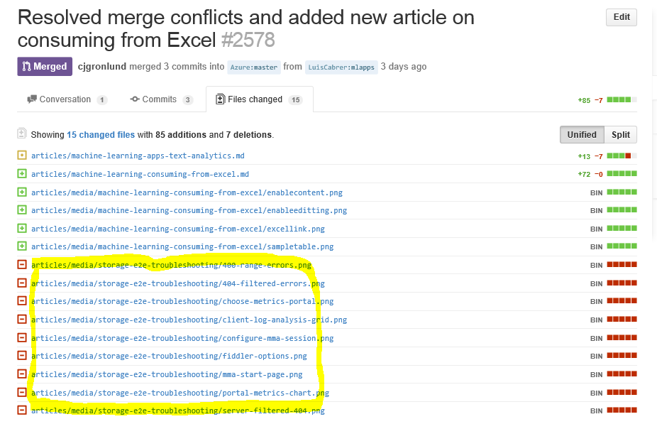
Check your pull requests in GitHub
Content loss can occur in our repo if correct processes are not followed.
Review your pull requests CAREFULLY when you submit them.
If there are unexpected files listed, cancel the pull request and troubleshoot.
Ask a peer to review your pull request prior to official review by a pull request reviewer.
Resolve all validation issues called out by the validation bot.
Check comments for feedback on your pull requests.
What are you supposed to look for? Files that are in the change list that you did not intend to change.

Slide 13
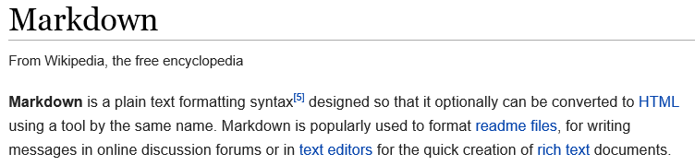
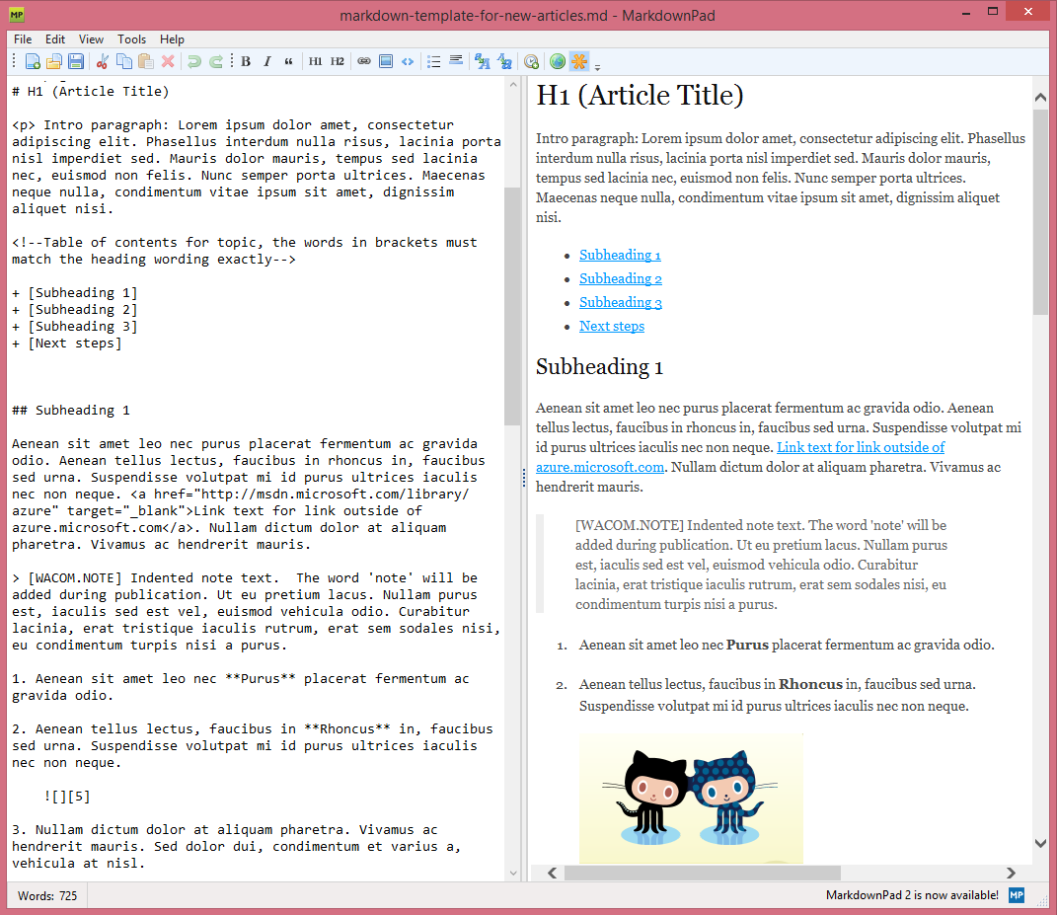
Creating and editing articles
We use Markdown to format content.
We use GitHub flavored markdown.
You can use whatever editor you prefer (we recommend ATOM)
You can create new articles directly in Windows Explorer, Atom, or at the command line.
We have a template article with common formatting so you can learn markdown by using it.
Special things like notes, videos, and other elements are enabled by extensions. See a template article for syntax.
To add images, you must create a folder in the “media” folder for each article, and then put your images in that folder. The folder name must be identical to the topic name. Each topic must have it’s own image folder – do not share images across topics.
More info – see the contributors guide.

Slide 14
Understand what you’re getting into
When you publish an article, it’s like having a child – you are committing to a long term effort around the article.
You’ll review and update articles every 3 months to ensure they are fresh.
You’ll monitor and respond to LiveFyre comments on articles.
You’ll review customer feedback submitted through the site and make improvements to address the feedback.
Content Freshness KPI
 Most Fresh (0-60 days)
 Fresh (61-90 days)
 Stale (91-120 days)
 Abandoned (121 days +)

Slide 15
Next steps
Set up your GitHub account and install the tools: Tools and setup for authoring in GitHub
External facing contributors’ guide: https://github.com/Azure/azure-content/blob/master/contributor-guide/contributor-guide-index.md
Internal wiki: https://microsoft.sharepoint.com/teams/azurecontentguidance
A more complete version of this deck is available: Azure content onboarding​

