Slide 1
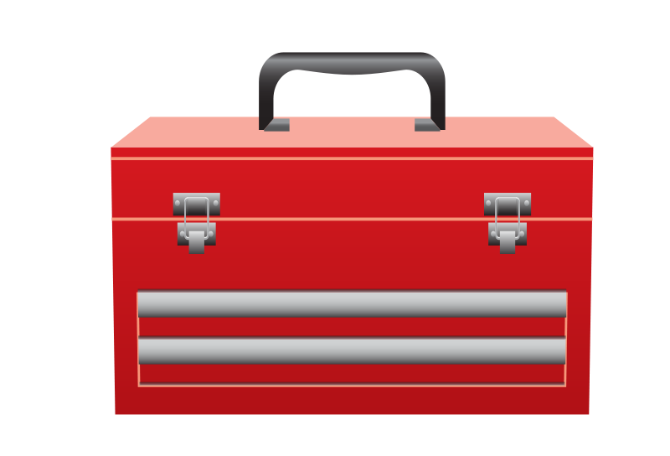
Azure Technical Content Contributor Training
Tyson Nevil
Updated 10/7/2015

Slide 2

Azure boot camp – what to expect
Sessions 1 and 2: Overview of content channels, site structure, and the basics
Session 3 – Understanding GitHub and the tools, and watch a demo of how to create a new article
Session 4 – Nuts and bolts (the details) of writing technical articles for Azure

Slide 3
Today we’ll talk about…
Content channels and structure (IA)
Authoring
Publishing
Community engagement
Metrics and freshness
Information sharing

Slide 4
Content channels and structure (IA)

Slide 5
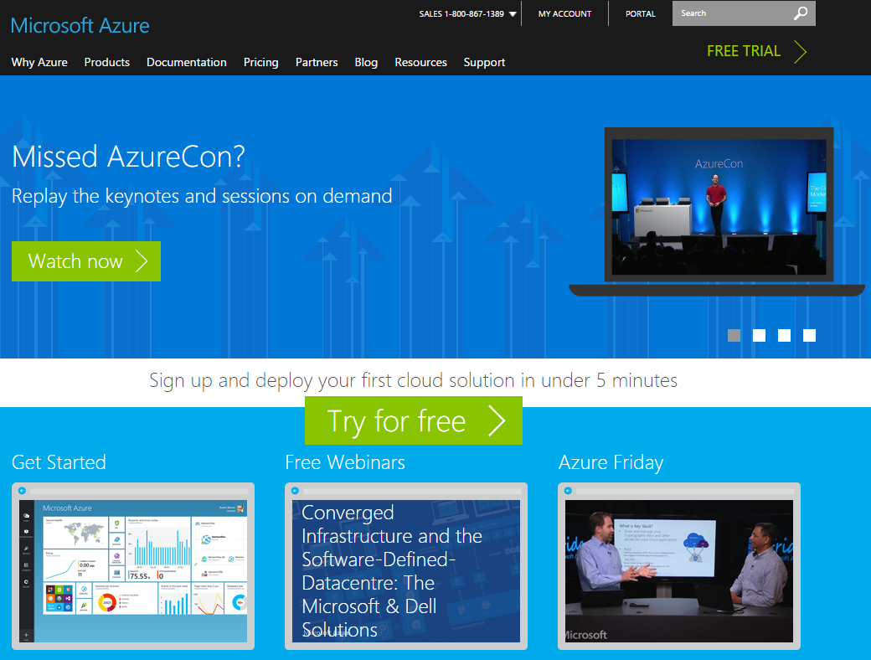
Azure.microsoft.com (aka “ACOM”)
Integrated product site for marketing content, technical content, pricing, videos, samples, support, and other content.
The content is sourced from multiple GitHub repos:
ACOM: GitHub repository for content that is built in Visual Studio (marketing content, landing pages, left navigation, learning paths). This content is not available for public contributions.
azure-content-pr: Technical documentation, open for public contributions.
Azure-Samples: Samples, open for public contributions.

Slide 6


What Goes Where?
azure.microsoft.com (the Front Door + all conceptual) | Windows Azure scoped library on MSDN (Reference only) https://msdn.microsoft.com/en-us/library/azure/dn578280.aspx | Azure blog (Driving awareness/ Official source of news)
Service documentation landing pages for public services that have a management portal UI: VM, HDInsight, SQL Database, etc. Developer documentation centers: .NET, Java, Mobile, etc. All conceptual, procedural and tutorial content | Reference content only .NET managed class library reference REST API reference (REST API reference (use REST API Topic Template in Dx) Windows JavaScript and C++ API reference (APIs for Windows Store and the newer Windows Universal apps) Windows PowerShell cmdlet reference | Product and feature promotions and announcements. Can include “how-to” information, but blog post should point to documentation if available. New content and new sample announcements. Niche content – content covering uncommon edge cases that don’t fit well into our standard documentation. Content with a very short life span or period of relevance. Posts that address sore points, that debunk misconceptions, that are short and helpful, or that speak to issues we are seeing in social listening. Workarounds for things that are not yet officially supported (not troubleshooting) .
Non .NET reference
Open source SDK reference documentation is published using language-specific tools to GitHub.io (Java, Node, Android, iOS, Python, PHP, Ruby, etc). Example: http://azure.github.io/azure-sdk-for-node/
Samples |  | Videos
All Azure samples belong in the ACOM samples gallery: https://azure.microsoft.com/en-us/documentation/samples/ |  | All Azure videos must be on Microsoft’s Channel 9 and integrated into the ACOM site using the acomportal video registration tool.
Core Azure vs. Hybrid Scenario Content
Content that is focused primarily on Azure services belongs in Azure-branded content channels. Content that is created to support hybrid scenarios and that is created primarily from the perspective of the on-premises technology belongs with the on-premises technology content.
Updated 10/7/2015

Slide 7





What are the standard deliverables for a service, and who is accountable for them?
Azure blog post
Hero Tutorial(s)
Service description page
Documentation landing page + left navigation
Designated content developers, PM partners, and other internal or external partners
Additional conceptual and tutorial content, troubleshooting (if resourced)
Marketing product manager
Pricing page
Designated content developer (Cpub), web team
Forum
Reference content
(if resourced)
Marketing product manager
The PM team is collaborating across all these areas, and each new service has a single “onboarding PM” who is on the hook from the PM side to ensure everything – software and content – is delivered.

Slide 8
Authoring

Slide 9
Is your content a doc article?
Documentation articles:
Are procedural, tutorial, best practices -- technical content
Are targeted at developers & IT Pros
Are available for community contributions through GitHub
Have Disqus comment threads that you must monitor and respond to
Many other channels in Azure.microsoft.com
Pricing & marketing pages, Service Updates, Blog, Regions, Feedback, Events, Video Center, etc. This content does not go in the tech content repo.
If in doubt, ask before contributing. The technical content channel should not be treated as a channel of convenience.

Slide 10
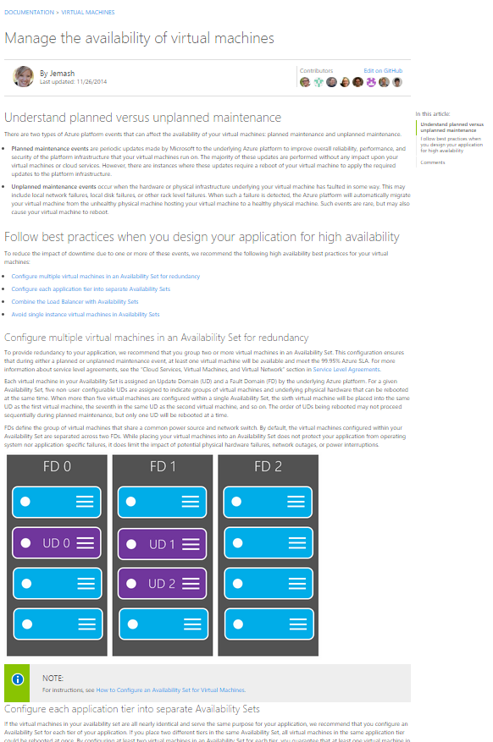
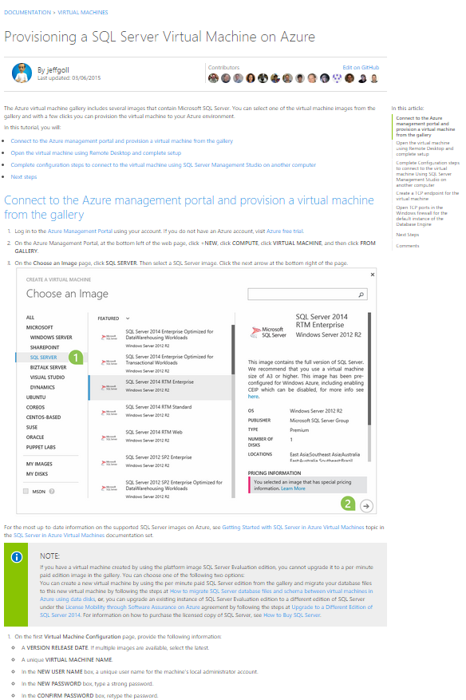
Characteristics of a good article
The article can stand alone on the web as a unit. It addresses a real customer information need, scenario, or problem.
Articles should be visually appealing. What does that mean?
Include code snippets and samples as appropriate
Useful, meaningful UI images
Diagrams or other images that help the customer understand something at a glance
Tutorials are the preferred deliverable
Supplement conceptual with diagrams if possible
Avoid creating “wall-of-text” articles
Good articles are updated frequently in response to customer feedback and ratings.

Slide 11
What tools do I use with each channel?
Channel | Content Management tools | Authoring tools | Database/ Repository | Resources
ACOM | GitHub and Git Bash | Atom (http://atom.io) | azure-content-pr (aka “the private repo”) azure-content (aka “the public repo”) | Tools and setup for authoring in GitHub Setup using VS and Git
 | Visual Studio | Markdown Mode
Azure Scoped Library (MSDN) | CAPS | CAPS | WS_Azure database Publishing project is WindowsAzure_MSDN | Library and TOC guidelines
Help Drawer (v1 portal only) Final classic portal update: March 3, 2016 | DxStudio | DxEditor | WS_Azure database Publishing project is AzureMPHelpMTPS | Help Drawer onboarding

Slide 12
What are the voice and style guidelines I need to follow?
Core reference resources
Microsoft Azure Style Guide
More…
Microsoft Brand Tools
Microsoft Manual of Style
Marketing, UX design, and other groups are diligent in following the guidance in the Azure Style Guide. Contribute to a consistent customer experience by knowing and following the guidance in the style guide.
Questions? azurestyle@microsoft.com
Advice
Do not use any old Microsoft website as a style guide
Don’t rely on published content on azure.microsoft.com to determine style. See the style guide.
! When you help launch a new service, ensure your service’s information is added to the style guide.

Slide 13
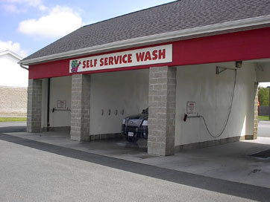
How do I get training and support for the tools?
Training for GitHub relies on a self-service and peer support model. See “Install and Prepare for Authoring with GitHub” and the README.md in the contributors’ guide.
Publishing problems – articles are not publishing or published incorrectly – file a pub desk ticket in the OneView TFS system, under Engineering/Pub Desk.
Validation and staging problems – see the troubleshooting topic on the wiki first, then file a pub desk ticket if you are stuck.
Other problems:
Step 1: Search the public contributor’s guide and the internal wiki. Test things yourself. Search the web and particularly StackOverflow for git commands.
Step 2: Contact your teammates to see if they can assist.
Step 3: If your teammates can’t help, contact the larger community of authors using the azcontentchat alias.

Slide 14
Publishing

Slide 15
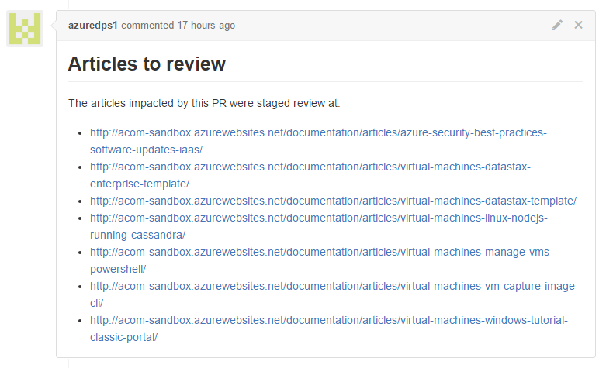
Staging
To publish live from GitHub, you must file a pull request to move the content into the master branch.
Whenever you create a pull request to the master branch, the updates are automatically staged.
Staging links are automatically written into the pull request comments within 15 minutes of submitting the pull request.

Slide 16




How does publishing work?
ACOM and MSDN are separate publishing streams.
MSDN publishing runs from CAPS, and each author controls publishing in CAPS.
ACOM publishing occurs Monday-Friday at 10 AM and 3 PM. Updates can take up to 30 minutes to appear. Publishing is run by the Pub Desk.
You are your own release manager and you must track your own milestone release dates.
ACOM live site
Master (branch)

Slide 17
Community engagement

Slide 18
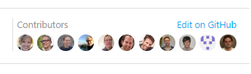
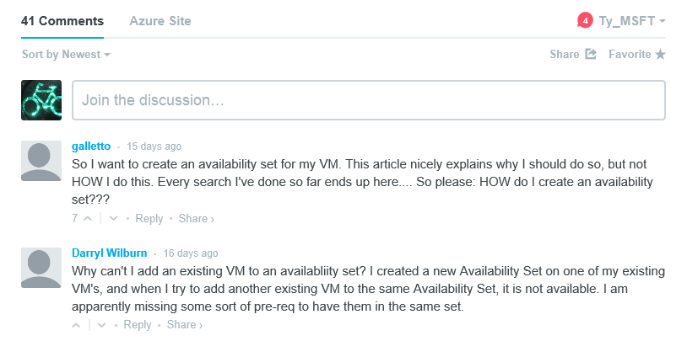
What is our open authoring and community strategy?
Disqus Comments Every published technical topic has a unique Disqus comment stream that authors and engineering partners monitor. For details on how it works and how to monitor and respond to comments, see the Disqus FAQ on the wiki. If you publish an article, it’s a requirement that you monitor and respond to the comments.
GitHub Link
Every published technical topic has a link to the GitHub page for the topic. Customers, partners, and engineering partners can contribute updates directly through GitHub.
Internal MSFT Contributors
PMs who want to contribute content author topics in GitHub directly. Content publishing should not be the middleman. Training is self-service using the same resources.

Slide 19
Metrics and freshness

Slide 20


How do I get metrics about my content?
Azure KPIs
For page views and top-level metrics for ACOM documentation, join the C+E Documentation KPI Announcements alias (ce-doc-kpi). Reports are sent every Monday.
Currently, we report the following for Azure content:
Azure services freshness
Azure services ratings
Disqus data
Azure services freshness raw data spreadsheet
The KPIs are reviewed monthly with executive service owners in pillar reviews, and monthly with C+E executive leadership.
MSDN
Use DevUEMetrix to review page views and ratings for library content. Select Azure in the Group box:

Slide 21
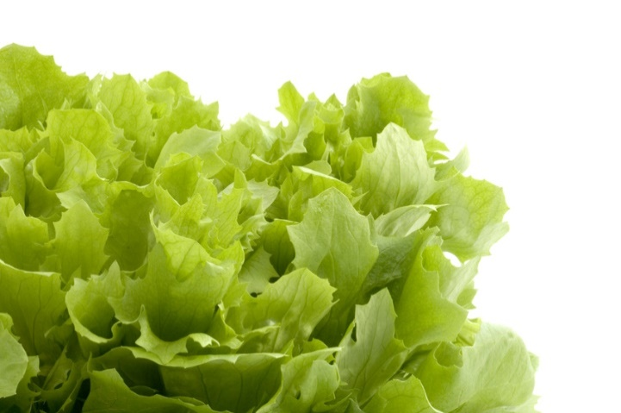
Content freshness
Details
Freshness is calculated based on the date you enter in the ms.date metadata attribute.
Weekly documentation KPI reports are sent to the C+E Documentation KPI Announcements alias (ce-doc-kpi).
You use the raw data to identify individual topics that are stale or about to become stale.
Engineering partners are expected to participate in content freshness for their services.
Take the appropriate action for your stale content:
If the content is fresh as-is, you republish it with a new date value.
If the content needs updates, you update it and republish it with a new date value.
If the content is out of date and you are not resourced to update it, you retire it.
The C+E KPI target for services content freshness is 100% of technical content is reviewed for freshness every three months and updated or retired as appropriate.
For the KPI, content is classified into four categories, based on the last time it was last reviewed:
£ Most Fresh (0-60 days)
£ Fresh (61-90 days)
£ Stale (91-120 days)
£ Abandoned (121 days +)

Slide 22
What’s included in a freshness review?
Understand traffic and content satisfaction ratings so you have an idea of current ‘health’ of the article.
Look at Disqus comments to see if customer comments can inform article updates.
Review the content to determine if it is technically accurate and up-to-date.
Make sure screen shots show the current service UI.
Make sure all links work and go to current and relevant targets.
POKING
Don’t flip the date for small or quick updates. Date updates should reflect full review.

Slide 23
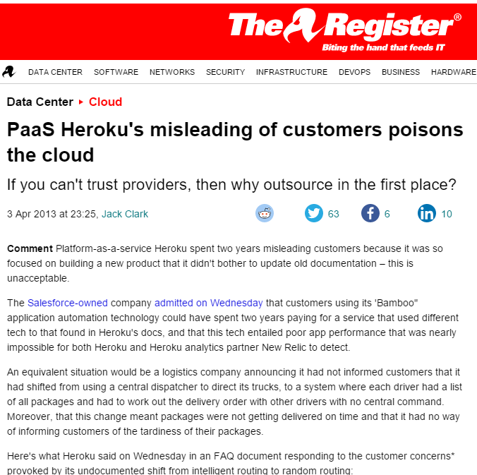
What can happen when you don’t keep content up to date
http://www.theregister.co.uk/2013/04/03/heroku_cloud_fail_blights_industry/

Slide 24
Information sharing

Slide 25
Where we share information
1. Azure weekly update meeting
Required for active Azure content contributors.
Occurs every Monday at 1 PM.
Includes updates on ACOM design, strategy, new site features, publishing features, changes, publishing, and large releases.
If you don’t have the invite, request it from tysonn.
2. The public contributors’ guide in the Azure-Content repository https://github.com/Azure/azure-content
3. The internal Azure Content Guidance wiki
https://microsoft.sharepoint.com/teams/azurecontentguidance/wiki/Pages/Content%20Guidance%20Wiki%20Home.aspx
4. ACOMDocs
For work you have to do in the ACOM repository (doc landing pages, left navs, and learning paths)
http://acomdocs.azurewebsites.net/?audience=contributors

Slide 26

Stay plugged in with the right aliases
wacom-tech-authors: join this alias to receive publishing notifications, content strategy updates, process updates, and ACOM feature updates. Required if you are working on Azure technical content. Only specified senders can mail to this alias.
azcontentchat: Use this optional chat alias to ask questions or to get peer assistance with authoring content.
ce-doc-kpi: Weekly KPI report distribution for freshness, page views, and ratings. Recommended.
azdocprs: Contact this alias if your pull request reviewer is not available and you need a high priority pull request reviewed.
azdoclp: Use this alias to ask questions or to get peer assistance with content updates in the ACOM repository – documentation landing pages, left navigation, and learning paths.

Slide 27
Onboard your partners
Share this presentation – it’s posted to the Azure Content Onboarding topic on the wiki
Boilerplate mail:
Hi <person>,
Anybody at MSFT can contribute technical content for Azure through GitHub. Basically, you create your content in markdown format, upload it to our content repository in GitHub, and then it is published to the tech docs area of the site. Content that is published there is reviewed by its author every 3 months; content that is not reviewed on schedule is removed from the site. We also require that contributors monitor customer comments on the pages and respond to them using Disqus. What’s very cool is that customers can propose changes to your content – so you may be asked to review periodic customer contributions once your article is published. We’ve got information to get you started here:
Tools and setup for authoring in GitHub
Azure technical content contributor’s guide

Slide 28

Next Steps
Session 2: Understanding GitHub, tools, and demo
Session 3: Nuts and bolts - creating content for Azure.microsoft.com – articles, landing pages
Review the contributor’s guide and the wiki for more information

Slide 29






Who owns what on ACOM?
Carol is the cross-team lead for all Azure content efforts in CSI. She works with a designated group of CSI Cpub managers to set Azure technical content strategy and to evaluate all proposed technical content innovations in the Azure space.
Primarily content in these paths: http://azure.microsoft.com/en-us/documentation/
http://azure.microsoft.com/en-us/documentation/articles/
The Azure Cpub manager reps are:
Unlock Insights with Data: Jennifer Hubbard and Paulette McKay
Enable Modern Apps Wade Pickett and David Wrede
Transform the Datacenter Adina Hagege and Tim Teebken
Enterprise Mobility Terry Lanfear and Matthew Baldwin
James is accountable for the overall site experience. He leads the website team responsible for development of the entire azure.microsoft.com website. Carolz is CSI’s primary contact point with James. All of http://azure.microsoft.com
Needs update
Peter is the product manager who oversees all marketing content on ACOM. He provides guidance to product managers for individual services. Your service product manager works closely with him. If you have suggestions for service or pricing pages, you would provide them to your product manager. Everything under:
http://azure.microsoft.com/en-us/services/
http://azure.microsoft.com/en-us/pricing/
Elena runs ship room for ACOM. Carol and Carolyn Gronlund work with Elena to prioritize Cpub requests made through the web team’s VSO in ship room.
Jennifer is responsible for driving publishing infrastructure improvements for ACOM, in partnership with the Azure web team.

Slide 30
What’s the lifecycle of an ACOM Article?
Vet idea and content with stakeholders
Create MD file and submit pull request into the appropriate branch
Vet idea and content with stakeholders
Review the content of the pull request, validate the file name complies with guidance, provide guidance on merge conflicts, and verify correct branch and repository are being used. Accept or reject the pull request.
Topic Idea
Review the content of the pull request, validate the file name complies with guidance, provide guidance on merge conflicts, and verify correct release branch and repository are being used. Accept or reject the pull request.
Topic Idea
Identify appropriate crosslinking opportunities
Identify appropriate crosslinking opportunities
Author
Author works with Cpub team, other authors, the managing editor, and others
Address any issues with pull request, then resubmit
Address any issues with pull request, then resubmit
Author & Editor, other stakeholders as appropriate
Needs update
Author
Pull request acceptor
Note: Author and Editor refer to the person who has the knowledge and tool perms to perform the required tasks, regardless of actual title or role in the org. An author is the technical SME who writes the topic. An editor is a person who is responsible for landing page curation and who manages pull requests in GitHub.
Review the publishing schedule for deadline for final changes, and submit pull request by specified deadline.
Review live articles, verify crosslinks and formatting work.
If you discover issues you cannot fix, contact wacom-tech-authors for advice. If you still cannot resolve issues, file a work request to the pub desk in the OneView /Engineering TFS.
Update topic as necessary using the DailyPub branch or the appropriate release branch.
Update topic as necessary using the DailyPub branch or the appropriate release branch.
If a topic appears in monthly content freshness reports as stale, update the content, reset the date on it, or retire it if you are no longer able to maintain it or if the content is no longer relevant
If a topic appears in monthly content freshness reports as stale, update the content, reset the date on it, or retire it if you are no longer able to maintain it or if the content is no longer relevant
Author
Author
Author
Author
Author

