Slide 1

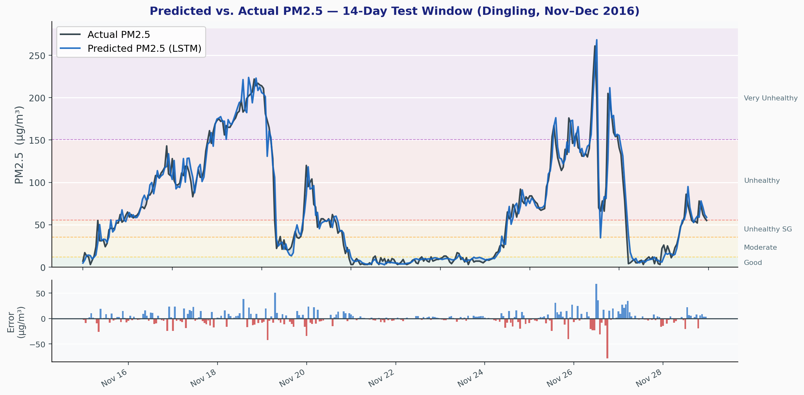
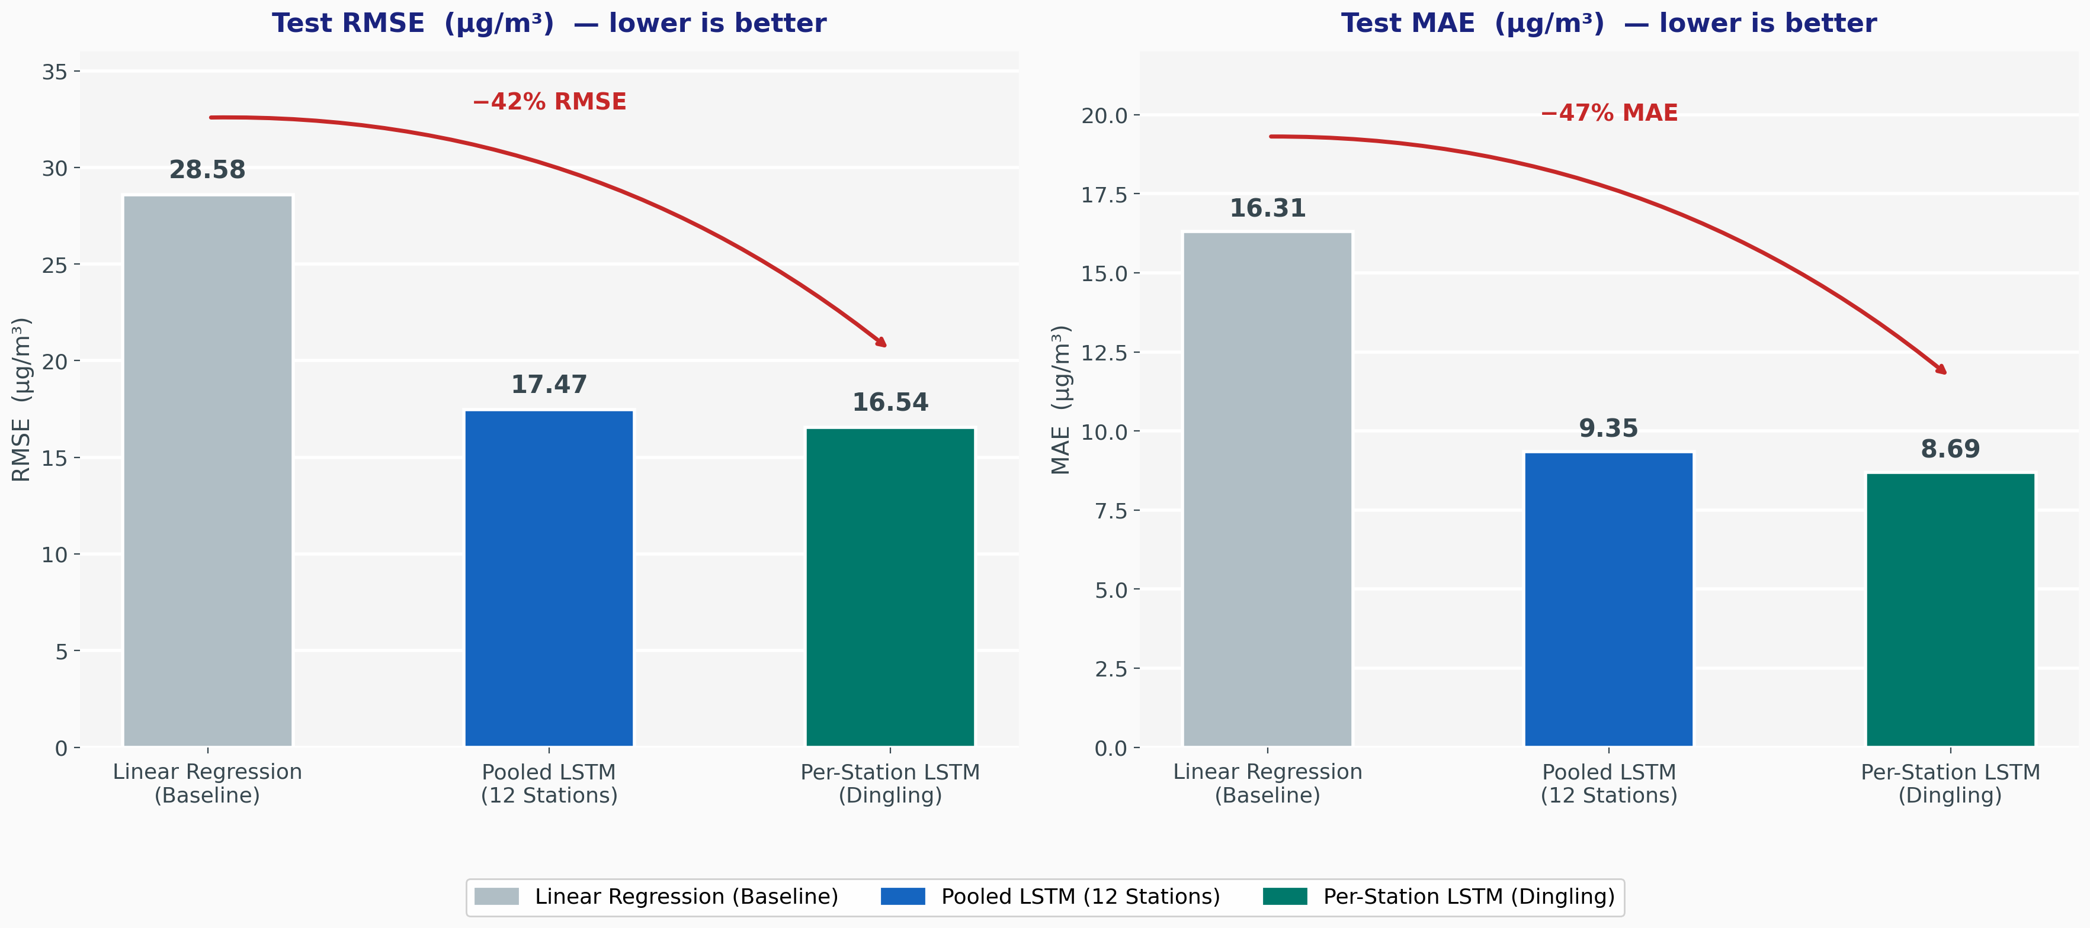
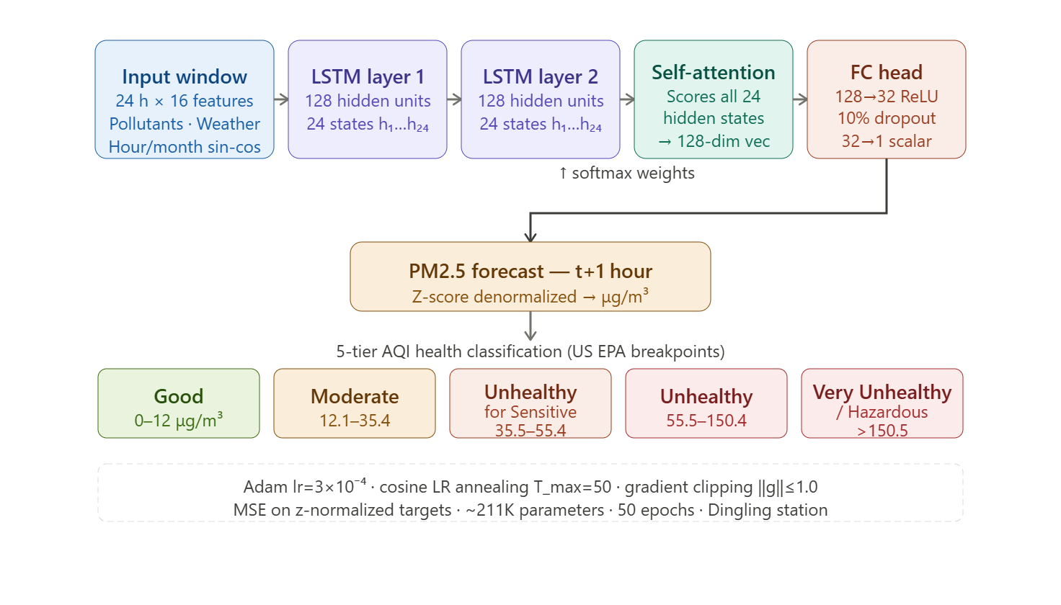
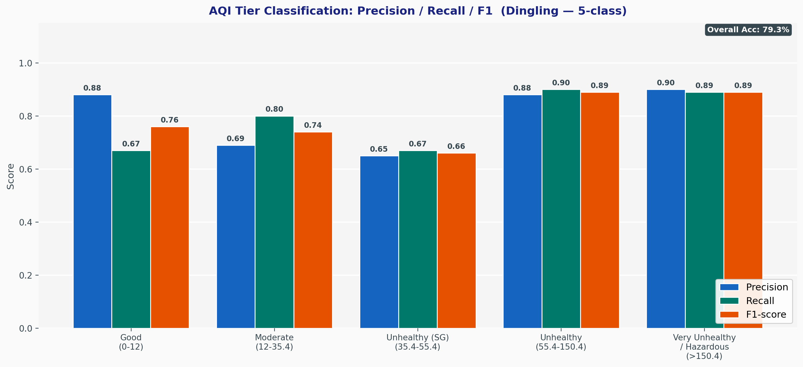
AI Student Symposium 2026
ECE 542
NNDL.101
Forecasting Urban Air Quality
Key Results
Problem Statement
Adam Davis, Austin Jenkins, Sebastian King
Fine particulate matter (PM2.5) is among the most hazardous airborne pollutants with WHO estimating 7M+ premature deaths per year attributed to air pollution
Beijing's rapid industrialization creates extreme PM2.5 variability (daily swings of 100+ μg/m³), making accurate short-term forecasting essential for public health alerts, urban planning, and individual protective action
Goal: Build an LSTM-based forecasting model that predicts PM2.5 concentration one hour ahead from multi-sensor environmental inputs, enabling real-time 5-tier AQI health risk classification
16.54
RMSE ug/m3 (best)
8.69
MAE ug/m3 (best)
79.3%
AQI 5-tier accuracy
42%
RMSE reduction vs baseline
Data
Beijing Multi-Site Air Quality Dataset [1] includes data at 12 stations across Beijing from March 2013 to February 2017
420,768 hourly observations, 16 features: PM2.5, PM10, SO2, NO2, CO, O3, Temp, Pres, Dew, Rain, Wind, Hour/Month (sin/cos encoded)
Temporal split: Train Mar 2013 to Apr 2016 (77%), Test Apr 2016 to Feb 2017 (23%)
Approach
Preprocess: Interpolate missing values, encode wind direction (deg), sin/cos encoding hour & month, StandardScaler on input features, z-score normalize target
Sliding window: 24-hour input sequence predicts PM2.5 at t+1,
Baseline model: Linear Regression on input features
LSTM models: Pooled (all 12 stations) then per-station (Dingling, lowest variance); 2-layer LSTM with temporal self-attention
Evaluation Plan and Results
Metric selection: RMSE chosen as it penalizes large errors, crucial for underpredicting hazardous air pollution. MAE provides a less outlier sensitive complement to RMSE
Model output: The result of the dual LSTM layer model with temporal self-attention and a fully-connected head is a single scalar value representing the predicted PM2.5 concentration (μg/m³) 1 hour into the future
AQI tier classification: AQI tier classification was derived post-hoc by bucketing continuous predictions into the five US EPA PM2.5 categories. No separate classification head was trained, so tier accuracy directly reflects the quality of the regression
Understanding the error rates: The per-station LSTM (RMSE 16.54) outperforms the pooled model (RMSE 17.47) despite training on roughly 15x less data, the pooled model's larger capacity and station embeddings cannot fully compensate for the spatial differences between the stations throwing off predictions
Network Architecture
Baseline comparison: The 42% RMSE reduction from LR indicates the strength of temporal memory in the LSTM by not isolating each 24-hour sliding window
Classification takeaways: Strong F1 on Unhealthy and Very Unhealthy are the most important result; the model is reliable when health stakes are high
Implications & Next Steps: The per-station result confirms that spatial differences across Beijing are large enough that our single shared model pays a meaningful accuracy penalty. To improve it, an approach could be spatial encoding of the various Beijing stations w.r.t. one another via a graph neural network layer
Main References
[1] Zhang, S. et al. Beijing Multi-Site Air Quality Data Set. UCI ML Repository. https://archive.ics.uci.edu/dataset/501/beijing+multi+site+air+quality+data
[2] US EPA. AQI Basics Guide. https://www.airnow.gov/aqi/aqi-basics/ WHO (2021). Global Air Quality Guidelines. Geneva, Switzerland.
[3] Hochreiter, S. & Schmidhuber, J. (1997). Long Short-Term Memory. Neural Computation, 9(8), 1735–1780.

