Slide 1

Cryptocurrency Gift Card
A way to onboard the masses

Slide 2



Cardano at Queen’s University
New club on campus founded this year!
Looking to grow decentralized finance development at Queen’s
Smart Contract Development
Don’t trust, verify!

Slide 3
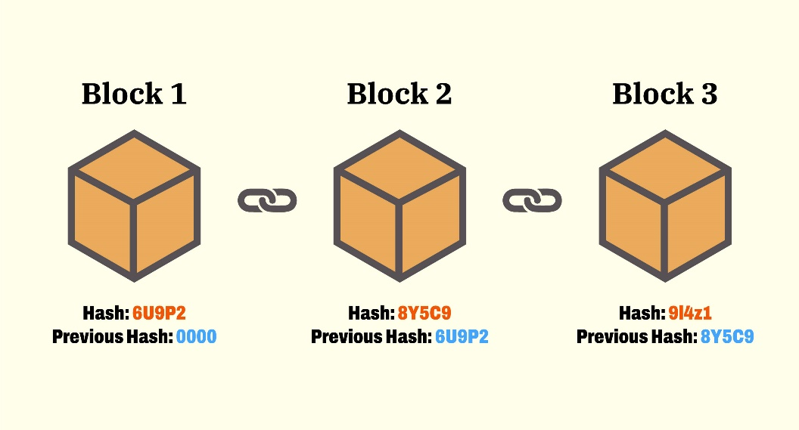
Cardano?
Cardano is a 3rd generation, proof-of-stake blockchain platform founded on peer-reviewed research and developed through evidence-based methods
A blockchain is a database that is used to store sequential data in a way that is secure, transparent, and potentially decentralized
An important feature of a blockchain is that it stores data that they cannot be changed, forged, or deleted
Distributed when the blockchain is stored and maintained by many members rather than a single centralized authority

Slide 4
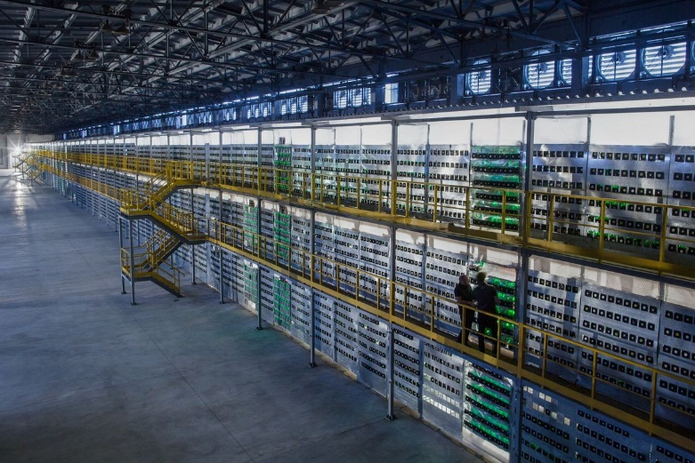
Energy Cost
Proof of work is a consensus mechanism in which computing power is used to choose who gets to add a block to the chain
Proof of work at scale requires huge amounts of energy, which only increases as more miners join the network
Proof of stake is a consensus mechanism in which a validator is granted the ability to add a block to the chain based on their staked value in the network
Made as an alternative to PoW to address energy consumption issues

Slide 5
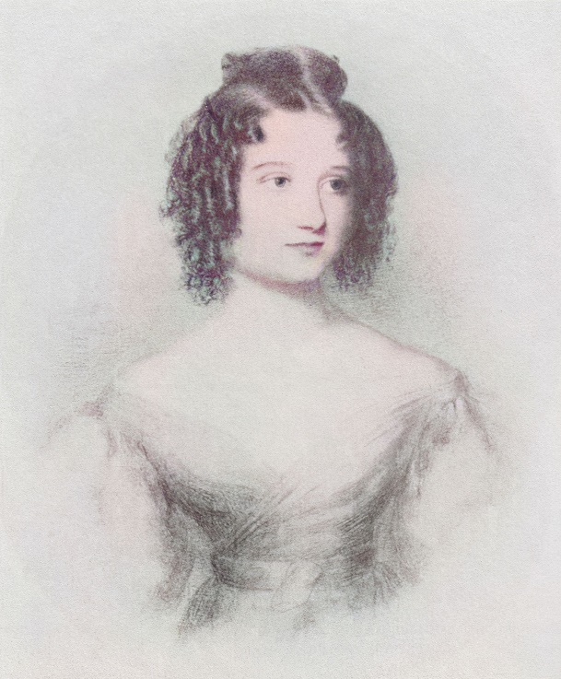
Ada Lovelace & Cryptocurrencies
A cryptocurrency is a digital asset, which is stored on the blockchain and is designed to serve as a medium of exchange for goods or services
Each blockchain has its own underlying cryptocurrency or native currency (Used to pay fees, and reward block producers)
Ada is the native currency of the Cardano blockchain
Ada Lovelace (1815-1852) – English Mathematician considered to be the first computer programmer

Slide 6
Our Hack
The Problem
Most people are not software developers
Crypto industry has ways to go in terms of accessibility and ease of use before mass adoption
Want to buy a fun gift for your Cardano-savvy friend or child but don’t know how
Cardano Ecosystem lacks a mechanism for the layman to purchase ADA for a Cardano-savvy friend without going through complex and tedious exchanges
Our Solution
The Cardano Gift Card
Purchase ADA for your friend with Fiat!
Automatically E-Mails them a link to claim the ADA you bought them!
They input their Cardano address and an on-chain transaction is generated sending them their ADA
An easy-to-use platform for non-technical individuals to purchase ADA with Fiat for their friends

Slide 7
DEMO

Slide 8
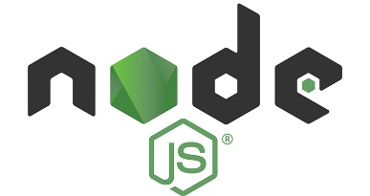






Technical Details
NodeJS, Express for handling POST requests
Stripe for handling payment processing
Stripe CLI for handling payment webhooks
SendGrid for handling emails
Lucid and Blockfrost for Cardano transaction creation and submission to chain
Velo for the frontend
Hedera Compatible!

