Slide 1

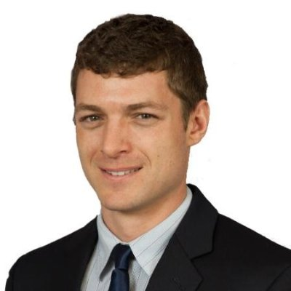










My career – Adam Corbin
Senior SW Engineering Section People Leader
GE Aviation
Next Role
Today
Senior SW People Leader
GE Aviation/Clearwater 1.5 years
Adjunct Professor
SPC/Clearwater
6 years
Develop talent, ensure software quality, and make certain project demands are supported.
Teach online classes for Intro to computer programming (Python), Java 1&2, JavaScript, SQL Databases, iOS Apps, C#
Staff Software Engineer
GE Aviation/Clearwater 2 years
(Team Lead)TrueCourseTM software lead for 3 Flight Plan management teams.
Project management – monitoring percent complete
Sr. Software Engineer
GE Aviation/Clearwater 1.5 years
Software Engineer
GE Aviation/Clearwater 2.5 years
(Team Lead) TrueCourseTM software design/dev for Flight Plan management.
Education
(IC) Software design/dev on AHMS for report generation to the ground and customer specific LED functionality.
(IC) KC46 Red label testing with test procedure updates.
B.S. Computer Engineering – FAU
M.S. Computer Engineering - FAU
About Me
-Love learning new things: (Android/iOS/Alexa apps/ Raspberry Pi )
-Competitive swimmer for 16 years -Like hot peppers/sauce -Love to cook and try new foods
AHMS

