Slide 1

Use-Case 2.0
Module 3 – Outlining and Slicing Use Cases

Slide 2
Objectives
Understand how we progress and complete the use cases
Understand how use cases drive the development activities
Understand the role of use-case slices and how to use them
Understand the importance of use-case outlines

Slide 3
Slicing up use cases to drive the development
A Use Case
A Use-Case Slice
Is described by a set of structured stories in the form of:
A use-case narrative containing flows and special requirements
And a set of matching Test Cases
Is created by selecting one or more stories for implementation
…, acts as a placeholder for all the work required to complete the implementation of the stories
…, and evolves to include the equivalent slices through design, implementation and test.
Notes:
Now we talk about use case, stories, narratives and use-case slices. Thus we have now:
Use cases are, as they have always been, sets of structured stories (user stories if you want). The stories are captured as a use-case narrative in the form of flows of events, special requirements and test scenarios.
Each story is managed and implemented as a use-case slice, which takes the story from its identification through its realization, implementation and test allowing the story to be executed.
Thus a use-case slice is all the work that goes together with a particular story. Each story and thus its slice is designed to be a proper backlog element, and realized within an iteration or a sprint.
The use-case strategy (starting from a use-case model) makes it significantly easier compared to the traditional user story strategy to identify the right user stories to work with and to understand how the ones selected make up the whole system. As the use cases are now developed slice-by-slice, the size of the use cases is not any longer a problem!
Thus, use cases are what they always have been. Stories are abstract scenarios a la user stories. Use-case slices are use-case modules made smaller, suitable as backlog entries. The terms scenario and use-case module will thus be replaced by story to remove the ambiguity between the abstract story-like scenarios and the concrete test scenarios and use-case slice.

Slide 4
First outline the Use Cases
To get a better idea of the complexity and scale of a use case you should create an outline to complement the brief description
Outlining a Use Case:
List the steps in the basic flow
Write down the actions in order
Enumerate the steps
Walk through, name and enumerate the main alternatives
Use Case Name
Brief description of use case
Actor Name
1 First Step 2 Second Step 3 Third Step
A1 First Alternate A2 Second Alternate
“This is the first step in the evolution of the use-case narrative”
Notes:
Outlining the use case will help to:
Clarify the size and extent of the use case
Clearly identify the important alternative flows for scope management purpose
Ensure that the purpose and value of the use case is clearly communicated.
An outline is needed to plan any continued work with the use cases.
Focus on outlining the most important use cases first
Outlines are often sufficient to capture the requirements for the solution especially for agile or more exploratory projects where there will be high-bandwidth communication between the team developing the use cases and the customer representatives supplying the requirements.

Slide 5
Exercise 3.1: Use-Case Outlines
In your groups
Each select one of the use cases discovered and briefly described in your group exercise
Create a use-case outline on flip-chart paper
Identify and name at least 3 Alternative flows
Each person briefly presents the use-case outline back to the group

Slide 6
Use Cases Drive Both Development and Testing
Use-Case Flows
Test Design and Preparation
Use-Case Slice
Test Cases
Use Case Realizations
Test using Test Cases
Code
Unit Tested
Software
Testable
Release
System Design and Preparation
Notes:
The use cases constitute the basis for identifying test cases and building tests. The system is verified by performing each use case.
The use cases provide us with a black box view of the system. The use-case realizations provide a white box view of the system and relate the requirements to the individual pieces of the system.
The key to deriving tests from the use cases, for black box testing, is the identification of a set of test cases that will achieve the test objectives for functional and requirements coverage. As they are based on the flows of events inside the use case each test case will describe a complete test scenario.
The key to deriving tests from the use cases, for white box testing, is the identification of a set of design level scenarios (from the interactions documented in the use case realizations) that will achieve the test objectives for design validation and component coverage. This relationship is shown by the arrow between the use-case realization and the test in the diagram above.
Based upon the use cases the test identification and preparation activities can proceed in parallel with the system design and preparation ones. This enables the tests to be available when the testable release becomes available. Test cases derived from the use cases take advantage of the way that use cases gather together the requirements to ensure good functional test coverage of the system and to produce robust, repeatable tests.

Slide 7
Use cases and test cases: knowing what to do and when it’s done
Use Case Model
Use-Case Narratives define what should be implemented
Test Cases verify that the system works as specified by the Requirements
Pass
Fail
Class...
Code implements the requirements
Test Cases & Test Results
Code
Testing - closing the loop and defining what “done” is.
Notes:
The relationship between use cases and test cases is very important. By developing the test cases at the same time as the use cases, and before developing the code, teams can adopt a test-first approach and significantly improve the quality of the software produced.

Slide 8
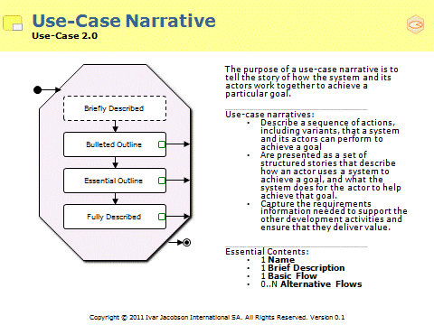
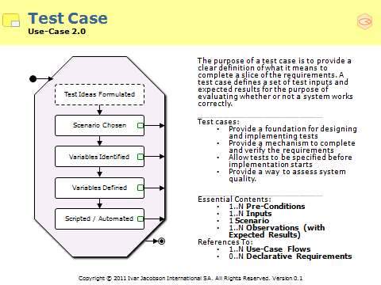
Start by defining “done”
Find a meaningful sub-set of the requirements
These should tell an end-to-end story and provide value to the users
These should be stable and unaffected by the addition of more requirements
These should be a small enough set to implement and test within a few days
Define the test cases
These should be scenario based
These should be repeatable
These should define what’s done
It takes more than just a set of requirements.
Notes:
To completely describe a use case takes more than just the creation of a use-case narrative. A corresponding set of test cases are also required.

Slide 9


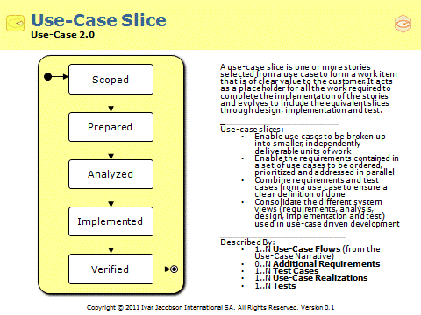
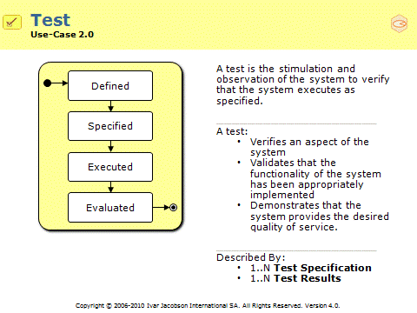
Use-Case Driven Development
Use-Case Slice
Use Case
Requirements
System
Test
Use-Case slices drive the development and focus the team on producing verified, working software.
Use-Case Slices – They’re more than just the stories.
Notes:
Note – use-case based testing has many uses.
Use cases can be used to drive:
Smoke testing
Regression testing
Performance testing
Usability testing
Acceptance testing
Stress testing
Load testing
Integration testing
As well as the more obvious white-box, system and functional testing.
This is really the subject for another course. If you are interested in learning more about use-case driven testing we would recommend our companion Use-Case Driven Testing Course.

Slide 10
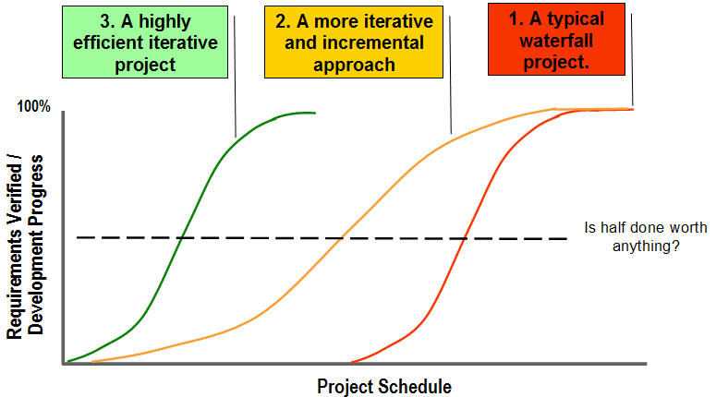
Measuring what’s done….
By implementing and testing the use cases we can measure what’s been done
Use cases help us find the value and define the right tests
Bad things to measure: Good things to measure:
Functions Slices completed
Progress through the disciplines Value to the users
Proportional earned value Quality
The number of tasks completed Tests passed
The only real measure of progress is working software ….and we only know it’s working once we've tested it.
Notes:
By implementing and testing the use cases we can measure what’s been done.
Use cases help us find the value and define the right tests.
Bad things to measure:
Functions
Progress through the disciplines
Proportional earned value
The number of tasks completed
Good things to measure:
Stories completed
Value to the users
Quality
Tests passed
If we’re going to measure working software….we better makes sure its also useful software.

Slide 11
How do we progress and complete the use-cases?
Scope the use-case slice
Identify the flows to be described and implemented
Prepare the slice
Write the use-case narrative
Write the test cases
Remember to cover special requirements and supporting definitions
Analyze the slice
Allocate the requirements described by the flow of events to the system’s implementation elements
Understand the impact of implementing the new requirements
Implement software to deliver the use case
Amend the affected implementation elements
Integrate the system
Verify the system produced
Execute tests based on the test cases to verify the system delivers the use cases as specified.
Scoped
Prepared
Analyzed
Implemented
Verified
Notes:
The use-case slices allow us to drive the creation of working software based upon the flows of events defined by the use cases.
To create suitable work items the use-case slices can be split into parts that together constitute the original use-case slice. This allows, for example, use-case slice 1 to be progressed in three parts : use-case slice 1a, use-case slice 1b and use-case slice 1c.
Each use-case slice part is progressed and tracked as though it were a use-case. This allows the most important flows of the use case to be verified, even before the other flows have been realized or implemented.

Slide 12
Use-case narratives contain many requirements…
… often too many to code and test in one go.
Notes:
The alternative flows of a use case can cover a lot of different requirements, many of which will be of a far lower priority than the basic flow.
We don’t want to try and implement the use case in one go – we want to be able to implement the basic flow before we start to develop all the lower priority alternative flows.
When developing a system based on a set of use cases it is very rare to implement entire use cases, every use case usually contains some alternative flows that never make it into production.

Slide 13
Use-case narratives tell many stories
1 Use Case
Many stories…
Start of use case
Step 1
Alt 1
Step 2
Step 3
Alt 4
Step 4
Alt 3
Step 5
Step 6
Alt 2
Step 7
End of use case
Notes:
What is a story?
Stories are instances, or specific occurrences, of use cases. Stories are useful because they help us think in concrete terms about what a system will do when a particular use case is performed. They help us walk through exactly what will happen to make sure that we have everything handled properly, and are useful when defining the test cases that are required to test the system to make sure that it performs the way the use cases say it should.
A typical use case will have a basic flow of events and lots of alternative flows of events. A single story will walk through one particular path through the use case, exploring a particular way that the use case can be performed from beginning to end.
Note: the graphical presentation is just a way to depict the stories. It is not using a specific language such as the UML. If so, the best diagram to represent the flows of a use case is the activity diagram.
Each use case describes one way (including variants) a user would like to use the system
Each use case must be tested
A use case includes multiple paths
Each path must be tested
Each path can take multiple inputs and produce multiple outputs
Each possible input and output must be tested

Slide 14
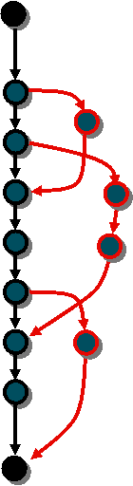
Use Case based Test Cases
Set of inputs and expected results for the purpose of evaluating whether or not a system correctly implements a specific test scenario
Allow tests to be specified before implementation starts
Inputs and expected results
- Insert email address with no ‘@’ - Verify that error message appears
Test
Scenario derived from the Use Case
Notes:
Use cases are a major input to testing:
Use Cases define many stories – Test Scenarios are those selected for testing.
Example:
Use case: Registration of Order
Test scenario: Successful registration of an order containing one item for a new customer
Test case:
Test scenario: Successful registration of an order containing one item for a new customer
Input
Customer: Gustav Svensson, Storgatan 23, 123 45 Staden
Item: 1 instance of MyBook
Confirm order
Output
Valid customer registration form
Valid item specification form
Unique order number
Result
A new order and a new customer are registered

Slide 15
Managing Scope Using Slices
Use-Case 1
Use-Case Slice 1.1
Priority 1
Use-Case Slice 1.2
Delayed until next release
Use-Case Slice 1.3
Priority 2
Notes:
Alternate flows can be shelved or re-prioritized while the use case still provides value. The key message here is that you don't have to implement all of the flows (or stories) from a use-case at one time. The different flows will have different priorities and not all of them will make the cut.

Slide 16
Use Cases and Use-Case Slices
Use Case 1
Basic Flow plus 15 Alternatives
…
Use-Case Slice 1.1
Use-Case Slice 1.2
Use-Case Slice 1.3
Use-Case Slice 1.N
Basic Flow plus Test Cases 1.1 – 1.5
Alt Flows 1-4 plus Test Cases 1.6 – 1.10
Alt Flows 5-7 plus Test Cases 1.11 – 1.15
Alt Flows M-15 plus Test Cases 1.x – 1.Y
The Use-Case Slices split the use case up into a number of smaller, separately deliverable parts
Notes:
Use-case slices allow you to sub-set and deliver parts of a use cases without having to re-structure or change your use-case model.

Slide 17
Handling non-functional and other requirements
Use-Case Slice 2.1
Use-Case Slice 2.2
Use-Case Slice 2.3
Basic Flow – Scenario 1 plus Test Case 2.1
Basic Flow – Rest of Scenarios plus Test Cases 2.2 – 2.8
Basic Flow – + Supp Req’t A, B & C Test Cases 2.9 – 2.10
Slice 1 – Build the basic flow and test with one test case (describing one key scenario).
Slice 2 – Complete the implementation and testing of the basic flow.
Slice 3 – Use the basic flow to performance and stress test the system.
The slices can include test cases to address the non-functional as well as the functional requirements.
Notes:
Because the use-case slices can contain test cases as well as flows from the use case, it is possible to define use-case slices to cover the special and other requirements.
This is very powerful as you should always test your non-functional requirements within the context of a real usage scenario.

Slide 18
Finding Use-Case Slices
Risks
Think about your risks and identify the most important stories
Think about the natural groups of flows
Think about testing and proving the system
Think work items and driving the development
4
It might be harder than we think (estimates)
Very High
Build Withdraw Cash
5
Reliability of the O/S platform
Very High
Build Withdraw Cash
6
Scalability of J2EE Infrastructure
Very High
Build Withdraw Cash
Build a simple cash withdrawal based on the Basic Flow
UCS 1.1 - Build a simple cash withdrawal based on the basic Flow
One test case one account / one amount.

Slide 19
Finding Use-Case Slices
There are a number of flows about card handling?
Think about your risks and identify the most important stories
Think about the natural groups of flows
Think about testing and proving the system
Think work items and driving the development
Wouldn’t you implement them all at the same time?
UCS 1.2 – Card handling during cash withdrawal
A 1.1 Handle Invalid Card
A 1.2 Handle Unreadable Card
A 1.3 Handle Card Jam
Numerous test cases

Slide 20
Finding Use-Case Slices
How can we address the supplementary requirements?
How will we know when we’re done?
Think about your risks and identify the most important stories
Think about the natural groups of flows
Think about testing and proving the system
Think work items and driving the development
Performance 1.1: Peak Loading
Performance 1.2: Transaction Service Levels
UCS 1.3 – Peak Load Testing
Basic Flow
P 1.1 Peak Loading
P 1.2 Service Levels
Numerous orchestrated test cases.

Slide 21
Finding Use-Case Slices
What are we going to do in the next iteration – 2 weeks.
Think about your risks and identify the most important stories
Think about the natural groups of flows
Think about testing and proving the system
Think work items and driving the development
Well we can’t do the whole use case?
UCS 1.A – Handle Security Breaches
UCS 1.B – Handle Loss of Critical Resources
UCS 1.C – Forgetful Customer
UCS 1.D – Non-Standard Amounts
UCS 1.E – Receipt Handling
…..

Slide 22
Sizing the work to be done
Use cases can be any size
And are often to big to describe, size, estimate or deliver in one go
Use-case slices can be split up or combined to create sensibly sized work items
Use case 1 – 30 flows
Use case 2 – 3 flows
Use case 3 – 15 really long flows
Use-Case Slice 1.1
Use-Case Slice 1.2
Use-Case Slice 1.3
Use-Case Slice 1.N
Large
Medium
Small
Very small
Notes:
Use cases can be any size…
Use case slices can be whatever size we want…
… but don’t mess with the basic flow!

Slide 23
Prioritizing and Ordering The Work To Be Done
Understand the need
Use-Case Slice 1.1
Priority 1
Use-Case Slice 2.1
Priority 1
Analyst
Find Actors and Use Cases
Project
Lead
For Iteration x
Slice the Use Cases
Analyst
Use-Case Slice 1.3
Priority 2
Use-Case Slice 3.3
Priority 2
Analyst
Prepare a Use-Case Slice
Inspect & Adapt the Use Cases
Developer
Analyze a Use-Case Slice
Test the System (as a whole)
Use-Case Slice 1.2
Delayed until next release
Use-Case Slice 3.2
Delayed until next release
Implement Software (for a slice)
Test the System (for a slice)
Release the System
Notes:
By scoping use-case slices, we decide which use-case flows to develop and verify as part of the planned release. Some use cases will be too large to make suitable units of work and may need to be split up into a series of smaller use-case slices to allow the flows of the use case to be developed independently of one another. When splitting up a use case slice in this way you are not really creating new use-case slices - you are just selecting parts of the existing slice to be developed. Because of this there is no need to re-write, structure or re-factor the underlying use case.
This activity results in updates to the use-case slices containing the use cases and, in some cases, the splitting of use-case slices into smaller use-case slices to allow scenarios and sub-sets of the use case’s flows to be progressed independently.
Remember what we are doing is agreeing on the priorities of the use-case slices to be developed and verified up to the next project milestone.

Slide 24
Exercise 3.2: Creating Use-Case Slices
Based on your outlines prioritize your flows of events and chunk up them up into a set of use-case slices
Estimate the size of each use-case slice using the scale very small, small, medium, large
What is in your largest use-case slice?
See if you can estimate the complexity of the implementation required using the scale trivial, easy, hard, very hard
What is you most complex use-case slice?
See if you can prioritize your use-case slices
Classify your slices using the MoSCoW rules
Place the slices you identify into a forced ranking
Notes:
The MoSCoW rules are a great way of quickly prioritizing requirements. They are used quite widely in the United Kingdom especially by followers of the Dynamic System Development Method (DSDM). In The Dynamic System Development Method, Jennifer Stapleton introduces the MoSCoW rules thus:"You will not find the MoSCoW rules in the DSDM Manual, but they have been adopted by many organizations using DSDM as an excellent way of managing the relative priorities of requirements in a RAD project. They are the brainchild of Dai Clegg of Oracle UK, who was one of the early participants in the DSDM Consortium."MoSCoW is derived from the first letters of the following prioritizing criteria:
•Must have (Mo)
•Should have (S)
•Could have (Co)
•Want to have but will not have time this round (W)

Slide 25
Estimating What You Can Do
2
4
6
9
Large
1
2
4
6
Medium
Size
0.5
1
2
4
Small
0.25
0.5
1
2
Very Small
Trivial
Easy
Hard
Very Hard
Complexity
Will a system with a complex design, have a complex use-case model?
Notes:
As we can control the size of the use-case slices we can make sure that they are easily grouped into a simple set of size bands. People are very good at this sort of relative sizing and accurate results can be obtained from use-case slices created purely from outlines.
This provides us with one part of our estimating formula. The other is to judge the relative complexity, which again can be done fairly easily if people have a good knowledge of the capabilities of the implementation technology.
By getting the team to estimate some typical examples of each category a matrix such as that shown above can easily be calibrated and used to generate an initial estimate. As the use case slices are completed the matrix can be tuned tuned based upon the team’s actual experiences.
Agile teams often use estimating schemes of this sort to calculate and track their velocity (the amount of work they can achieve within a fixed time period).
Note:
The matrix shown illustrates the kind of ratios typically seen between the different sizes and complexities.
Your very small use cases might be as large as another teams very large use cases. This kind of matrix must be calibrated individually for each team.
Things in the top right-hand corner should always be estimated by hand as there is no upper limit on the size and complexity of a slice.
Use Case Modeling

Slide 26
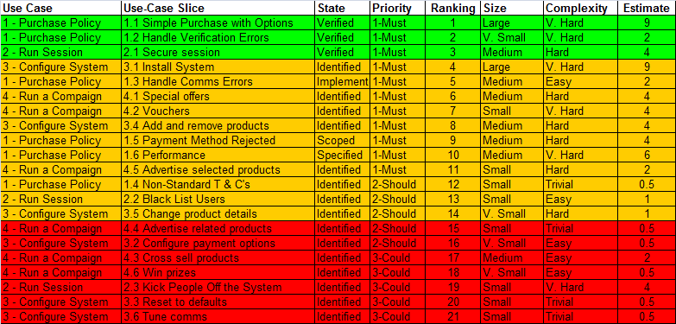
Tracking Done
Done
Doable
Where time runs out.
At risk
…and knowing how much more you can do.
Notes:
The use-case slices can be used to build a product backlog.
By tracking the state of the use-case slices and their estimate to complete it is possible to compare the list with the amount of time and effort available to the project.
In the graphic above the first three use-case slices have been completed and verified. These count as done.
Based on the estimates and the amount of time available to the team it looks as though the next 11 use-case slices can be completed before the end of the project (as indicated on the slide by the “where time runs out” arrow.
The use-case slices below the arrow are at risk, as the teams current rate of progress and estimates indicate that these will not be completed.

Slide 27
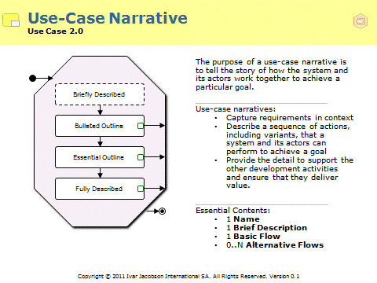
You only need to outline the flows to create the slices
Use-Case 1: Withdraw Cash
1.3 Card Handling Errors
Story: Wrong type of card.
Flows: BF, A1
Test Conditions: Invalid card
Story: Card Stuck on Entry or Exit
Flows: BF, A7
Test Conditions: Default Card, Default Account, Default Amount
1.2 Full Cash Withdrawal
Story: Empty an Account
Flows: BF
Test Conditions: Card 001, Account 001 containing £200
Story: Withdraw Daily Limit
Flows: BF
Test Conditions: Card 002, Account 002
Points:
1.1 Normal Cash Withdrawal
Use case narratives can be described at different levels of detail.
They start very lightweight by outlining the flows.
Story: Withdraw Beer Money
Flows: BF
Test Conditions: Default Card, Default Account, Default Amounts
Points:
This is enough detail to identify our stories and define our slices.
Points:
Notes:
Use cases can be documented at the level of detail needed to suit your needs

Slide 28
Summary
The use-case slices allow us to drive the creation of working software based upon the flows of events defined by the use cases
Use Cases have many forms and states and evolve during the software development lifecycle
Use Cases underpin all areas of the software development lifecycle (“use-case driven”), not just requirements
The authoring of use cases to increasing levels of completeness addresses differing areas of project risk

