Slide 1

Use-Case Model
Note: Ivar Jacobson International course material is for classroom use only

Slide 2
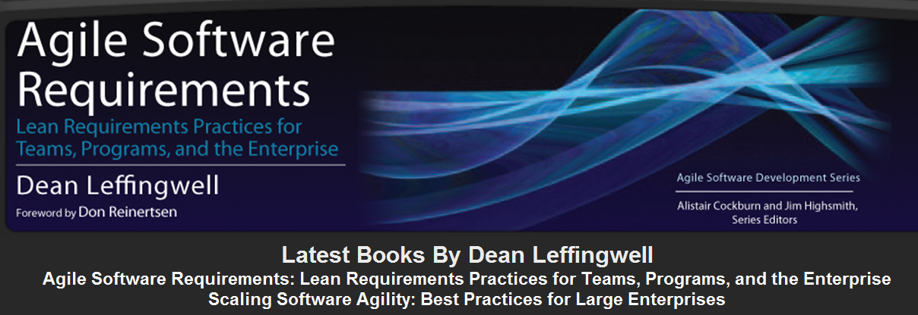
<Course Title> / <Module NR> - <Module Name>

Slide 3
User Story Template
I <in the role of XX> needs functionality <zzz> to achieve the goal of <YYY>
User storys first
– then further enhancements with a use case template
Recommendations:
Start with a list of user stories
Enhance the most important/complex user stories (with priorities in the backlog) with use case model
See next metamodel
<Course Title> / <Module NR> - <Module Name>

Slide 4
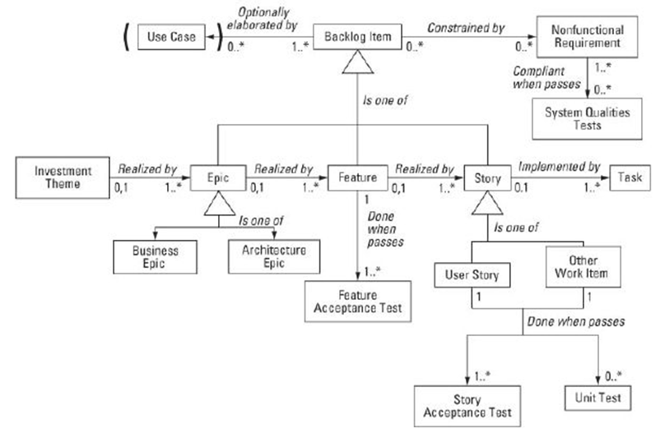
Backlog metamodel
<Course Title> / <Module NR> - <Module Name>

Slide 5
Use-Case 2.0
Module 2 – Finding Actors and Use Cases

Slide 6
Objectives
Understand the system boundary
How to identify primary and supporting actors
How to name and describe actors
Identifying primary and supporting use cases
How to name and describe use cases

Slide 7
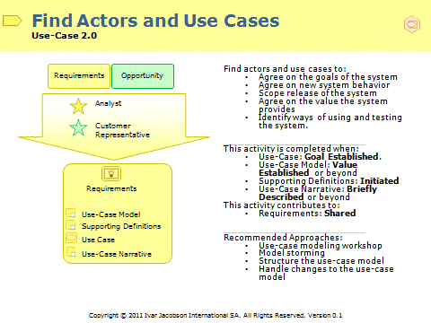
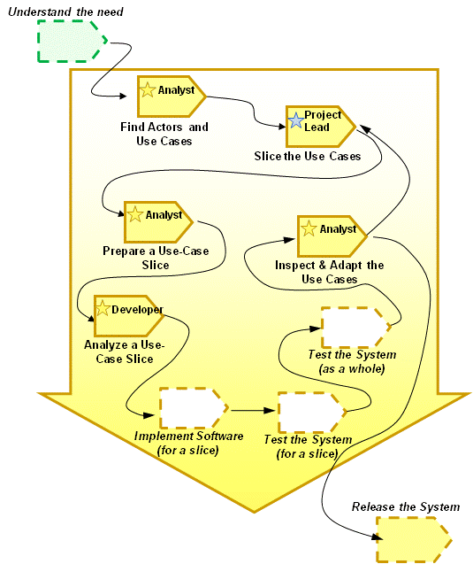
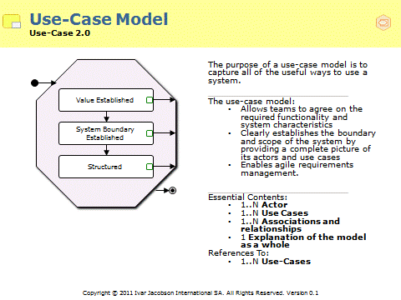
Where are we?

Slide 8
Exercise 2.1: Getting Started by Model Storming
In your group:
  Identify a target system
  Brainstorm as many candidate users as possible
    Anything that interacts with the system
    This could be people or it could be other systems
  Brainstorm as many candidate system usages as possible
    Any goal the system can fulfill
    Any service the system can provide
Usage A
Usage B
User C
Usage C
User A
User B

Slide 9
From model storm to use-case model
Use-Case Model contains Actors and Use Cases
Actor
  Someone or something outside the system that interacts with the system in a particular role
  A representation of one or more stakeholders who use the system and contribute to the completion of their goals
Use Case
  All the ways of using a system to achieve a particular goal for a particular user.

Slide 10



First scope the system
Understand your system boundary:
  Everything beyond this that interacts with the system is an actor
  Use a context diagram to help the thought process
Start by identifying the users and connected systems.
Notes:
Identify users
List all the different types of users that the system might have.
Focus questions to identify users:
Who are the intended users of the system?
Who administers the system?
Who manages the system?
Which people are providing information for the system?
Identify other systems
Complement the list of user types with a list of any other systems that the new system is required to interact with.
Filter the list to remove any systems that are just part of the system to be built or the infrastructure that will be used to enable the new system.
Focus questions to identify other systems:
Where will the data required by the system come from?
What will we do with the information we generate?
Slide notes and focus questions taken from the interactive guidance provided by Use-Case Express.

Slide 11
Find the most important actors
Identify the actors that will get the most value from the system
  These are the actors for which the system is built
Find the primary actors.
Notes:
Identify the actors that will get the most value from the system. These are known as the primary actors.
Primary actor focus questions:
Which users or external systems is the system built to serve in the first place?
Which users or external systems will use the system on a more or less daily basis?
Which users or external systems will benefit from the system from a business or domain perspective to fulfill their duties?
Remember the primary actors are the ones for whom the system is built.
Slide notes and focus questions taken from the interactive guidance provided by Use-Case Express.

Slide 12



Leverage the list of users and other systems
For each user or system identified:
  Ensure that there is at least one Actor defined to address their needs of the system
The actors that represent the roles adopted by the key users are the primary actors
User Types | Actors
Technology Adopter | Calling Subscriber, Callable Subscriber, Customer
Standard User | Calling Subscriber, Callable Subscriber, Customer
Messaging Devices | Calling Subscriber, Callable Subscriber
Remember: Actors are roles played with respect to the system
Calling
Subscriber
Callable
Subscriber
Customer
Notes:
Every user or external system that interacts with the system will need to be able to play the role of at least one actor.
It is often easiest to identify actors that are represented by people
Think of the users that will actually use the system (the subset of users that will get value)
The stakeholder analysis may already have identified some or all of them
Ignore for a moment those users who simply maintain the system
The actors represent the roles that the users and external systems play when they interact with the new system. Once you have a list of people (users), generalize and think about the roles they play

Slide 13


Work from the specific to the general
Don’t try and pluck the most suitable actor name ‘out of the air’ in a brainstorming session:
  Work down to a good actor name by first identifying a few people who play the same role with respect to the system
  Don’t get pre-occupied with the ‘perfect actor name’, ‘good enough’ is sufficient
If you get stuck think of real individuals who will use the system to help the thought process
Work from individuals to user types to actors if you need to

Slide 14
Include the secondary and supporting actors
Transfer Funds
Service
Administrator
Bank Customer
Withdraw Cash
Bank System
Check Balances
Security
Administrator
Does the ATM need any help when supplying cash?
Will anyone else need to be informed of any events?
Remember the actors are not always people.
Notes:
The primary actors are the ones for whom the system is built.
The secondary (or supporting actors) are those that support the use cases provided by the system and those that support the system itself. They are needed to help the system meet its goals. The secondary actors are most likely to be discovered once the use cases have started to appear.
Secondary actor focus questions:
Which users or external systems does the system need information from, to be able to provide its functionality to its primary actors?
Which users or external systems does the system need to provide information to, to be able to provide its functionality to its primary actors?
Which users or external systems are required to start and stop the system?
Which users or external systems are required to set up and maintain the databases (if any) of the system?
Which users or external systems are required to administrate users (e.g. names and passwords of primary and secondary actors) of the system?
In general, which users or external systems are required to administrate and maintain the system from a technical point of view?
Example
Consider a simple fire detection system that monitors a series of fire detection sensors for signs of fire, and when one is detected it rings an alarm, sets off a set of sprinklers and notifies the local fire department. Identifying the main use case, Detect Fire, is simple enough, but without human users the actors are hard to determine. A little analysis identifies the following actors: the sprinkler control, the fire detector, and the fire department.
Slide notes and focus questions taken from the interactive guidance provided by Use-Case Express.

Slide 15
Focus on the system boundary
Considering other systems as actors forces you to confront the boundary of the system you are creating
Where is the information that will be required to support the behavior?
Transfer Funds
Bank Customer
Withdraw Cash
Bank System
Check Balances
Notes:
Big problems occur if you do not identify “your” system boundaries.
Be careful to not overdo the set of secondary actors. When scoping the system, make sure to only include actors that are really needed.

Slide 16

Discussion: Don’t pre-empt the design
Is the other system really an actor or part of the system’s assembly?
Is a printer an actor?
What is the actor for batch processes?
✓
x
Bank System
Middleware
If the system is required to communicate with another system, represent it as an actor in the model
x
x
Web Browser
?
Operating System
Printer ?
Notes:
Use case modelers must never pre-empt designers and try to use the use case model to design the system.
Be careful not to confuse the actors with the devices they use.

Slide 17
Naming your actors
Actor names should describe the role the actor plays in relation to the system
Good actor names are descriptive of their responsibilities
Actor Name | Comments
ATM Operator | Good actor name, describes the role of keeping the ATM in good working order and stocked with cash and paper.
Repair Person | Poor actor name, the actor’s role goes quite a bit beyond simply repairing the machine.
Be sure to capture a brief description for each actor as soon as it is discovered
  No more than a few sentences
  Should describe the role the actor plays
  Should state the goals the actor expects to achieve
Notes:
The name of an actor should represent the role that the actor plays towards the system:
Actor names should describe the role the actor plays in relation to the system.
Good actor names are descriptive of their responsibilities.
Don’t confuse actors with organizational roles/job titles.
Don’t use job titles in the use-case model.
Don’t over generalize.
Avoid the trap of simply restating the use case name as an actor name, “Withdraw Cash” as “Cash Withdrawer”.
When naming the actors ensure there is enough distinction from the other system actors to warrant a new actor; list alternatives and compare them if you are having difficulty.
Briefly describe the actor. Since the actors are not really part of the system to be modeled the description can be fairly high-level. Typically a short paragraph is sufficient.
Be sure to capture a brief description for each actor as soon as it is discovered.
No more than a few sentences.
Should describe the role the actor plays.
Should state the goals the actor expects to achieve.
Tip: Do not leave the initial documentation of Actor (or use case) brief descriptions until after the modeling session. You will not be able to remember the descriptions that were intended when they were discovered.
Example - Brief description for the actor Bank Customer in an ATM System
The Bank Customer conducts transactions at the ATM. He or she may withdraw funds, check account balances, deposit funds, and transfer amounts between accounts. A Bank Customer is created when a person opens an account at an affiliated financial institution.
Slide notes adapted from the interactive guidance provided by Use-Case Express.

Slide 18
Actors – General rules
Don’t confuse Actors with organizational roles/job titles
Don’t use job titles in the Use-Case Model
Don’t over generalize
Use roles instead of job titles as Actor names
Characterize your actors
Orders
Enter Customer Orders
Handle Customer Queries
Administrator
Maintain Sector Diaries
x
Support Engineer
Generate Temporary Software
Handle Customer Queries
Keys
Enter Customer Orders
Sales
✓
Administrator
Maintain Sector Diaries
Process Expenses
Team
Generate Temporary Software
Administrator
Keys
Process Expenses
Notes:
It is not always easy to avoid job titles, ‘Project Manager’ is a good example, but where possible, strive to be clear about the difference between actor names and job titles. In an organization where “Shipping Clerk” is already a job title, naming an actor the same will only cause to confuse the stakeholder representatives. A more ‘role based’ name like ‘Package Shipper’ emphasizes how the actor uses the system and avoids the confusion with the job title.
In an attempt to make actor names ‘generic’ and ‘reusable’ some teams go too far
They end up with one very general actor, “Performer” that does everything
Make sure your actor names remain descriptive of the role they are performing
Remember the same person can play many roles as they use the system to do different things
The characteristics of an actor might influence how the system is developed and should be recorded, consider:
The scope of the actor’s responsibility
The physical environment in which the actor will be using the system
The number and type of users represented
The frequency of system use
Other characteristics that can be derived from the actor’s related users include:
Level of domain knowledge
Computer experience etc.

Slide 19
Exercise 2.2: Finding actors
In your group:
  Using the Model Storm results of the previous exercise
  Name and Briefly Describe a set of Candidate Actors for the system to be developed
  Choose someone to present your findings back to the class

Slide 20
Finding use cases
Start by identifying Actor Goals
For each actor identified list the things that the actor needs to achieve by using the system
Get an account balance from the ATM
Make a cash Withdrawal from the ATM
Request a statement from the ATM
Deposit cash in the ATM. Etc……..
?
Candidate Use Cases
What about “Verify PIN”?
Bank Customer
Notes:
Every actor will need to be involved in at least one use case; if they are not then they will not be able to interact with the system. The easiest way to find the use cases is to think about the functionality that each actor will require from the system.
Just like there are primary and secondary actors there are primary and secondary use cases. The primary actors and use cases capture the essence of why the system is built. The primary use cases provide the value to the actors that need that value. However, secondary use cases are necessary to enable and support the effective operation of the system.
By looking at the goals of the primary actors we will find the primary use cases. Listing out only what needs to be achieved will help you find the correct level of use case.
Primary use case focus questions
What will the primary users and external systems (primary actors) achieve when interacting with the system?
What kind of business or domain-related services will the system provide to the primary users and external systems (primary actors)?
What tasks will the primary users and external systems (primary actors) perform with the help of the system?
Slide notes and focus questions taken from the interactive guidance provided by Use-Case Express.

Slide 21
Don’t confuse use cases with “Functions”
Functional decomposition prevents the identification of meaningful scenarios and obscures the systems important requirements.
Delete Order
Add Order
Change Order
Customer
x
Approve Order
Order Inquiry
Browse Products and Place
Orders
Customer
✓
Track Orders
Notes:
The above diagram illustrated incorrect use of use cases as menu options or functions.
Use cases are not functions. A use-case model is based on identifying the value offered by the system and describing the end-to-end interactions required to achieve this value. It is not the decomposition of the requirements into a series of reusable function definitions
Take care to focus on value to the user:
The communicative value of the model will soon be lost if functional decomposition creeps in.
Don’t end up drowning in hundreds of use cases

Slide 22
Derive the use cases from the system’s vision
All existing requirements information should be leveraged to help identify candidate use cases
Do the use cases conform to any constraints placed upon the system?
Are all the users responsibilities sufficiently addressed by the system?
Other Product Requirements, Constraints
Stakeholders, Stakeholder Roles and User Types
Stakeholder Needs and Problem Statement
Identified System Features (Capabilities)
Does the system provide the behavior to satisfy the stakeholder needs and solve the problem?
Are the set of identified use cases capable of delivering all the features defined?

Slide 23
Identify supporting and operational use cases
Think about the information and other things that the actor will need to obtain from the system:
  Does it get there by magic? How will it get there?
Customer
Withdraw Cash
Shopper
Get New and
Special Offers
This primary use cases cannot provide value if there is no cash in the machine.
How do new and special offers get into the system?
ATM Engineer
Refill and Service Machine
Marketer
Run Sales Campaign
This secondary use cases makes cash available and keeps the machine running..
Another use case allows them to be set
Notes:
Find and briefly describe any other use cases that will be needed to:
Set up and maintain the system.
Monitor and report on the state of the system.
Many of the secondary use cases can be found as functionality needed by the secondary actors, and that the system needs to provide to make the primary use cases effective. Common examples are use cases for supervising, monitoring, profiling, configuring and starting the system.
Be careful to not overdo the set of secondary use cases. When scoping the system, make sure to only include use cases that are really needed.
Secondary use case focus questions:
In order to enable the primary functionality (represented by use cases) of the system, what needs to be achieved by interacting with secondary users and external systems (represented by actors)?
Will users or external systems (secondary actors) need to start and stop the system?
Will users or external systems (secondary actors) need to set up and maintain the databases (if any) of the system?
Will users or external systems (secondary actors) need to administrate users (e.g. names and passwords) of the system?
In general, what will the users and external systems (secondary actors) need to do to administrate and maintain the system from a technical point of view?
Slide notes and focus questions taken from the interactive guidance provided by Use-Case Express.

Slide 24
Associate the use cases to their actors
After you have identified a use case with one or more associated actors:
  Create a use-case diagram
Bank Customer
Withdraw Cash
Bank System
Remember:
  The arrows indicate the initiator of the use case not “data flow”

Slide 25
Capturing the requirements
Evolve the set of use cases alongside the set of actors
  The two activities go hand-in-hand, simultaneously and iteratively
  Chicken–and–egg, the identification of new use cases can lead to the identification of more actors and vice-versa
While identifying use cases, supporting information will also be identified
  Glossary Terms, Business Rules, System Wide Quality Attributes, Standards, Regulations
  System-wide requirements that don’t apply to any particular use case
The requirements should be evolved in parallel
Notes:
Capture those important global requirements and quality attributes that don’t relate to any single use case.

Slide 26
Name the use cases
Give the use cases active names
  Newly Identified Use Cases may have long names while brainstorming - this is a good start on the brief description
Passive Name | Active Name
Risk Assessment | Assess Risk
Flight Scheduling | Schedule Flight
Resource Management | Manage Resources
Capture a brief description for each use case as soon as it is discovered
  Never accept the argument that it is “obvious”; it seldom is
  No more than a few sentences providing a short synopsis of what the system does to provide the value
  Should make clear which Stakeholders are receiving the value
  Should capture the specific value provided to those stakeholders
Notes:
The name of a use case should indicate what is achieved by performing the use case:
Give the use cases active names.
Active names imply something gets done. Passive names can sound like functions or functional areas within an organization.
Ask yourself can you concatenate the actor and use-case name and make a meaningful sentence – “Bank Customer” “Withdraws cash”.
Briefly describe the use cases. Typically a short paragraph is sufficient:
Capture a brief description for each use case as soon as it is discovered.
Never accept the argument that it is “obvious”; it seldom is.
No more than a few sentences providing a short synopsis of what the system does to provide the value.
The description should make clear which Stakeholders are receiving the value.
The description should capture the specific value provided to those stakeholders.
A use case begins as just a name. The use case may be illustrated in a diagram and associated with a system actor. At this point, it merely acts as a placeholder for the description necessary to understand and define some system functionality. The use case should be given a brief description to ensure that everyone can understand its purpose.
A use-case narrative is briefly described when: The use case is named, and has a short and informative brief description.
Example: Brief description for the use case Withdraw Cash in an ATM System
This use case describes how a Bank Customer uses an ATM to withdraw money from his or her bank account.
Slide notes adapted from the interactive guidance provided by Use-Case Express.

Slide 27
Exercise 2.3: Finding use cases
In your group:
  Using the Model Storm results and the Actors from the previous exercises
  Name and Briefly Describe a set of Candidate Use Cases for the system to be developed
  Create a first cut Use-Case diagram
  Indicate which use cases address which features
  Choose someone to present your findings back to the group

Slide 28
How much do you need to model?
Level of Detail | The Use-Case Model has achieved this level of detail when :
Value Established | Primary actors are named and briefly described Primary use cases are named and briefly described There is an explanation of the use-case model as a whole
System Boundary Established | Secondary actors and use cases have been identified to enable the primary use cases Each actor and use case appears in at least one diagram All relevant backlog items can be traced to use cases, actors or other requirements
Structured | Include and generalization relationships are used to improve clarity of the use-case model. Extends relationships are used to express extension behavior The use-case model is still understandable to a novice stakeholder
Notes:
Value Established
The first step towards a complete use-case model is to identify the most important actors and use cases – the primary ones. The primary use cases are the ones that provide the value of the system.
A mere list of actors and use cases is not sufficient for communicating the use-case model. The model has to be illustrated and explained. The format for this is often diagrams with actors and use cases, accompanied by explanatory text (here called “explanation of the model as a whole”).
System Boundary Established
The primary actors and use cases capture the essence of why the system is built. The primary use cases provide the value to the actors that need that value. However, secondary actors and use cases are necessary to enable and support the effective operation of the system.
Many of the secondary actors can be found by looking for roles to perform administration, maintenance and supporting operations.
Many of the secondary use cases can be found as functionality needed by the secondary actors, and that the system needs to provide to make the primary use cases effective. Common examples are use cases for supervising, monitoring, profiling, configuring and starting the system.
Be careful to not overdo the set of secondary use cases. When scoping the system, make sure to only include use cases that are really needed.
Structured
The use-case model often contains redundant information, such as common sequences or patterns of interaction. Structuring the use-case model is the way to deal with these redundancies.

Slide 29
Summary
The key to a successful start with use cases:
  Understand the purpose and boundary of the system
  When identifying Actors work from the specific to the general
  Don’t forget external systems that interact with the system being developed
  A use case should provide independent value to the actor, if you have to execute several use cases in a sequence to add ‘value’, you have gone wrong
  First focus on the obvious and familiar – don’t get bogged down dealing with the unusual and uncommon
  Evolve the set of actors and use cases alongside each other in an iterative and incremental fashion
Notes:
Ensure that agreement is real
Don’t do it on your own
- Make sure that the right people (users, domain experts and other stakeholders) are involved and actively contributing to the creation of the use-case model
Don’t get bogged down dealing with the unusual
- Get a good understanding of what the system will do before moving onto the more esoteric areas.
Evolve the set of actors alongside the set of use cases
- The two activities go hand-in-hand, simultaneously and iteratively

Slide 30
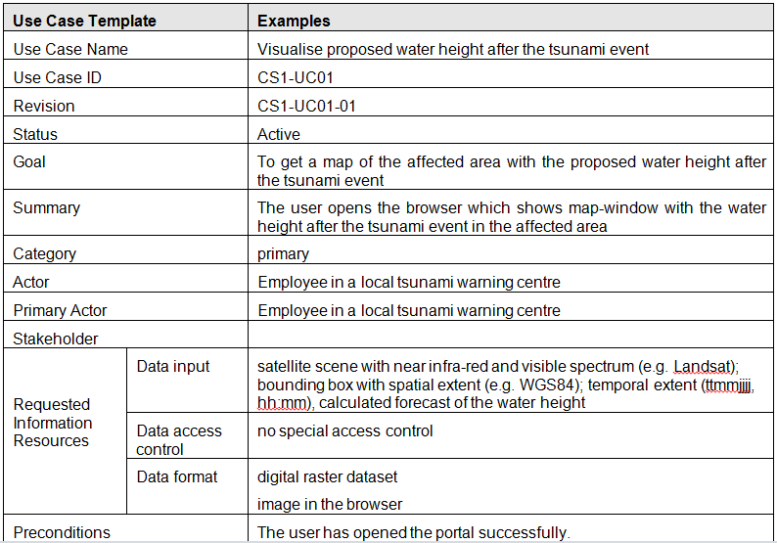
Template of a Use Case Description
……….

Slide 31
Introduction to The Essentials
Module 3 – Use-Case Essentials
Notes:
Module 02 - Software Development Essentials
Introduction to The Essentials
The objectives of this module are to:
Understand the value that the Use Case Essentials practice provides
Focus on Use Cases – what are they and how are they used?
Focus on people – what competencies will we need?
What do we need to progress and produce
What things do we need to do
Some important Do’s and Don’ts
Explore how to apply the Use Case Essentials practice.

Slide 32
Use-Case Essentials
A way to establish the requirements of the system
  Use cases place requirements in context
A way to establish the system boundary
  The model identifies who or what interacts with the system and what the system should do
A way to iteratively evolve the requirements
A way to communicate the requirements to all the stakeholders
  The use cases provide a common thread through all project activities
A way to focus the development efforts on delivering customer value
A way to verify that the requirements have been implemented
A way to effectively gather requirements and ensure that the system delivers real value to the customers and users
Introduction to The Essentials / 03 - Use-Case Essentials
Notes:
Module 03 - Use-Case Essentials
Introduction to The Essentials
The use-case essentials practice provides an agile, scalable approach to requirements management, development and system testing.
This practice allows teams to:
Work with customers to capture the truly essential requirements
Work together more effectively to quickly develop a useable solution
Identify and deliver the value expected from the system
Establish the correct level of requirements detail to support their needs and the needs of their customers
Prioritize and sub-set requirements to identify a minimal solution and drive iterative development
Use a systematic approach to ensure the correct design, implementation and verification of requirements

Slide 33
What is a Use Case?
  A use case describes a sequence of actions a system performs that yields an observable result of value to a particular actor
Use cases are shown in UML diagrams
Use cases are described in text
  They tell the story of the interactions between actors and the system
Bank Customer
Withdraw Cash
Introduction to The Essentials / 03 - Use-Case Essentials
Notes:
Module 03 - Use-Case Essentials
Introduction to The Essentials
The basic principles behind use cases are very simple, to get to the heart of what a system must do you should:
Focus on who, (or what) will use it, or be used by it,
Look at what the system must do for those users in order to achieve something useful
To support the above, use-case modeling has two main concepts:
Actors (things external to the system)
Use Cases (what the system must do for the actors)
The concept and visual representation of Actors and Use Cases are defined by the Unified Modeling Language (UML).
An Actor (represented by a stick figures) defines a role that a user can play when interacting with the system. A user can either be an individual or another system.
Formal UML definition - An actor specifies a role played by a user or any other system that interacts with the subject.
A Use Case (represented by an ellipse) describes how an actor uses a system to achieve a goal, and what the system does for the actor to achieve that goal. It tells the story of how the system and its actors collaborate to deliver something of value for at least one of the actors.
Formal UML definition - A use case is the specification of a set of actions performed by a system, which yields an observable result that is, typically, of value for one or more actors or other stakeholders of the system.
UML definitions taken from the ‘UML 2.0 Superstructure Specification’, The Object Management Group, October 2004. See www.uml.org for details of the UML specification.

Slide 34
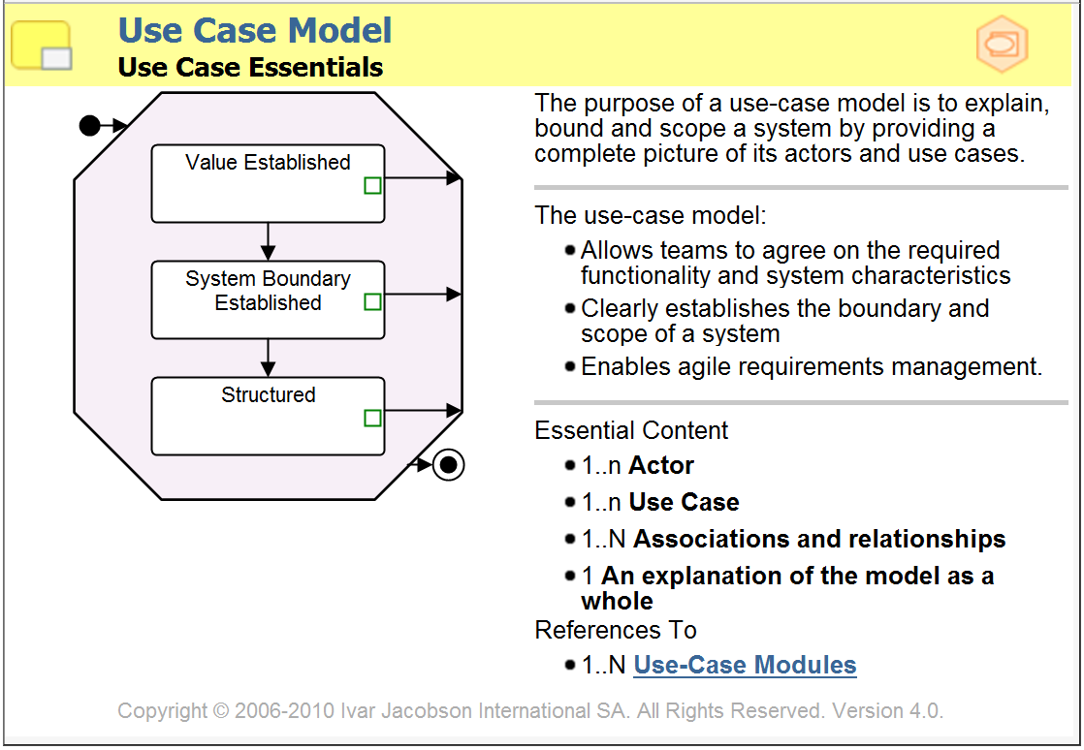
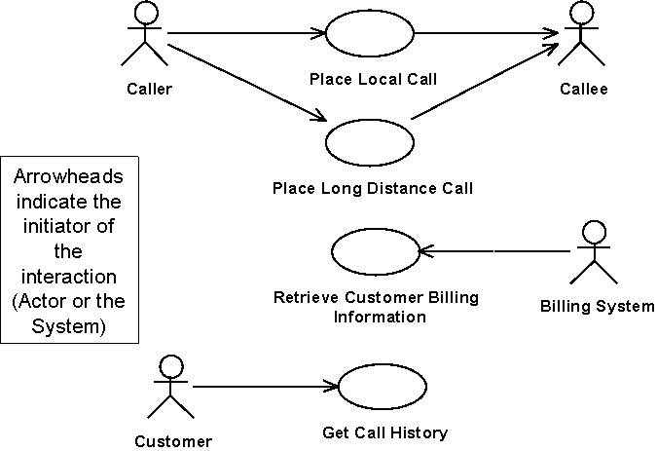

What is a Use-Case Model?
Handout:
Example Use-Case Model
Introduction to The Essentials / 03 - Use-Case Essentials
Notes:
Module 03 - Use-Case Essentials
Introduction to The Essentials
Use cases are an incredibly powerful tool for requirements management. They provide a simple and intuitive way to:
Establish the requirements of the system. The use cases place the requirements into the context of the user’s goals and the value to be delivered by the system.
Visualize the value to be provided by a system. The use cases themselves provide a visual index into the capabilities and value to be provided by the solution.
Establish the system boundary. The model identifies who or what interacts with the system and what the system should do.
Structure the requirements to support release planning and manage change.
Communicate the requirements to all the stakeholders. The use cases provide a common thread through all project activities, communicating with both the stakeholder community and the development community.
The slide shows a simple use case model representing the requirements for a simple telephone system. From this diagram alone you should be able to intuitively understand the value this system would provide to its users and form your own opinion about the suitability of the proposed solution.
Use-case models can be detailed at various levels to either:
Succinctly capture the value expected from the system
Fully describe the system boundary and all the interactions between the system and its actors, or
Allow complex models to be structured to facilitate reuse, enhancements and project planning.
The handout contains a fuller description of an example use-case model.

Slide 35
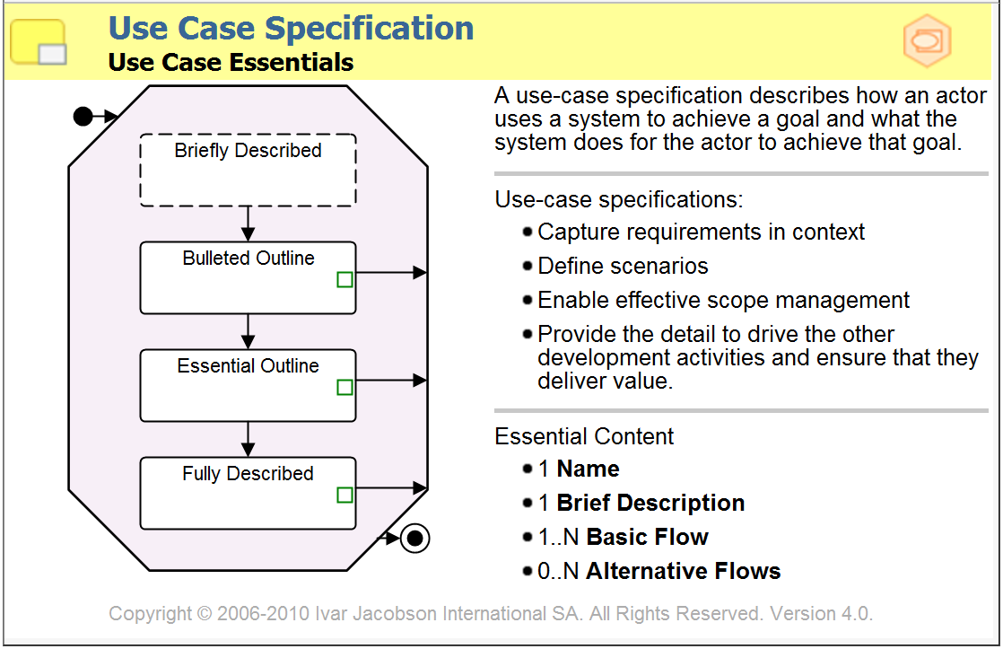
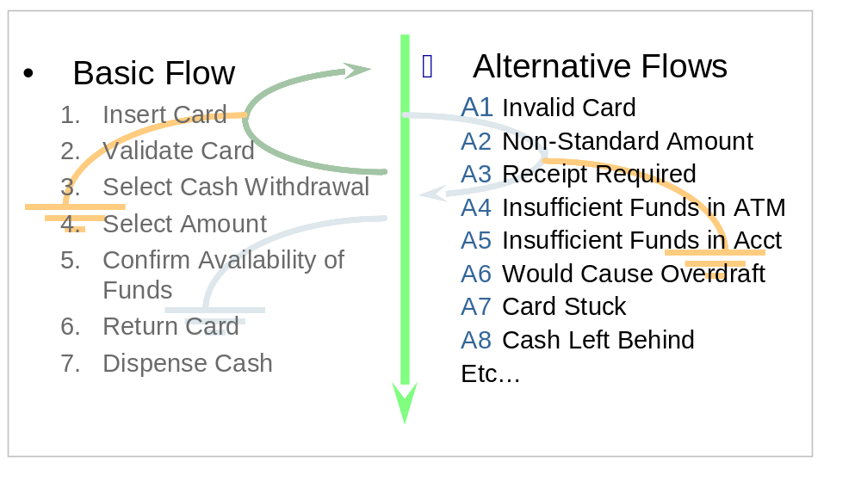
Describing a Use-Case
Handout:
Example Use-Case (Outline)
Handout:
Example Use-Case (Fully Described)
Introduction to The Essentials / 03 - Use-Case Essentials
Notes:
Module 03 - Use-Case Essentials
Introduction to The Essentials
A use-case specification is composed of the following elements:
A Basic Flow of Events
The normal way of attaining the value,
The expected path through the use case
The assumption behind the basic flow is that it will successfully enable the actor to achieve the goal and extract the value represented by the use case
Alternative Flows of Events
Other ways of attaining the value
Exception and error conditions
The structure of the flow of events is additive with the alternative flows being defined in terms of their variance from the basic flow. The graphic behind the flows illustrates the typical structure of a flow of events. The straight arrow represents the basic flow of events, and the curves represent the alternative paths in relation to the basic flow. Some alternative paths return to the basic flow of events, whereas others end the use case.
There are other attributes that can be used to characterize and add more information to the use-case specifications but they are all optional. The elements listed are the essential components of a use case.

Slide 36
Use Cases Drive Both Development and Testing
Use-Case Flows
Test Design and Preparation
Scenarios
Test Cases
Use Case Realizations
Test
using Test Cases
Code
Unit Tested
Software
Testable
Release
System Design and Preparation
Introduction to The Essentials / 03 - Use-Case Essentials
Notes:
Module 03 - Use-Case Essentials
Introduction to The Essentials
The use cases constitute the basis for identifying test cases and building tests. The system is verified by performing each use case.
The use cases provide us with a black box view of the system. The use-case realizations provide a white box view of the system and relate the requirements to the individual pieces of the system.
The key to deriving tests from the use cases, for black box testing, is the identification of a set of test cases that will achieve the test objectives for functional and requirements coverage. As they are based on the flows of events inside the use case each test case will describe a complete test scenario.
The key to deriving tests from the use cases, for white box testing, is the identification of a set of design level scenarios (from the interactions documented in the use case realizations) that will achieve the test objectives for design validation and component coverage. This relationship is shown by the arrow between the use-case realization and the test in the diagram above.
Based upon the use cases the test identification and preparation activities can proceed in parallel with the system design and preparation ones. This enables the tests to be available when the testable release becomes available. Test cases derived from the use cases take advantage of the way that use cases gather together the requirements to ensure good functional test coverage of the system and to produce robust, repeatable tests.
What is a Scenario?
Scenarios are instances, or specific occurrences, of use cases. Scenarios are useful because they help us think in concrete terms about what a system will do when a particular use case is performed. They help us walk through exactly what will happen to make sure that we have everything handled properly, and are useful when defining the test cases that are required to test the system to make sure that it performs the way the use cases say it should.
A typical use case will have a main flow of events and several alternate flows of events. A single scenario will walk through one particular path through the use case, exploring a particular way that the use case can be performed from beginning to end.

Slide 37
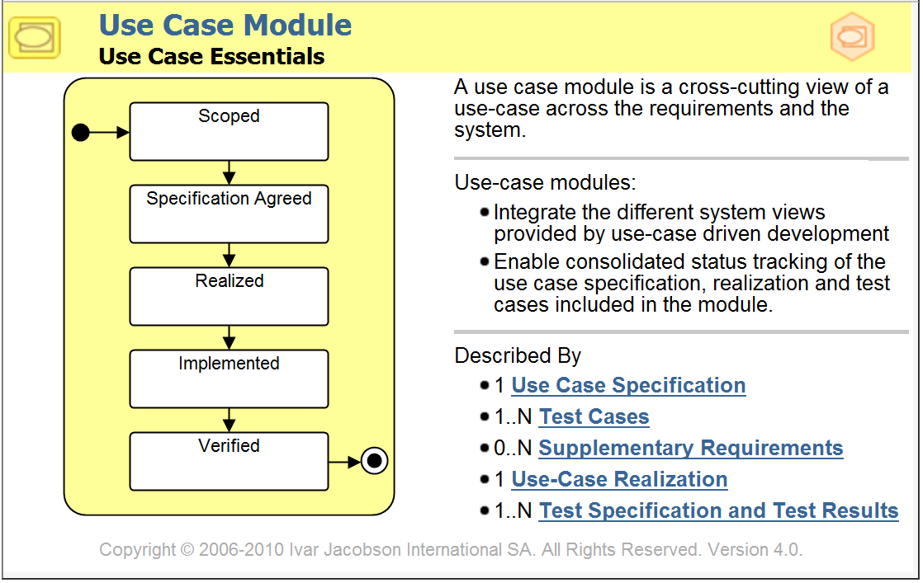
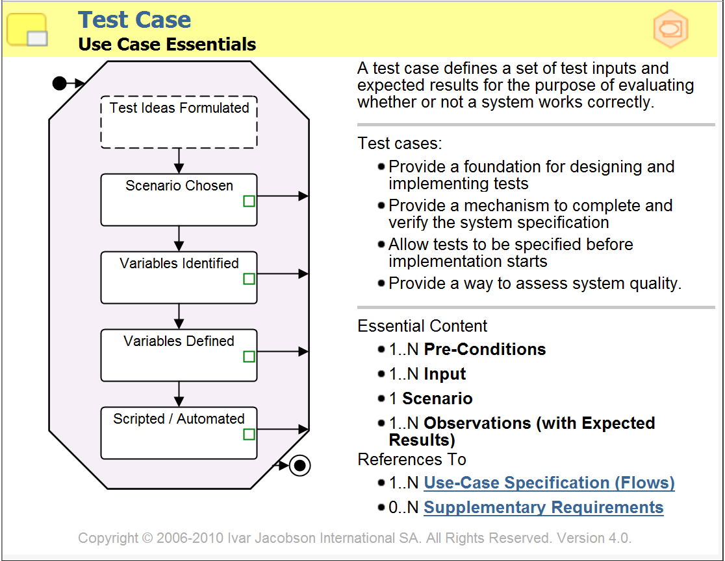
The Use-Case Module
The use-case module gathers together a set of use-case flows and their corresponding test cases to fully describe an aspect of the System
Introduction to The Essentials / 03 - Use-Case Essentials
Notes:
Module 03 - Use-Case Essentials
Introduction to The Essentials
The use-case module gathers together all the specification information about a particular aspect of the system. This includes both the requirements information and the test cases to be used to verify that the requirements have been met.
This 1) ensures that sufficient information is captured to implement and test the system and 2) allows the team to select the appropriate place to capture the detail of the requirements.
Using the use-case module:
The default is one use-case module per use-case. So use case 1 leads to the creation of use-case module 1.
When selecting and prioritizing use cases to work on, the use-case modules may need to be sub-divided if 1) the team wishes to develop sub-sets of the flows of the use case at different times or 2) the use case module as it stands is too large a piece of work to fit into the team’s plans.
For example, use-case module 1 might be split up creating use-case modules 1a, 1b and 1c. The underlying use-case and its use-case specification would remain un-changed.
Each resulting use-case module is then driven and progressed through the activities in the process to produce working software.

Slide 38
The use-case module is key to being agile
Working with Use-Case Modules
  Think about your risks and identify the key scenarios
  Think about the natural groups of flows
  Think about testing and proving the system
  Think work items and about driving the development
Lightweight use cases are enough to identify and reason about use-case modules
Use-case modules are in a sense similar to user stories w.r.t. agility but there is a significant difference:
  The context of a use-case model provides a more powerful way of reasoning about the requirements
    Completeness/scope
    Reference/detail/understandability
    Scalability
Introduction to The Essentials / 03 - Use-Case Essentials
Notes:
Module 03 - Use-Case Essentials
Introduction to The Essentials

Slide 39
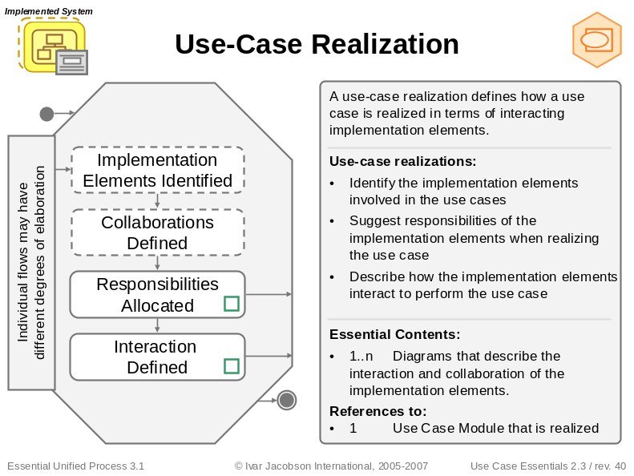
Use-case Realizations
Use
-
cases
Use
-
case Realizations
Elements of the Implemented System collaborating to perform the use cases.
Reserve
Customer
Reserve
Room
Screen
Room
Reservation
Handler
Room
Staff
Check In
Reservation
Use cases from the Specified System.
Check
-
In
Screen
Handler
Customer
Room
Check
-
Out
Staff Screen
Check Out
Room
Customer
Handler
Aligning the Specified and Implemented Systems
Introduction to The Essentials / 03 - Use-Case Essentials
Notes:
Module 03 - Use-Case Essentials
Introduction to The Essentials
Use-case realizations illustrate how the elements of the Implemented System will collaborate together to enable the system to perform the use case.
Use-case realizations can take many forms:
Visually as UML interaction diagrams
Textually as a narrative description
Or just as a cross reference between the flow of events and the implementation elements involved.

Slide 40


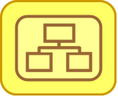

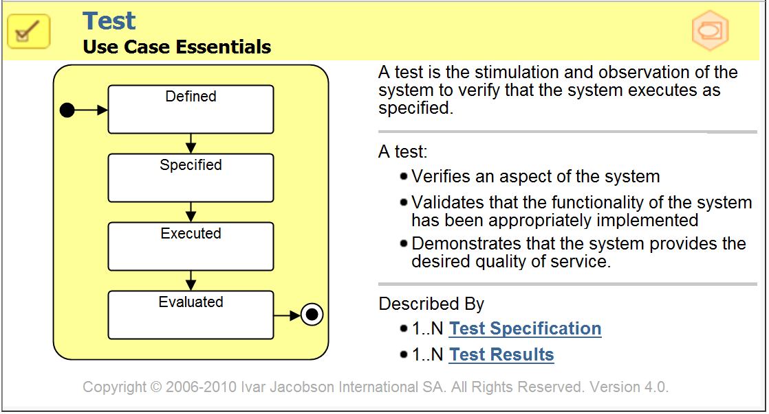
Tests verify the implementation of the Use-Cases
Use-Case
Module
Requirements
System
Test
For the use-case module
to be verified it requires the corresponding test to be executed and evaluated.
Introduction to The Essentials / 03 - Use-Case Essentials
Notes:
Module 03 - Use-Case Essentials
Introduction to The Essentials

Slide 41
Use-Case Specifications enable agility
Authoring State | Primary Purpose | Supports
Briefly Described | Identify the use case and summarize its purpose. | Basic scope management Discussions about requirements
Bulleted Outline | Summarize the shape and extent of the use case. | Scope management Low fidelity estimation. Collaborative test definition Impact analysis and prototyping. Component identification
Essential Outline | Summarize the essence of the use case. | User Interface design. Prototyping. Collaborative, creative analysis and design Collaborative test definition High fidelity estimation
Fully Described | Provide a full, detailed requirements specification for the use case. | Analysis and design Implementation and testing Creation of user documentation. High fidelity estimation
Introduction to The Essentials / 03 - Use-Case Essentials
Notes:
Module 03 - Use-Case Essentials
Introduction to The Essentials
Within the framework provided by the use cases there are a number of strategies available for capturing the correct amount of detail to address the risks inherent in the project. For example the following approaches are all compatible with the use case driven approach:
Lightweight Requirements - For many systems outlines that clearly denote the responsibilities of the system and the actors (a form known as an Essential Outline or Essential Use Case[1] is sufficient, with the detail of the specification being documented via prototyping and analysis modeling activities.
Formal Requirements – the use case specifications can be elaborated into a full and complete, formal requirements specification defining all of the system’s inputs, outputs and responses. The use cases can then be used to act as a formal contract between the customers and the developers.
Test First – based upon use case outlines the requirements detail can be captured in test cases derived from the use cases’ flows of events. The development team can then develop software to pass the set of test cases.
Creative Analysis and Design – In some cases it is impossible to define what the detailed requirements are without first developing the solution, because no one has seen or experienced the kind of solution that needs to be developed. In these case cases capturing the goals of the stakeholders and the value to be realized by the system in the form of a set of outlined use cases provides a firm foundation for the creative design of the solution whilst also supporting its controlled iterative development.[2]
What is important in all cases is that the additive structure of the use cases and the flows of events allow the requirements, whatever their level of detail, to be considered in terms of the value that they deliver and be approached as complete end-to-end stories that if implemented will enable that value to be realized.
This flexibility in the use of the early outline-level requirements statements empowers the team to approach the problem iteratively and to iteratively evolve the solution whilst continuing to iteratively evolve the requirements. Given even the briefest outlines of a set of use cases and their flows of events it is possible to start to prototype candidate solutions and consider their impact on any existing components and solutions intended for use as part of the new system.
[1] Larry Constantine is most often associated with this formulation of use cases; see Constantine, L. "The Case for Essential Use Cases." Object Magazine, May 1997. NY, NY: SIGS Publications.
[2] Note that capturing the goals in this way is also useful when using packaged solutions, where the detailed requirements of the customer are secondary to the current implementation of the package. The use case outlines allow the package to be verified against the user goals and the system’s expected value without the overhead of creating irrelevant, detailed specifications.

Slide 42








Use Cases and the project team
Use Cases can be used as a unifying principle that unites the activities of the project
User Experience Designers -
Customers -
Is the right system getting built?
Need to understand the users goals
Managers -
Plan and monitor
Analysts -
Need to describe and document what the system does
Project
Developers -
Need to understand what the system does
Testers -
Need to know what the system does
Technical
Writers -
Need to know what the system does
Introduction to The Essentials / 03 - Use-Case Essentials
Notes:
Module 03 - Use-Case Essentials
Introduction to The Essentials
Use cases provide benefit to all the members of the team.
They describe what the system does in an agile and easily accessible fashion.
Use-case modules make effective work items to drive the development practices and ensure that the software produced delivers real business value.

Slide 43
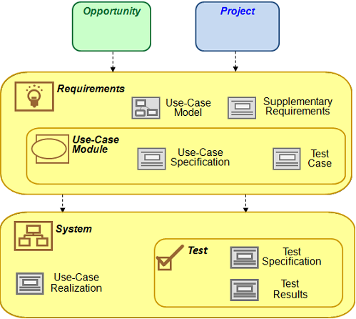
What do we need to produce?
Introduction to The Essentials / 03 - Use-Case Essentials
Notes:
Module 03 - Use-Case Essentials
Introduction to The Essentials
Inputs include:
Opportunity: an understanding of the problem & stakeholder needs
Project: work items and plans
Use-Case Model
Defines the extent and boundary of the Requirements
Supplementary Requirements
Captures any requirements that do not fit into the use-case model
Use-Case Module
A cross-cutting view of a use case (or a set of use case flows) across the Specified, Implemented and Executable systems.
Use-Case Specification
A document describing a use case’s flow of events
Use-Case Realization
A description of the pieces of the implemented system involved in implementing the use case module
Test Case
A description of how to verify a specific set of requirements (in this case scenarios based on the flow of events)
Test
A physical test undertaken to verify the implementation of the use cases
Test Specification
Specifies how to run a test and the test cases covered by the test
Test Results
Results of the use-case based testing

Slide 44
How do we progress and complete the use-cases?
Scope the use-case module
  Identify the flows to be described and implemented
Agree the Specification
  Write the use-case specification
  Write the test cases
  Remember to cover special and supplementary requirements
Realize the flows of events
  Allocate the requirements described by the flow of events to the elements of the Implemented System
  Understand the impact of implementing the new requirements
Implement software to deliver the use case
  Amend the affected implementation elements
  Integrate the system
Verify the system produced
  Execute tests based on the test cases to verify the system delivers the use cases as specified.
Scoped
Specification
Agreed
Realized
Implemented
Verified
Introduction to The Essentials / 03 - Use-Case Essentials
Notes:
Module 03 - Use-Case Essentials
Introduction to The Essentials
The use-case modules allow us to drive the creation of working software based upon the flows of events defined by the use cases.
To create suitable work items the use-case modules can be split into parts that together constitute the original use-case module. This allows say use-case module 1 to be progressed in three parts use-case module 1a, use-case module 1b and use-case module 1c.
Each use-case module part is progressed and tracked as though it were a use-case module.
This allows the most important flows of the use case to be taken all the way to verified before the other flows have been realized or implemented.

Slide 45
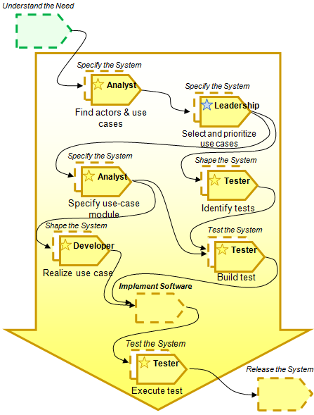
What activities do we need to do?
Introduction to The Essentials / 03 - Use-Case Essentials
Notes:
Module 03 - Use-Case Essentials
Introduction to The Essentials
Precursors include:
Understand the need: establish a shared understanding of the system to be built
This provides the context needed to create an effective use-case model
Find Actors and Use Cases
Discover the use cases that the system should provide
Identify the actors that will interact with the system
Create the initial set of use-case modules
Select and Prioritize Use Cases
Select the flows of events to be implemented
Prioritize the flows so that their business value and technical risk is clear
Re-factor the use-case modules to support team working and the project plans
Specify use-case module
Clearly capture the system’s requirements by describing the use cases and their corresponding test cases
Realize a use-case
Understand the impact of adding the use case to the implemented system
Distribute the requirements captured by the use case to the elements of the implementable system
Identify Tests.
Set the test strategy for verifying the use cases and identify the set of tests to be run
Build Test
Develop repeatable tests using the test cases defined in the use-case modules
Execute Test
Execute a test to verify one or more use-case modules

Slide 46


What competencies do we need?
Analyst
At least one team member able to:
  Build the use-case model and facilitate workshops
Many team members able to:
  Specify the use cases
  Involve stakeholders so that true
  requirements are captured
Applies
Applies
Complementary
Complementary
Techniques
Techniques
Adapts
Adapts
Techniques
Techniques
Facilitates
Facilitates
Discussions
Discussions
Customer
Builds Models
Representative
Builds Models
At least one customer able to:
  Advise the project
Many customers to be able to:
  Provide information
Directs the
Directs the
Clearly Describes
Clearly Describes
Business
What
Business
What
’
’
s Needed
s Needed
Actively Manages
Actively Manages
Scope
Tester
Scope
Ambassador
Leads Large
Ambassador
Leads Large
-
-
Scale
Scale
User
Testing Efforts
User
Testing Efforts
At least one team member able to:
  Identify an appropriate set of tests
Many team members to:
  Specify test cases
  Involve stakeholders so that true requirements are tested
  Prepare the executable system for testing
Project
Plans Testing
Project
Plans Testing
Advisor
Advisor
Subject Matter
Leads
Subject Matter
Leads
Expert
Testing
Expert
Testing
Specifies
Specifies
Test Cases
Test Cases
Executes Tests
Executes Tests
Introduction to The Essentials / 03 - Use-Case Essentials
Notes:
Module 03 - Use-Case Essentials
Introduction to The Essentials
The core competencies required are:
Analyst – the team must posses analytical and modeling skills to construct a well-formed use-case model
Tester – the team must have the ability to defined test cases and build effective tests from these
Customer Representative – the team must include people with the ability to represent the customers, This could be in the form of an on-site customer, a user group, or some friendly stakeholders.
The Developer competency is obviously also needed to turn the use-cases into a suitable implementation.
If the development is to be out-sourced this competency will be provided by the supplier.
If the development is to be done in-house then because the use cases cut across the elements of the implemented system it is advised to have at least one developer at the Shapes Systems competency level to do the impact analysis and help to scope the use-case modules. Other developers will be needed to do the rest of the development work.

Slide 47
Some important Do’s and Don’ts
Do track progress with use cases
  Track progress in terms of verified requirements
  The software does not count as finished until it has been verified against the use case
Do select use-cases to implement based on project risk
  The flows in the use case allow specific risks to be targeted
Do use use-case modules to enable scenario-based planning
  The use-case modules and their flows provide an effective scenario-based planning mechanisms
Do just-enough requirements
  Stop at the first level of detail that addresses your risks
Do share use cases with the customers
  Customer collaboration is essential to produce good use-case models and use-case specifications
Introduction to The Essentials / 03 - Use-Case Essentials
Notes:
Module 03 - Use-Case Essentials
Introduction to The Essentials

Slide 48





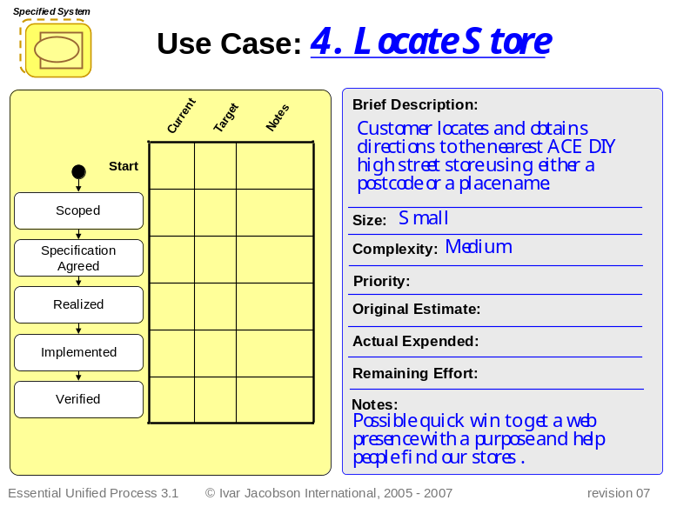

The use-case modules control the game
Requirements
ACE DIY On
-
Line
Requirements:
______________
Conceived
Shared
Stable
Correct
Testable
Fulfilled
Brief Description:
Current
Target
Notes
Start
Conceived
Size:
Start
Shared
Complexity:
Stable
Original Estimate:
Actual Expended:
Correct
Remaining Effort:
Testable
Notes:
Scoped
Fulfilled
Essential Unified Process
©
Ivar Jacobson International, 2006
revision 07
Specification
Case Modules
Agreed
-
Realized
Use
Implemented
Verified
Introduction to The Essentials / 03 - Use-Case Essentials
Notes:
Module 03 - Use-Case Essentials
Introduction to The Essentials

Slide 49
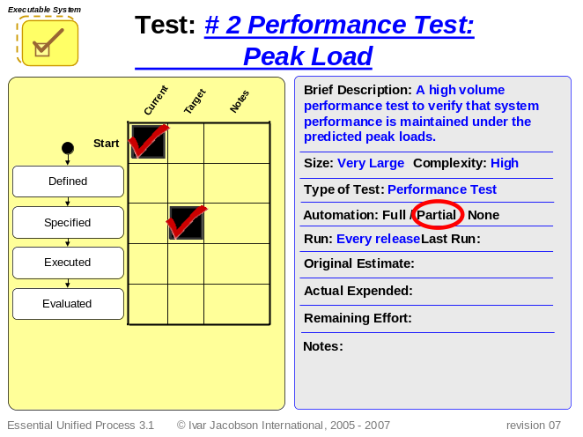




Tests are needed to verify the implementation
System
Assembled
Approach
Functionality
Ready to
Accepted
Operational
Validated
Validated
Deploy
Start
Defined
Tests
Specified
Executable System
Test:
# 1 System Test
Current
Target
Notes
Brief Description:
An automated
Executed
system test covering all implemented
use cases. Run every day a new build
Start
is produced.
Defined
Size:
Large
Complexity:
High
Type of Test: System Test
Specified
Automation: Full / Partial / None
Evaluated
Run:
Every day
Last Run:
Executed
Original Estimate:
Evaluated
Actual Expended:
Remaining Effort:
Notes:
Essential Unified Process 3.1
©
Ivar Jacobson International, 2005
-
2007
revision 07
Introduction to The Essentials / 03 - Use-Case Essentials
Notes:
Module 03 - Use-Case Essentials
Introduction to The Essentials

Slide 50
Exercise: Applying the use-case essentials practice
Using:
The exercise instructions
The supplied instance cards and matrix
The supplied game boards
Requirements:
ACE DIY On
-
Line
______________
Current
Target
Notes
Brief Description:
Start
?
Conceived
Size:
Shared
Complexity:
Original Estimate:
Stable
Actual Expended:
Correct
Remaining Effort:
Notes:
Handout:
State to activity matrix
Testable
Fulfilled
Essential Unified Process
©
Ivar Jacobson International, 2006
revision 07
Apply the use-case essentials practice to simulate the development of the Ace DIY system.
Introduction to The Essentials / 03 - Use-Case Essentials
Notes:
Module 03 - Use-Case Essentials
Introduction to The Essentials

Slide 51
Summary
The Use-Case Essentials practice enables teams to specify and drive the development of a complex software solution
  It involves peopled skilled in analysis and testing, and with the ability to effectively represent the customers
  It captures the requirements in the form of use cases and described how to realize and test these use cases to ensure that a high quality, high value system is produced
  It can be used with any software development practices
  It supports many models of team size and distribution including
    Small collocated teams
    Large distributed teams
    Out-sourced development activities
Other practices may be needed to
  Define the business case and project plans
  Develop the software
  Release the system
Key points
Key points
Introduction to The Essentials / 03 - Use-Case Essentials
Notes:
Module 03 - Use-Case Essentials
Introduction to The Essentials

