Slide 1
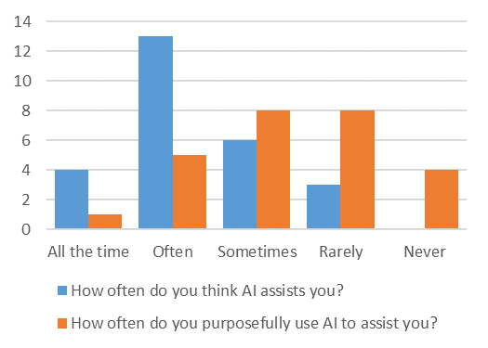

Slide 2
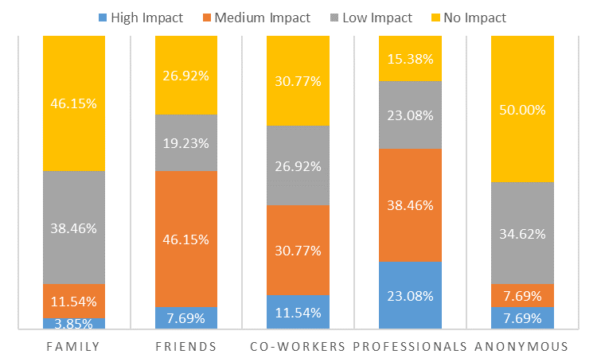

Slide 3
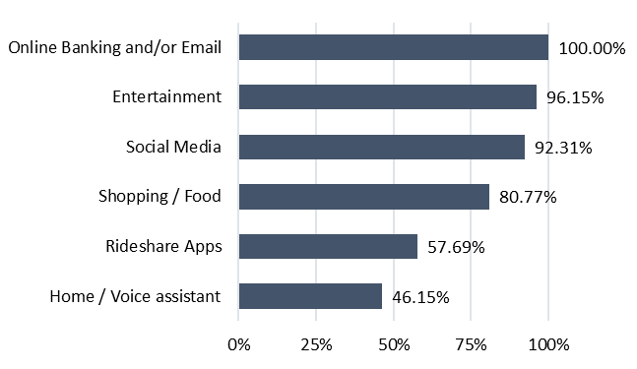
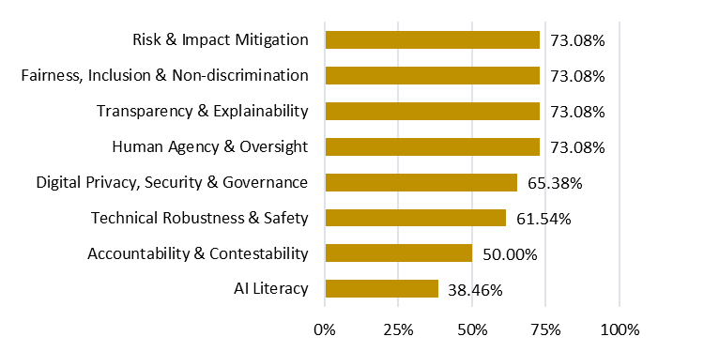
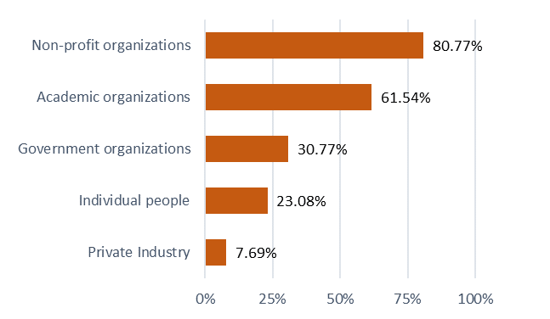
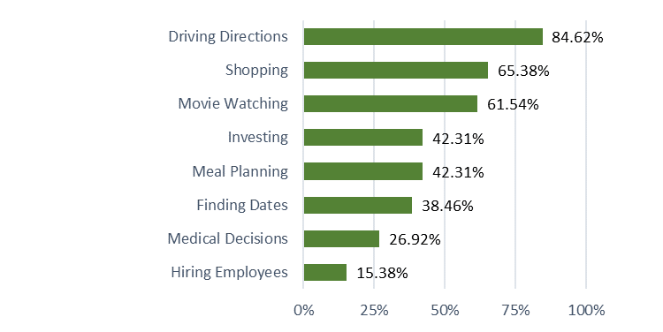
Which of the following…
…AI technologies do you regularly use?
…are important for trust in AI?
a
b
…do you trust to regulate AI?
…do you trust AI to assist you with?
c
d

Slide 4
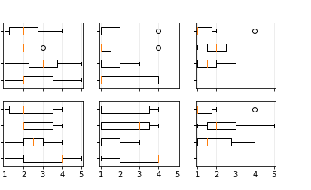
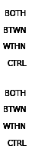
How often did the recommendations affect your decision?
How useful were the recommendations?
How useful were the reviews?
1 – Not at all
5 – All the time
a
b
c
Hiring
d
e
f
Movies

