Slide 1
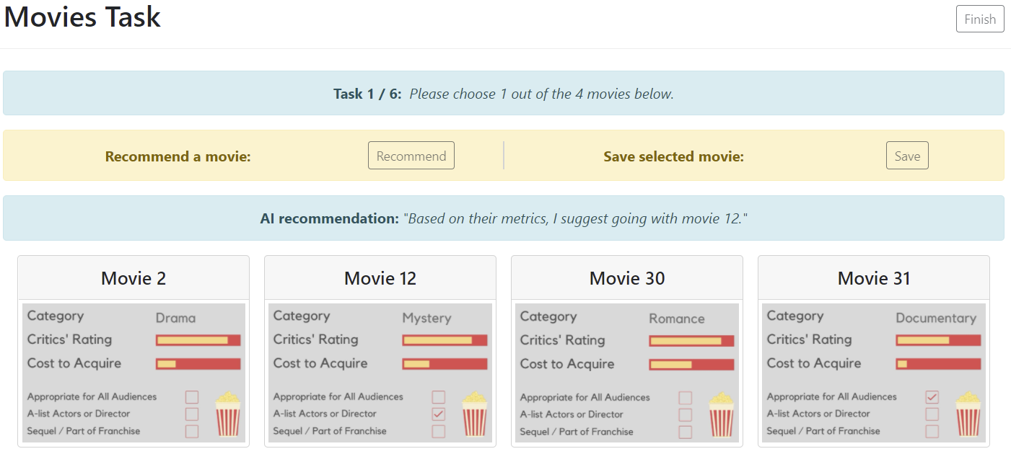
a
b
c
d
e

Slide 2
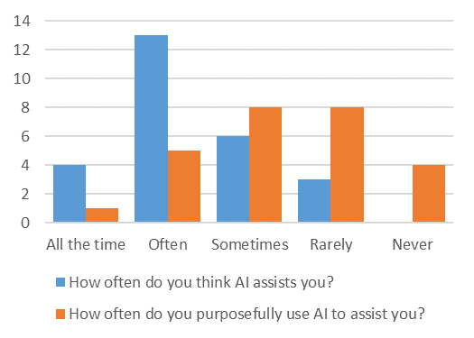

Slide 3
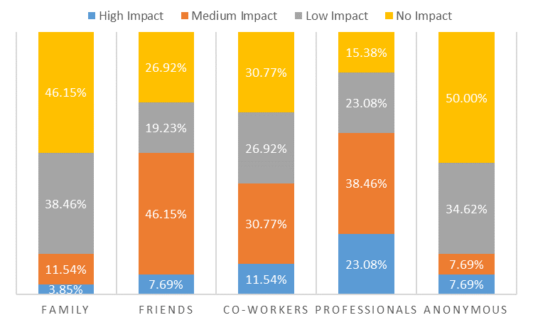

Slide 4
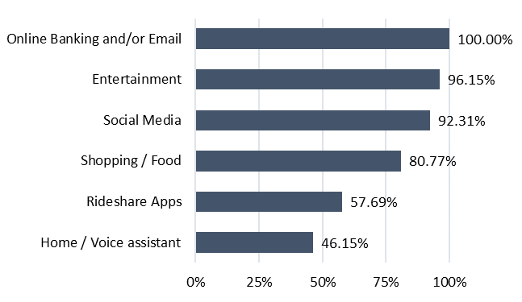
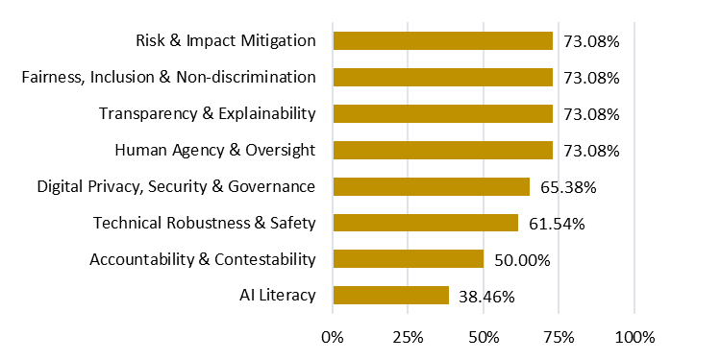
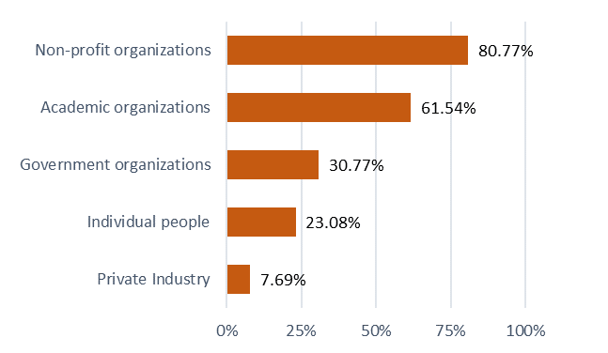
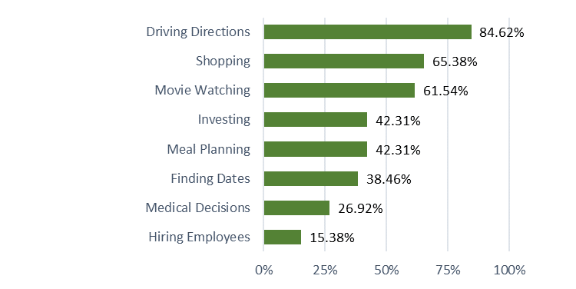
Which of the following…
…AI technologies do you regularly use?
…are important for trust in AI?
a
b
…do you trust to regulate AI?
…do you trust AI to assist you with?
c
d

Slide 5
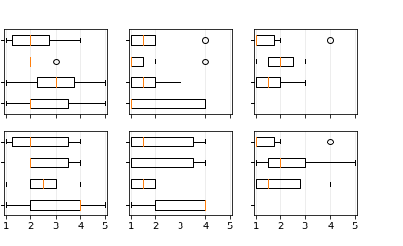
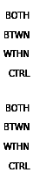
1 – Not at all
5 – All the time
How often did the recommendations affect your decision?
How useful were the recommendations?
How useful were the reviews?
a
e
c
Hiring
b
f
d
Movies

Slide 6
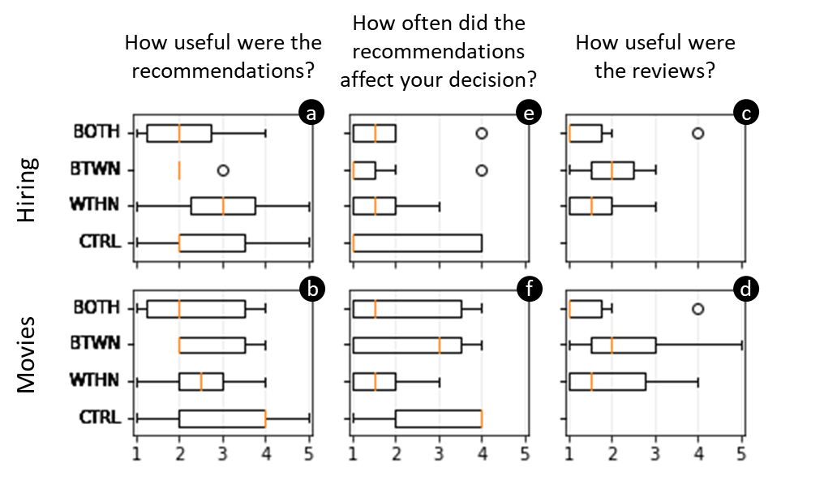
1 – Not at all useful 5 – Very useful
1 – Never 5 – Always

Slide 7
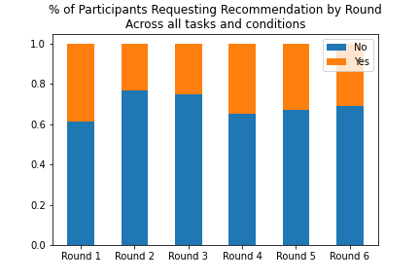
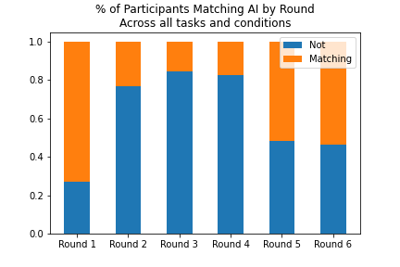

Slide 8
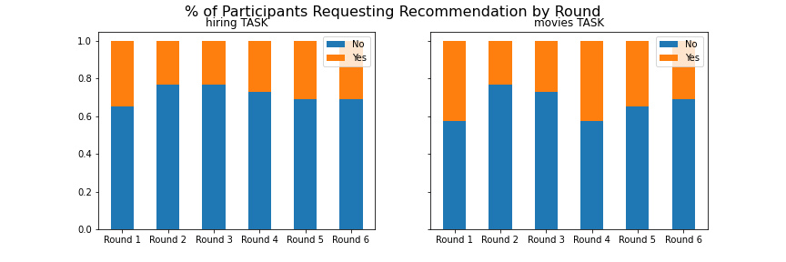
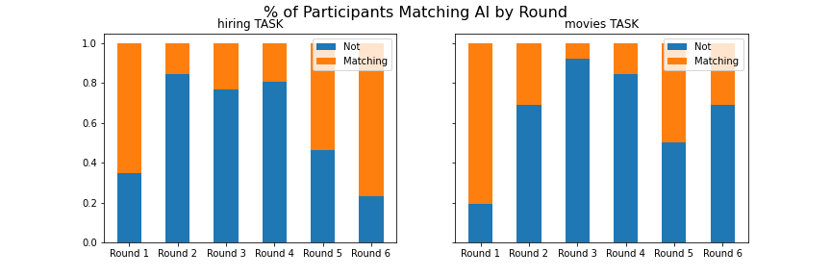
% of Participants Requesting
Recommendation by Round
% of Participants Matching
AI Selection by Round
Hiring Task
Hiring Task
Movies Task
Movies Task

Slide 9
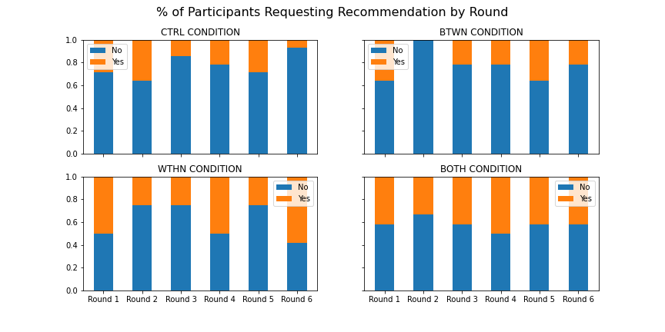
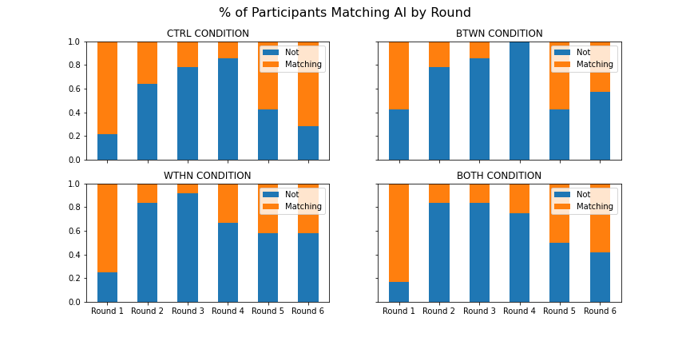
% of Participants Requesting
Recommendation by Round
% of Participants Matching
AI Selection by Round

Slide 10
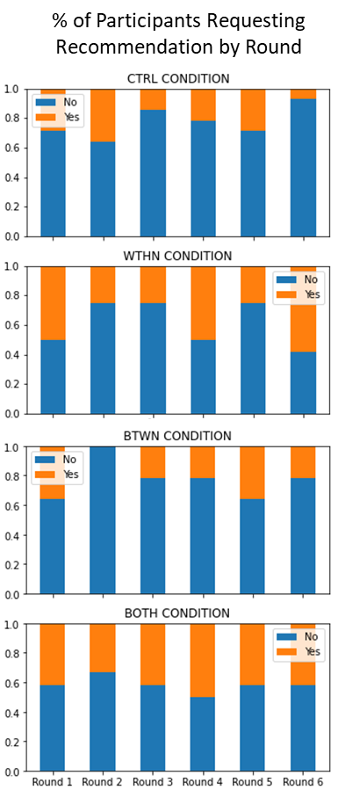
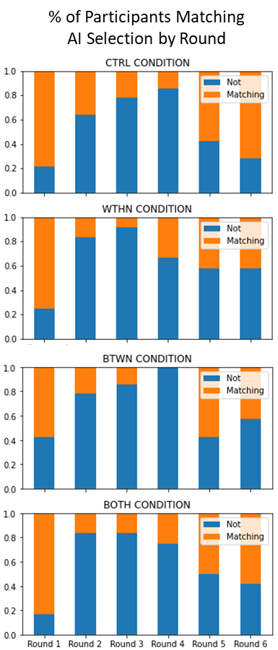
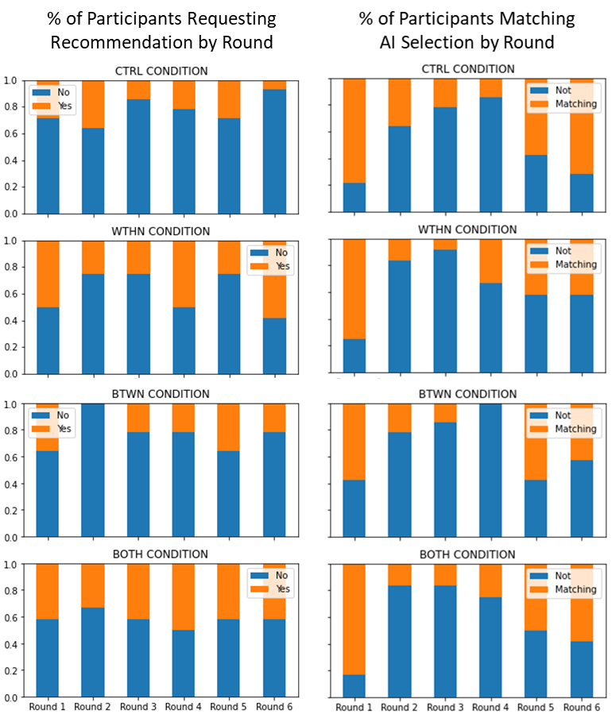
a
b

Slide 11
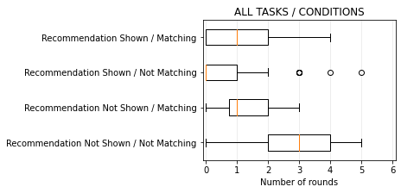

Slide 12
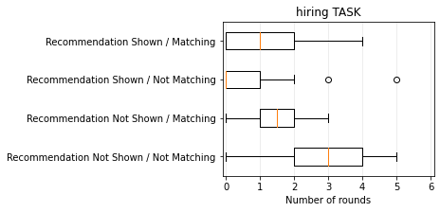
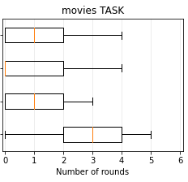

Slide 13
