Slide 1




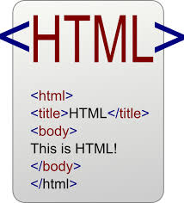


Data Inputs
Analysis and Process
Products
knitr
Sweave
Version Control

Slide 2
Data Inputs
Analysis and Process
Products
knitr
Sweave

Slide 3
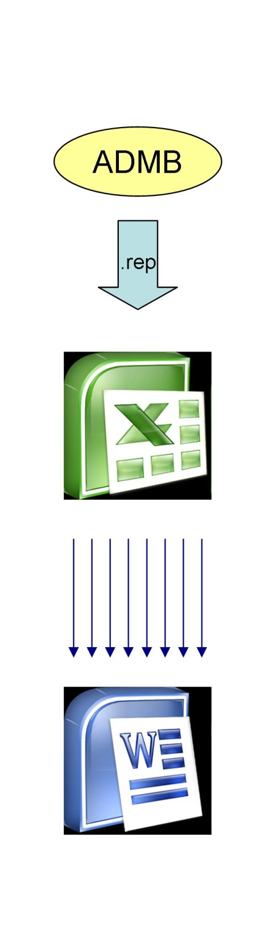

Slide 4
*.rnw
knitr(rnw)
*.tex
latex(tex)
*.pdf

Slide 5
*.rnw
knitr(rnw)
*.tex
latex(tex)
*.pdf
*.tpl
tpl2cpp
*.cpp
compile
*.exe

Slide 6
