Slide 1




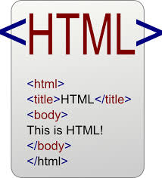


Data Inputs
Analysis and Process
Products
knitr
Sweave
Version Control

Slide 2
Data Inputs
Analysis and Process
Products
knitr
Sweave

Slide 3
