Slide 1




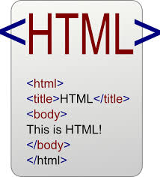


Data Inputs
Analysis and Process
Products
knitr
Sweave
Version Control

Slide 2
Data Inputs
Analysis and Process
Products
knitr
Sweave

Slide 3
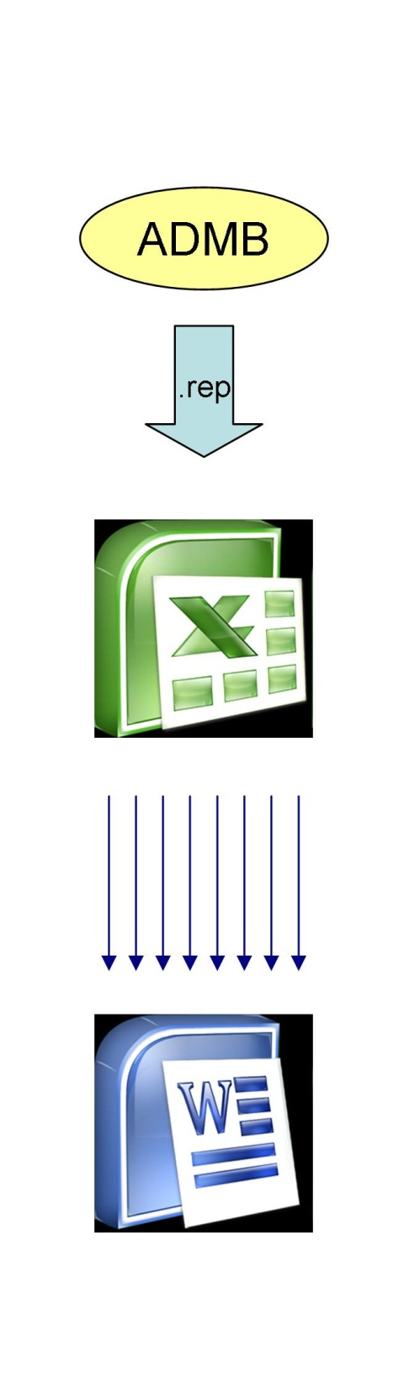

Slide 4
*.rnw
knitr(rnw)
*.tex
latex(tex)
*.pdf

Slide 5
*.rnw
knitr(rnw)
*.tex
latex(tex)
*.pdf
*.tpl
tpl2cpp
*.cpp
compile
*.exe

Slide 6
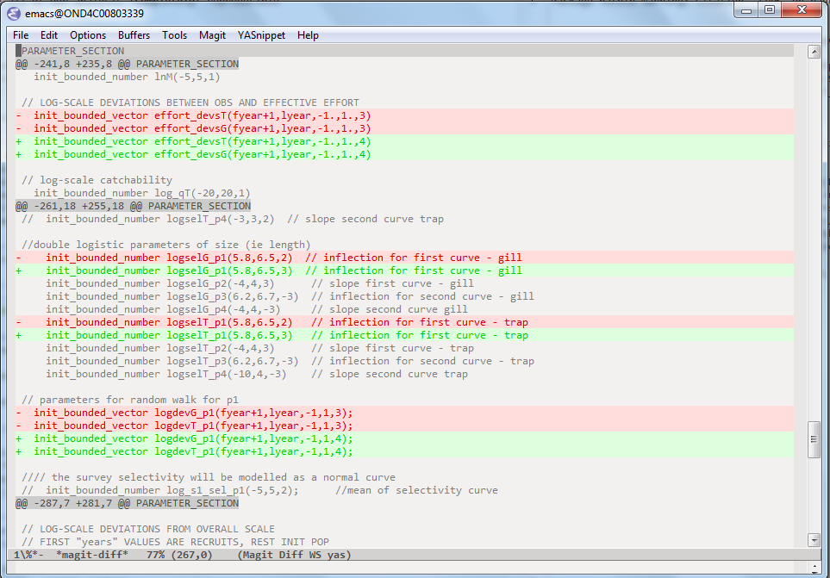

Slide 7
a5c64ca
fb0e936
branch
merge
2eabdd2
fef4257
d448487
5565a92
96e1c1b
HEAD

Slide 8
2eabdd2
HEAD

