Slide 1




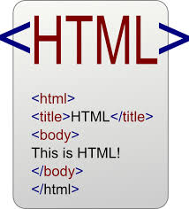


Data Inputs
Analysis and Process
Products
knitr
Sweave
Version Control

Slide 2
Data Inputs
Analysis and Process
Products
knitr
Sweave

Slide 3
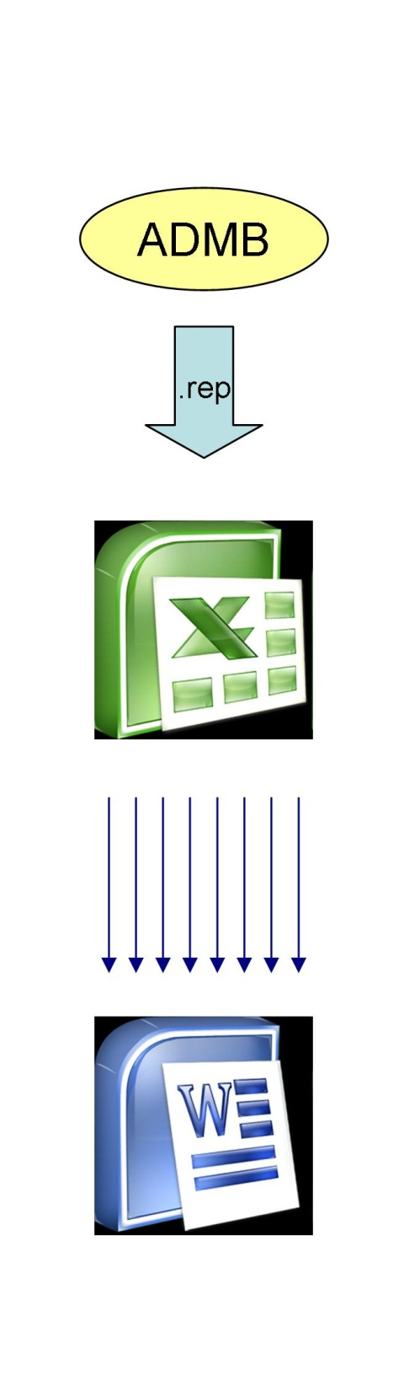

Slide 4
*.rnw
knitr(rnw)
*.tex
latex(tex)
*.pdf

Slide 5
*.rnw
knitr(rnw)
*.tex
latex(tex)
*.pdf
*.tpl
tpl2cpp
*.cpp
compile
*.exe

Slide 6
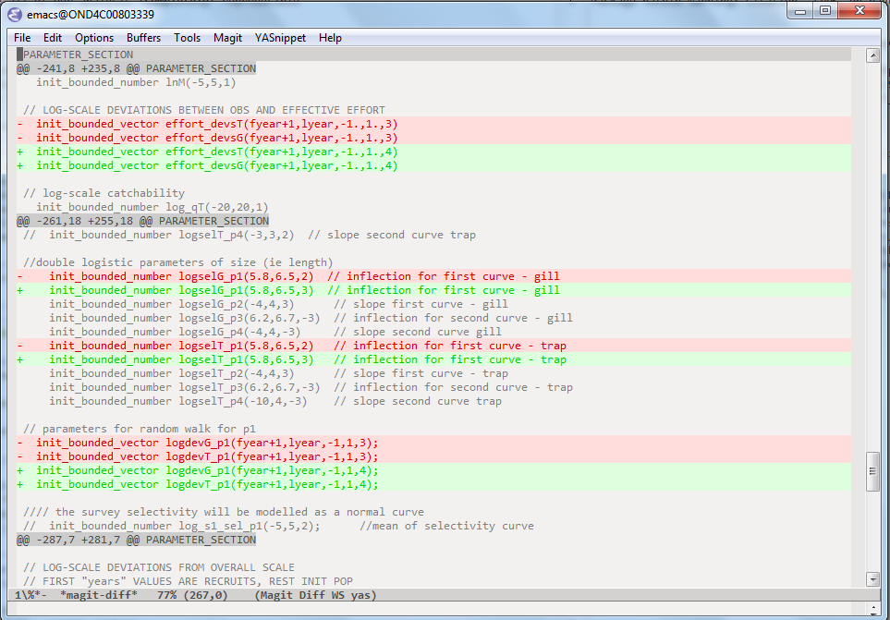

Slide 7
2eabdd2
HEAD

Slide 8
2eabdd2
fef4257
HEAD

Slide 9
2eabdd2
fef4257
d448487
HEAD

Slide 10
2eabdd2
fef4257
d448487
HEAD

Slide 11
a5c64ca
branch
HEAD
2eabdd2
fef4257
d448487

Slide 12
a5c64ca
fb0e936
branch
HEAD
2eabdd2
fef4257
d448487

Slide 13
a5c64ca
fb0e936
branch
2eabdd2
fef4257
d448487
5565a92
HEAD

Slide 14
a5c64ca
fb0e936
branch
merge
2eabdd2
fef4257
d448487
5565a92
96e1c1b
HEAD

