Slide 1
Direct3D EndScene() Hooking
EndScene() called by game when frame is ready for rendering
Idea: Intercept this call and draw more elements before calling EndScene()
=> Screen Overlays

Slide 2
Normal EndScene Call
Game Render Loop
Call
When all graphics elements for the frame are drawn
Direct3D EndScene()
Render graphics on screen

Slide 3
EndScene Hooking
Game Render Loop
Modified call address to redirect call
Custom Function
Can draw more elements
Call original function
Direct3D EndScene()
Render graphics on screen

Slide 4
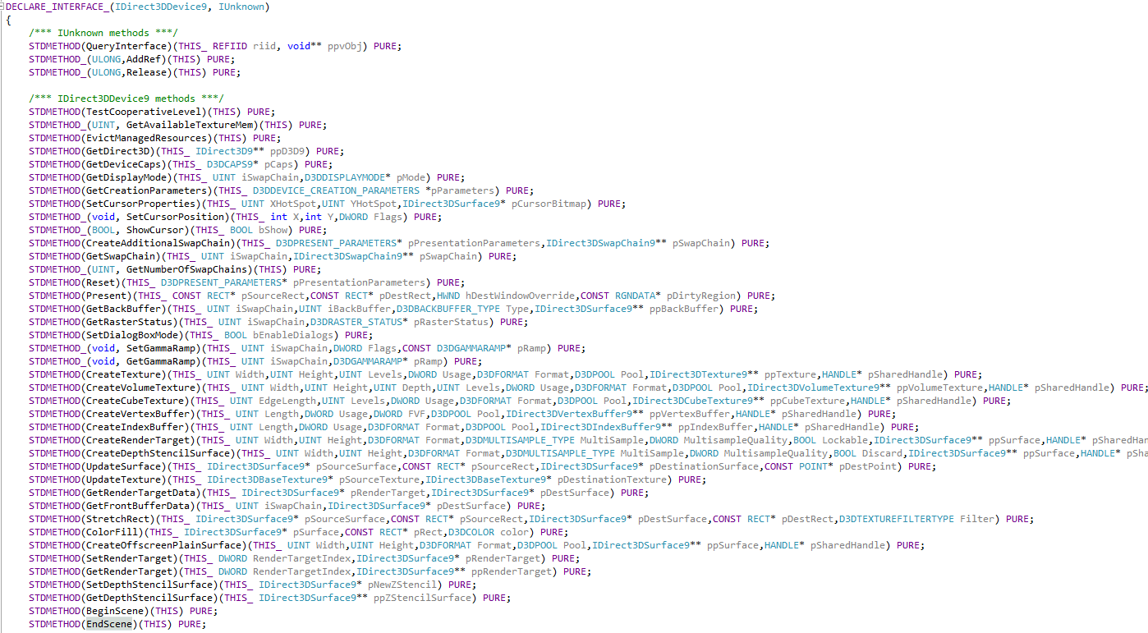
EndScene is a virtual member function of the IDirect3DDevice9 class
=> Hook in virtual method table (VMT)

Slide 5
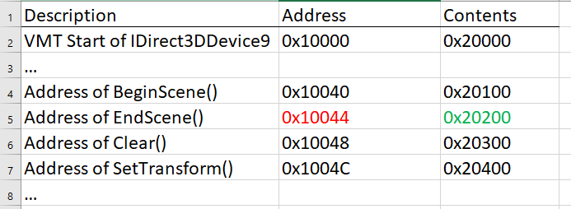
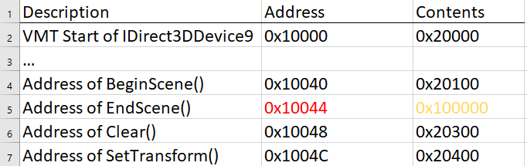
Virtual Method Table
Hooking:
Find VMT in RAM (by pattern/“magic number“)
Find address of EndScene() entry (0x10044 in this case). Just a fixed offset from the VMT start
Back up the 4 bytes at this address (0x20200 in this case).
These 4 bytes contain the address of the actual EndScene function
Overwrite the 4 bytes with the address of the custom function (0x100000 in this case)
=> When game calls EndScene(), it now calls the custom function!

Slide 6

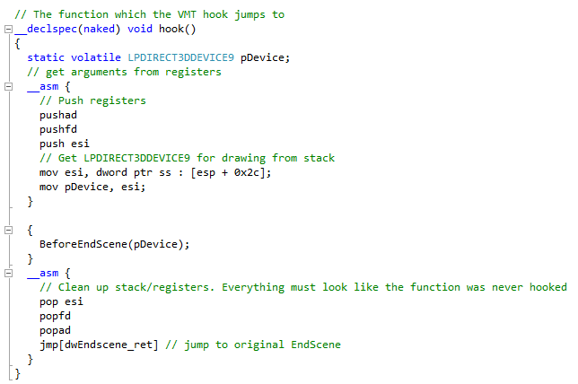
Custom Function
Called whenever EndScene is called by the game
Custom function can draw more elements, e.g. text by LPD3DXFONT->DrawText()
Elements act like part of the game
Time between 2 calls = time between 2 frames => FPS counter
Must call original EndScene when the function is finished
Stack and CPU registers + flags must be in original state, else undefined behavior
„Naked“ function => Compiler doesn‘t generate any entry/exit code
Store CPU registers + flags on stack
Get D3D device for drawing from stack
Call another custom function
Restore original stack+registers
Jump to actual EndScene() (address backed up before, 0x20200 in this case).

Slide 7
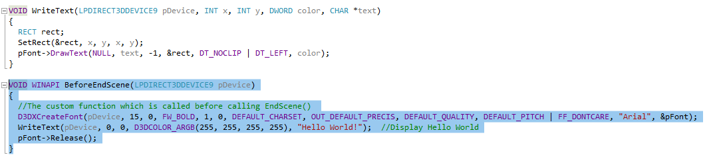
Secondary Custom Function
Called from the hook function
Does the actual drawing

Slide 8
DLL Injection – Quick Overview
Custom Function
Can draw more elements
Place to put our custom functions
DLL acts like part of the program; same address space
DLLMain() called when loaded => Hook can be applied here
How to load DLL into game???
=> DLL Injection

Slide 9
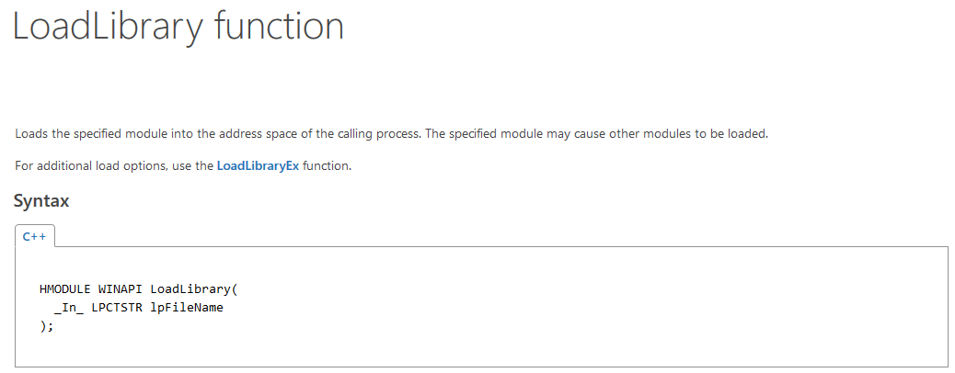
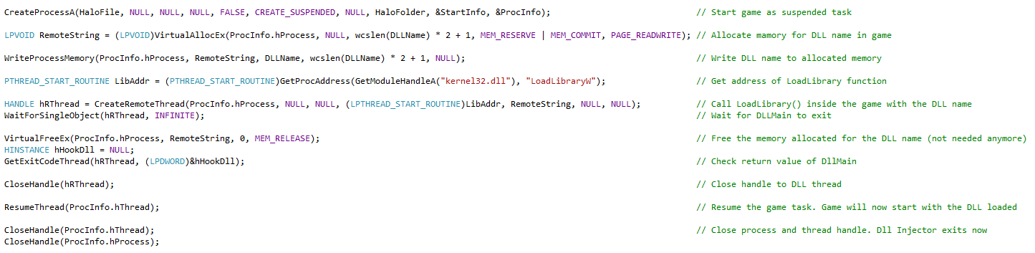
DLL Injection
Make game load the hooking DLL via LoadLibrary()

Slide 10
Putting it Together
Create injected DLL
- Hooks EndScene() on being loaded
- Executes custom function within the DLL before calling original EndScene()
- Custom function can draw more graphics elements
- DLL can access game memory freely
=> May use any data from the game and display them in overlay
Create DLL injector
Loads DLL into game
Universal
Uses for Direct3D Overlays:
FPS Counters
Status messages in games
Wallhacks

Slide 11
Sources
https://www.unknowncheats.me/wiki/Direct3D:DirectX_9_EndScene_Midfunction_Hook_Example

