Slide 1
Pulsar simulation with PSRPopPy
Adam D

Slide 2
Procedure
Calculate gain + observation time for each pulsar location
Apply radiometer equation to calculate SNR (using SNR cut off 9)
Generate order 100000 Pulsar

Slide 3
Results
118122 pulsars simulated
See order ~2000 , the number deviates everytime by ~100
Order ~20000 too faint
Order ~20000 smeared
Order ~70000 not in CHIME sky region
(showing 1796 pulsars detected, 25754 too faint, 19841 smeared, 70731 not in sky region)

Slide 4
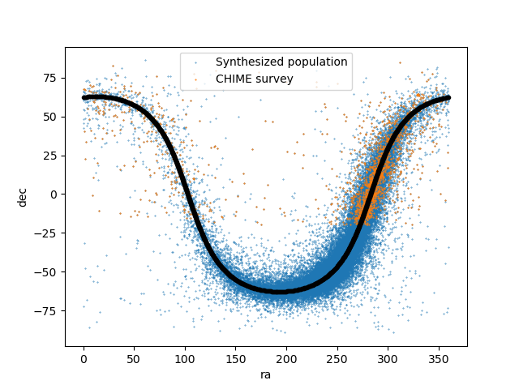
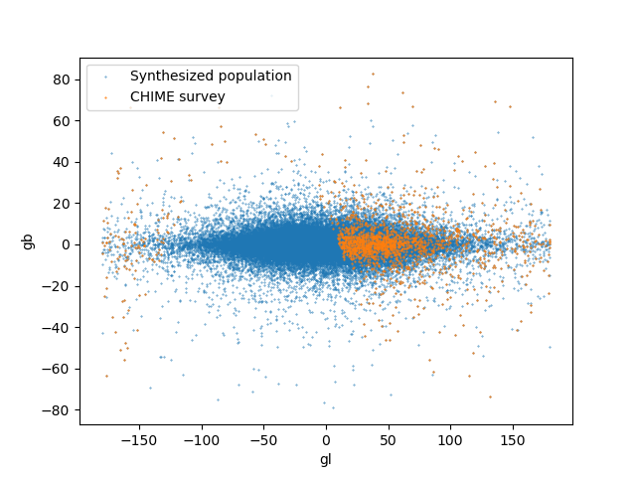

Slide 5
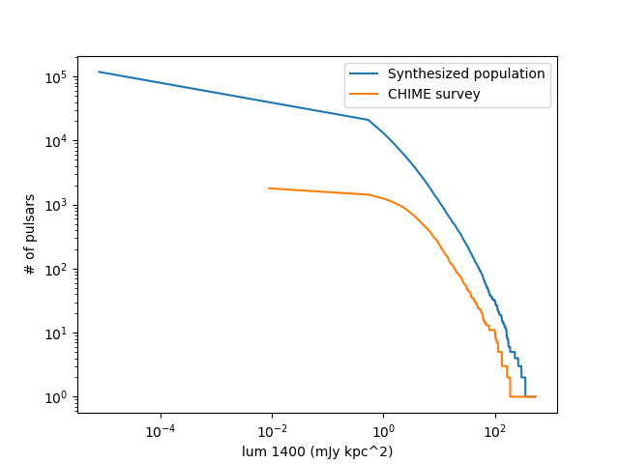
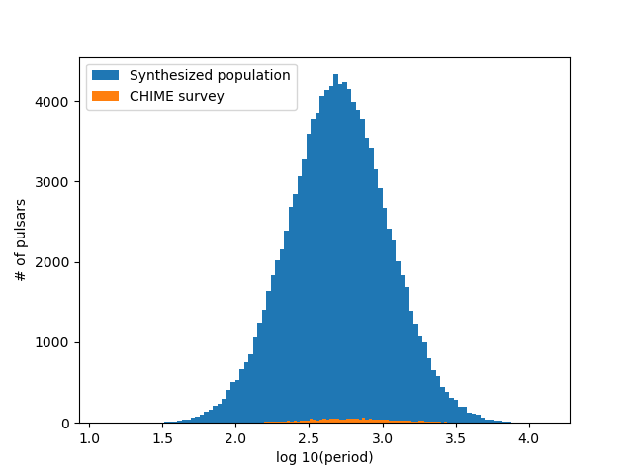
Luminosity distribution
Log norm [-1.1,0.9]

Slide 6
Parameters
Duty percent = 6%
Scindex = - 3.86 – spectral index of scattering model
Radial distribution type=lfl06
SiDistPars=[-1.6,0.35] mean, sig – Gaussian
Period dist = [2.7,-0.34] mean, sig – log norm
Radiometer single pulse eq:
  Where S_sys = T_sys/gain
  Beta is the telescope degredation factor =1

Slide 7
1.0 ! survey degradation factor
1.16 ! antenna gain (K/Jy)
641. ! days on sky (CHIME specific parameter)
1. ! sampling time (ms)
60. ! system temperature (K)
600. ! centre frequency (MHz)
400. ! bandwidth (MHz)
0.244140625 ! channel bandwidth (MHz)
2 ! number of polarizations
17.18 ! full-width half maximum (arcmin)
0. ! minimum RA (deg)
360. ! maximum RA (deg)
-20. ! minimum DEC (deg)
90. ! maximum DEC (deg)
-180. ! minimum Galactic longitude (deg)
180 ! maximum Galactic longitude (deg)
0. ! minimum abs(Galactic latitude) (deg)
90 ! maximum abs(Galactic latitude) (deg)
1. ! fractional sky coverage (0-1)
9.0 ! minimum signal-to-noise

Slide 8
Results
See order ~1000 rrats, the number deviates everytime by ~100
Order ~1 doesn’t burst while CHIME is watching
Order ~10000 too faint
Order ~10000 smeared
(showing 1302 rrats detected, 3 didn’t burst, 21939 too faint, 16838 smeared)

Slide 9
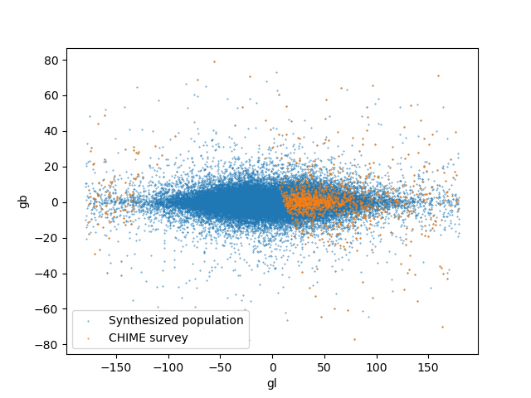
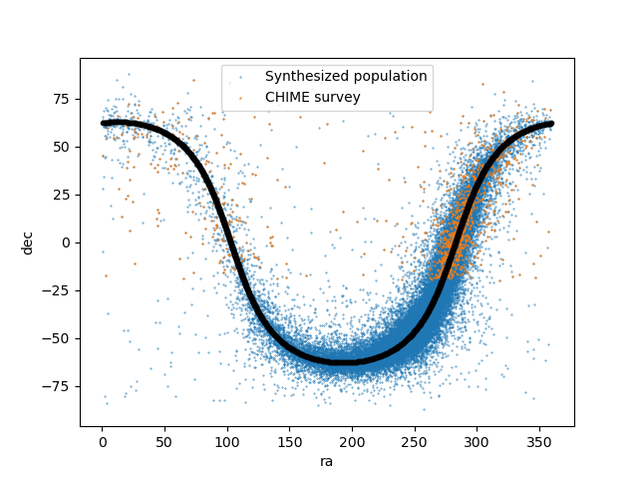

Slide 10
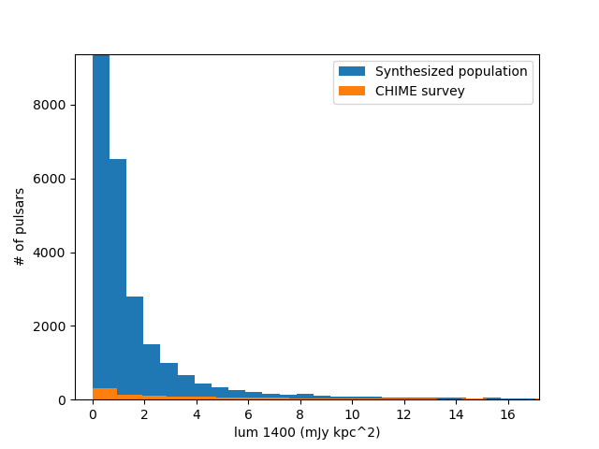
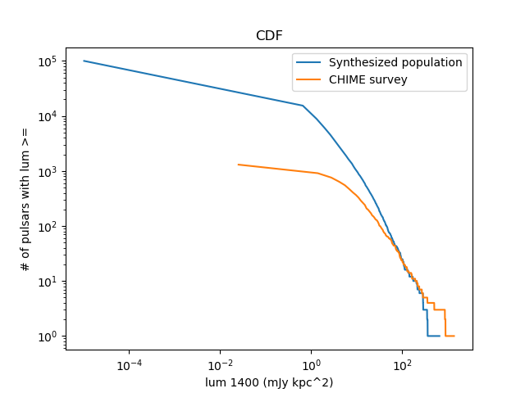
Generating properties
Lum distribution – Faucher-Giguere, Kaspi 2006 (blue is the generated population, orange is the portion detected by CHIME) – log norm [-1.1,0.9]
This bar goes higher

Slide 11
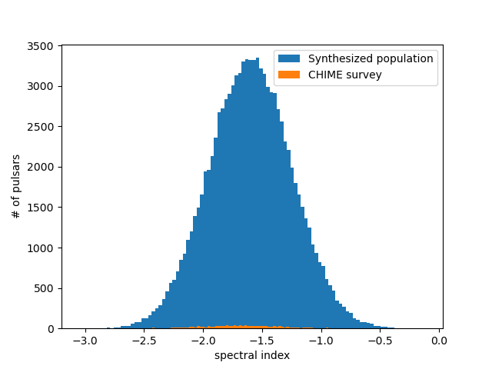
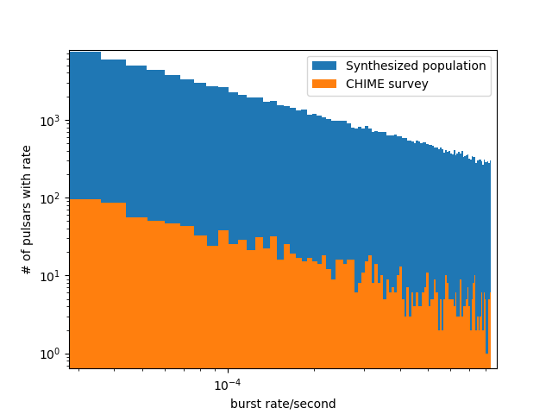
Mean -1.6 sigma 0.35
Uniform log distribution, low 0.1, high 3

Slide 12
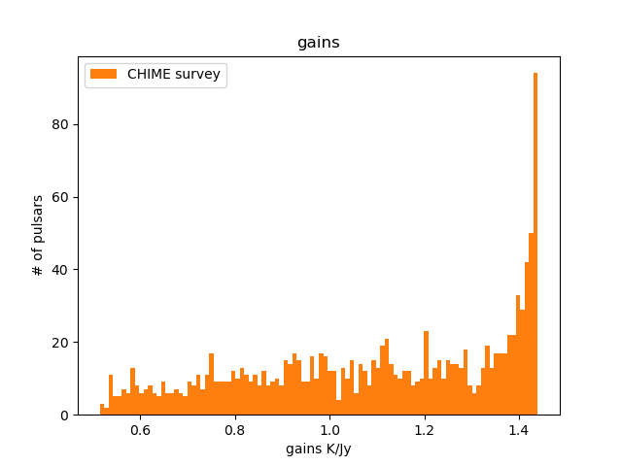
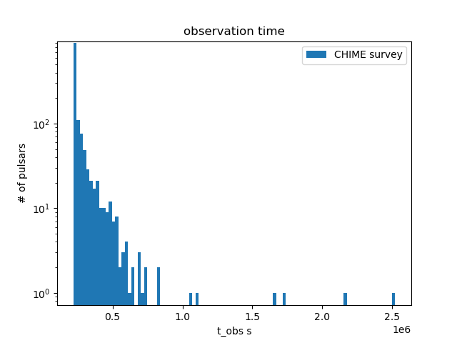
GAINS AND OBSERVATION TIMES
(# OF RRATS DETECTED BY CHIME)

Slide 13
Giant pulses?
Apply radiometer equation to calculate SNR (using SNR cut off 9)
Calculate gain + observation time for each pulsar location
Check period and how many GPs is emitted
Draw from a luminosity distribution derived from crab
Assume a fraction of periods have GPs
Simulate a population of pulsars based on PMSURV

Slide 14
Results- 113474 pulsars simulated
See order ~900 GP emitters, the number deviates everytime by ~100
Order ~0 too faint
Ignoring smearing
(showing 902 GP detected, 44290 don’t do GP, 68282 not in region)

Slide 15
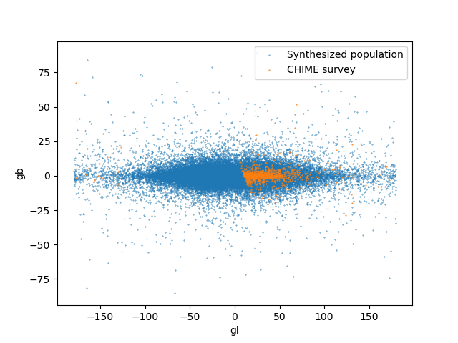
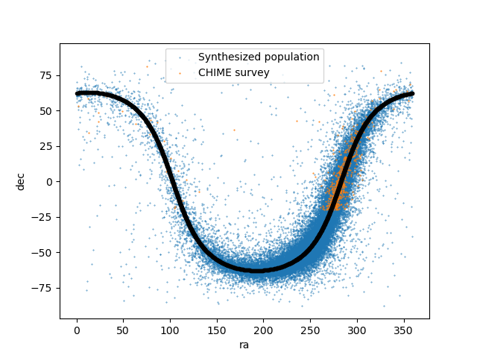

Slide 16
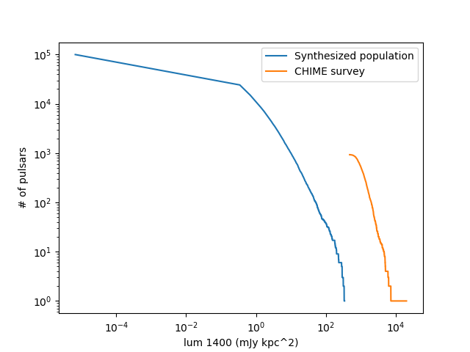

Period drawn from log norm dist
GP lum drawn from double power distribution (Popov et al. 07)
Blue line shows pulsar normal luminosity
Orange line show giant pulse luminosity that has been detected by CHIME FRB
I just did a cut off

Slide 17
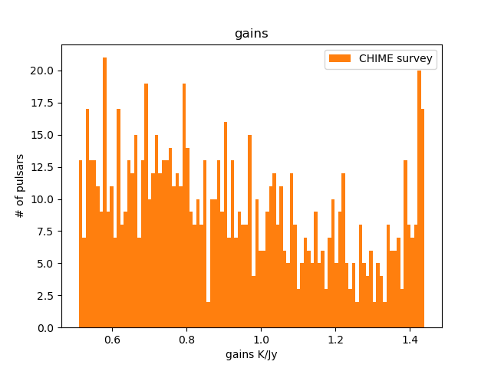
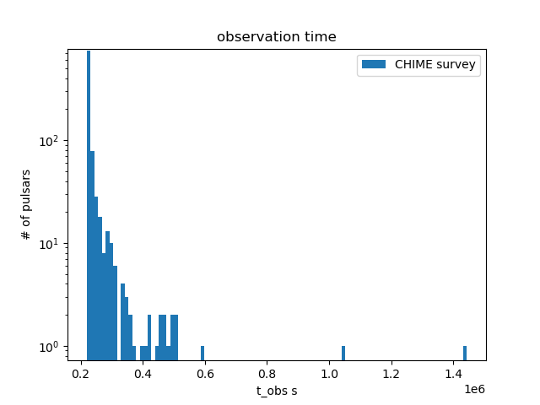

Slide 18
To do
Get radiometer equation constants from injections
Draw fraction of periods that emit GP from same distribution as lum
Get a wider range of luminosities from more than just Crab
GP cut off – light cylinder
Compare with actual CHIME results

