Slide 1

Training and Validation of Machine learning & Deep Learning models;
For the classification and prediction of type diabetes in individuals

Slide 2
Background: Why Diabetes?
-Diabetes Canada released new 2022 figures that show the continued rising trend of diabetes rates in Canada with no signs of leveling or decreasing
_“The new diabetes figures show a steady, continued increase in diabetes in our country with 11.7 million Canadians living with diabetes or prediabetes,” says Laura Syron, President and CEO of Diabetes Canada. “

Slide 3
Background
“Today, there are more than 5.7 million Canadians living with diagnosed diabetes (type 1 or type 2 diabetes), however, there are 11.7 million Canadians living with diabetes or prediabetes—a condition that, if left unmanaged, can develop into type 2 diabetes” (Diabetes Canada)
“Diabetes is also costing the healthcare system of Canada $30 billion per year to treat people with diabetes. The high prevalence of diabetes and its overwhelming impact in our communities and health-care system mean that we must further diabetes research” (Diabetes Canada)

Slide 4
Data Sources
The datasets used in the training and validation of models were sourced from varying sources with further data preprocessing and feature reduction carried out.
Sources include:
The National Health and Nutrition Examination
Kaggle

Slide 5
Features
Variables utilized after data processing
ID, age, sex, height and weight
BMI, Cholesterol, other health data
Smoker/non-smoker, drinker/non-drinker, family history of diabetes

Slide 6
Data exploration
Exploratory data analysis was performed using vscode and jupyter notebook.
Followed by data preprocessing and cleaning, which started renaming columns, replacing values to numeric values, dropping nulls.
Density graphs, counting values, crosstab
Questions we hope to answered:
Has the total number of people with diabetes changed due to the pandemic?
What are the variables that are key identifiers in determining if someone has diabetes?
Can trained models classify individuals with type 2 diabetes from data which high degree of accuracy?

Slide 7
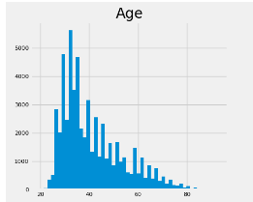
Data Analysis

Slide 8
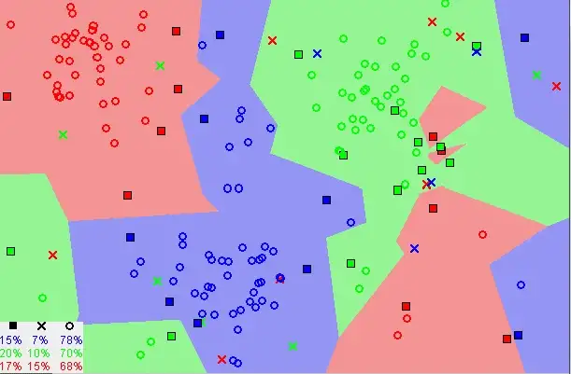
Models
KNN model (K- Nearest Neighbors Algorithm)
Supervised model used for classification
Split data
Train data
Scale data
Select number of neighbors

Slide 9
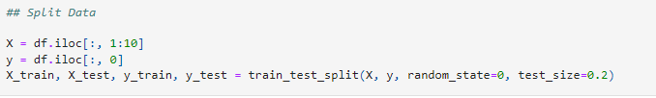
How Was Data Split, features, why this model?
Data was split using sklearn, train_test_split
We chose this model because of its use in classification analysis and its high degree of accuracy.
Data was split using sklearn train_test_split

Slide 10
Storyboard
Tool to use - Javascript/CSS/HTML
Interactive elements we wish to have - pages/graphs/toolbar etc (look at examples)

Slide 11
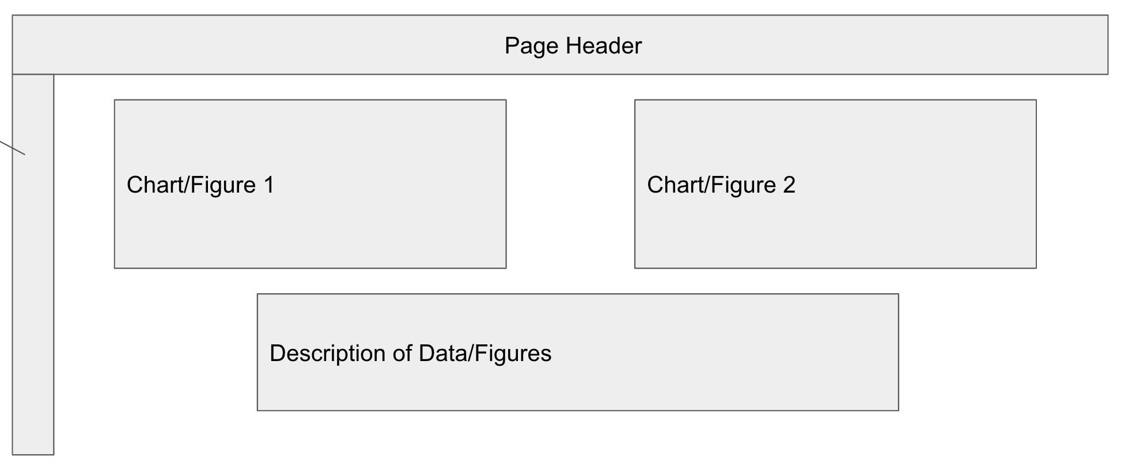
Example Storyboard

