Slide 1


Cyber and Intelligence
“From bits to information”

Slide 2



Outline
DAC (Digital to Analogue) Convertor
Actuators
(Motor)
ADC (Analogue to Digital) Convertor
Digital world
Analogue world
Sensors
1010101..
0010
Light, heat, movement

Slide 3
Outline
Industry 4.0
Digitization
(21st Century)
Industry 3.0
Automation
(20th Century)
Industry 2.0
Electrification
(1870-1914)
Industry 1.0
Mechanization
(1760-1820)
Steam-power or water-powered engines
Railways, factories,
telegram
Electronics,
Electrical generator, CPU, Internet, Web
Virtualization, AI, Cyberphysical, IoT

Slide 4

Outline
RFC 791. Defines the format of IP packets (IPv4)
RFC 793. Defines TCP (Transport Control Protocol), which provides the foundation of the virtually all of the traffic that exists on the Internet.

Slide 5
Industry 4.0
“From bits to information”

Slide 6
6vs and 6Cs
Industry 4.0 brings:
6 Cs: Connection (sensor and networks); Cloud (computing and data on demand); Cyber (model and memory); Content/context (meaning and correlation); Community (sharing and collaboration); and Customization (personalization and value).
6 Vs: Volume; Velocity; Variety; Variability; Veracity; and Value.

Slide 7
Intelligence
“From bits to information”

Slide 8
Intelligence
Industry 4.0 brings: physical systems, IoT, Cloud Computing and Cognitive computing.
Neisser defines:
Individuals differ from one another in their ability to understand complex ideas, to adapt effectively to the environment, to learn from experience, to engage in various forms of reasoning, and to overcome obstacles by taking thought.
Intelligence is a very general mental capability that, among other things, involves the ability to reason, plan, solve problems, think abstractly, comprehend complex ideas, learn quickly and learn from experience.

Slide 9
Types of intelligence
Naturalist Intelligence (nature smart). This involves the ability to discriminate between living things and their interaction with the natural world.
Musical Intelligence (sound smart). This involves the ability to understand pitch, rhythm, and tone, especially focused on the ability to create, analyse and reproduce music, such as in stimulating emotions around music.
Logical-Mathematical Intelligence (number/reasoning smart). This involves the ability to calculate, hypothesize, and quantify using mathematical operations. Key skills are to: abstract; define reasoned approaches; and to apply inductive and deductive thinking methods.
Existential Intelligence (life smart). This involves the ability to search for deep meanings to life, such as why we exist, and why we must die.
Inter-personal Intelligence (people smart). This involves the ability to understand other people using both verbal and non-verbal communications. Those with the best abilities for this are typically strong communicators and can understand the feelings and motivations of others.

Slide 10
Types of intelligence
Intra-personal Intelligence (self smart). This involves the ability to understand yourself, and how you relate to others.
Bodily-Kinesthetic Intelligence (body smart). This involves the ability to move, manipulation or influence physical objectives, normally with the use of physical body movements. Athletes typically have good levels of this type of intelligence, but it might also involve those who are expert in computer games.
Linguistic Intelligence (word smart). This involves the ability to create and manipulate language in order to express and define meaning. Great writers and public speakers often have this ability.
Spatial Intelligence (picture smart). This involves the ability to abstract into three dimensions. Architects normally have good abilities in this area, such as where they are able to abstract 2D drawings into a 3D space.

Slide 11
Humans v Computers
Learning. Humans adapt to changing situations, and generally quickly learn tasks. Unfortunately, once these tasks have been learnt, this can often lead to boredom if they are repeated repetitively.
Strategy. Humans are excellent at taking complex tasks and splitting them into smaller, less complex, tasks. Then, knowing the outcome, they can implement these in the required way, but can make changes depending on conditions.
Enterprise. Computers, as they are programmed at the present, are an excellent business tool. They generally allow for better decision making, but, at present, they cannot initiate new events.
Creativity. As with enterprise, humans are generally more creative than computers. This is likely to change over the coming years as they could programmed with the aid of psychologists, musicians, and artists, and will could include elements which are pleasing to the human senses.

Slide 12
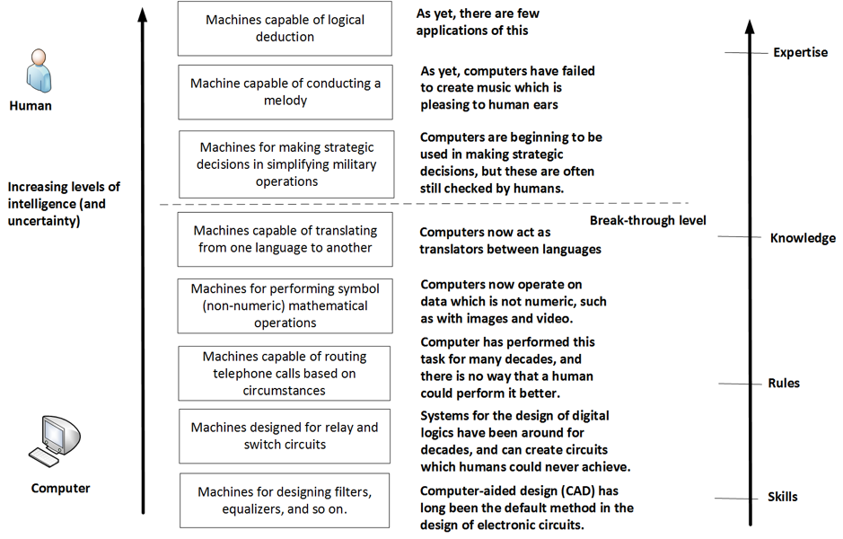
Humans v Computers

Slide 13
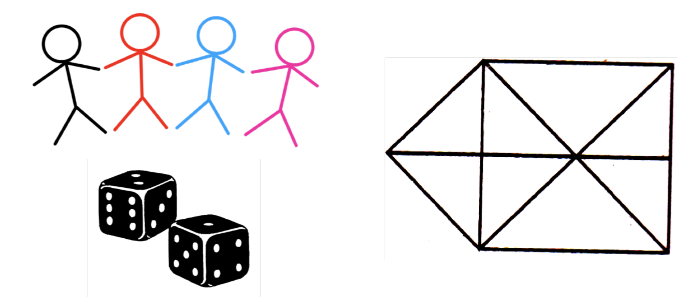
Humans v Computers
Spatial. This is the ability to differentiate between two- and three- dimensional objects. Computers, even running powerful image processing software, often have difficulty in differentiating between two-dimensional objects and three-dimensional ones. Humans, though, find this easy, but can be tricked by optical illusions, where a two-dimensional object is actually a three-dimensional object. The objects in left-hand side of figure are a mixture of a two-dimensional and three-dimensional object. Humans can quickly determine objects which are defined in 2D and which in 3D.
Perception. This is the skill of identifying simple shapes from complex ones. For example, humans can quickly look at a picture and determine the repeated sequences, shapes, and so on. For example, look at the picture on the right-hand side of figure and determine how many triangles it contains? It is relatively easy for a human to determine this, as they have good perception skills. This is because the human brain can easily find simple shapes from complex ones. But, imagine writing a computer program which would determine all of the triangles in an object, then modifying it so it finds other shapes, such as squares, hexagons, and so on?
Memory. This is the skill of memorizing and recalling objects which do not have any logical connection. Humans have an amazing capacity for recalling objects, typically by linking objects, and from one to the next. Computers can implement this with a linked-list approach, but it becomes almost impossible to manage when the number of objects becomes large.

Slide 14
Humans v Computers
Numerical. Most humans can manipulate numbers in various ways. Humans are by no-way as fast as computers, but humans can often simply complex calculations, either by approximating, or by eliminating terms which have little effect on the final answer. For example, we may have a tasks to find the approximate area for a room that is 6.9 metres and 9.1 meters? Many humans just approximate this to 7 times 9, and find the answer of 63 meters squared.
Verbal. This involves the comprehension of language, and while there has been great advances in the way that machines are able to process speech, they are often still weaker than humans in extracting meaning.
Lexical. This is a manipulation of vocabulary. Machines can generally analyse the lexical structure of written work, but they often still struggle to create their own lexical structures, and which lack interest or even meaning. They are thus generally good at spotting spelling mistakes and at grammar checking.
Reasoning. This is induction and deduction. Humans can often deduce things when they are not given a complete set of information.

Slide 15
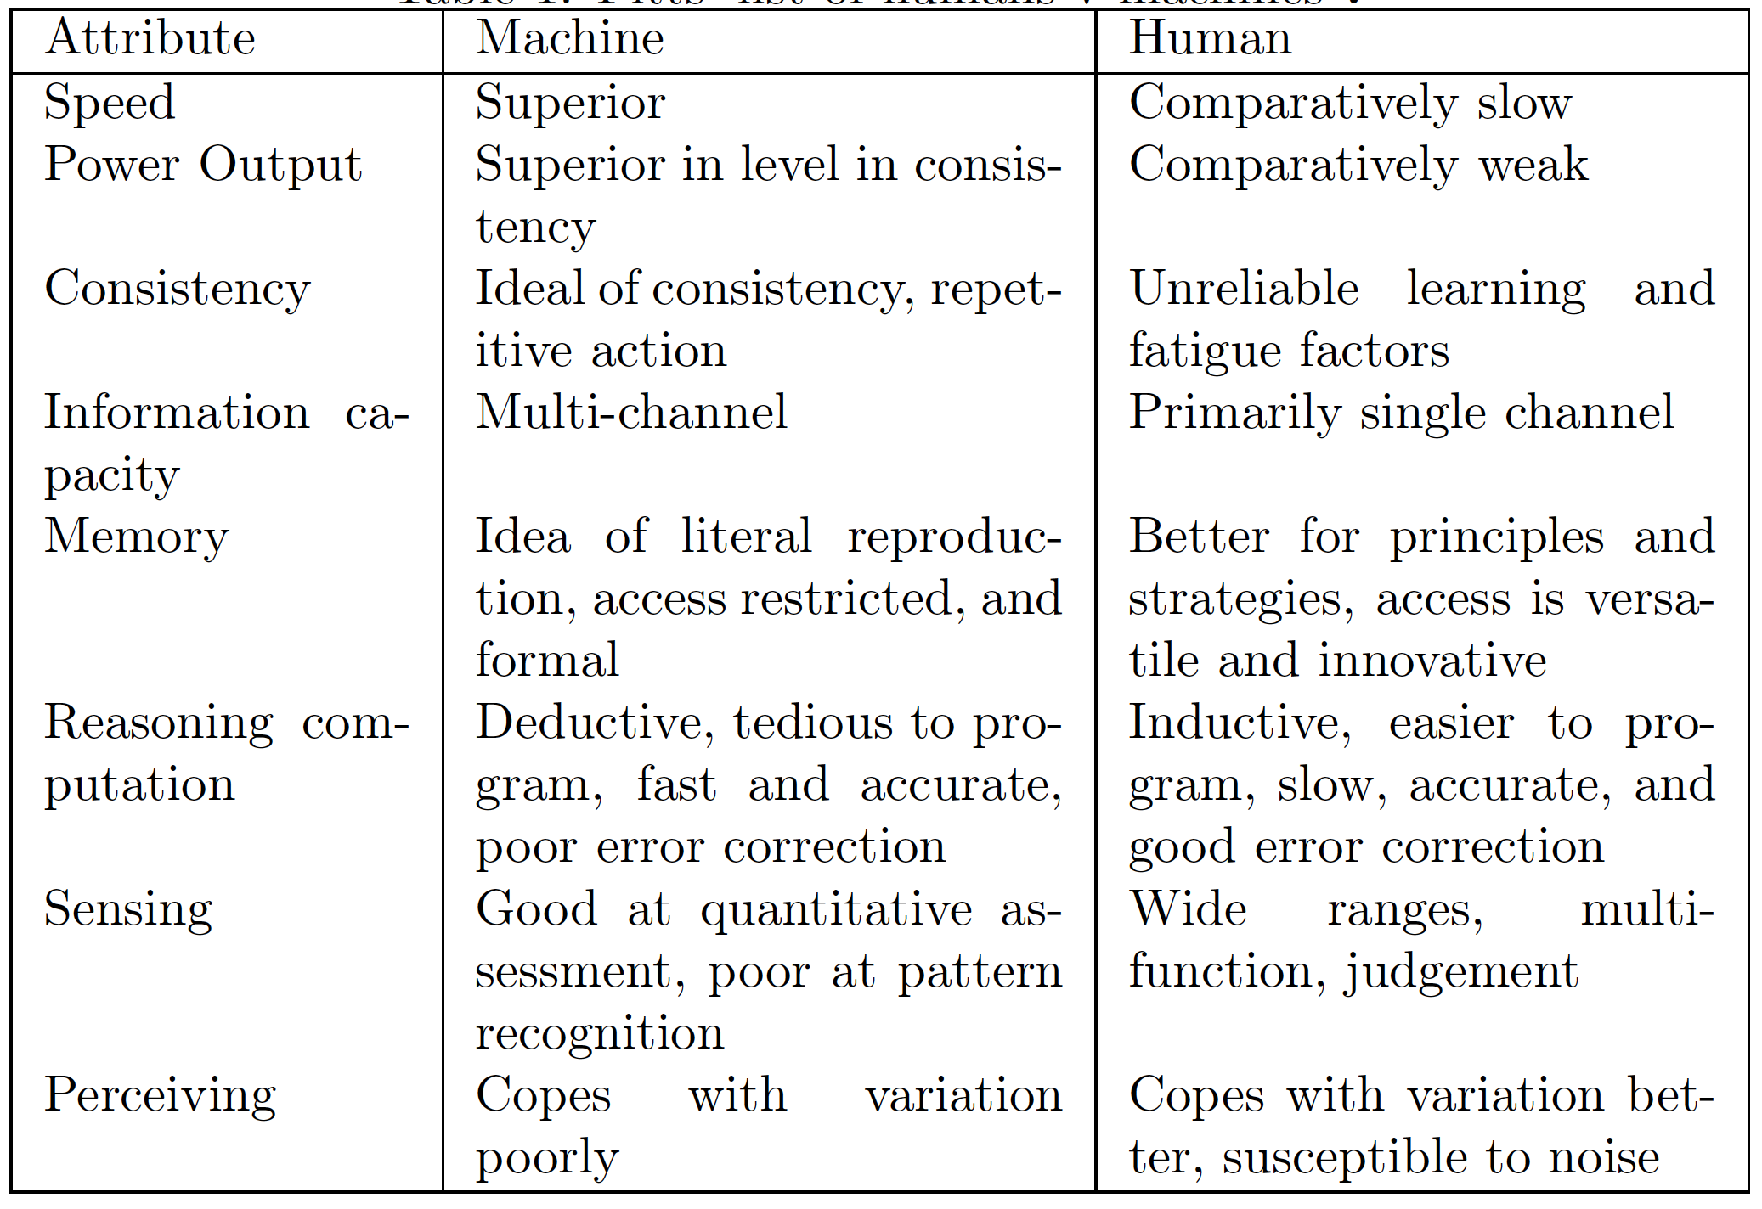
Humans v Computers

Slide 16
Cyber and Intelligence
“From bits to information”

