Slide 1
MGS 723: Geodynamics
Class 15: Finite Differences III
Content mainly sourced from Becker and Kaus, Numerical Geodynamics

Slide 2
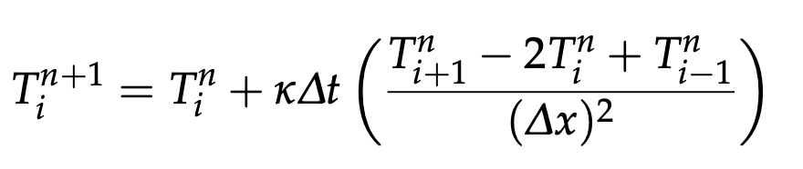
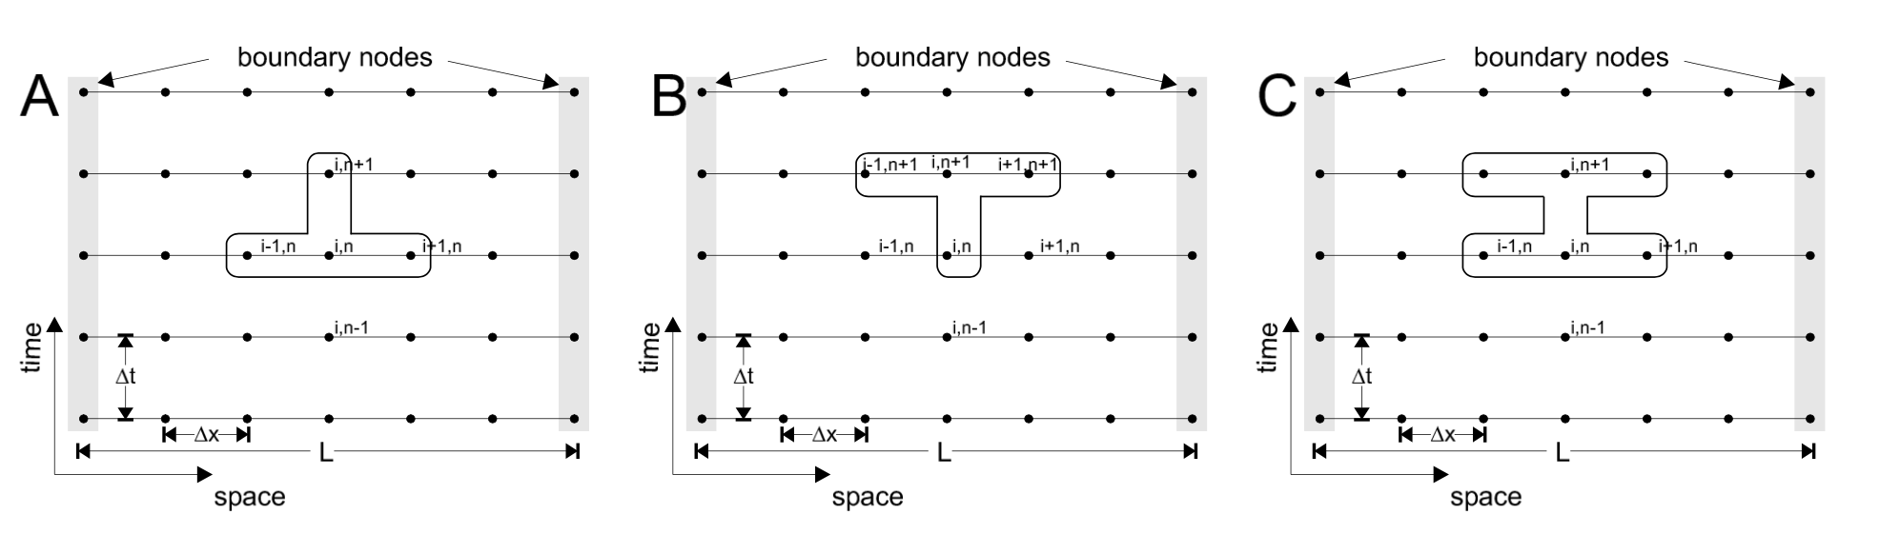
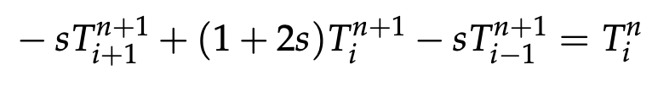
Recap: Different discretization schemes
Crank-Nicholson FD
discretization
Explicit FD discretization
O($∆t)$, O($∆x^{2})$
O($∆t)$, O($∆x^{2})$
Implicit FD discretization

Slide 3
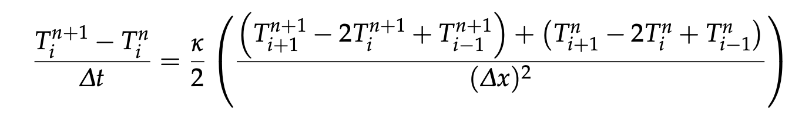
Recap: Different discretization schemes
Crank-Nicholson FD
discretization
O($∆t^{2})$, O($∆x^{2})$
Crank-Nicholson combines the explicit and implicit spatial derivatives (i.e., is “partially implicit") to get the best accuracy

Slide 4
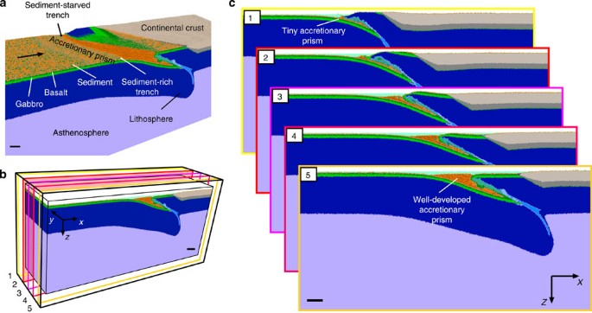
All to model the evolution of the Solid Earth…
Malatesta et al., 2013

Slide 5
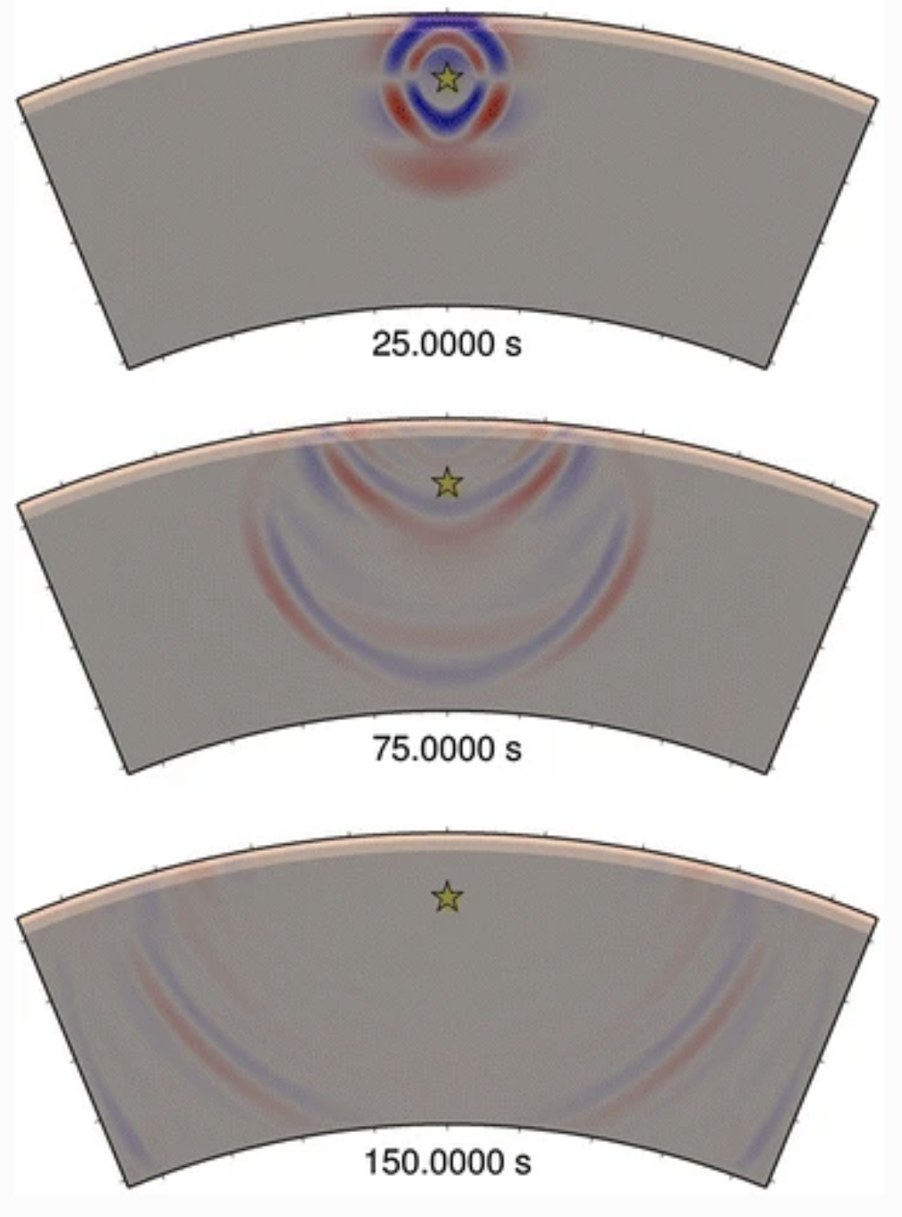
All to model the evolution of the Solid Earth…
Malatesta et al., 2013
Or wave propagation…
Takenaka et al., 2017

Slide 6
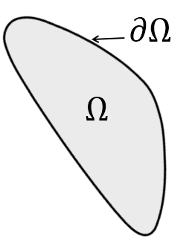
Boundary conditions

Slide 7
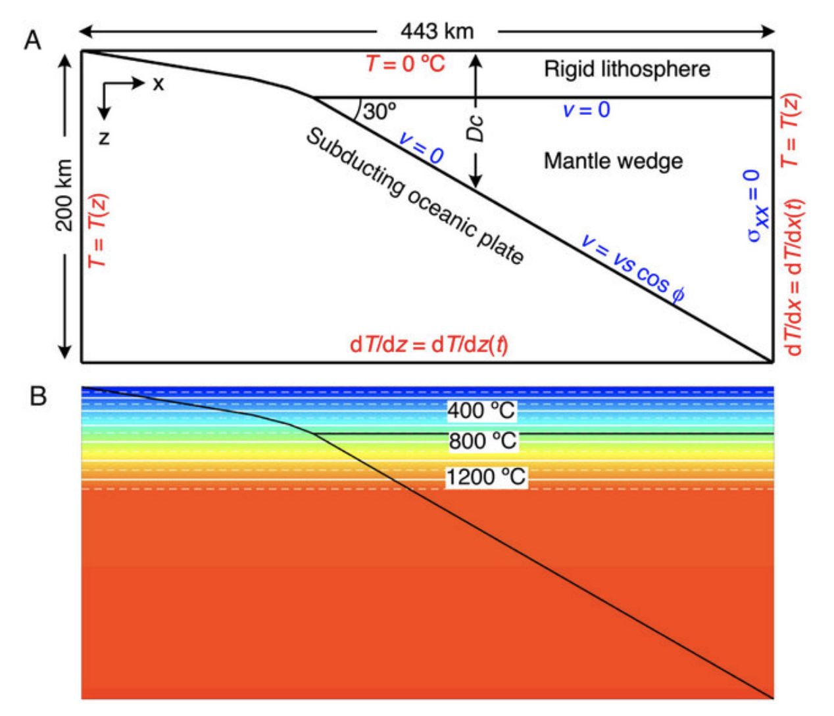
Boundary conditions
Ishii and Wallis, 2019

Slide 8
Boundary conditions
Two main types:
DIRICHLET boundary conditions:
Specify values of the PDE solution function (e.g., T).
NEUMANN boundary conditions:
Specify the gradient of the PDE solution function (e.g.,
dT/dx).

Slide 9
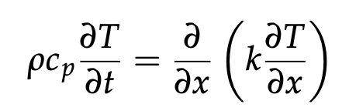

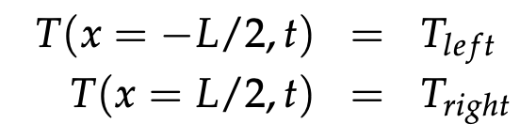
Boundary conditions
Two main types:
DIRICHLET boundary conditions:
Specify values of the PDE solution function (e.g., T).
NEUMANN boundary conditions:
Specify the gradient of the PDE solution function (e.g.,
dT/dx).
Easy to implement. Compute temperature in interior nodes (implicitly or explicitly) and just manually fix the boundary temperatures.
For over set:

Slide 10
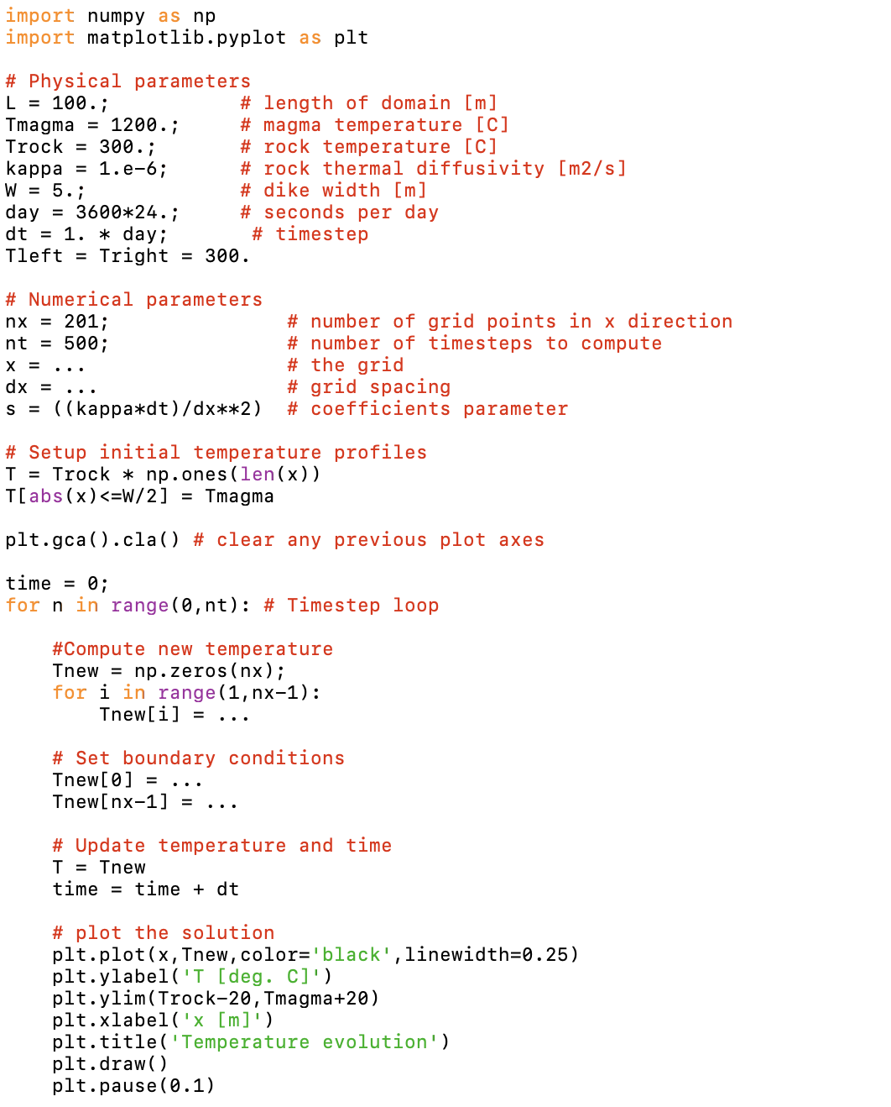
Explicit FDs
Code stencil:

Slide 11
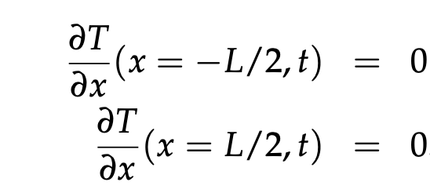
Boundary conditions
Two main types:
DIRICHLET boundary conditions:
Specify values of the PDE solution function (e.g., T).
NEUMANN boundary conditions:
Specify the gradient of the PDE solution function (e.g.,
dT/dx).
Usually a little trickier to implement. Set spatial derivatives at the domain boundary
For over set:
(Zero heat flux)

Slide 12
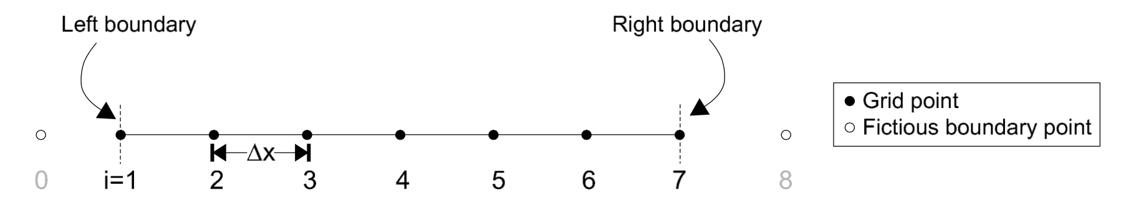
(Implementing) Neumann Boundary conditions
x = 0
x = L

Slide 13
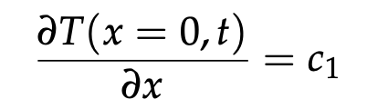
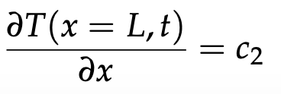
(Implementing) Neumann Boundary conditions
x = 0
x = L
The simplest way to express the Neumann BCs:
But these expressions are only first-order accurate in $Δx$

Slide 14
(Implementing) Neumann Boundary conditions
x = 0
x = L
The simplest way to express the Neumann BCs:
But these expressions are only first-order accurate in $Δx$
A way around this: Fictitious boundary points

Slide 15
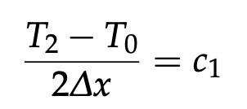
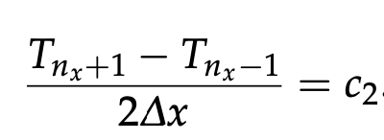
(Implementing) Neumann Boundary conditions
x = 0
x = L
Using Fictitious boundary points, we compute the Neumann derivative as follows:
At i=1: At i=n_{x}:

Slide 16
(Implementing) Neumann Boundary conditions
x = 0
x = L
Using Fictitious boundary points, we compute the Neumann derivative as follows:
At i=1: At i=n_{x}:
[Obvious caveat: T₀ and T_{nx+1} are not real. But we can get around this]

Slide 17
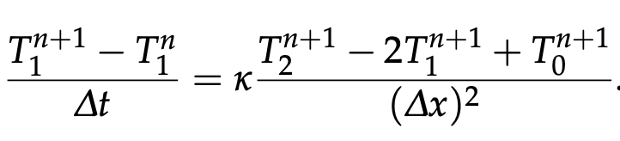
(Implementing) Neumann Boundary conditions
x = 0
x = L
Using Fictitious boundary points, we compute the Neumann derivative as follows:
At i=1: At i=n_{x}:
Implicit expression for temperature at 1st node (i=1):

Slide 18

(Implementing) Neumann Boundary conditions
x = 0
x = L
Using Fictitious boundary points, we compute the Neumann derivative as follows:
At i=1: At i=n_{x}:
Implicit expression for temperature at 1st node (i=1):
and

Slide 19
(Implementing) Neumann Boundary conditions
x = 0
x = L
Using Fictitious boundary points, we compute the Neumann derivative as follows:
At i=1: At i=n_{x}:
Implicit expression for temperature at 1st node (i=1):
and
Combining the two above Eqn’s…

Slide 20
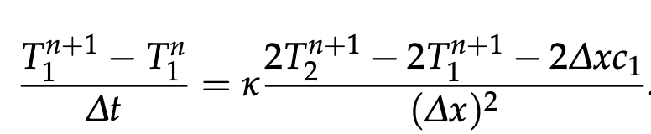
(Implementing) Neumann Boundary conditions
x = 0
x = L
and
(Implicit)

Slide 21
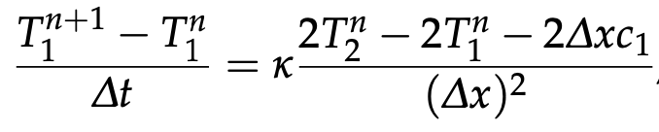
(Implementing) Neumann Boundary conditions
x = 0
x = L
and
(Implicit)
(Explicit)

Slide 22
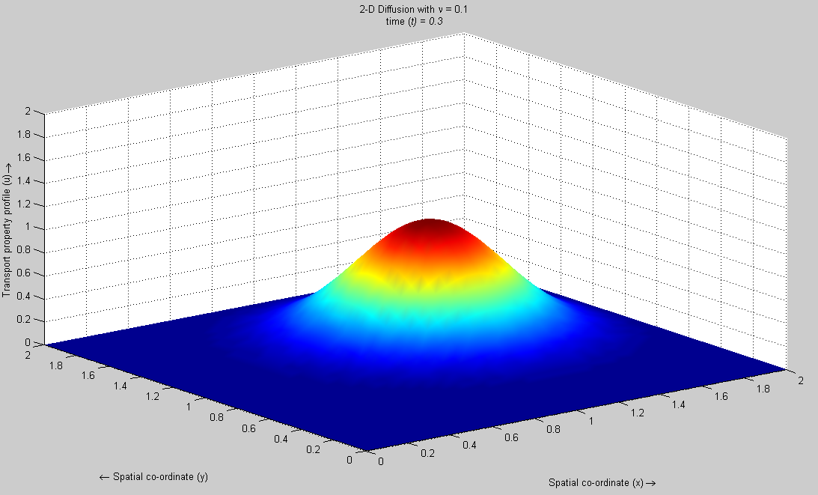
Moving to 2-D…

Slide 23
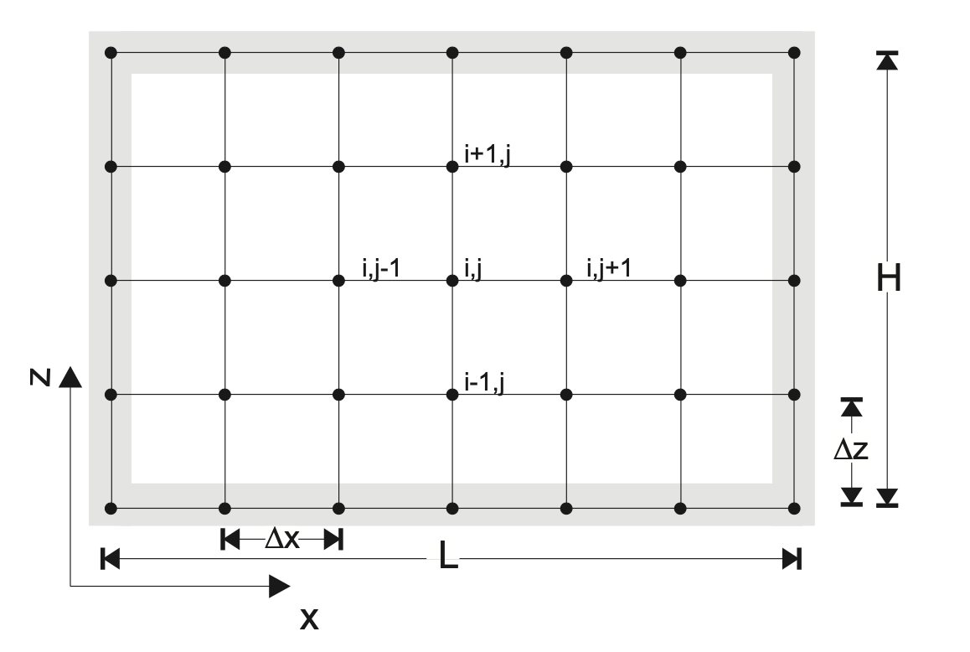
FD discretization of the 2-D heat conduction equation

Slide 24
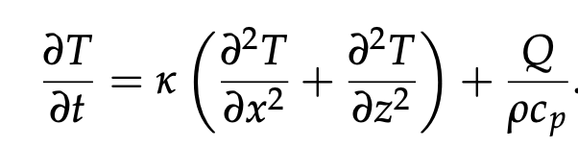
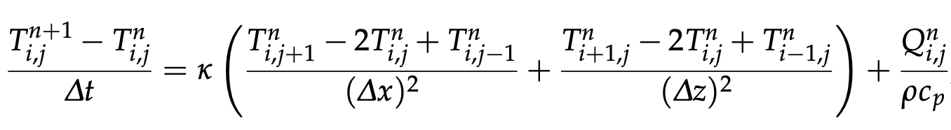
FD discretization of the 2-D heat conduction equation
(Constant and isotropic thermal conductivity, k_{x}=k_{z})
Explicit:

Slide 25
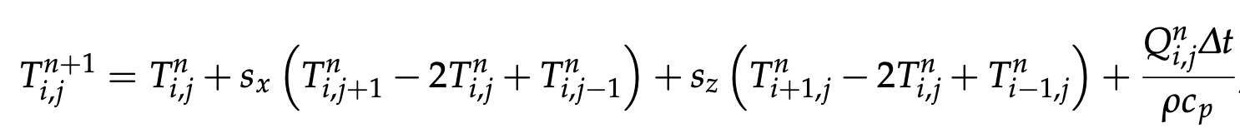
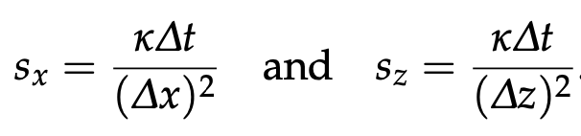
FD discretization of the 2-D heat conduction equation
(Constant and isotropic thermal conductivity, k_{x}=k_{z})
Explicit:
with

Slide 26
FD discretization of the 2-D heat conduction equation
with
To implement Neumann BCs, e.g., at j=1 (left boundary of model):

Slide 27
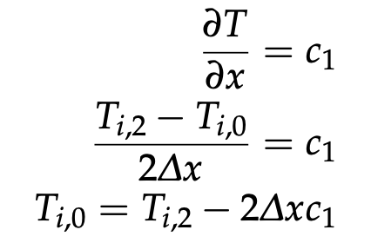
FD discretization of the 2-D heat conduction equation
with
To implement Neumann BCs, e.g., at j=1 (left boundary of model):
Set the derivative and rearrange for fictitious point:

Slide 28
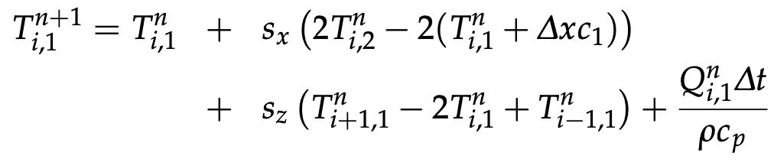
FD discretization of the 2-D heat conduction equation
with
To implement Neumann BCs, e.g., at j=1 (left boundary of model):
Set the derivative and rearrange for fictitious point:
Plug into the above explicit discretization:

Slide 29
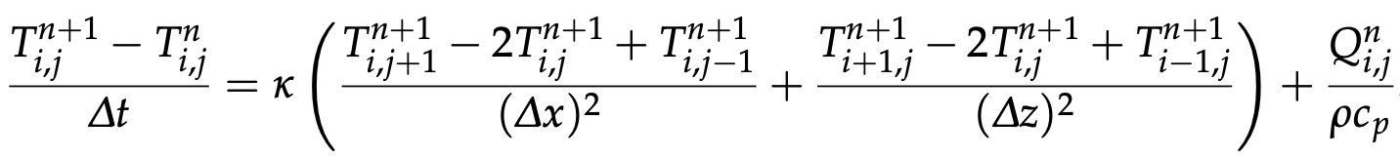
FD discretization of the 2-D heat conduction equation
A bit more complicated for the Implicit method:
Discretization looks very similar:

Slide 30
FD discretization of the 2-D heat conduction equation
A bit more complicated for the Implicit method:
Discretization looks very similar:
Rearranging (n+1 on left, n on right):

Slide 31
FD discretization of the 2-D heat conduction equation
A bit more complicated for the Implicit method:
Discretization looks very similar:
Rearranging (n+1 on left, n on right):
Again, need to write as matrix equation: Ax = b
But requires careful book-keeping as matrix needs to be n_{x}*n_{z} by n_{x}*n_{z} and the two vectors both of length n_{x}*n_{z}

Slide 32
FD discretization of the 2-D heat conduction equation

Slide 33
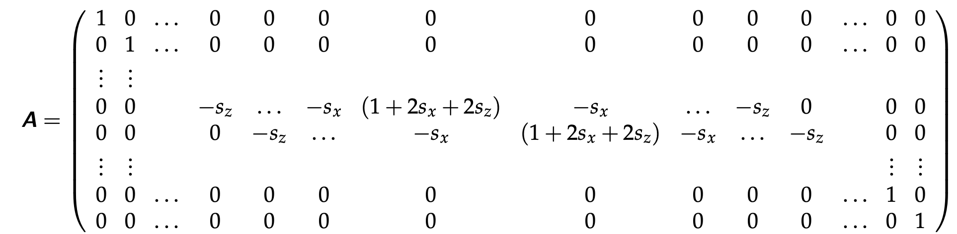
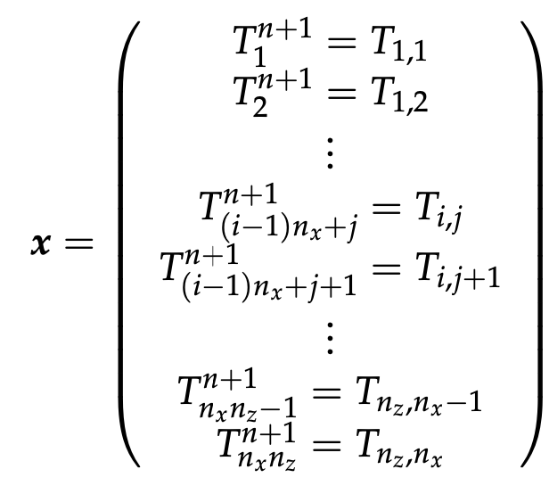
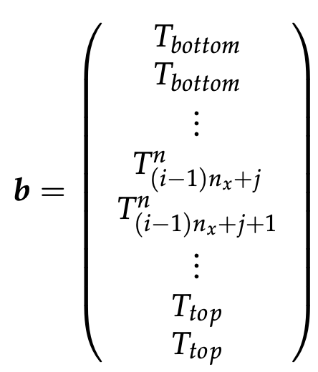
FD discretization of the 2-D heat conduction equation
See Becker and Kaus, Section 4, for a more detailed explanation

Slide 34
Rest of class: Open time to work on/discuss the
numerical exercises….

Slide 35
Take homes:
Boundary conditions: Neumann vs. Dirichlet BCs.
Dirichlet BCs very easy to implement in FD method.
Neumanns BCs a bit trickier: Fictitious boundary conditions an important strategy to do this.
Finite differences easily extendable to 2-D problems (although need to be careful constructing big matrices for the implicit method.

