Slide 1
MGS 723: Geodynamics
Classwork session

Slide 2
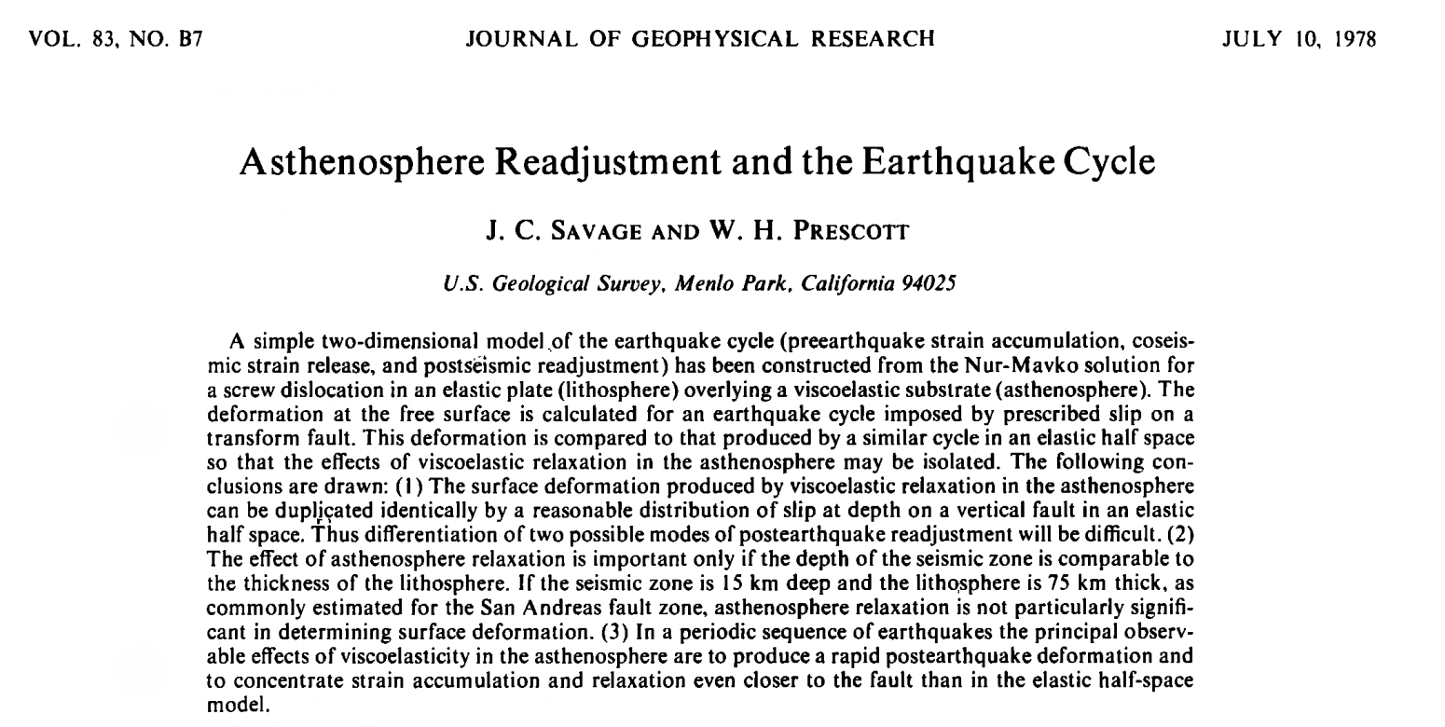
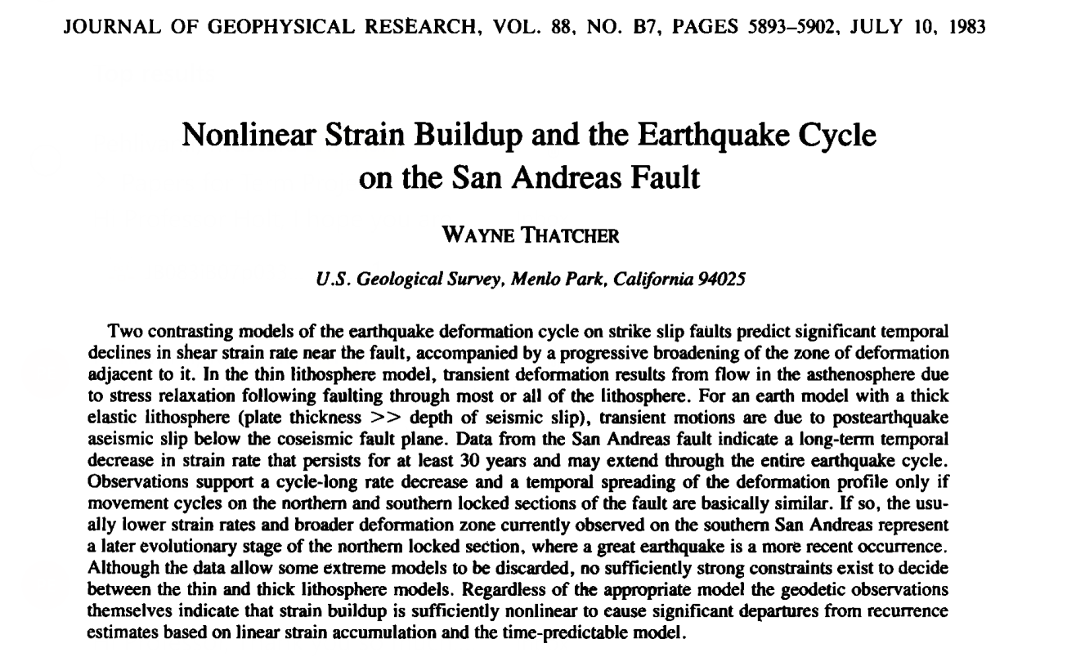
Class project: Emirhan

Slide 3
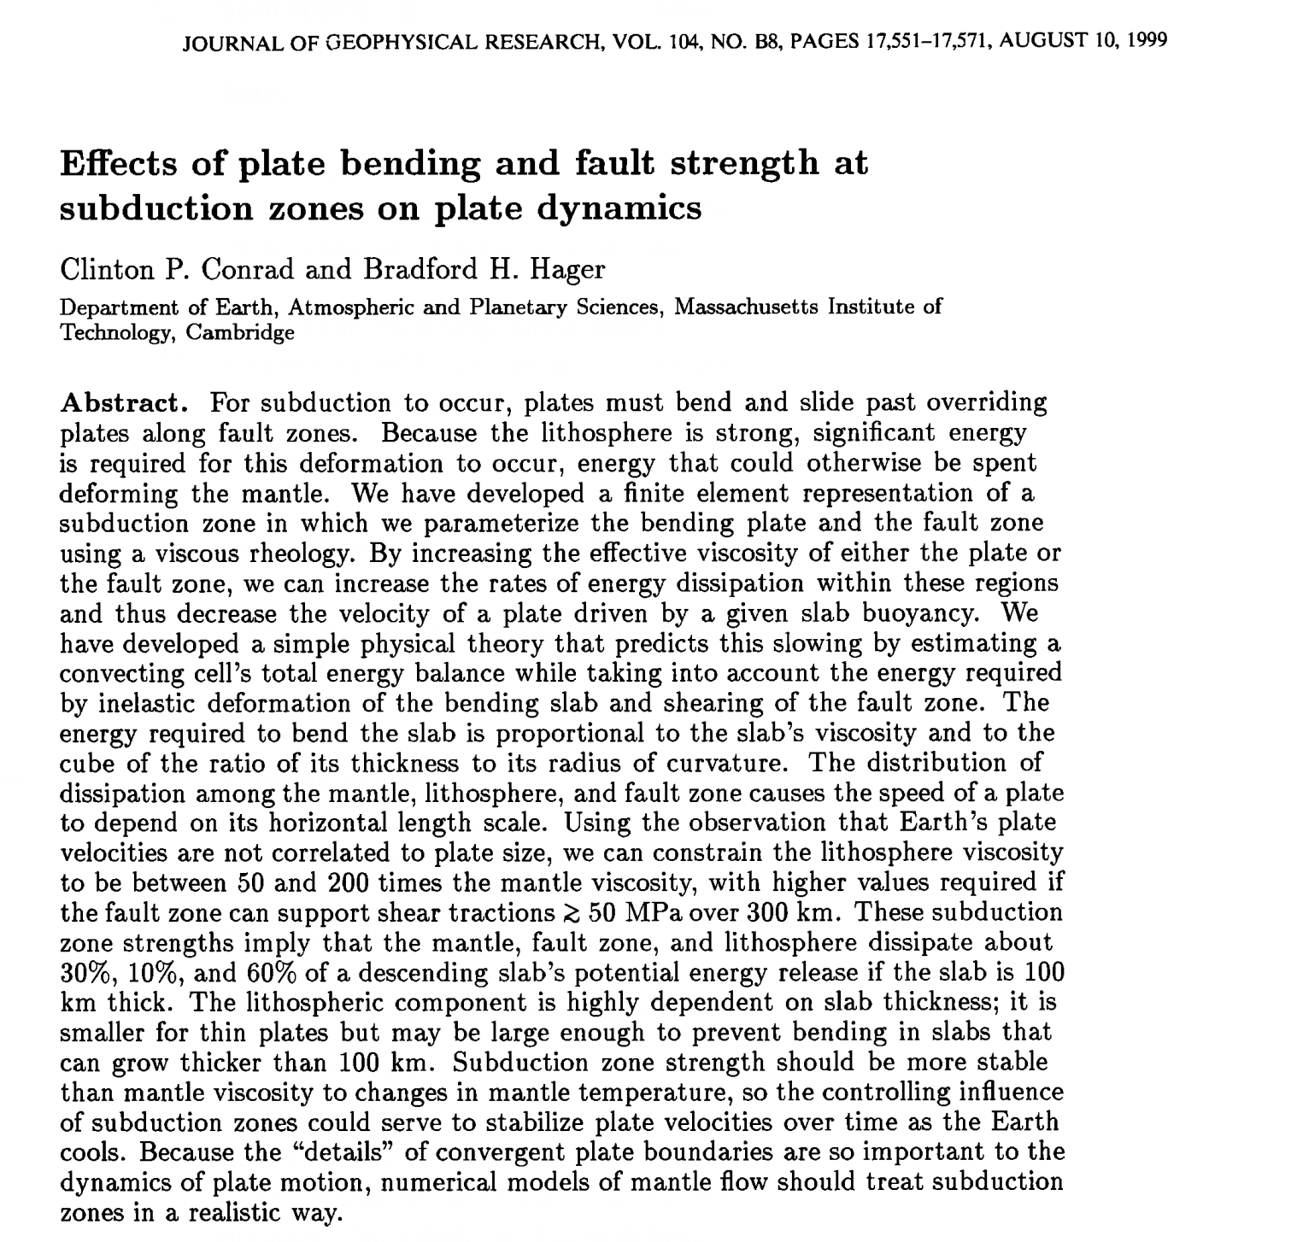
Class project: Yidan

Slide 4
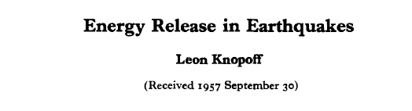
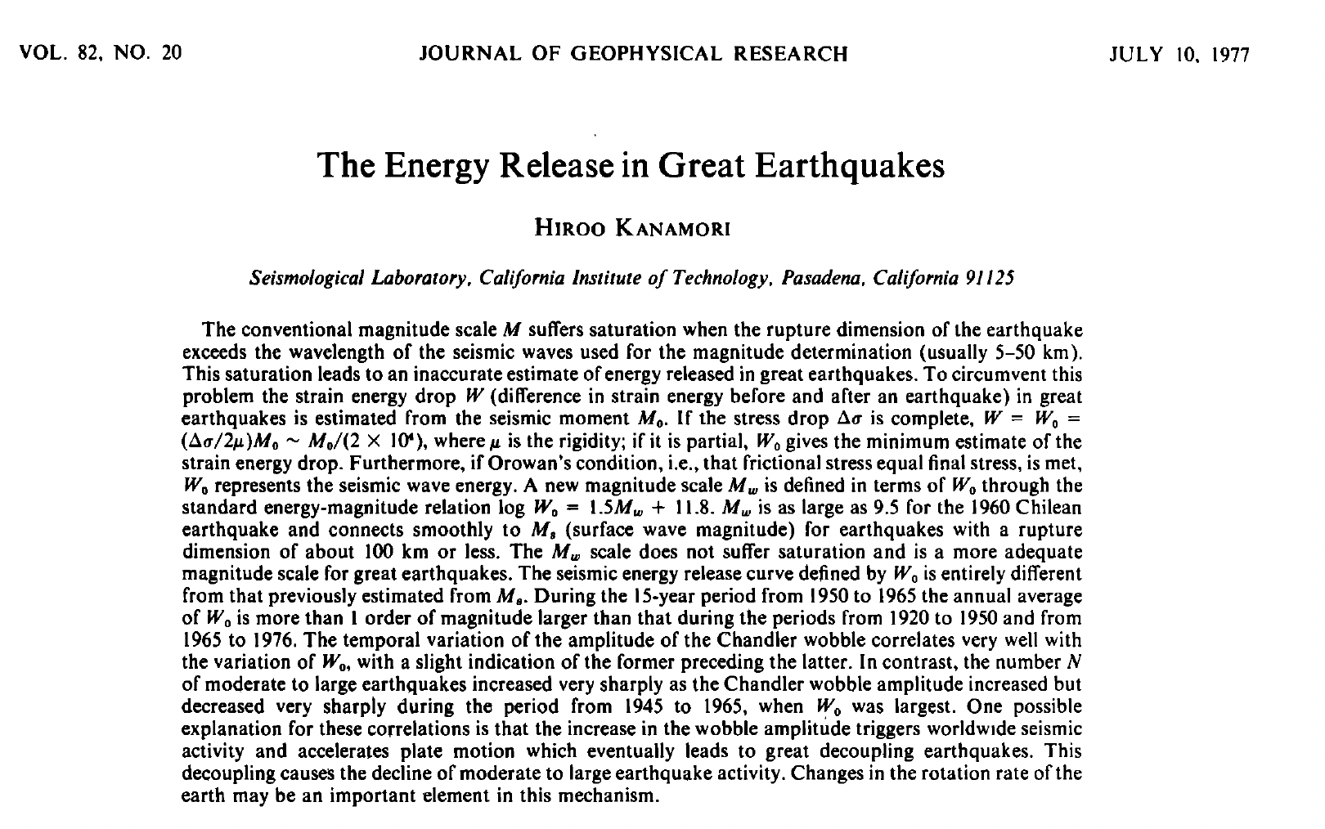
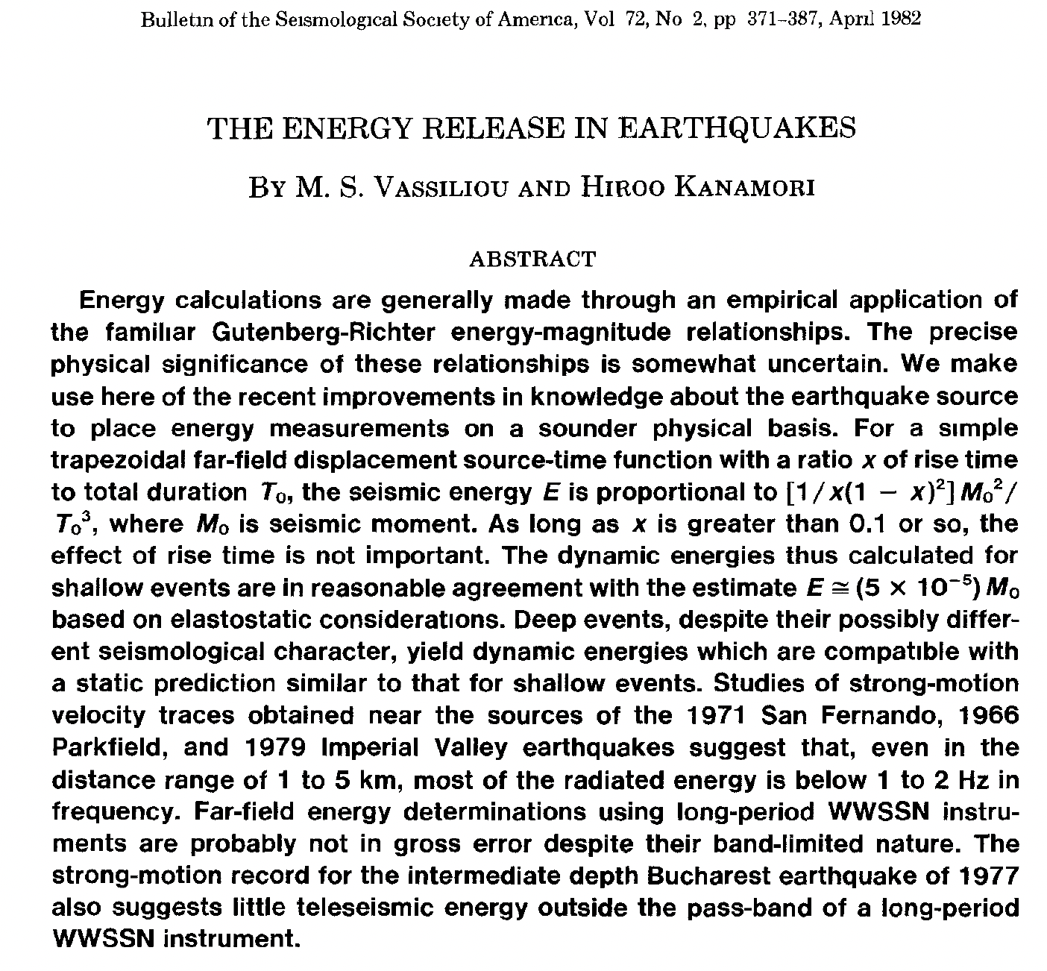
Class project: Khang

Slide 5
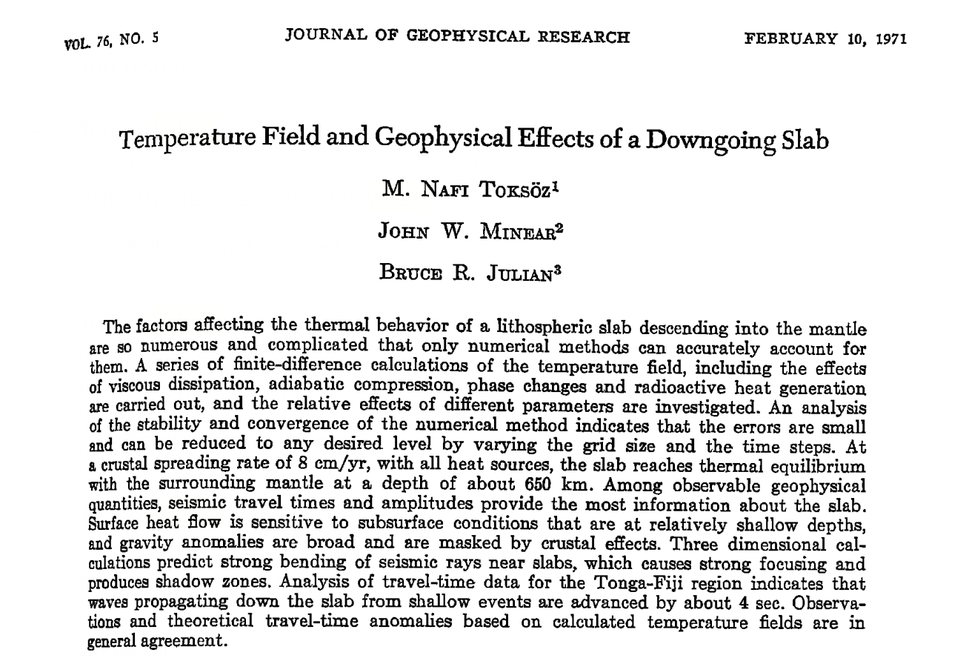
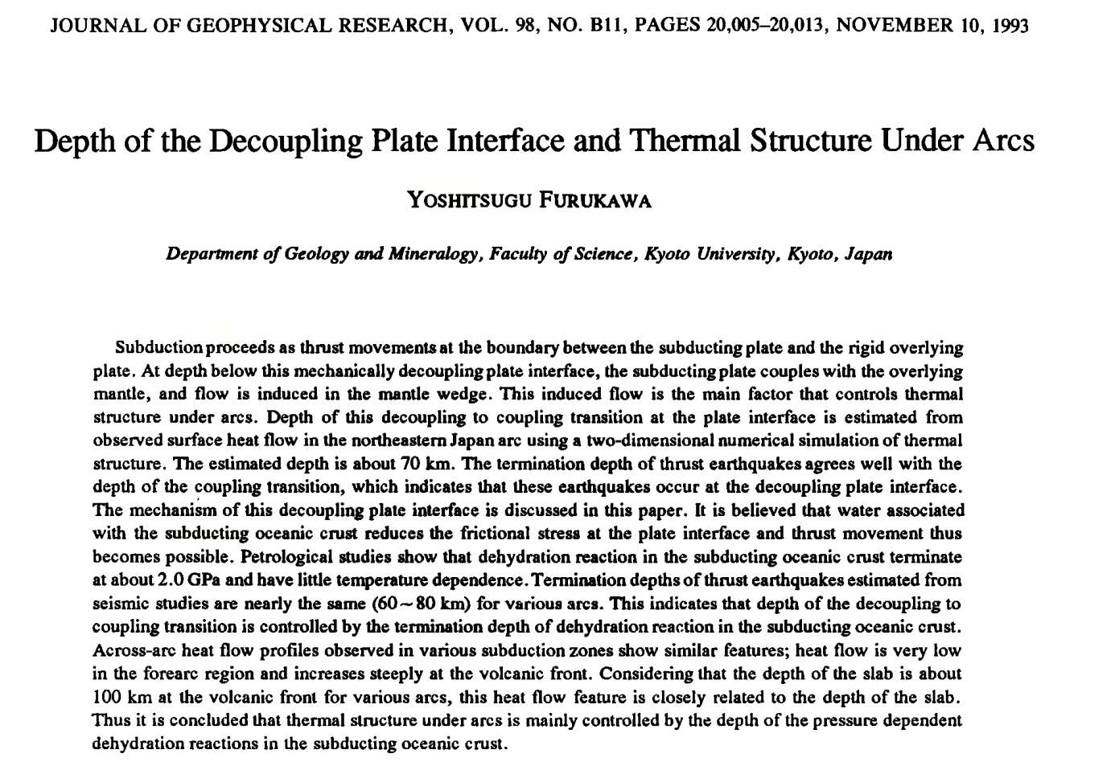
Class project: Valeria

Slide 6
Class project
The paper and presentation should outline a Geodynamics research topic using the following strategy: Firstly, outline an influential and quantitative Geodynamics paper (one which introduced a concept, expression, or modeling approach). Next, place this advance into the context of recent research (e.g., what subsequent research did this concept help with? What are problems that is/has been used to address? How has the original model/concept been modified to address different/more complex problems?)

Slide 7
Class project
The paper and presentation should outline a Geodynamics research topic using the following strategy: Firstly, outline an influential and quantitative Geodynamics paper (one which introduced a concept, expression, or modeling approach). Next, place this advance into the context of recent research (e.g., what subsequent research did this concept help with? What are problems that is/has been used to address? How has the original model/concept been modified to address different/more complex problems?)
Suggested paper outline:
Introductory paragraph summarizing the overarching topic.
An outline of the problem that the “classic” paper aims to solve.
Summarize the geodynamics component of the classic paper. Be sure to cover the quantitative component. E.g.:
How is the main expression derived? Or the model setup?
What are the main results of the model/concept/expression?
How does this apply to the Earth?
Synthesize more recent research that uses/is inspired by/builds upon this concept, e.g.:
What subsequent research problems did this model/concept/expression help to solve?
Did the original model/expression get modified to tackle other problems (e.g., more complex ones)?
Has an entirely different methodology surpassed this old technique/expression/model?
What are the current big questions (/areas of focus) in the sub-field of the “classic” paper?
Wrap up with a concise conclusion.

Slide 8
Class project
The paper and presentation should outline a Geodynamics research topic using the following strategy: Firstly, outline an influential and quantitative Geodynamics paper (one which introduced a concept, expression, or modeling approach). Next, place this advance into the context of recent research (e.g., what subsequent research did this concept help with? What are problems that is/has been used to address? How has the original model/concept been modified to address different/more complex problems?)
Paper format guidelines
Total length of 5 or more full text pages (excluding title page, references, and figures).
Include a least one relevant figure that adds to scientific understanding.
Use of equations is encouraged (particularly when outlining the concept of the “classic” paper).
Use a font size that’s roughly equivalent to 11 or 12pt Times New Roman, single spaced.
Use a consistent scientific referencing style and include a significant number of references (as the
2nd portion of the paper is basically a literature review).

Slide 9
Class project
The paper and presentation should outline a Geodynamics research topic using the following strategy: Firstly, outline an influential and quantitative Geodynamics paper (one which introduced a concept, expression, or modeling approach). Next, place this advance into the context of recent research (e.g., what subsequent research did this concept help with? What are problems that is/has been used to address? How has the original model/concept been modified to address different/more complex problems?)
Presentation recommendations
In terms of content, there is no need to depart from your paper (first cover the classic paper –
e.g., walk through the equations as I do in class – and then summarize the modern research).
Presentation time: Aim for 20 minutes.
Presentation tips:
Include large figures (it should be much more visual than the paper!)
Don’t use too much text (just the key points!)
Practice it before class.
Wrap the talk up with a concise conclusion/summary.

Slide 10
Class project
The paper and presentation should outline a Geodynamics research topic using the following strategy: Firstly, outline an influential and quantitative Geodynamics paper (one which introduced a concept, expression, or modeling approach). Next, place this advance into the context of recent research (e.g., what subsequent research did this concept help with? What are problems that is/has been used to address? How has the original model/concept been modified to address different/more complex problems?)
Presentation recommendations
In terms of content, there is no need to depart from your paper (first cover the classic paper –
e.g., walk through the equations as I do in class – and then summarize the modern research).
Presentation time: Aim for 20 minutes.
Presentation tips:
Include large figures (it should be much more visual than the paper!)
Don’t use too much text (just the key points!)
Practice it before class.
Wrap the talk up with a concise conclusion/summary.
Any questions???

Slide 11

Exercise #5: Implicit heat eq. in 2-D
Solving the 2-D heat equation with finite differences:
$\frac{∂T}{∂t}=κ\left(\frac{∂^{2}T}{∂x^{2}}+\frac{∂^{2}T}{∂z^{2}}\right)$
The implicit discretization:
$\frac{T_{i,j}^{n+1}−T_{i,j}^{n}}{∆t}=κ\left(\frac{T_{i+1,j}^{n+1}−2T_{i,j}^{n+1}+T_{i−1,j}^{n+1}}{{(∆x)}^{2}}+\frac{T_{i,j+1}^{n+1}−2T_{i,j}^{n+1}+T_{i,j−1}^{n+1}}{{(∆z)}^{2}}\right)$

Slide 12

Exercise #5: Implicit heat eq. in 2-D
Solving the 2-D heat equation with finite differences:
$\frac{∂T}{∂t}=κ\left(\frac{∂^{2}T}{∂x^{2}}+\frac{∂^{2}T}{∂z^{2}}\right)$
The implicit discretization:
Rearranging for temperatures at the next step (n + 1) and introducing constants that combine the time-step, grid spacings, and conductivity:
$\frac{T_{i,j}^{n+1}−T_{i,j}^{n}}{∆t}=κ\left(\frac{T_{i+1,j}^{n+1}−2T_{i,j}^{n+1}+T_{i−1,j}^{n+1}}{{(∆x)}^{2}}+\frac{T_{i,j+1}^{n+1}−2T_{i,j}^{n+1}+T_{i,j−1}^{n+1}}{{(∆z)}^{2}}\right)$
${−s}_{x}T_{i+1,j}^{n+1} {− s}_{z}T_{i,j+1}^{n+1}+\left(1+2s_{x}+2s_{z}\right)T_{i,j}^{n+1}−s_{x}T_{i−1,j}^{n+1}−s_{z}T_{i,j−1}^{n+1}=T_{i,j}^{n}$
with $s_{x}=$ $\frac{κ∆t}{{(∆x)}^{2}}, { s}_{z}=$ $\frac{κ∆t}{{(∆z)}^{2}}$

Slide 13
Exercise #5: Implicit heat eq. in 2-D
Solving the 2-D heat equation with finite differences:
$\frac{∂T}{∂t}=κ\left(\frac{∂^{2}T}{∂x^{2}}+\frac{∂^{2}T}{∂z^{2}}\right)$
The implicit discretization:
Rearranging for temperatures at the next step (n + 1) and introducing constants that combine the time-step, grid spacings, and conductivity:
Let’s think about how to put it into matrix form…
$\frac{T_{i,j}^{n+1}−T_{i,j}^{n}}{∆t}=κ\left(\frac{T_{i+1,j}^{n+1}−2T_{i,j}^{n+1}+T_{i−1,j}^{n+1}}{{(∆x)}^{2}}+\frac{T_{i,j+1}^{n+1}−2T_{i,j}^{n+1}+T_{i,j−1}^{n+1}}{{(∆z)}^{2}}\right)$
${−s}_{x}T_{i+1,j}^{n+1} {− s}_{z}T_{i,j+1}^{n+1}+\left(1+2s_{x}+2s_{z}\right)T_{i,j}^{n+1}−s_{x}T_{i−1,j}^{n+1}−s_{z}T_{i,j−1}^{n+1}=T_{i,j}^{n}$
with $s_{x}=$ $\frac{κ∆t}{{(∆x)}^{2}}, { s}_{z}=$ $\frac{κ∆t}{{(∆z)}^{2}}$

Slide 14
Exercise #5: Implicit heat eq. in 2-D
i
Top/surface
T_{1,1}=T₁
T_{2,1}=T₂
T_{3,1}=T₃
T_{4,1}=T₄
T_{5,1}=T₅
j
T_{1,2}=T₆
T_{2,2}=T₇
T_{3,2}=T₈
T_{4,2}=T₉
T_{5,2}=T₁₀
T_{1,3}=T₁₁
T_{2,3}=T₁₂
T_{3,3}=T₁₃
T_{4,3}=T₁₄
T_{5,3}=T₁₅
T_{1,4}=T₁₆
T_{2,4}=T₁₇
T_{3,4}=T₁₈
T_{4,4}=T₁₉
T_{5,4}=T₂₀
T_{1,5}=T₂₁
T_{2,5}=T₂₂
T_{3,5}=T₂₃
T_{4,5}=T₂₄
T_{5,5}=T₂₅
Bottom/base

Slide 15
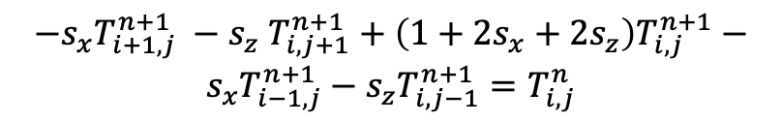
Exercise #5: Implicit heat eq. in 2-D
i
Top/surface
${−s}_{x}T_{i+1,j}^{n+1} {− s}_{z}T_{i,j+1}^{n+1}+\left(1+2s_{x}+2s_{z}\right)T_{i,j}^{n+1}−s_{x}T_{i−1,j}^{n+1}−s_{z}T_{i,j−1}^{n+1}=T_{i,j}^{n}$
T_{1,1}=T₁
T_{2,1}=T₂
T_{3,1}=T₃
T_{4,1}=T₄
T_{5,1}=T₅
j
T_{1,2}=T₆
T_{2,2}=T₇
T_{3,2}=T₈
T_{4,2}=T₉
T_{5,2}=T₁₀
$$Ax=b$$
T_{1,3}=T₁₁
T_{2,3}=T₁₂
T_{3,3}=T₁₃
T_{4,3}=T₁₄
T_{5,3}=T₁₅
T_{1,4}=T₁₆
T_{2,4}=T₁₇
T_{3,4}=T₁₈
T_{4,4}=T₁₉
T_{5,4}=T₂₀
T_{1,5}=T₂₁
T_{2,5}=T₂₂
T_{3,5}=T₂₃
T_{4,5}=T₂₄
T_{5,5}=T₂₅
Bottom/base

Slide 16
Exercise #5: Implicit heat eq. in 2-D
i
Top/surface
${−s}_{x}T_{i+1,j}^{n+1} {− s}_{z}T_{i,j+1}^{n+1}+\left(1+2s_{x}+2s_{z}\right)T_{i,j}^{n+1}−s_{x}T_{i−1,j}^{n+1}−s_{z}T_{i,j−1}^{n+1}=T_{i,j}^{n}$
T_{1,1}=T₁
T_{2,1}=T₂
T_{3,1}=T₃
T_{4,1}=T₄
T_{5,1}=T₅
j
T_{1,2}=T₆
T_{2,2}=T₇
T_{3,2}=T₈
T_{4,2}=T₉
T_{5,2}=T₁₀
$$Ax=b$$
T_{1,3}=T₁₁
T_{2,3}=T₁₂
T_{3,3}=T₁₃
T_{4,3}=T₁₄
T_{5,3}=T₁₅
T_{1,4}=T₁₆
T_{2,4}=T₁₇
T_{3,4}=T₁₈
T_{4,4}=T₁₉
T_{5,4}=T₂₀
T_{1,5}=T₂₁
T_{2,5}=T₂₂
T_{3,5}=T₂₃
T_{4,5}=T₂₄
T_{5,5}=T₂₅
Bottom/base

Slide 17
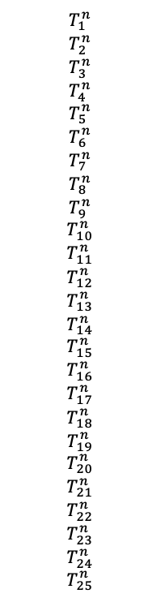
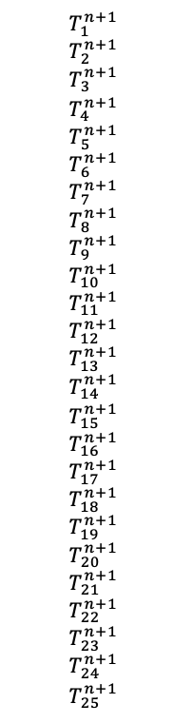
Exercise #5: Implicit heat eq. in 2-D
i
Top/surface
${−s}_{x}T_{i+1,j}^{n+1} {− s}_{z}T_{i,j+1}^{n+1}+\left(1+2s_{x}+2s_{z}\right)T_{i,j}^{n+1}−s_{x}T_{i−1,j}^{n+1}−s_{z}T_{i,j−1}^{n+1}=T_{i,j}^{n}$
T_{1,1}=T₁
T_{2,1}=T₂
T_{3,1}=T₃
T_{4,1}=T₄
T_{5,1}=T₅
j
T_{1,2}=T₆
T_{2,2}=T₇
T_{3,2}=T₈
T_{4,2}=T₉
T_{5,2}=T₁₀
$$Ax=b$$
$$T_{1}^{n}$$
$$T_{2}^{n}$$
$$T_{3}^{n}$$
$$T_{4}^{n}$$
$$T_{5}^{n}$$
$$T_{6}^{n}$$
$$T_{7}^{n}$$
$$T_{8}^{n}$$
$$T_{9}^{n}$$
$$T_{10}^{n}$$
$$T_{11}^{n}$$
$$T_{12}^{n}$$
$$T_{13}^{n}$$
$$T_{14}^{n}$$
$$T_{15}^{n}$$
$$T_{16}^{n}$$
$$T_{17}^{n}$$
$$T_{18}^{n}$$
$$T_{19}^{n}$$
$$T_{20}^{n}$$
$$T_{21}^{n}$$
$$T_{22}^{n}$$
$$T_{23}^{n}$$
$$T_{24}^{n}$$
$$T_{25}^{n}$$
$$T_{1}^{n+1}$$
$$T_{2}^{n+1}$$
$$T_{3}^{n+1}$$
$$T_{4}^{n+1}$$
$$T_{5}^{n+1}$$
$$T_{6}^{n+1}$$
$$T_{7}^{n+1}$$
$$T_{8}^{n+1}$$
$$T_{9}^{n+1}$$
$$T_{10}^{n+1}$$
$$T_{11}^{n+1}$$
$$T_{12}^{n+1}$$
$$T_{13}^{n+1}$$
$$T_{14}^{n+1}$$
$$T_{15}^{n+1}$$
$$T_{16}^{n+1}$$
$$T_{17}^{n+1}$$
$$T_{18}^{n+1}$$
$$T_{19}^{n+1}$$
$$T_{20}^{n+1}$$
$$T_{21}^{n+1}$$
$$T_{22}^{n+1}$$
$$T_{23}^{n+1}$$
$$T_{24}^{n+1}$$
$$T_{25}^{n+1}$$
T_{1,3}=T₁₁
T_{2,3}=T₁₂
T_{3,3}=T₁₃
T_{4,3}=T₁₄
T_{5,3}=T₁₅
T_{1,4}=T₁₆
T_{2,4}=T₁₇
T_{3,4}=T₁₈
T_{4,4}=T₁₉
T_{5,4}=T₂₀
T_{1,5}=T₂₁
T_{2,5}=T₂₂
T_{3,5}=T₂₃
T_{4,5}=T₂₄
T_{5,5}=T₂₅
Bottom/base

Slide 18
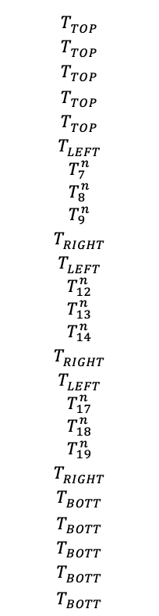
Exercise #5: Implicit heat eq. in 2-D
i
Top/surface
${−s}_{x}T_{i+1,j}^{n+1} {− s}_{z}T_{i,j+1}^{n+1}+\left(1+2s_{x}+2s_{z}\right)T_{i,j}^{n+1}−s_{x}T_{i−1,j}^{n+1}−s_{z}T_{i,j−1}^{n+1}=T_{i,j}^{n}$
T_{1,1}=T₁
T_{2,1}=T₂
T_{3,1}=T₃
T_{4,1}=T₄
T_{5,1}=T₅
j
T_{1,2}=T₆
T_{2,2}=T₇
T_{3,2}=T₈
T_{4,2}=T₉
T_{5,2}=T₁₀
$$Ax=b$$
$$T_{TOP}^{}$$
$$T_{TOP}^{}$$
$$T_{TOP}^{}$$
$$T_{TOP}^{}$$
$$T_{TOP}^{}$$
$$T_{LEFT}^{}$$
$$T_{7}^{n}$$
$$T_{8}^{n}$$
$$T_{9}^{n}$$
$$T_{RIGHT}^{}$$
$$T_{LEFT}^{}$$
$$T_{12}^{n}$$
$$T_{13}^{n}$$
$$T_{14}^{n}$$
$$T_{RIGHT}^{}$$
$$T_{LEFT}^{}$$
$$T_{17}^{n}$$
$$T_{18}^{n}$$
$$T_{19}^{n}$$
$$T_{RIGHT}^{}$$
$$T_{BOTT}^{}$$
$$T_{BOTT}^{}$$
$$T_{BOTT}^{}$$
$$T_{BOTT}^{}$$
$$T_{BOTT}^{}$$
$$T_{1}^{n+1}$$
$$T_{2}^{n+1}$$
$$T_{3}^{n+1}$$
$$T_{4}^{n+1}$$
$$T_{5}^{n+1}$$
$$T_{6}^{n+1}$$
$$T_{7}^{n+1}$$
$$T_{8}^{n+1}$$
$$T_{9}^{n+1}$$
$$T_{10}^{n+1}$$
$$T_{11}^{n+1}$$
$$T_{12}^{n+1}$$
$$T_{13}^{n+1}$$
$$T_{14}^{n+1}$$
$$T_{15}^{n+1}$$
$$T_{16}^{n+1}$$
$$T_{17}^{n+1}$$
$$T_{18}^{n+1}$$
$$T_{19}^{n+1}$$
$$T_{20}^{n+1}$$
$$T_{21}^{n+1}$$
$$T_{22}^{n+1}$$
$$T_{23}^{n+1}$$
$$T_{24}^{n+1}$$
$$T_{25}^{n+1}$$
T_{1,3}=T₁₁
T_{2,3}=T₁₂
T_{3,3}=T₁₃
T_{4,3}=T₁₄
T_{5,3}=T₁₅
T_{1,4}=T₁₆
T_{2,4}=T₁₇
T_{3,4}=T₁₈
T_{4,4}=T₁₉
T_{5,4}=T₂₀
T_{1,5}=T₂₁
T_{2,5}=T₂₂
T_{3,5}=T₂₃
T_{4,5}=T₂₄
T_{5,5}=T₂₅
Bottom/base

Slide 19
Exercise #5: Implicit heat eq. in 2-D
i
Top/surface
${−s}_{x}T_{i+1,j}^{n+1} {− s}_{z}T_{i,j+1}^{n+1}+\left(1+2s_{x}+2s_{z}\right)T_{i,j}^{n+1}−s_{x}T_{i−1,j}^{n+1}−s_{z}T_{i,j−1}^{n+1}=T_{i,j}^{n}$
T_{1,1}=T₁
T_{2,1}=T₂
T_{3,1}=T₃
T_{4,1}=T₄
T_{5,1}=T₅
j
T_{1,2}=T₆
T_{2,2}=T₇
T_{3,2}=T₈
T_{4,2}=T₉
T_{5,2}=T₁₀
$$Ax=b$$
$$T_{TOP}^{}$$
$$T_{TOP}^{}$$
$$T_{TOP}^{}$$
$$T_{TOP}^{}$$
$$T_{TOP}^{}$$
$$T_{LEFT}^{}$$
$$T_{7}^{n}$$
$$T_{8}^{n}$$
$$T_{9}^{n}$$
$$T_{RIGHT}^{}$$
$$T_{LEFT}^{}$$
$$T_{12}^{n}$$
$$T_{13}^{n}$$
$$T_{14}^{n}$$
$$T_{RIGHT}^{}$$
$$T_{LEFT}^{}$$
$$T_{17}^{n}$$
$$T_{18}^{n}$$
$$T_{19}^{n}$$
$$T_{RIGHT}^{}$$
$$T_{BOTT}^{}$$
$$T_{BOTT}^{}$$
$$T_{BOTT}^{}$$
$$T_{BOTT}^{}$$
$$T_{BOTT}^{}$$
$$T_{1}^{n+1}$$
$$T_{2}^{n+1}$$
$$T_{3}^{n+1}$$
$$T_{4}^{n+1}$$
$$T_{5}^{n+1}$$
$$T_{6}^{n+1}$$
$$T_{7}^{n+1}$$
$$T_{8}^{n+1}$$
$$T_{9}^{n+1}$$
$$T_{10}^{n+1}$$
$$T_{11}^{n+1}$$
$$T_{12}^{n+1}$$
$$T_{13}^{n+1}$$
$$T_{14}^{n+1}$$
$$T_{15}^{n+1}$$
$$T_{16}^{n+1}$$
$$T_{17}^{n+1}$$
$$T_{18}^{n+1}$$
$$T_{19}^{n+1}$$
$$T_{20}^{n+1}$$
$$T_{21}^{n+1}$$
$$T_{22}^{n+1}$$
$$T_{23}^{n+1}$$
$$T_{24}^{n+1}$$
$$T_{25}^{n+1}$$
T_{1,3}=T₁₁
T_{2,3}=T₁₂
T_{3,3}=T₁₃
T_{4,3}=T₁₄
T_{5,3}=T₁₅
T_{1,4}=T₁₆
T_{2,4}=T₁₇
T_{3,4}=T₁₈
T_{4,4}=T₁₉
T_{5,4}=T₂₀
T_{1,5}=T₂₁
T_{2,5}=T₂₂
T_{3,5}=T₂₃
T_{4,5}=T₂₄
T_{5,5}=T₂₅
Bottom/base
Now the tricky part: A

Slide 20
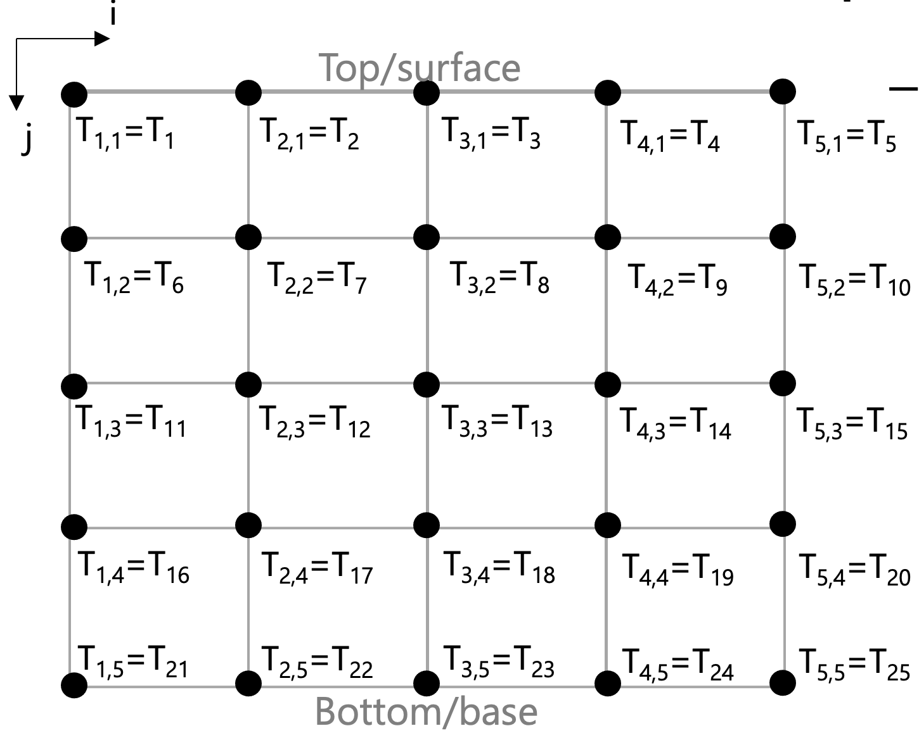
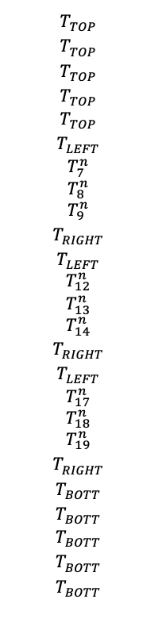

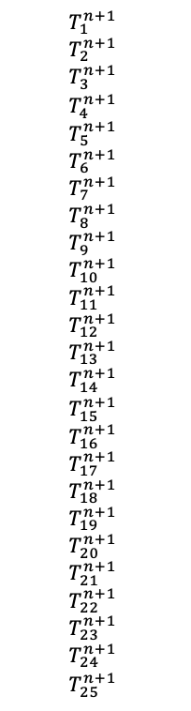
A_{z}
A_{x}
A_{xz}
${−s}_{x}T_{i+1,j}^{n+1} {− s}_{z}T_{i,j+1}^{n+1}+\left(1+2s_{x}+2s_{z}\right)T_{i,j}^{n+1}−s_{x}T_{i−1,j}^{n+1}−s_{z}T_{i,j−1}^{n+1}=T_{i,j}^{n}$
A: First the rows related to BCS
1 | - | - | - | - | - | - | - | - | - | - | - | - | - | - | - | - | - | - | - | - | - | - | - | -
- | 1 | - | - | - | - | - | - | - | - | - | - | - | - | - | - | - | - | - | - | - | - | - | - | -
- | - | 1 | - | - | - | - | - | - | - | - | - | - | - | - | - | - | - | - | - | - | - | - | - | -
- | - | - | 1 | - | - | - | - | - | - | - | - | - | - | - | - | - | - | - | - | - | - | - | - | -
- | - | - | - | 1 | - | - | - | - | - | - | - | - | - | - | - | - | - | - | - | - | - | - | - | -
- | - | - | - | - | 1 | - | - | - | - | - | - | - | - | - | - | - | - | - | - | - | - | - | - | -
- | - | - | - | - | - | - | - | - | - | - | - | - | - | - | - | - | - | - | - | - | - | - | - | -
- | - | - | - | - | - | - | - | - | - | - | - | - | - | - | - | - | - | - | - | - | - | - | - | -
- | - | - | - | - | - | - | - | - | - | - | - | - | - | - | - | - | - | - | - | - | - | - | - | -
- | - | - | - | - | - | - | - | - | 1 | - | - | - | - | - | - | - | - | - | - | - | - | - | - | -
- | - | - | - | - | - | - | - | - | - | 1 | - | - | - | - | - | - | - | - | - | - | - | - | - | -
- | - | - | - | - | - | - | - | - | - | - | - | - | - | - | - | - | - | - | - | - | - | - | - | -
- | - | - | - | - | - | - | - | - | - | - | - | - | - | - | - | - | - | - | - | - | - | - | - | -
- | - | - | - | - | - | - | - | - | - | - | - | - | - | - | - | - | - | - | - | - | - | - | - | -
- | - | - | - | - | - | - | - | - | - | - | - | - | - | 1 | - | - | - | - | - | - | - | - | - | -
- | - | - | - | - | - | - | - | - | - | - | - | - | - | - | 1 | - | - | - | - | - | - | - | - | -
- | - | - | - | - | - | - | - | - | - | - | - | - | - | - | - | - | - | - | - | - | - | - | - | -
- | - | - | - | - | - | - | - | - | - | - | - | - | - | - | - | - | - | - | - | - | - | - | - | -
- | - | - | - | - | - | - | - | - | - | - | - | - | - | - | - | - | - | - | - | - | - | - | - | -
- | - | - | - | - | - | - | - | - | - | - | - | - | - | - | - | - | - | - | 1 | - | - | - | - | -
- | - | - | - | - | - | - | - | - | - | - | - | - | - | - | - | - | - | - | - | 1 | - | - | - | -
- | - | - | - | - | - | - | - | - | - | - | - | - | - | - | - | - | - | - | - | - | 1 | - | - | -
- | - | - | - | - | - | - | - | - | - | - | - | - | - | - | - | - | - | - | - | - | - | 1 | - | -
- | - | - | - | - | - | - | - | - | - | - | - | - | - | - | - | - | - | - | - | - | - | - | 1 | -
- | - | - | - | - | - | - | - | - | - | - | - | - | - | - | - | - | - | - | - | - | - | - | - | 1
$$T_{1}^{n+1}$$
$$T_{2}^{n+1}$$
$$T_{3}^{n+1}$$
$$T_{4}^{n+1}$$
$$T_{5}^{n+1}$$
$$T_{6}^{n+1}$$
$$T_{7}^{n+1}$$
$$T_{8}^{n+1}$$
$$T_{9}^{n+1}$$
$$T_{10}^{n+1}$$
$$T_{11}^{n+1}$$
$$T_{12}^{n+1}$$
$$T_{13}^{n+1}$$
$$T_{14}^{n+1}$$
$$T_{15}^{n+1}$$
$$T_{16}^{n+1}$$
$$T_{17}^{n+1}$$
$$T_{18}^{n+1}$$
$$T_{19}^{n+1}$$
$$T_{20}^{n+1}$$
$$T_{21}^{n+1}$$
$$T_{22}^{n+1}$$
$$T_{23}^{n+1}$$
$$T_{24}^{n+1}$$
$$T_{25}^{n+1}$$
$$T_{TOP}^{}$$
$$T_{TOP}^{}$$
$$T_{TOP}^{}$$
$$T_{TOP}^{}$$
$$T_{TOP}^{}$$
$$T_{LEFT}^{}$$
$$T_{7}^{n}$$
$$T_{8}^{n}$$
$$T_{9}^{n}$$
$$T_{RIGHT}^{}$$
$$T_{LEFT}^{}$$
$$T_{12}^{n}$$
$$T_{13}^{n}$$
$$T_{14}^{n}$$
$$T_{RIGHT}^{}$$
$$T_{LEFT}^{}$$
$$T_{17}^{n}$$
$$T_{18}^{n}$$
$$T_{19}^{n}$$
$$T_{RIGHT}^{}$$
$$T_{BOTT}^{}$$
$$T_{BOTT}^{}$$
$$T_{BOTT}^{}$$
$$T_{BOTT}^{}$$
$$T_{BOTT}^{}$$
$$=$$

Slide 21
A_{z}
A_{x}
A_{xz}
${−s}_{x}T_{i+1,j}^{n+1} {− s}_{z}T_{i,j+1}^{n+1}+\left(1+2s_{x}+2s_{z}\right)T_{i,j}^{n+1}−s_{x}T_{i−1,j}^{n+1}−s_{z}T_{i,j−1}^{n+1}=T_{i,j}^{n}$
A: Now an interior node
1 | - | - | - | - | - | - | - | - | - | - | - | - | - | - | - | - | - | - | - | - | - | - | - | -
- | 1 | - | - | - | - | - | - | - | - | - | - | - | - | - | - | - | - | - | - | - | - | - | - | -
- | - | 1 | - | - | - | - | - | - | - | - | - | - | - | - | - | - | - | - | - | - | - | - | - | -
- | - | - | 1 | - | - | - | - | - | - | - | - | - | - | - | - | - | - | - | - | - | - | - | - | -
- | - | - | - | 1 | - | - | - | - | - | - | - | - | - | - | - | - | - | - | - | - | - | - | - | -
- | - | - | - | - | 1 | - | - | - | - | - | - | - | - | - | - | - | - | - | - | - | - | - | - | -
- | A_{z} | - | - | - | A_{x} | A_{xz} | A_{x} | - | - | - | A_{z} | - | - | - | - | - | - | - | - | - | - | - | - | -
- | - | - | - | - | - | - | - | - | - | - | - | - | - | - | - | - | - | - | - | - | - | - | - | -
- | - | - | - | - | - | - | - | - | - | - | - | - | - | - | - | - | - | - | - | - | - | - | - | -
- | - | - | - | - | - | - | - | - | 1 | - | - | - | - | - | - | - | - | - | - | - | - | - | - | -
- | - | - | - | - | - | - | - | - | - | 1 | - | - | - | - | - | - | - | - | - | - | - | - | - | -
- | - | - | - | - | - | - | - | - | - | - | - | - | - | - | - | - | - | - | - | - | - | - | - | -
- | - | - | - | - | - | - | - | - | - | - | - | - | - | - | - | - | - | - | - | - | - | - | - | -
- | - | - | - | - | - | - | - | - | - | - | - | - | - | - | - | - | - | - | - | - | - | - | - | -
- | - | - | - | - | - | - | - | - | - | - | - | - | - | 1 | - | - | - | - | - | - | - | - | - | -
- | - | - | - | - | - | - | - | - | - | - | - | - | - | - | 1 | - | - | - | - | - | - | - | - | -
- | - | - | - | - | - | - | - | - | - | - | - | - | - | - | - | - | - | - | - | - | - | - | - | -
- | - | - | - | - | - | - | - | - | - | - | - | - | - | - | - | - | - | - | - | - | - | - | - | -
- | - | - | - | - | - | - | - | - | - | - | - | - | - | - | - | - | - | - | - | - | - | - | - | -
- | - | - | - | - | - | - | - | - | - | - | - | - | - | - | - | - | - | - | 1 | - | - | - | - | -
- | - | - | - | - | - | - | - | - | - | - | - | - | - | - | - | - | - | - | - | 1 | - | - | - | -
- | - | - | - | - | - | - | - | - | - | - | - | - | - | - | - | - | - | - | - | - | 1 | - | - | -
- | - | - | - | - | - | - | - | - | - | - | - | - | - | - | - | - | - | - | - | - | - | 1 | - | -
- | - | - | - | - | - | - | - | - | - | - | - | - | - | - | - | - | - | - | - | - | - | - | 1 | -
- | - | - | - | - | - | - | - | - | - | - | - | - | - | - | - | - | - | - | - | - | - | - | - | 1
$$T_{1}^{n+1}$$
$$T_{2}^{n+1}$$
$$T_{3}^{n+1}$$
$$T_{4}^{n+1}$$
$$T_{5}^{n+1}$$
$$T_{6}^{n+1}$$
$$T_{7}^{n+1}$$
$$T_{8}^{n+1}$$
$$T_{9}^{n+1}$$
$$T_{10}^{n+1}$$
$$T_{11}^{n+1}$$
$$T_{12}^{n+1}$$
$$T_{13}^{n+1}$$
$$T_{14}^{n+1}$$
$$T_{15}^{n+1}$$
$$T_{16}^{n+1}$$
$$T_{17}^{n+1}$$
$$T_{18}^{n+1}$$
$$T_{19}^{n+1}$$
$$T_{20}^{n+1}$$
$$T_{21}^{n+1}$$
$$T_{22}^{n+1}$$
$$T_{23}^{n+1}$$
$$T_{24}^{n+1}$$
$$T_{25}^{n+1}$$
$$T_{TOP}^{}$$
$$T_{TOP}^{}$$
$$T_{TOP}^{}$$
$$T_{TOP}^{}$$
$$T_{TOP}^{}$$
$$T_{LEFT}^{}$$
$$T_{7}^{n}$$
$$T_{8}^{n}$$
$$T_{9}^{n}$$
$$T_{RIGHT}^{}$$
$$T_{LEFT}^{}$$
$$T_{12}^{n}$$
$$T_{13}^{n}$$
$$T_{14}^{n}$$
$$T_{RIGHT}^{}$$
$$T_{LEFT}^{}$$
$$T_{17}^{n}$$
$$T_{18}^{n}$$
$$T_{19}^{n}$$
$$T_{RIGHT}^{}$$
$$T_{BOTT}^{}$$
$$T_{BOTT}^{}$$
$$T_{BOTT}^{}$$
$$T_{BOTT}^{}$$
$$T_{BOTT}^{}$$
$$=$$

Slide 22
A_{z}
A_{x}
A_{xz}
${−s}_{x}T_{i+1,j}^{n+1} {− s}_{z}T_{i,j+1}^{n+1}+\left(1+2s_{x}+2s_{z}\right)T_{i,j}^{n+1}−s_{x}T_{i−1,j}^{n+1}−s_{z}T_{i,j−1}^{n+1}=T_{i,j}^{n}$
A: Now all the interior nodes – A is complete
1 | - | - | - | - | - | - | - | - | - | - | - | - | - | - | - | - | - | - | - | - | - | - | - | -
- | 1 | - | - | - | - | - | - | - | - | - | - | - | - | - | - | - | - | - | - | - | - | - | - | -
- | - | 1 | - | - | - | - | - | - | - | - | - | - | - | - | - | - | - | - | - | - | - | - | - | -
- | - | - | 1 | - | - | - | - | - | - | - | - | - | - | - | - | - | - | - | - | - | - | - | - | -
- | - | - | - | 1 | - | - | - | - | - | - | - | - | - | - | - | - | - | - | - | - | - | - | - | -
- | - | - | - | - | 1 | - | - | - | - | - | - | - | - | - | - | - | - | - | - | - | - | - | - | -
- | A_{z} | - | - | - | A_{x} | A_{xz} | A_{x} | - | - | - | A_{z} | - | - | - | - | - | - | - | - | - | - | - | - | -
- | - | A_{z} | - | - | - | A_{x} | A_{xz} | A_{x} | - | - | - | A_{z} | - | - | - | - | - | - | - | - | - | - | - | -
- | - | - | A_{z} | - | - | - | A_{x} | A_{xz} | A_{x} | - | - | - | A_{z} | - | - | - | - | - | - | - | - | - | - | -
- | - | - | - | - | - | - | - | - | 1 | - | - | - | - | - | - | - | - | - | - | - | - | - | - | -
- | - | - | - | - | - | - | - | - | - | 1 | - | - | - | - | - | - | - | - | - | - | - | - | - | -
- | - | - | - | - | - | A_{z} | - | - | - | A_{x} | A_{xz} | A_{x} | - | - | - | A_{z} | - | - | - | - | - | - | - | -
- | - | - | - | - | - | - | A_{z} | - | - | - | A_{x} | A_{xz} | - | - | - | - | A_{z} | - | - | - | - | - | - | -
- | - | - | - | - | - | - | - | A_{z} | - | - | - | A_{x} | A_{xz} | A_{x} | - | - | - | A_{z} | - | - | - | - | - | -
- | - | - | - | - | - | - | - | - | - | - | - | - | - | 1 | - | - | - | - | - | - | - | - | - | -
- | - | - | - | - | - | - | - | - | - | - | - | - | - | - | 1 | - | - | - | - | - | - | - | - | -
- | - | - | - | - | - | - | - | - | - | - | A_{z} | - | - | - | A_{x} | A_{xz} | A_{x} | - | - | - | A_{z} | - | - | -
- | - | - | - | - | - | - | - | - | - | - | - | A_{z} | - | - | - | A_{x} | A_{xz} | A_{x} | - | - | - | A_{z} | - | -
- | - | - | - | - | - | - | - | - | - | - | - | - | A_{z} | - | - | - | A_{x} | A_{xz} | A_{x} | - | - | - | A_{z} | -
- | - | - | - | - | - | - | - | - | - | - | - | - | - | - | - | - | - | - | 1 | - | - | - | - | -
- | - | - | - | - | - | - | - | - | - | - | - | - | - | - | - | - | - | - | - | 1 | - | - | - | -
- | - | - | - | - | - | - | - | - | - | - | - | - | - | - | - | - | - | - | - | - | 1 | - | - | -
- | - | - | - | - | - | - | - | - | - | - | - | - | - | - | - | - | - | - | - | - | - | 1 | - | -
- | - | - | - | - | - | - | - | - | - | - | - | - | - | - | - | - | - | - | - | - | - | - | 1 | -
- | - | - | - | - | - | - | - | - | - | - | - | - | - | - | - | - | - | - | - | - | - | - | - | 1
$$T_{1}^{n+1}$$
$$T_{2}^{n+1}$$
$$T_{3}^{n+1}$$
$$T_{4}^{n+1}$$
$$T_{5}^{n+1}$$
$$T_{6}^{n+1}$$
$$T_{7}^{n+1}$$
$$T_{8}^{n+1}$$
$$T_{9}^{n+1}$$
$$T_{10}^{n+1}$$
$$T_{11}^{n+1}$$
$$T_{12}^{n+1}$$
$$T_{13}^{n+1}$$
$$T_{14}^{n+1}$$
$$T_{15}^{n+1}$$
$$T_{16}^{n+1}$$
$$T_{17}^{n+1}$$
$$T_{18}^{n+1}$$
$$T_{19}^{n+1}$$
$$T_{20}^{n+1}$$
$$T_{21}^{n+1}$$
$$T_{22}^{n+1}$$
$$T_{23}^{n+1}$$
$$T_{24}^{n+1}$$
$$T_{25}^{n+1}$$
$$T_{TOP}^{}$$
$$T_{TOP}^{}$$
$$T_{TOP}^{}$$
$$T_{TOP}^{}$$
$$T_{TOP}^{}$$
$$T_{LEFT}^{}$$
$$T_{7}^{n}$$
$$T_{8}^{n}$$
$$T_{9}^{n}$$
$$T_{RIGHT}^{}$$
$$T_{LEFT}^{}$$
$$T_{12}^{n}$$
$$T_{13}^{n}$$
$$T_{14}^{n}$$
$$T_{RIGHT}^{}$$
$$T_{LEFT}^{}$$
$$T_{17}^{n}$$
$$T_{18}^{n}$$
$$T_{19}^{n}$$
$$T_{RIGHT}^{}$$
$$T_{BOTT}^{}$$
$$T_{BOTT}^{}$$
$$T_{BOTT}^{}$$
$$T_{BOTT}^{}$$
$$T_{BOTT}^{}$$
$$=$$

Slide 23
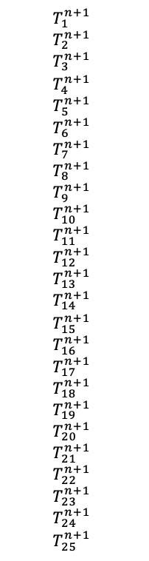
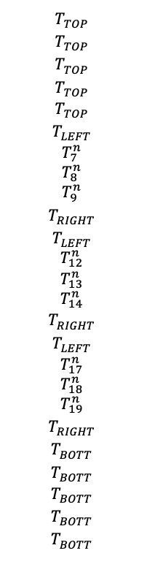

1 | - | - | - | - | - | - | - | - | - | - | - | - | - | - | - | - | - | - | - | - | - | - | - | -
- | 1 | - | - | - | - | - | - | - | - | - | - | - | - | - | - | - | - | - | - | - | - | - | - | -
- | - | 1 | - | - | - | - | - | - | - | - | - | - | - | - | - | - | - | - | - | - | - | - | - | -
- | - | - | 1 | - | - | - | - | - | - | - | - | - | - | - | - | - | - | - | - | - | - | - | - | -
- | - | - | - | 1 | - | - | - | - | - | - | - | - | - | - | - | - | - | - | - | - | - | - | - | -
- | - | - | - | - | 1 | - | - | - | - | - | - | - | - | - | - | - | - | - | - | - | - | - | - | -
- | A_{z} | - | - | - | A_{x} | A_{xz} | A_{x} | - | - | - | A_{z} | - | - | - | - | - | - | - | - | - | - | - | - | -
- | - | A_{z} | - | - | - | A_{x} | A_{xz} | A_{x} | - | - | - | A_{z} | - | - | - | - | - | - | - | - | - | - | - | -
- | - | - | A_{z} | - | - | - | A_{x} | A_{xz} | A_{x} | - | - | - | A_{z} | - | - | - | - | - | - | - | - | - | - | -
- | - | - | - | - | - | - | - | - | 1 | - | - | - | - | - | - | - | - | - | - | - | - | - | - | -
- | - | - | - | - | - | - | - | - | - | 1 | - | - | - | - | - | - | - | - | - | - | - | - | - | -
- | - | - | - | - | - | A_{z} | - | - | - | A_{x} | A_{xz} | A_{x} | - | - | - | A_{z} | - | - | - | - | - | - | - | -
- | - | - | - | - | - | - | A_{z} | - | - | - | A_{x} | A_{xz} | - | - | - | - | A_{z} | - | - | - | - | - | - | -
- | - | - | - | - | - | - | - | A_{z} | - | - | - | A_{x} | A_{xz} | A_{x} | - | - | - | A_{z} | - | - | - | - | - | -
- | - | - | - | - | - | - | - | - | - | - | - | - | - | 1 | - | - | - | - | - | - | - | - | - | -
- | - | - | - | - | - | - | - | - | - | - | - | - | - | - | 1 | - | - | - | - | - | - | - | - | -
- | - | - | - | - | - | - | - | - | - | - | A_{z} | - | - | - | A_{x} | A_{xz} | A_{x} | - | - | - | A_{z} | - | - | -
- | - | - | - | - | - | - | - | - | - | - | - | A_{z} | - | - | - | A_{x} | A_{xz} | A_{x} | - | - | - | A_{z} | - | -
- | - | - | - | - | - | - | - | - | - | - | - | - | A_{z} | - | - | - | A_{x} | A_{xz} | A_{x} | - | - | - | A_{z} | -
- | - | - | - | - | - | - | - | - | - | - | - | - | - | - | - | - | - | - | 1 | - | - | - | - | -
- | - | - | - | - | - | - | - | - | - | - | - | - | - | - | - | - | - | - | - | 1 | - | - | - | -
- | - | - | - | - | - | - | - | - | - | - | - | - | - | - | - | - | - | - | - | - | 1 | - | - | -
- | - | - | - | - | - | - | - | - | - | - | - | - | - | - | - | - | - | - | - | - | - | 1 | - | -
- | - | - | - | - | - | - | - | - | - | - | - | - | - | - | - | - | - | - | - | - | - | - | 1 | -
- | - | - | - | - | - | - | - | - | - | - | - | - | - | - | - | - | - | - | - | - | - | - | - | 1
$$T_{1}^{n+1}$$
$$T_{2}^{n+1}$$
$$T_{3}^{n+1}$$
$$T_{4}^{n+1}$$
$$T_{5}^{n+1}$$
$$T_{6}^{n+1}$$
$$T_{7}^{n+1}$$
$$T_{8}^{n+1}$$
$$T_{9}^{n+1}$$
$$T_{10}^{n+1}$$
$$T_{11}^{n+1}$$
$$T_{12}^{n+1}$$
$$T_{13}^{n+1}$$
$$T_{14}^{n+1}$$
$$T_{15}^{n+1}$$
$$T_{16}^{n+1}$$
$$T_{17}^{n+1}$$
$$T_{18}^{n+1}$$
$$T_{19}^{n+1}$$
$$T_{20}^{n+1}$$
$$T_{21}^{n+1}$$
$$T_{22}^{n+1}$$
$$T_{23}^{n+1}$$
$$T_{24}^{n+1}$$
$$T_{25}^{n+1}$$
$$T_{TOP}^{}$$
$$T_{TOP}^{}$$
$$T_{TOP}^{}$$
$$T_{TOP}^{}$$
$$T_{TOP}^{}$$
$$T_{LEFT}^{}$$
$$T_{7}^{n}$$
$$T_{8}^{n}$$
$$T_{9}^{n}$$
$$T_{RIGHT}^{}$$
$$T_{LEFT}^{}$$
$$T_{12}^{n}$$
$$T_{13}^{n}$$
$$T_{14}^{n}$$
$$T_{RIGHT}^{}$$
$$T_{LEFT}^{}$$
$$T_{17}^{n}$$
$$T_{18}^{n}$$
$$T_{19}^{n}$$
$$T_{RIGHT}^{}$$
$$T_{BOTT}^{}$$
$$T_{BOTT}^{}$$
$$T_{BOTT}^{}$$
$$T_{BOTT}^{}$$
$$T_{BOTT}^{}$$
$$=$$
Setting this up is in Python matrix/arrays is the trickiest part. Can then use existing Python libraries to invert the matrix and get T^{n+1}

Slide 24
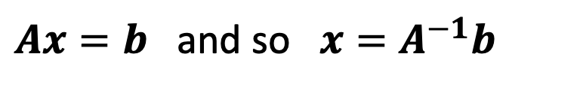
1 | - | - | - | - | - | - | - | - | - | - | - | - | - | - | - | - | - | - | - | - | - | - | - | -
- | 1 | - | - | - | - | - | - | - | - | - | - | - | - | - | - | - | - | - | - | - | - | - | - | -
- | - | 1 | - | - | - | - | - | - | - | - | - | - | - | - | - | - | - | - | - | - | - | - | - | -
- | - | - | 1 | - | - | - | - | - | - | - | - | - | - | - | - | - | - | - | - | - | - | - | - | -
- | - | - | - | 1 | - | - | - | - | - | - | - | - | - | - | - | - | - | - | - | - | - | - | - | -
- | - | - | - | - | 1 | - | - | - | - | - | - | - | - | - | - | - | - | - | - | - | - | - | - | -
- | A_{z} | - | - | - | A_{x} | A_{xz} | A_{x} | - | - | - | A_{z} | - | - | - | - | - | - | - | - | - | - | - | - | -
- | - | A_{z} | - | - | - | A_{x} | A_{xz} | A_{x} | - | - | - | A_{z} | - | - | - | - | - | - | - | - | - | - | - | -
- | - | - | A_{z} | - | - | - | A_{x} | A_{xz} | A_{x} | - | - | - | A_{z} | - | - | - | - | - | - | - | - | - | - | -
- | - | - | - | - | - | - | - | - | 1 | - | - | - | - | - | - | - | - | - | - | - | - | - | - | -
- | - | - | - | - | - | - | - | - | - | 1 | - | - | - | - | - | - | - | - | - | - | - | - | - | -
- | - | - | - | - | - | A_{z} | - | - | - | A_{x} | A_{xz} | A_{x} | - | - | - | A_{z} | - | - | - | - | - | - | - | -
- | - | - | - | - | - | - | A_{z} | - | - | - | A_{x} | A_{xz} | - | - | - | - | A_{z} | - | - | - | - | - | - | -
- | - | - | - | - | - | - | - | A_{z} | - | - | - | A_{x} | A_{xz} | A_{x} | - | - | - | A_{z} | - | - | - | - | - | -
- | - | - | - | - | - | - | - | - | - | - | - | - | - | 1 | - | - | - | - | - | - | - | - | - | -
- | - | - | - | - | - | - | - | - | - | - | - | - | - | - | 1 | - | - | - | - | - | - | - | - | -
- | - | - | - | - | - | - | - | - | - | - | A_{z} | - | - | - | A_{x} | A_{xz} | A_{x} | - | - | - | A_{z} | - | - | -
- | - | - | - | - | - | - | - | - | - | - | - | A_{z} | - | - | - | A_{x} | A_{xz} | A_{x} | - | - | - | A_{z} | - | -
- | - | - | - | - | - | - | - | - | - | - | - | - | A_{z} | - | - | - | A_{x} | A_{xz} | A_{x} | - | - | - | A_{z} | -
- | - | - | - | - | - | - | - | - | - | - | - | - | - | - | - | - | - | - | 1 | - | - | - | - | -
- | - | - | - | - | - | - | - | - | - | - | - | - | - | - | - | - | - | - | - | 1 | - | - | - | -
- | - | - | - | - | - | - | - | - | - | - | - | - | - | - | - | - | - | - | - | - | 1 | - | - | -
- | - | - | - | - | - | - | - | - | - | - | - | - | - | - | - | - | - | - | - | - | - | 1 | - | -
- | - | - | - | - | - | - | - | - | - | - | - | - | - | - | - | - | - | - | - | - | - | - | 1 | -
- | - | - | - | - | - | - | - | - | - | - | - | - | - | - | - | - | - | - | - | - | - | - | - | 1
$$T_{1}^{n+1}$$
$$T_{2}^{n+1}$$
$$T_{3}^{n+1}$$
$$T_{4}^{n+1}$$
$$T_{5}^{n+1}$$
$$T_{6}^{n+1}$$
$$T_{7}^{n+1}$$
$$T_{8}^{n+1}$$
$$T_{9}^{n+1}$$
$$T_{10}^{n+1}$$
$$T_{11}^{n+1}$$
$$T_{12}^{n+1}$$
$$T_{13}^{n+1}$$
$$T_{14}^{n+1}$$
$$T_{15}^{n+1}$$
$$T_{16}^{n+1}$$
$$T_{17}^{n+1}$$
$$T_{18}^{n+1}$$
$$T_{19}^{n+1}$$
$$T_{20}^{n+1}$$
$$T_{21}^{n+1}$$
$$T_{22}^{n+1}$$
$$T_{23}^{n+1}$$
$$T_{24}^{n+1}$$
$$T_{25}^{n+1}$$
$$T_{TOP}^{}$$
$$T_{TOP}^{}$$
$$T_{TOP}^{}$$
$$T_{TOP}^{}$$
$$T_{TOP}^{}$$
$$T_{LEFT}^{}$$
$$T_{7}^{n}$$
$$T_{8}^{n}$$
$$T_{9}^{n}$$
$$T_{RIGHT}^{}$$
$$T_{LEFT}^{}$$
$$T_{12}^{n}$$
$$T_{13}^{n}$$
$$T_{14}^{n}$$
$$T_{RIGHT}^{}$$
$$T_{LEFT}^{}$$
$$T_{17}^{n}$$
$$T_{18}^{n}$$
$$T_{19}^{n}$$
$$T_{RIGHT}^{}$$
$$T_{BOTT}^{}$$
$$T_{BOTT}^{}$$
$$T_{BOTT}^{}$$
$$T_{BOTT}^{}$$
$$T_{BOTT}^{}$$
$$=$$
Setting this up is in Python matrix/arrays is the trickiest part. Can then use existing Python libraries to invert the matrix and get T^{n+1}
$Ax=b$ and so $x=A^{−1}b$
Take advantage of sparseness

Slide 25

Would anything else be helpful to discuss?
https://tisch.nyu.edu/research/events/fall-2020/virtual-art-lounge

