Slide 1

Young Institute for Advanced Manufacturing of Pharmaceuticals at Purdue University
Co-Directors:
Alina Alexeenko, Eric Munson, Garth Simpson

Slide 2
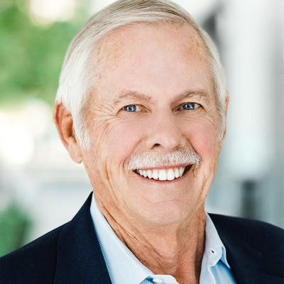
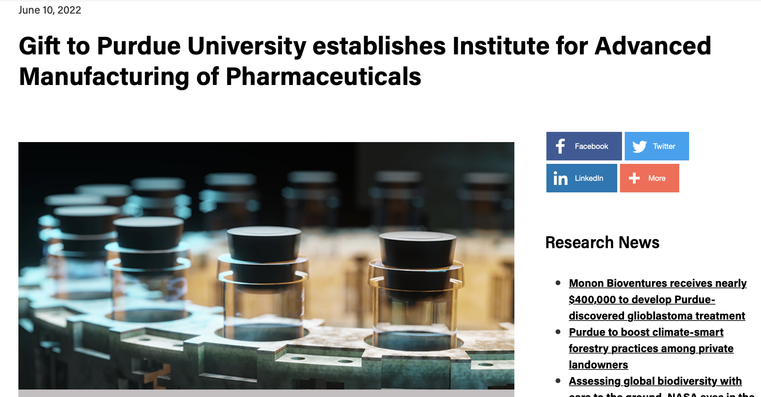

William D. Young Institute for Advanced Manufacturing of Pharmaceuticals
Dr. Bill Young (BS CHE’66) Career Highlights:
2009 – Present: Senior Advisor, Blackstone Life Sciences
2010 – 2014: Chairman of the Board, Biogen-IDEC
1999 – 2009: CEO Monogram Biosciences
1980 – 1999: COO Genentech, inaugural VP Manufacturing
1993: Election to the National Academy of Engineering
1966 – 1980: Various roles at Eli Lilly including VP Engineering
Formally approved by Board of Trustees on June 10, 2022
Young Institute Mission: To advance pharmaceutical manufacturing through discoveries and workforce development for the benefit of the Indiana and the nation.

Slide 3







Young Institute for Advanced Manufacturing of Pharmaceuticals Institute (AMP)
The AMP Institute leverages Purdue strength and expertise to support innovative industry-academic collaboration, advance research and foster workforce development in life science manufacturing for the benefit of the state and nation.
Value added for:
Indiana and the Midwest
Industry
Government
Purdue and regional higher ed partners

Slide 4
Workforce development ecosystem
Indiana is building from a strong foundation of existing institutions and supplementing with investment to take the state’s workforce to the next level.
Continuum of industry needs (e.g. Workforce Tech Profiles)
Ecosystem Building Blocks
Competencies (MS&T process engineer, microbiologist, device technology expert, etc)
Curriculum
Technical Curriculum (Ivy Tech)
University Undergrad Curriculum
Undergrad specialization (pharma certificate)
Professional Degrees (PharmD, DVM, Prof. Masters)
Specialized Expertise, Research (phd)
Continuum of offerings from operator to technician to bachelors to phd (not all Purdue)
regional community college (ivy tech) for operator training
In addition to existing curriculum, new offering include
Pharma certificate w/ experiential requirement (2023)
Purdue online offering for upskilling professional employees (future)
Partner with state for training facilities –
Model after NIBRT, BTEC, others
Three locations along “hard tech corridor” - west Lafayette, Lebanon, and Indianapolis
What’s in the ecosystem
Programming
Ivy tech curriculum
BS degree programs
Pharma certificate
Professional degrees – PharmD, DVM, phD, professional masters
Research -> specialized expertise
Purdue Online – professional development
Facilities
Facilities
Pharma Focused Facilities in the “hard tech corridor”¹
University Labs
Gov’t Partner
State, Federal Funding
Grant Funding
Industry Partner
Direct hire, facilities support,
Exp. Ed (intern, co-op, “horizontal company rotations”)
Capstone Projects, Exp. Ed
Sponsored Research, Industry Fellowships
1. https://www.forbes.com/sites/mungchiang/2022/05/31/hard-tech-corridor-in-the-heartland/?sh=bc8967a67f1c

Slide 5
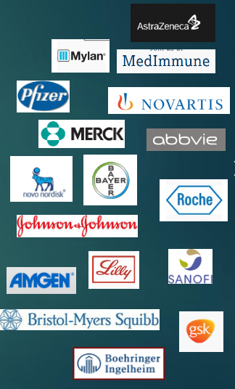
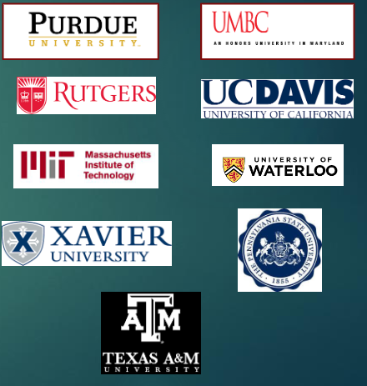


Workforce of the Future history
WFOTF provides a strong, collaborative foundation for building the next gen Pharma workforce that fits perfectly into the AMP mission.
Job profiles developed 2018
Eng 103 course launched in 2022 – industry participation via WFOTF
Pharma certificate developed out of WFOTF industry/academic collaboration
Next step:
Connecting WFOTF initiative to AMP

Slide 6
How does WFOTF fit into the ecosystem?
Focus on integrating and improving with established operational systems, establish a learning loop
1
Existing Curriculum
Does curriculum fullfill the job profile need? What else could we do?
2
Focus to specialize in Pharma
Pharma manufacturing certificate
Engineering
5
Pharma “electives”
Internships/Co-Ops
Pharmacy
Relevant existing courses become pharma certificate curriculum
Industry provides relevant experiential education
Learn and improve
Science
4
Connect the two together
etc
Job profiles
Faculty lead
Job profile team
Current Curriculum in doesn’t change
Industry lead
Form one for each job profile
Academia
Industry
Work Force of the Future Collaboration
3
Foundational collaboration

Slide 7
Summary – what’s next
WFOTF provides a very strong foundation for building a next gen pharma workforce and merges cleanly into Purdue’s AMP initiative
General next steps: Workforce development sub-teams are getting established at Purdue and within Indiana
AMP next steps:
Organizational structure - 1-2 months
Workforce dev – continue building - ongoing
Research – define research priorities
WFOTF + AMP next steps
Elevate visibility of WFOTF initiative within Purdue system
Identify and establish “job profile teams”

